Slide 1
PCEP-Certify entry level
Victoria Shtern

Slide 2
PCEP
Fundamental terms and definitions (e.g. compilation vs. interpretation),
Logic and structure (e.g. keywords, instructions, indentation),
Literals, variables, numeral systems, operators, and data types
I/O operations
Control flow mechanisms (conditional blocks and loops),
Data collections (lists, tuples, dictionaries, strings),

Slide 3
PCEP
Functions (decomposition, built-in and user-defined functions, organizing interaction between functions and their environment, generators, recursion),
Exceptions (exception handling, hierarchies), as well as the essentials of Python programming language syntax, semantics, and the runtime environment

Slide 4
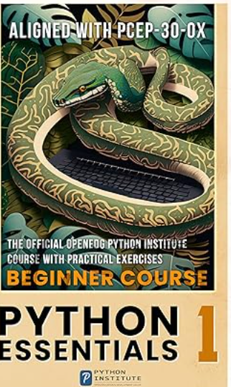
Book
Python Essentials 1: The Official OpenEDG Python Institute beginners course with practical exercises – learn the basics of Python in seven days and pass the PCEP certification exam

Slide 5
Basic Concept

Slide 6
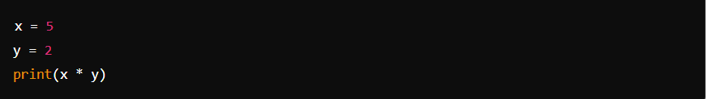
Q1
What is the output of the following code snippet?
10
7
25
52

Slide 7
answer
10

Slide 8
Q2
Which of the following is not a valid variable name in Python?
my_variable
_myVariable
3myvariable
MY_VARIABLE

Slide 9
Answer
In Python, variable names must adhere to certain rules. They must start with a letter (a-z, A-Z) or an underscore (_) and can be followed by letters, digits (0-9), or underscores. However, they cannot start with a digit

Slide 10
Q3
What is the result of 10 / 3 in Python?
3.3333
3
3.0
3.33

Slide 11
Answer
In Python, when you perform division using the / operator with two integers, the result is a floating-point number (float) representing the quotient.
3.33

Slide 12
Q4
What is the correct syntax to create an empty list in Python?
List = {}
list = []
list = [0]
list = ()

Slide 13
Answer
list = []

Slide 14

Q5
What will be the output of the following code?
Hello
World!
,
llo, World!

Slide 15
Answer
The code prints a substring of the my_string variable starting from index 7 to the end of the string
World!

Slide 16
Data type
Victoria Shtern

Slide 17
Q1
Which data type is mutable in Python
Tuple
Integer
String
List

Slide 18
Answer
In Python, the data type that is mutable, meaning its elements can be changed after creation, is a List.
List

Slide 19
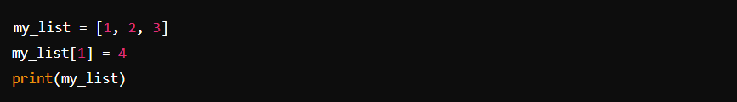
Q2
What is the output of the following code?
[1, 2, 3]
[1, 4, 3]
[1, 2, 4]
[4, 2, 3]

Slide 20
Answer
The code snippet modifies the second element of the list my_list and then prints the list.
[1, 4, 3]

Slide 21
Q3
What is the result of True + True in Python?
2
True
False
1

Slide 22
Answer
In Python, True and False are represented internally as 1 and 0, respectively, when used in numerical operations. So, when you perform addition with True, it's equivalent to adding 1.
Therefore, the result of True + True in Python is 2.

Slide 23
Q4
Which data type is immutable in Python?
Dictionary
List
Set
Tuple

Slide 24
Answer
In Python, the data type that is immutable, meaning its elements cannot be changed after creation, is a Tuple.
Tuple

Slide 25

Q5
What is the output of the following code snippet?
(1, 2, 3)
1
2
(1)

Slide 26
Answer
it's important to note that (1) is not interpreted as a tuple with a single element. In Python, a single value enclosed in parentheses is not considered a tuple. To create a tuple with a single element, you need to include a comma after the element:
1

Slide 27
Control Flow
Victoria Shtern

Slide 28
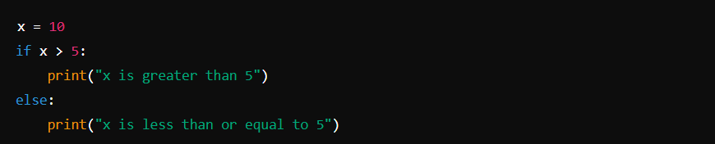
Q1
What is the output of the following code?
x is greater than 5
x is less than or equal to 5
x is equal to 5
SyntaxError

Slide 29
Answer
x is less than or equal to 5

Slide 30

Q2
What is the result of the following code?
1 2 3
0 1 2
1 2 3 4
0 1 2 3

Slide 31
Answer
1 2 3

Slide 32
Q3
Which statement is used to exit a loop prematurely in Python?
stop
exit
break
continue

Slide 33
Answer
When break is encountered within a loop (such as a for or while loop), it immediately exits the loop, regardless of whether the loop's condition has been fully satisfied or not.
It is typically used to terminate a loop early based on a certain condition.
Break

Slide 34
Q5
What does the pass statement do in Python?
Exits the loop
Skips the current iteration
Continues to the next iteration of the loop
Does nothing

Slide 35
Answer
The pass statement in Python does nothing. It is a null operation; it means "do nothing" or "skip this block of code." It's often used as a placeholder where code will eventually go, allowing the program to run without throwing an error during development

Slide 36
Functions
Victoria Shtern

Slide 37
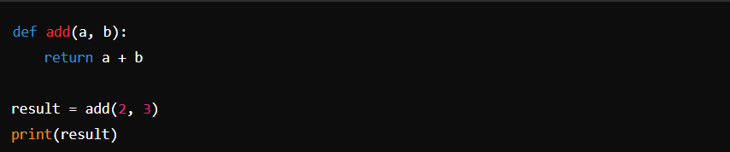
Q1
What is the output of the following code snippet?
5
6
23
None

Slide 38
Answer
The provided code defines a function named add that takes two arguments a and b, adds them together using the + operator, and returns the result.
Then, the function add is called with arguments 2 and 3, and the returned value is assigned to the variable result.

Slide 39
Q2
Which of the following is not a valid way to call a function in Python?
Add (2, 3)
Add (a=2, b=3)
Add (a=2, 3)
Add (b=3, a=2)

Slide 40
Answer
in Python, when calling a function with keyword arguments, you must specify the parameter name followed by an equals sign = before the argument value. Therefore, 3 cannot be directly passed as a keyword argument without specifying the parameter name it corresponds to.
The correct way to call the function would be: add(a=2, b=3)
Not valid Add (a=2, 3)

Slide 41
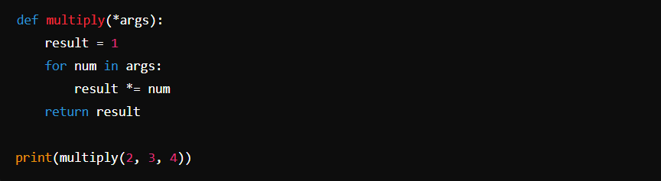
Q3
What will be the output of the following code snippet?
2
12
24
(2, 3, 4)

Slide 42
Answer
The provided code defines a function named multiply that takes any number of arguments using the *args syntax. It then multiplies all the arguments together and returns the result.
When multiply(2, 3, 4) is called, the function receives three arguments: 2, 3, and 4. It multiplies them together (2 * 3 * 4) and returns the result, which is 24.
So, the output of the code will be: 24

Slide 43
Q4
What is the purpose of the return statement in a function?
Prints a value to the console
Terminates the function execution
Returns a value to the caller
Defines a function

Slide 44
Answer
The purpose of the return statement in a function is to return a value to the caller.
When a return statement is encountered in a function, it immediately exits the function and passes the specified value (if any) back to the code that called the function. This allows the function to communicate its result or any other information back to the part of the program that invoked it.

Slide 45
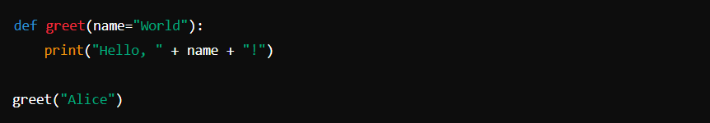
Q5
What will be the output of the following code?
Hello, Alice!
Hello, World!
Hello, !
SyntaxError

Slide 46
Answer
The provided code defines a function named greet that takes an optional parameter name, which defaults to "World". Inside the function, it prints a greeting message using the provided name.
When greet("Alice") is called, it overrides the default value of name with "Alice" and invokes the function. Therefore, the output of the code will be:

Slide 47
Modules and Packages
Victoria Shtern

Slide 48
Q1
Which statement is used to import a module in Python?
Include
Use
Import
Require

Slide 49
Answer
The import statement allows you to bring functionalities from other modules into your current Python script, making them available for use. This enables code reuse and modularity in Python programming.

Slide 50
Q2
What is the purpose of the __init__.py file in a Python package?
It contains the main code of the package.
It initializes the package.
It is not necessary for a Python package.
It is used for version control.

Slide 51
Answer
The purpose of the __init__.py file in a Python package is to initialize the package.
While it may contain code, including initialization code, it is not primarily intended to hold the main code of the package. Instead, it serves as a marker to Python that the directory should be treated as a package.
When a package is imported, Python executes the code in its __init__.py file, allowing you to perform any necessary setup, such as importing modules or defining variables and functions.

Slide 52
Q3
Which statement is used to import a specific function from a module in Python?
import module
import module.function
from module import function
from module import *

Slide 53
Answer
This statement imports only the specified function (function) from the module (module). It allows you to use the function directly in your code without needing to prefix it with the module name.
from module import function

Slide 54

Q4
What will be the output of the following code snippet?
4
16
2
256

Slide 55
Answer
import math: This statement imports the math module, which provides mathematical functions and constants.
print(math.sqrt(16)): This line calls the sqrt() function from the math module with 16 as its argument. The sqrt() function calculates the square root of its argument

Slide 56
Q5
What is the purpose of the __name__ variable in Python?
It contains the name of the current module.
It contains the name of the current function.
It is used for debugging purposes.
It is used

Slide 57
Answer
The purpose of the __name__ variable in Python is to indicate the name of the current module.
When a Python script is executed, Python sets the value of the __name__ variable to "__main__" if the script is being run directly. If the script is imported as a module into another script, the __name__ variable is set to the name of the module.
This allows you to differentiate between when a script is being run as the main program versus when it is being imported as a module into another script.
Answer: It contains the name of the current module.

Slide 58
Q6
What is a module in Python?
A collection of related classes
A file containing Python code
A built-in function in Python
A type of data structure

Slide 59
Answer
A module in Python is a file containing Python code
Answer: A file containing Python code

Slide 60
Q7
How can you import a module named example_module in Python?
import example_module
include example_module
use example_module
require example_module

Slide 61
Answer
import example_module

Slide 62
Q8
What is the purpose of the import statement in Python?
To include external libraries
To define a new module
To execute a Python script
To terminate a program

Slide 63
Answer
To include external libraries

Slide 64
Q10
What is the benefit of organizing code into modules in Python?
It makes the code more readable.
It improves the performance of the code.
It allows for better code reuse.
It prevents errors in the code.

Slide 65
Answer
The benefit of organizing code into modules in Python is that it allows for better code reuse.
By breaking down code into modules, you can encapsulate related functionalities together, making it easier to understand, maintain, and reuse. Modules promote modular programming, which enhances code organization and reduces redundancy. Additionally, modules facilitate collaboration among developers by providing a clear structure for code organization and sharing.
Answer It allows for better code reuse.

Slide 66
Q11
What is a package in Python?
A collection of related modules
A type of data structure
A built-in function in Python
An executable file

Slide 67
Answer
A package in Python is a collection of related modules.

Slide 68
Q12
Which file must be present in a directory to make it a Python package?
init.py
package.py
__main__.py
module.py

Slide 69
Answer
The file that must be present in a directory to make it a Python package is:
The __init__.py file serves as an indicator to Python that the directory should be treated as a package. It can also contain initialization code for the package if needed.
__init__.py

Slide 70
Q13
What is the purpose of the __init__.py file in a Python package?
It initializes the package.
It contains the main code of the package.
It is not necessary for a Python package.
It is used for version control.

Slide 71
Answer
The purpose of the __init__.py file in a Python package is to initialize the package.
It initializes the package.

Slide 72
Q15
How can you import a module named example_module from a package named example_package in Python?
import example_package.example_module
import example_module from example_package
import example_module as example_package
from example_package import example_module

Slide 73
Answer
The correct way to import a module named example_module from a package named example_package in Python is:
from example_package import example_module

Slide 74
Q16
What is the purpose of the dir() function in Python?
To display the directory structure of a package.
To list all files in the current directory.
To list all attributes of a module or object.
To delete a directory in the file system.

Slide 75
Answer
The purpose of the dir() function in Python is to list all attributes of a module or object.

Slide 76
Q17
How can you access a function named my_function from a module named my_module?
import my_function from my_module
my_module.my_function()
my_function.my_module()
from my_module import my_function

Slide 77
Answer
The correct way to access a function named my_function from a module named my_module in Python is:
from my_module import my_function

Slide 78
Q18
What will happen if you attempt to import a module that does not exist in Python?
Python will automatically create the module.
Python will raise a SyntaxError.
Python will raise an ImportError.
Python will prompt the user to create the module.

Slide 79
Answer
An ImportError is raised when Python cannot find the module you're trying to import. This could happen if the module does not exist or if Python cannot locate it in the directories specified in the sys.path variable.
Python will raise an ImportError.

Slide 80
Q20
What is the purpose of the as keyword in the import statement in Python?
To import all functions from a module.
To rename a module or function.
To exclude specific functions from import.
To import modules conditionally.

Slide 81
Answer
to rename a module or function.

Slide 82
Q21
How can you execute a Python script named script.py located in a package named example_package from the command line?
a) python script.py
b) python example_package.script.py
c) python -m example_package.script
d) python -m script.py example_package

Slide 83
Answer
The correct way to execute a Python script named script.py located in a package named example_package from the command line is:
python -m example_package.script

