Slide 1
Dictironary

Slide 2
Q1
1. What is a dictionary in Python?
- A) An ordered collection of items
- B) A mutable unordered collection of key-value pairs
- C) An immutable collection of items
- D) A collection of lists

Slide 3
Answer
1. A mutable unordered collection of key-value pairs

Slide 4
Q2
2. How do you create a dictionary in Python?
- A) `dict = []`
- B) `dict = ()`
- C) `dict = {}`
- D) `dict = <>`

Slide 5
Answer
2. C) `dict = {}`

Slide 6

Q3
What will the following code print?
- A) 1
- B) 2
- C) 'b'
- D) KeyError

Slide 7
Answer
B) 2

Slide 8
Q4
Which method is used to add a key-value pair to a dictionary?
- A) add()
- B) append()
- C) insert()
- D) update()

Slide 9
Answer
D) update()

Slide 10

Q5
What will the following code print?
- A) None
- B) 0
- C) KeyError
- D) 'c'

Slide 11
Answer
B) 0

Slide 12
Q6
How do you remove a key from a dictionary?
- A) remove(key)
- B) del key
- C) pop(key)
- D) Both B and C

Slide 13
Answer
6. D) Both B and C
language ={"name":"python","version":3}
del language['name']
language.pop('version')
print(language)

Slide 14
Q7
7. Which method returns a list of keys in a dictionary?
- A) keys()
- B) all_keys()
- C) list_keys()
- D) get_keys()

Slide 15
Answer
A) keys()

Slide 16
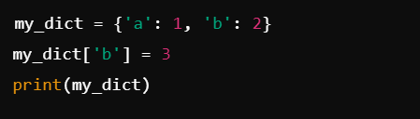
Q8
What is the output of the following code?
- A) `{'a': 1, 'b': 2}`
- B) `{'a': 1, 'b': 3}`
- C) `{'b': 3, 'a': 1}`
- D) KeyError

Slide 17
Answer
B) `{'a': 1, 'b': 3}`

Slide 18
Q9
9. What does the `items()` method return?
- A) List of keys
- B) List of values
- C) List of key-value pairs
- D) A single key-value pair

Slide 19
Answer
C) List of key-value pairs

Slide 20
Q10
10. What will happen if you try to access a key that does not exist in a dictionary?
- A) It will return None
- B) It will return 0
- C) It will raise a KeyError
- D) It will create a new key with value None

Slide 21
Answer
C) It will raise a KeyError

Slide 22
Q11
How can you create a dictionary with default values?
- A) Using `defaultdict`
- B) Using `dict.fromkeys()`
- C) Using `dict()`
- D) Both A and B

Slide 23
Answer
D) Both A and B
keys = ['a', 'b', 'c']
default_value = 0
my_dict = dict.fromkeys(keys, default_value)
print(my_dict) # Output: {'a': 0, 'b': 0, 'c': 0}

Slide 24
Q12
Which of the following is not a valid dictionary key?
- A) Integer
- B) List
- C) String
- D) Tuple

Slide 25
Answer
B) List

Slide 26

Q13
13. **What will the following code output?**
- A) 1
- B) 2
- C) 3
- D) KeyError

Slide 27
Answer
B) 2

Slide 28
Q14
Which method is used to clear all items from a dictionary?
- A) clear()
- B) delete()
- C) remove()
- D) reset()

Slide 29
Answer
A) clear()

Slide 30
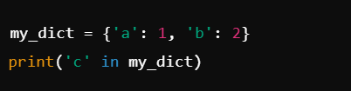
Q15
What will the following code print?
- A) True
- B) False
- C) None
- D) KeyError

Slide 31
Answer
B) False

Slide 32
Q16
How can you merge two dictionaries in Python 3.9 and later?
- A) Using `update()`
- B) Using the `|` operator
- C) Using `merge()`
- D) Both A and B

Slide 33
Answer
B) Using the `|` operator

Slide 34
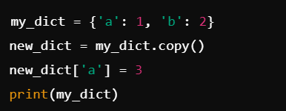
Q17
What will the following code produce?
- A) `{'a': 3, 'b': 2}`
- B) `{'a': 1, 'b': 2}`
- C) `{'b': 2, 'a': 3}`
- D) KeyError

Slide 35
Answer
B) `{'a': 1, 'b': 2}`

Slide 36

Q18
What is the output of this code?
- A) one
- B) two
- C) KeyError
- D) 2

Slide 37
Answer
B) two

Slide 38
Q19
Which of the following statements will not modify the dictionary?
- A) my_dict['new_key'] = 'value'
- B) my_dict.update({'key': 'value'})
- C) my_dict.get('key', 'default')
- D) del my_dict['key']

Slide 39
Answer
C) my_dict.get('key', 'default')

Slide 40
Q20
What will happen if you use a mutable object (like a list) as a key in a dictionary?
- A) It will work fine
- B) It will raise an error
- C) It will create a new entry
- D) It will return None

Slide 41
Answer
B) It will raise an error

