Slide 1
Python Certification
3rd Meeting

Slide 2
Started up

Slide 3
Q1
A. 3.333
B. 3
C. 3.0
D. 3.33
A. 3.333
B. 3
C. 3.0
D. 3.33
What is the result of the following Python expression? 10 / 3
- A. `3.333`
- B. `3`
- C. `3.0`
- D. `3.33

Slide 4
Answer
Answer: C

Slide 5
Q2
2. Which of the following data types is mutable in Python?
- A. Tuple
- B. String
- C. List
- D. Set

Slide 6
Answer
- **Answer: C**
Lists in Python can be modified by adding, removing, or changing elements. They are ordered collections and use square brackets [ ] for initialization

Slide 7
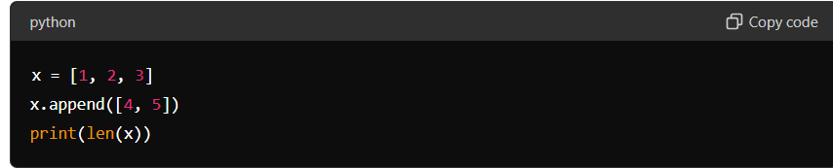
Q3
What will the following Python code output?
- A. `3`
- B. `4`
- C. `5`
- D. `6`

Slide 8
Answer
- **Answer: A**
Here's what happens:
x is initially a list [1, 2, 3].
The append() method is called on x with [4, 5] as an argument. This appends the list [4, 5] as a single element to the end of x.
After appending, x becomes [1, 2, 3, [4, 5]].
len(x) returns the number of elements in the list x.
So, when we print len(x), it will output:
This is because x now contains four elements: [1, 2, 3, [4, 5]].

Slide 9
Q4
4. Which statement is true about Python's `range()` function?
- A. It returns a list of integers from 0 to n-1.
- B. It returns a sequence of integers from a specified start value to a specified end value.
- C. It generates a random number within a specified range.
- D. It is used to create an empty range object.

Slide 10
Answer
- **Answer: A
· Python's range() function generates a sequence of integers starting from a specified start value (inclusive) up to a specified end value (exclusive).
· It can also optionally take a step size as a third argument to specify the interval between values.
· Example: range(1, 5) generates a sequence [1, 2, 3, 4].

Slide 11
Q5
5. What is the correct way to open a file named "data.txt" in read mode in Python?
- A. `file = open("data.txt", "r")`
- B. `file = open("data.txt", mode="read")`
- C. `file = open("data.txt", "read")`
- D. `file = open("data.txt", "readmode="r")`

Slide 12
Answer
- **Answer: A**
· In Python, the open() function is used to open files.
· The first argument is the file path or name ("data.txt" in this case).
· The second argument specifies the mode in which the file is opened. "r" indicates read mode, which allows you to read data from the file.

Slide 13
Q6
6. **Which Python keyword is used to define a function?**
- A. `def`
- B. `function`
- C. `define`
- D. `func`

Slide 14
Answer
- **Answer: A**

Slide 15
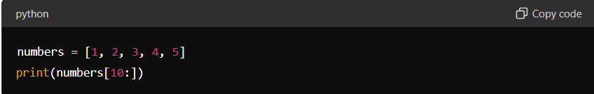
What will be the output of the following code snippet?
- A. `[1, 2, 3, 4, 5]`
- B. `[10]`
- C. `[]`
- D. `IndexError`

Slide 16
Answer
- **Answer: C**
Let's break down what happens:
numbers is a list [1, 2, 3, 4, 5].
numbers[10:] tries to slice the list starting from index 10 to the end.
In Python, if you try to access an index that is out of range for a list, it doesn't raise an IndexError; instead, it returns an empty list [].
Therefore, the output will be:
C. []

Slide 17
Q8
8. **Which of the following is used to add a new item to a dictionary in Python?**
- A. `add()`
- B. `insert()`
- C. `append()`
- D. `update()`

Slide 18
Answer
- **Answer: D**
In Python, the update() method is used to add new items or modify existing items in a dictionary.
It takes either another dictionary object or an inerrable of key-value pairs as its argument.
If the key is already present in the dictionary, its corresponding value is updated; if it's not present, a new key-value pair is added.

Slide 19
Answer
A. add(): There is no add() method for dictionaries in Python. It is not a valid method for adding items to a dictionary.
B. insert(): This method is used for inserting elements into lists at a specific index. It is not applicable to dictionaries.
C. append(): This method is used for adding elements to the end of a list. It is not applicable to dictionaries.

Slide 20
Q8
9. **What is the purpose of the `__init__` method in Python classes?**
- A. To initialize a new object of a class.
- B. To define the main entry point of a program.
- C. To destroy an object of a class.
- D. To declare a private method within a class.

Slide 21
Answer
- A
• In Python, the __init__ method (initiated with double underscores) is a special method that is automatically called when a new instance (object) of a class is created.
• Its primary purpose is to initialize the attributes (or properties) of the object.
• It allows you to set up the initial state of the object by assigning values to instance variables.
• This method is not meant to destroy objects (option C) but rather to initialize them.
• It is not related to defining the main entry point of a program (option B) or declaring private methods (option D).

Slide 22
Q10
10. **Which of the following is not a valid method of a Python set?**
- A. `add()`
- B. `remove()`
- C. `pop()`
- D. `delete()`

Slide 23
Answer
- D
• Sets have several methods to manipulate their elements.
A. add(): Adds an element to the set.
B. remove(): Removes a specified element from the set. Raises a KeyError if the element is not found.
C. pop(): Removes and returns an arbitrary element from the set. Raises a KeyError if the set is empty.
D. delete(): There is no delete() method for sets in Python. This is not a valid method.

Slide 24
Q11
11. What does the `__name__` variable represent in Python?
- A. The name of the current module.
- B. The name of the current function.
- C. The name of the current class.
- D. The name of the current package.

Slide 25
Answer
- A
• In Python, the __name__ variable is a special variable that exists in every module.
• When a Python file is run directly (as the main program), Python sets the __name__ variable for that module to "__main__".
• When a Python file is imported as a module in another file, the __name__ variable is set to the name of the module (i.e., the filename without the .py extension).
• This feature allows modules to be both imported and run as standalone programs, with different behaviors based on how they are executed.

Slide 26
Q12
12. Which of the following is used to handle exceptions in Python?
- A. `try/except`
- B. `if/else`
- C. `for/while`
- D. `switch/case`

Slide 27
Answer
Answer: A

Slide 28
Q13
13. **Which of the following is a correct way to create a tuple with a single element?**
- A. `tup = (1)`
- B. `tup = (1,)`
- C. `tup = 1,`
- D. `tup = (1,);`

Slide 29
Answer
- **Answer: B**
• When creating a tuple with a single element, you need to include a comma , after the element inside parentheses ().
• This is because Python uses parentheses for grouping expressions, so (1) without a comma would be interpreted as just the integer 1 in parentheses, not as a tuple.
• Adding a comma after the single element ensures that Python recognizes it as a tuple containing one element.

Slide 30
Q14
14. What does the `pass` statement do in Python?
- A. It halts the program execution.
- B. It is used to indicate a function definition.
- C. It is used to do nothing and acts as a placeholder.
- D. It is used to skip the current iteration in a loop.

Slide 31
Answer
Answer: C
In Python, the pass statement is a null operation; it doesn't do anything when it is executed.
It is used as a placeholder in situations where syntactically a statement is required but you don't want any action to occur.
For example, it can be used in empty function definitions, class definitions, or conditional statements where the code block is intentionally left blank.

Slide 32
Answer
A. It halts the program execution: This is incorrect. pass does not halt the program execution; it simply moves to the next statement.
B. It is used to indicate a function definition: This is incorrect. def keyword is used to define functions, not pass.
D. It is used to skip the current iteration in a loop: This is incorrect. pass does not affect loops in any way; continue is used to skip the current iteration in a loop.

Slide 33
Q15
15. Which of the following is true about Python's `global` keyword?
- A. It is used to define a variable inside a function as global.
- B. It is used to import global variables from another module.
- C. It is used to override the scope of a variable globally.
- D. It is used to declare a function as global and accessible from any module.

Slide 34
Answer
- **Answer: A**
It is used to define a variable inside a function as global.

Slide 35
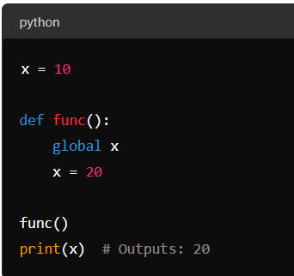
Answer
• In Python, the global keyword is used inside a function to declare that a variable inside the function is global (i.e., it should refer to the globally scoped variable of the same name).
• This allows you to modify the global variable from within a function.

Slide 36
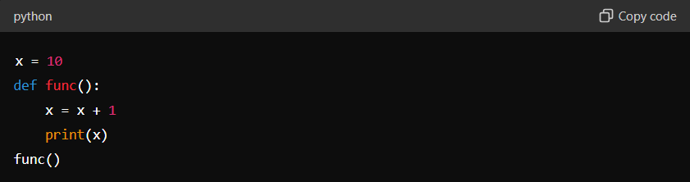
What will the following code output?
- A. `10`
- B. `11`
- C. `NameError`
- D. `SyntaxError`

Slide 37
Answer
- **Answer: C**
The variable x is defined outside the function func and has a value of 10.
Inside the function func, there is an attempt to modify x using x = x + 1.
Now, here's the key issue:
When you try to assign a value to a variable inside a function, Python assumes that variable is local to the function unless explicitly stated otherwise.
Therefore, x = x + 1 tries to access x locally within func, but x has not been defined locally (because global x was not declared), leading to a NameError.

Slide 38
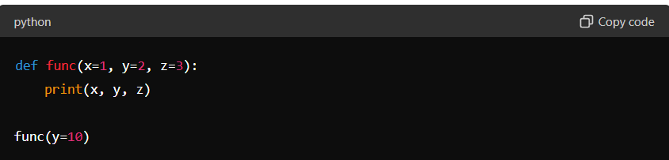
Q17
17. What is the output of the following code snippet?
- A. `1 2 3`
- B. `1 10 3`
- C. `1 10 10`
- D. `10 2 3`

Slide 39
Answer
- **Answer: B**
The function func is defined with three parameters: x, y, and z, with default values 1, 2, and 3 respectively.
When func(y=10) is called:
The value of y is explicitly set to 10.
The default values are used for x and z.
Therefore, the output of func(y=10) will be:
B. 1 10 3

Slide 40
Q18
18. Which of the following statements is true about Python's `lambda` functions?
- A. They can have multiple expressions.
- B. They can be decorated with `@staticmethod`.
- C. They are used to define anonymous functions.
- D. They cannot accept arguments.

Slide 41
Answer
- Answer: C
• In Python, lambda functions are small anonymous functions that can have any number of arguments but only one expression.
• They are defined using the lambda keyword, followed by a comma-separated list of arguments, a colon :, and the expression.
• Lambda functions are often used where a small function is needed temporarily and does not require a formal def statement.

Slide 42
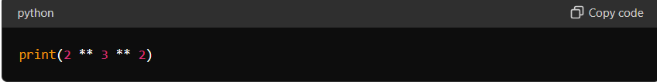
Q19
19. What will be the output of the following code snippet?
- A. `64`
- B. `512`
- C. `72`
- D. `Error`

Slide 43
Answer
- Answer: A
• numbers is a list [1, 2, 3, 4, 5].
• When you try to access numbers[10:], you are slicing the list from index 10 to the end.
• In Python, if you try to access an index that is out of range for a list, it doesn't raise an IndexError; instead, it returns an empty list [].

Slide 44
Q20
20. **Which of the following modules in Python provides support for working with dates and times?**
- A. `time`
- B. `datetime`
- C. `calendar`
- D. `timedelta`

Slide 45
Answer
- Answer: B

Slide 46
Object Oriented

Slide 47
Q1
1. What is the primary goal of Object-Oriented Programming (OOP)?
A. To simplify debugging
B. To improve code readability and reusability
C. To reduce program complexity
D. To optimize program execution

Slide 48
Answer
- Answer: B
Object-Oriented Programming (OOP) is a programming paradigm that focuses on organizing software design around objects and data rather than actions and logic.
By using OOP principles such as encapsulation, inheritance, and polymorphism, code becomes more modular, easier to understand, and easier to maintain.
OOP promotes reusability of code through mechanisms like inheritance and composition, which allow classes and objects to be reused in different parts of a program or in different programs altogether.

Slide 49
Q2
2. Which of the following is not a fundamental concept of OOP?
A. Inheritance
B. Encapsulation
C. Iteration
D. Polymorphism

Slide 50
Answer
Answer: C
Iteration is a fundamental concept in programming, but it is not specific to Object-Oriented Programming (OOP).
Iteration refers to the process of repeating a set of instructions a specified number of times or until a condition is met.
It is used in various programming paradigms, including procedural programming and functional programming, not just OOP.

Slide 51
Answer
A. Inheritance: Inheritance is a core concept of OOP where a class (subclass) can inherit attributes and methods from another class (superclass). It promotes code reuse and supports the "is-a" relationship.
B. Encapsulation: Encapsulation is another fundamental concept of OOP where data (attributes) and methods (functions) that operate on the data are bundled together within a class. It hides the internal state and requires interactions to be performed through well-defined interfaces.
D. Polymorphism: Polymorphism allows objects of different classes to be treated as objects of a common superclass. It enables a single interface to be used for entities of different types and supports flexibility and extensibility in code.

Slide 52
Q3
3. In Python, what is used to define a class?
A. `class`
B. `def`
C. `struct`
D. `type`

Slide 53
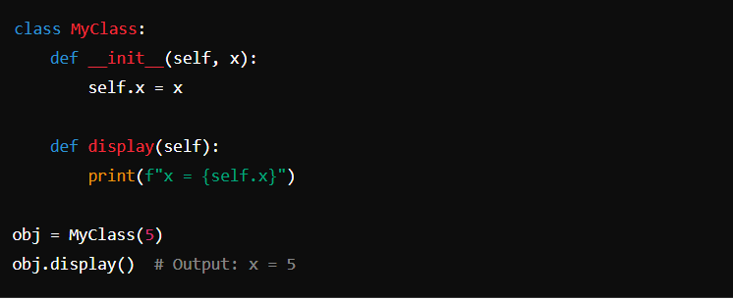
Answer
Answer: A

Slide 54
Q4
4. Which keyword is used to create an instance of a class in Python?
- A. `new`
- B. `create`
- C. `make`
- D. `None of the above`

Slide 55
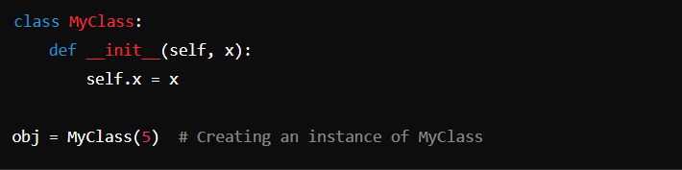
Answer
Answer: D
• In Python, the keyword used to create an instance (object) of a class is class_name().
• Unlike languages such as Java or C++, Python does not use a separate keyword like new to create instances.

Slide 56
Q5
5. Which of the following best describes inheritance in Python?
A. A way to hide implementation details
B. A way to restrict access to methods and attributes
C. A way to define a new class based on an existing class
D. A way to override built-in Python functions

Slide 57
Answer
Answer: C
Inheritance in Python is a mechanism where a new class (subclass) can inherit attributes and methods from an existing class (superclass).
This promotes code reusability and allows for hierarchical relationships between classes.
Subclasses can add their own attributes and methods, modify existing ones (method overriding), or extend the behavior of the superclass.

Slide 58
Answer
A. A way to hide implementation details: This describes encapsulation, not inheritance. Encapsulation is achieved by bundling the data (attributes) and methods that operate on the data within a class, hiding the internal state and requiring interactions to be performed through well-defined interfaces.
B. A way to restrict access to methods and attributes: This describes access control mechanisms like private and protected members, which are not directly related to inheritance but are enforced through naming conventions (_ prefix for protected, __ double underscore prefix for private) in Python.
D. A way to override built-in Python functions: This is not related to inheritance but rather to method overriding, where a subclass provides a specific implementation of a method that is already defined in its superclass.

Slide 59
Q6
6. In Python, how is the `__init__` method defined within a class?
- A. `init(self)`
- B. `def __init__(self)`
- C. `function __init__(self)`
- D. `constructor(self)`

Slide 60
Answer
Answer: B
• The __init__ method (often referred to as the initializer or constructor) is a special method in Python classes.
• It is automatically called when a new instance (object) of the class is created.
• The method is defined using the def keyword to indicate it's a function, followed by __init__ within double underscores, and (self) as the first parameter, which refers to the instance being created.

Slide 61
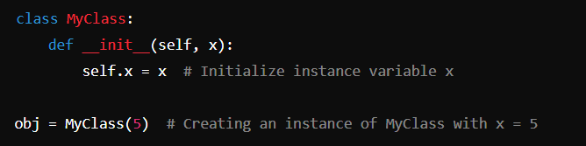
Answer

Slide 62
Q7
7. Which method in Python is used to provide a string representation of an object?
- A. `to_string()`
- B. `str()`
- C. `describe()`
- D. `__str__()`

Slide 63
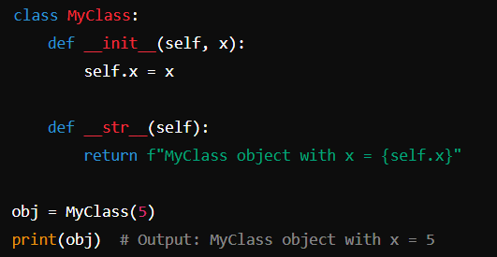
Answer
- Answer: D

Slide 64
Q8
8. What does the `super()` function do in Python?
- A. Calls the parent class constructor
- B. Calls a method from the parent class
- C. Returns a reference to the current instance
- D. Initializes a new instance of a class

Slide 65
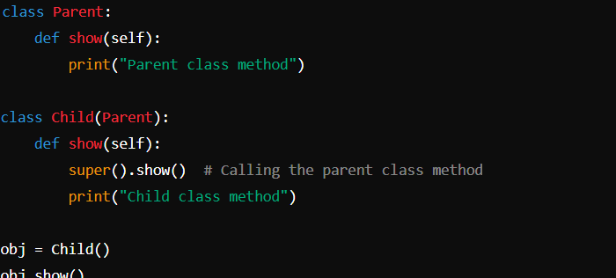
Answer
- Answer: B
• In Python, the super() function is used to call a method from a parent class.
• It allows you to access methods and properties from the parent class that have been overridden or extended in a subclass.

Slide 66
Q9
9. Which statement about encapsulation in Python is correct?
- A. It is the ability to bundle data and methods that operate on that data within the same class.
- B. It is the ability to inherit attributes and methods from a parent class.
- C. It is the ability to restrict access to methods and attributes.
- D. It is the ability to override methods from a superclass.

Slide 67
Answer
Answer: A -It is the ability to bundle data and methods that operate on that data within the same class.
Encapsulation is one of the fundamental concepts of Object-Oriented Programming (OOP).
It involves bundling the data (attributes) and methods (functions) that operate on the data within a single class.
Encapsulation allows for data hiding, where the internal state of an object is hidden from the outside world, and interactions with the object are performed through well-defined interfaces (methods).
This helps in achieving modularization and separation of concerns in software design.

Slide 68
Q10
10. What does the term "polymorphism" mean in the context of OOP?
A. The ability to define multiple constructors in a class
B. The ability to define multiple methods with the same name but different signatures
C. The ability to restrict access to certain methods and attributes
D. The ability to create instances of a class

Slide 69
Answer
Answer: B
Polymorphism in Object-Oriented Programming (OOP) refers to the ability of different objects to respond to the same method or message in different ways.
It allows methods to be defined with the same name but different parameter lists (method overloading) or to be overridden in subclasses (method overriding).
This enables flexibility and allows different objects to be treated as instances of a common superclass, simplifying code and promoting reusability.

Slide 70
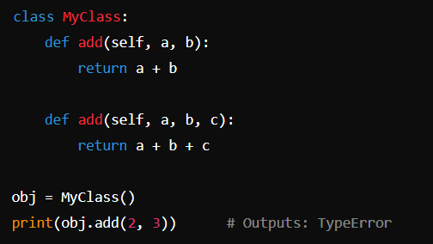
Answer

Slide 71
Q11
11. Which statement about method overriding in Python is true?
A. It allows a subclass to hide methods from its superclass.
B. It allows a subclass to provide a specific implementation of a method that is already provided by its superclass.
C. It allows a subclass to inherit all methods from its superclass.
D. It allows a subclass to define methods that cannot be overridden.

Slide 72
Answer
- Answer: B -It allows a subclass to provide a specific implementation of a method that is already provided by its superclass.
Method overriding in Python (and in object-oriented programming in general) allows a subclass to provide its own implementation of a method that is already defined in its superclass.
This enables the subclass to customize the behavior of inherited methods without modifying the superclass.
Method overriding is achieved by defining a method in the subclass with the same name and signature as the method in the superclass.

Slide 73
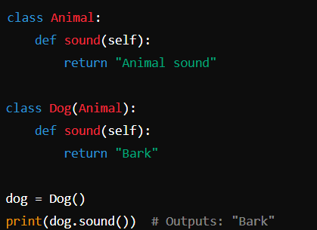
Answer

Slide 74
Q12
12. In Python, what is the purpose of the `@classmethod` decorator?
- A. It indicates that a method is private and cannot be accessed from outside the class.
- B. It indicates that a method belongs to a specific instance of a class.
- C. It indicates that a method can be called directly on the class itself, rather than on an instance of the class.
- D. It indicates that a method should be overridden in a subclass.

Slide 75
Answer
Answer: C -It indicates that a method can be called directly on the class itself, rather than on an instance of the class.
• In Python, the @classmethod decorator is used to define a method that operates on the class itself rather than on instances of the class.
• Such methods receive the class itself as the first argument (cls by convention), instead of the instance (self).
• @classmethod allows these methods to access or modify class-level variables and perform operations related to the class.

Slide 76
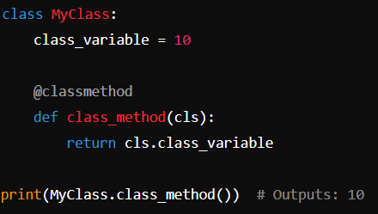
Answer

Slide 77
Q13
13. What is the concept of "multiple inheritance" in Python?
- A. The ability of a class to inherit from more than one superclass.
- B. The ability to override methods in more than one superclass.
- C. The ability to inherit from a subclass.
- D. The ability to define multiple constructors in a class.

Slide 78
Answer
Answer: A - The ability of a class to inherit from more than one superclass
• Multiple inheritance in Python allows a class to inherit attributes and methods from more than one parent class.
• This means a subclass can inherit behaviors and features from multiple sources, promoting code reuse and facilitating complex relationships.

Slide 79
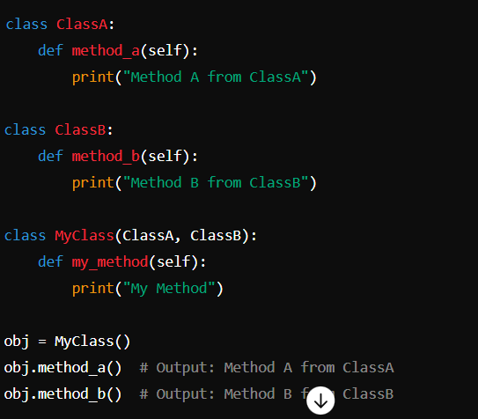
Answer

Slide 80
Q14
14. Which statement best describes a "base class" in Python?
- A. A class that inherits from another class.
- B. A class that cannot be instantiated directly and is used only for inheritance.
- C. A class that has no methods defined within it.
- D. A class that cannot have subclasses.

Slide 81
Answer
- Answer: B - A class that cannot be instantiated directly and is used only for inheritance.
• In Python, a base class (also known as an abstract base class) is a class that is designed to be inherited by other classes.
• It provides common attributes and methods that subclasses can inherit and override as needed.
• A base class typically defines methods that can be shared across multiple subclasses, promoting code reuse and enforcing a common interface.
• Instances of a base class cannot be created directly; it serves as a blueprint for other classes to inherit from.

Slide 82
Q15
15. What is the purpose of the `__del__` method in Python?
- A. It is used to delete an instance of a class explicitly.
- B. It is used to define a destructor for a class.
- C. It is used to prevent garbage collection in Python.
- D. It is used to define the equality operator for a class.

Slide 83
Answer
- Answer: B - It is used to define a destructor for a class
• In Python, the __del__ method is a special method that is called when an object is about to be destroyed (deallocated or garbage collected).
• It is used to perform cleanup actions or resource deallocation when an object is no longer needed.
• The __del__ method is analogous to destructors in other programming languages like C++.

Slide 84
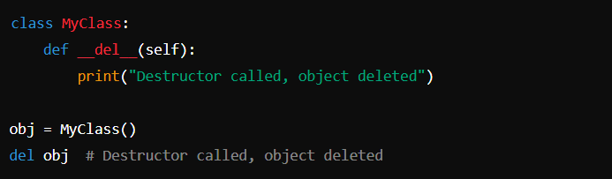
Answer

Slide 85
Q16
16. Which keyword in Python is used to create a new instance of a subclass that inherits from a superclass?
- A. `new`
- B. `super`
- C. `extend`
- D. `None of the above`

Slide 86
Answer
- Answer: D
• In Python, the creation of a new instance of a subclass that inherits from a superclass is not directly tied to a specific keyword among the options provided.
• Instead, instances of classes (both subclasses and superclasses) are created using the class name followed by parentheses containing any necessary arguments to initialize the instance.

Slide 87
Answer
• A. new: In Python, new is not used to create instances of classes. Instead, it's a method that Python's object creation mechanism calls to create a new instance.
• B. super: The super keyword is used to access methods and properties from a superclass within a subclass. It's not directly involved in creating new instances of subclasses.
• C. extend: There is no keyword extend in Python related to creating instances of classes.

Slide 88
Q17
17. What is the purpose of the `@staticmethod` decorator in Python?
- A. It indicates that a method belongs to a specific instance of a class.
- B. It indicates that a method can be called directly on the class itself, rather than on an instance of the class.
- C. It indicates that a method should not be overridden in a subclass.
- D. It indicates that a method is private and cannot be accessed from outside the class.

Slide 89
Answer
- Answer: B -It indicates that a method can be called directly on the class itself, rather than on an instance of the class.
• In Python, the @staticmethod decorator is used to define a static method within a class.
• A static method belongs to the class rather than to instances of the class.
• It does not receive self or cls as the first parameter, and therefore, it cannot access or modify class or instance state.
• Static methods are commonly used for utility functions that are related to the class but do not require access to instance data.

Slide 90
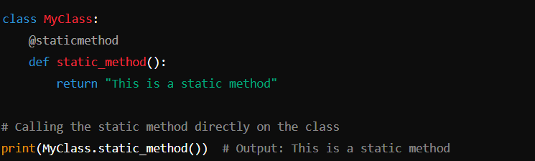
Answer

Slide 91
Q18
18. What does the term "class variable" refer to in Python?
- A. A variable that belongs to a specific instance of a class.
- B. A variable that is accessible only within the class that defines it.
- C. A variable that is shared by all instances of a class.
- D. A variable that cannot be modified after it has been initialized.

Slide 92
Answer
- Answer: C -A variable that is shared by all instances of a class
• In Python, a class variable is a variable that is defined within a class but outside of any instance method.
• Class variables are shared by all instances (objects) of the class.
• They are accessed using the class name rather than instance variables, and changes made to the class variable will affect all instances of the class.

Slide 93
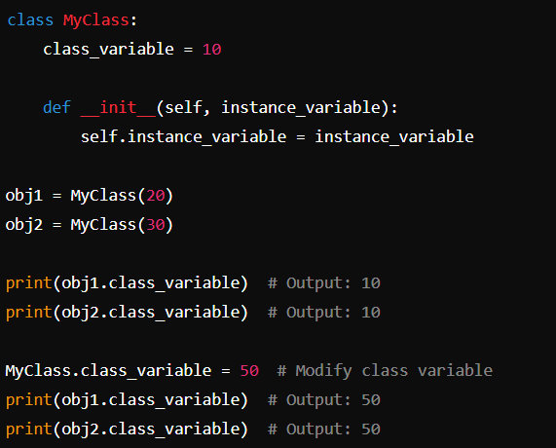
Answer

Slide 94
Q19
19. Which of the following is an advantage of using OOP principles in software development?
- A. Increased complexity and reduced modularity
- B. Reduced code reusability and increased coupling
- C. Improved code organization and maintainability
- D. Decreased flexibility and increased development time

Slide 95
Answer
Answer C. Improved code organization and maintainability
• Object-Oriented Programming (OOP) promotes improved code organization by encapsulating data (attributes) and behaviors (methods) within objects (instances of classes).
• OOP enhances maintainability by modularizing code into classes and objects, which allows for easier debugging, testing, and updating of code components.
• By focusing on concepts such as inheritance, encapsulation, and polymorphism, OOP encourages code that is easier to understand and modify, reducing the risk of introducing errors during maintenance.

Slide 96
Q20
20. What is the term for the process of creating a new instance of a class?
- A. Instantiation
- B. Inheritance
- C. Polymorphism
- D. Abstraction

Slide 97
Answer
- Answer: A
• In object-oriented programming (OOP), instantiation refers to the process of creating a new instance (object) of a class.
• When an instance of a class is created, memory is allocated for the object, and the __init__ method (constructor) of the class is called to initialize the object's attributes.
• Instantiation allows multiple objects (instances) of the same class to exist independently, each with its own set of attributes and potentially different behaviors defined by methods.

Slide 98
Answer
• B. Inheritance: Inheritance is the mechanism by which a class can inherit attributes and methods from another class (superclass or base class). It is not directly related to creating instances of a class.
• C. Polymorphism: Polymorphism refers to the ability of different classes to be treated as instances of the same class through a common interface. It is not directly related to creating instances of a class.
• D. Abstraction: Abstraction is the process of hiding the complexity of a system by focusing on the essential aspects while ignoring irrelevant details. It is a concept that promotes simplification and clarity in design, not related to the creation of instances.

