Slide 1
Python Certification

Slide 2
Levels
PCEP - Certified Entry-Level Python Programmer
PCAP - Certified Associate in Python Programming
PCPP - Certified Professional in Python Programming

Slide 3
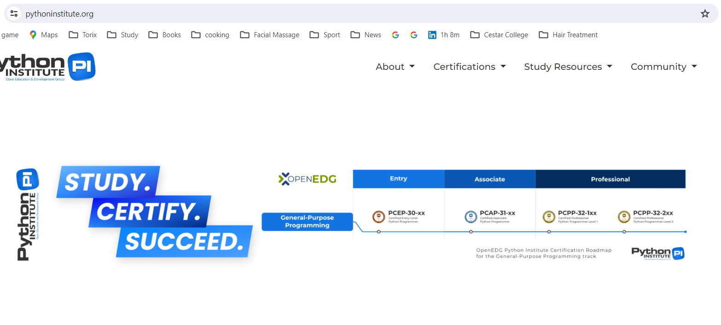
https://pythoninstitute.org/

Slide 4
Cost / Frequency
Registry online
Cost between around 60 -250$ USD
Take it any time you would like
If you are failing, please take time for upgrading your skills

Slide 5
Courses
Coursera Python for Everybody Specialization - Offered by the University of Michigan, this specialization covers Python programming from basics to advanced topics, including
data structures,
web scraping,
data visualization.

Slide 6
Courses
Udemy Python Courses: Udemy hosts a wide range of Python courses, including
Complete Python Bootcamp:: Go from zero to hero in Python 3
Python for Data Science
Python for Machine Learning Bootcamp
Automate the Boring Stuff with Python Programming

Slide 7
Courses
LinkedIn Learning Python Certifications: LinkedIn Learning offers various Python courses and certifications, such as:
Python Essential Training
Learning Python
Python: Design Patterns

Slide 8
Courses
Certified Python Developer by Coding Dojo: Coding Dojo offers a Python certification program covering
Python fundamentals,
Web development
Data science.

Slide 9
Courses
Google IT Automation with Python Professional Certificate: Offered by Google on Coursera, this certificate program teaches Python for IT automation, including using
Python to automate tasks
Manipulate data
Interact with APIs.

