Slide 1
ENIAC
PARTNERSHIP EVALUATION:
ENIAC X MAGIST
EXPLORING PRODUCT FIT & DELIVERY EFFICIENCY
SHENIA & VICTORIA
ENIAC’S DATA ANALYST TEAM
OCTOBER 2018

Slide 2
CONTEXT & OBJECTIVES
ENIAC
Background
Eniac is expanding into Brazil and evaluating Magist as a potential partner
Magist granted limited access to their marketplace data for evaluation
Objective & Focus Areas
As Eniac’s data analyst team, we explored Magist’s data to assess:
Product price segmentation & demand
Delivery timelines & reliability

Slide 3
RECOMMENDATION
ENIAC
Partnership is not recommended
unless Magist can demonstrate improved delivery performance and proven experience with premium-tier products
Main concerns:
Product & Pricing Alignment
Delivery standards

Slide 4
RECOMMENDATION
ENIAC
Why These Concerns Were Prioritized
All purchases happen on Eniac’s website – customers won’t know Magist is involved
Any issues with delivery, product quality, packaging, or returns will be blamed on Eniac
⚠️ Risk of Brand Damage

Slide 5
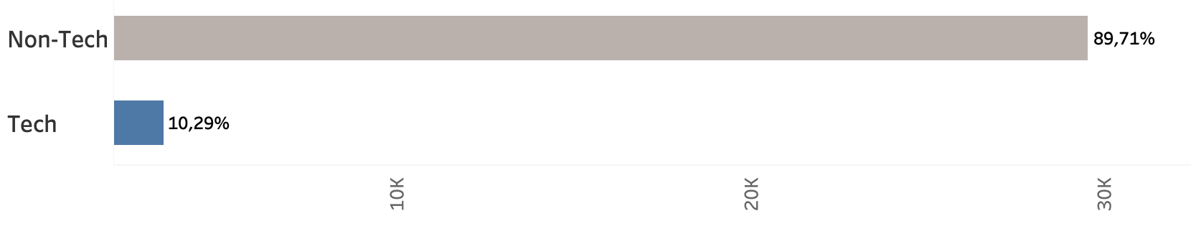
CONCERN 1 – Product Alignment
ENIAC
Product Category Distribution: Tech vs Non-Tech
👉 Only 10% of Magist’s catalogue consists of tech products, while 90% are non-tech

Slide 6
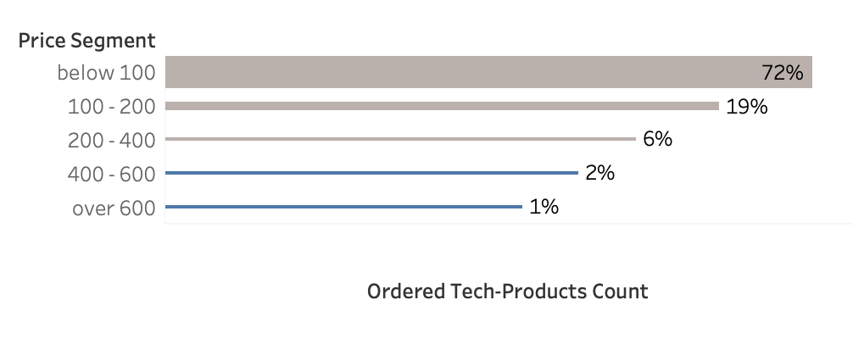
CONCERN 1 – Pricing Alignment
ENIAC
Price Segment Product Distribution
Eniac Item Avg Price (540)
👉 Only 2% of Magist products are priced near Eniac’s average €540
👉 Magist’s average product price* €140
* in related categories (e.g. computers, accessories, telephony)

Slide 7
CONCERN 1 – Product & Pricing Alignment
ENIAC
Possible Implications of Poor Alignment
Mismatched categories or pricing can cause problems with product listings and inventory syncing.
Magist’s logistics might not suit premium products, leading to delays or inconsistent service.
Poor alignment could slow down orders, stock updates, and returns, creating internal issues and unhappy customers.

Slide 8
CONCERN 1 – Key Metrics Overview
ENIAC
Product Category Misalignment
Only 10% of Magist’s catalogue consists of tech products
Pricing Misalignment
Magist’s avg product price: €140
Eniac’s avg product price: €540
Only 2% of Magist products are priced near Eniac’s average

Slide 9
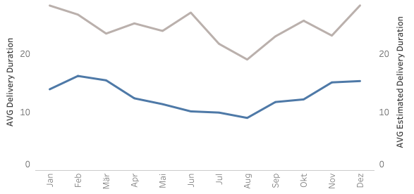
CONCERN 2 – Delivery standards
ENIAC
👉 Magist’s average delivery duration - 12,5 days
👉 Magist’s average estimated delivery duration - 24 days

Slide 10
CONCERN 2 – Delivery standards
ENIAC
2018 Brazil Delivery Standards
Market Leaders 5-10 days
(Mercado Livre, Americans)
Magist 12.5 days
National Post 15-20 days

Slide 11
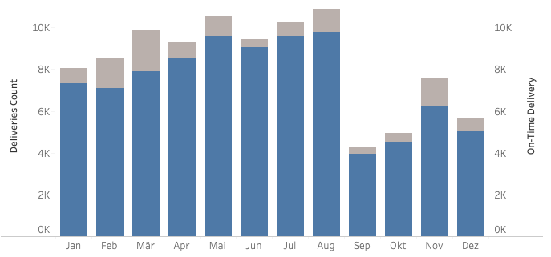
CONCERN 2 – Delivery standards
ENIAC
👉 Magist’s OTDR is 90%
👉 Magist’s average delay rate is 8%

Slide 12
CONCERN 2 – Delivery standards
ENIAC
Metric Magist Benchmark Gap
OTD Rate 90% ≥95% -5%
Delay Rate 8% ≤3% +5%

Slide 13
CONCERN 2 – Key Metrics Overview
ENIAC
OTDR and Delay Rate are below market standard
Avg. Shipping Cost: €19.99 (Heavy: €35.51, PCs: €48.45)
Heavy packages are more likely to be delayed — possibly due to Magist’s infrastructure not optimized for tech items like PCs
Delivery cost is higher for delayed orders, which reduces operational efficiency
👉 While cost is a factor, reliability and consistency are more critical for Eniac’s premium customers

Slide 14
MAIN CONCERNS RECAP
ENIAC
Price mismatch: Only 2% of catalogue near Eniac’s average (€540)
Delivery risk: OTDR 90%, Avg. Delay Rate 8%
Product misalignment: Only 10% tech, unclear category tagging
Backend misfit: Customer experience still affected despite own sales channel

Slide 15
INTERPRETATION
ENIAC
Key Risks to Eniac’s Premium Positioning
Limited experience with premium pricing → Risk of inconsistent care, delivery speed, and post-sale service
Delivery standards below expectation → Declining OTDR and slow fulfillment could damage customer satisfaction
Backend misalignment with product needs → Handling, storage, and support not optimized for tech or high-value goods
Indirect brand risk despite own-site sales → Any backend failure reflects on Eniac’s brand and reputation

Slide 16
FINAL RECOMMENDATION
ENIAC
Partnership Not Advised
Unless Magist demonstrates clear improvements in:
Delivery reliability and speed
Handling of premium tech products
Operational alignment with Eniac’s product structure and standards

Slide 17
ALTERNATIVE RECOMMENDATION
ENIAC
Start with a limited product range: Test accessories that align with Magist’s low-to-mid price segment
Run a 3-month pilot program to evaluate sales potential and delivery performance
Explore alternative logistics options for improved delivery speed and reliability
Hold back high-value items (e.g., iPhones, iPads) until demand and service levels are proven

Slide 18
FINAL RECOMMENDATION
ENIAC
Without stronger alignment, Magist’s current setup may compromise operational efficiency and customer trust, particularly in the premium segment.

Slide 19
ENIAC
Thank you for your attention!
Feel free to reach out if you have any questions or need further clarification

