Slide 1


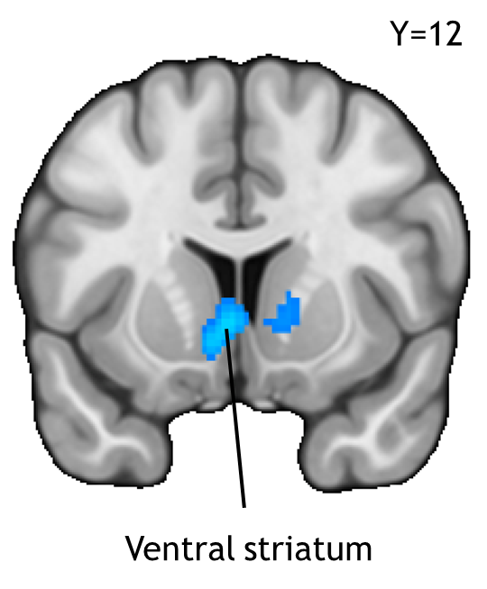
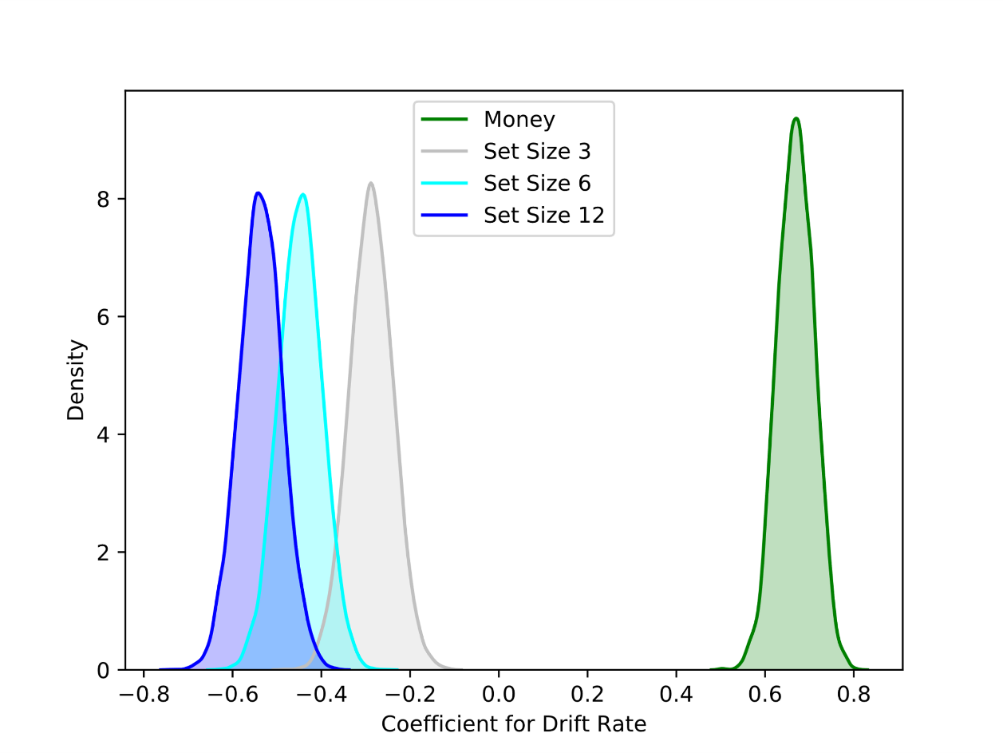
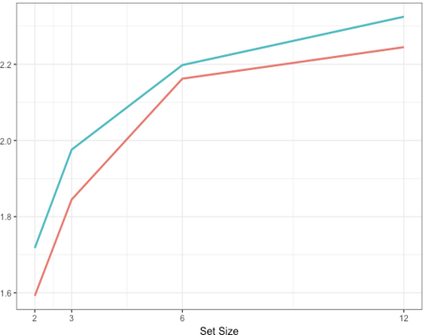

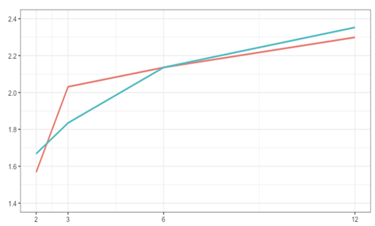
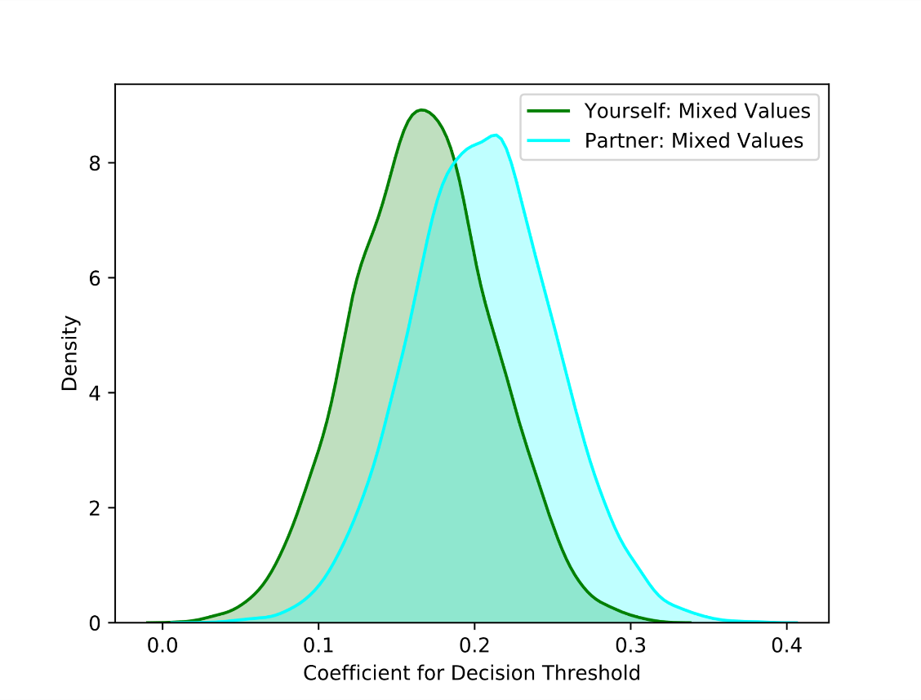
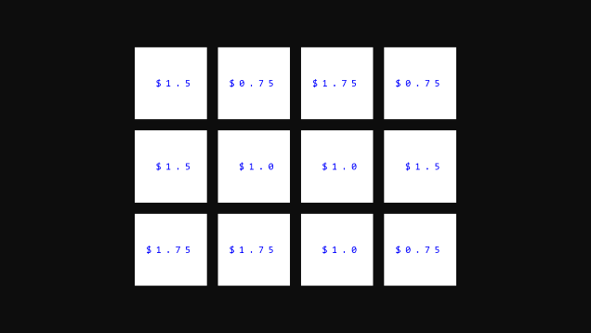
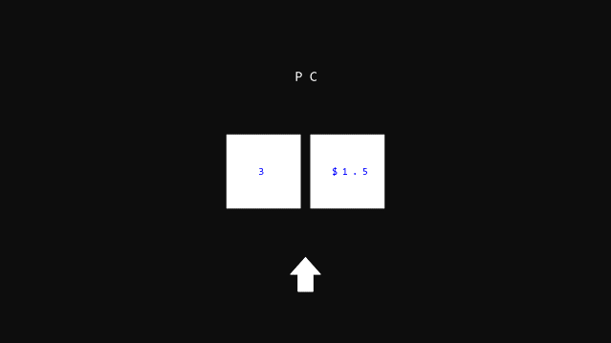
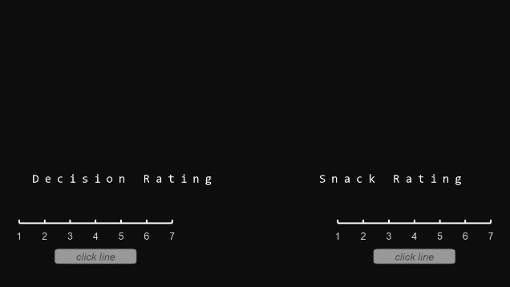
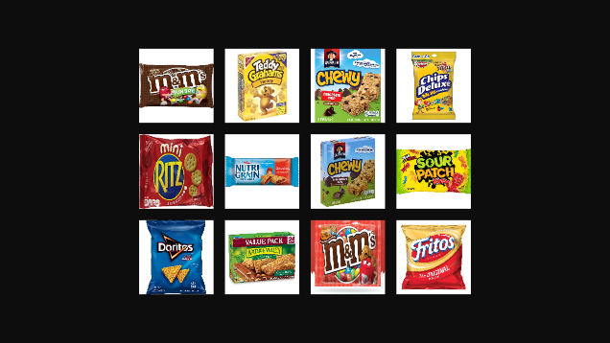
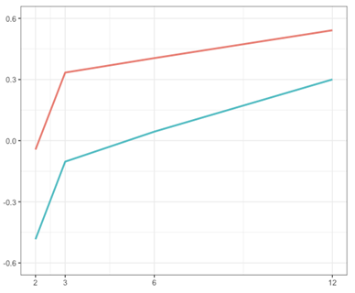
The More the Merrier: Participants Value Having More Options to Choose From
Victoria Kelly¹, Matthew Slipenchuk¹, Srikar Katta¹, John A. Clithero², David V. Smith¹
¹Temple University, ²University of Oregon
1. Introduction
3. Is There an Association Between Set Size and Response Time?
5. Modeling Initial Choice (DDM)
Though people prefer having more items to choose from, they are less satisfied with their choices after choosing among many options as opposed to only a few (Iyengar & Lepper, 2000). However, this effect reverses when making decisions for others, despite being presented with many options (Polman, 2012). Our study examines valuation when making decisions for oneself and another person.
.
Modeling the initial choice using a Drift-Diffusion Model (DDM) framework found support for trial-to-trial fluctuations in evidence accumulation that track changes in monetary amount and set size (p<0.001).
In order to determine whether there was an association between set size and response time, we ran a repeated measures ANOVA analysis.
Participants took longer to select food items from groups containing more options than those containing fewer options (p<0.001).
This demonstrates that more choices tend to increase the time it requires to make a decision.
Though we hypothesized that choice would become less valuable once the set size reaches 6 items, we did not see evidence of this.
This is based on the increase in response time across set sizes.
2. Methods
Response Time (seconds)
Fifteen gender-matched pairs of college students (N=30) participated in a two-part experiment consisting of a Ratings Task and a Decision Task.
Ratings Task
Participants rate a series of food items by preference and familiarity. These ratings determine which food items are used in the Decision Task. Only familiar food items (rated at least a 4 on a 1-7 Likert scale) are used for the Decision Task.
Decision Task
Choice 1 Choice 2 Post-Choice Rating
Response Time (seconds)
There was also a significant effect in decision threshold on mixed-choice trials (p<0.001), evidence in favor of increased decision conflict.
Participants see a prompt dictating the type of decision they are making. Participants choose between a prescribed set size (2, 3, 6 or 12) or a listed monetary amount.
If a participant chooses the listed set size, he/she chooses a food item from a list (of either all high-rated food items or a mix of high and low-rated food items). If a participant chooses the listed monetary amount, he/she must confirm his or her selection.
Participant is asked to rate their selection based on the item itself and decision overall.
Set Size
4. Is There an Association Between Set Size and Item Rating?
6. Conclusions and Future Directions
In order to determine whether there was an association between set size and item preference, we ran a repeated measures ANOVA analysis.
We used the revaluated ratings data to represent item preference.
Participants’ ratings of snack items increased after selecting those items for themselves from a high-value group of items as set size increased (p<0.05).
This suggests that they valued a greater set size.
Preliminary results with exploratory sample:
Satisfaction with decisions may be linked to the overall satisfaction of items within a decision set.
Value type in a set plays a role in how individuals perceive choice difficulty.
Future directions:
Explore most recent data.
Transition current study into an imaging study in order to explore the neurological components of decision overload and valuation.
Revaluated Rating
Indicates who the participant is making decisions for (themselves or their partner).
Number of different food items that the participant will choose from.
Set Size
7. Citations
Sample monetary option.
Fujiwara, J., Usui, N., Eifuku, S., Iijima, T., Taira, M., Tsutsui, K., & Tobler, P. N. (2017) Journal of Cognitive Neuroscience
Iyengar, S. S. & Lepper, M. R. (2000) Journal of Personality and Social Psychology
Polman, E. (2012) Journal of Personality and Social Psychology
High-value, mixed-value, or computer decision.

