Slide 1
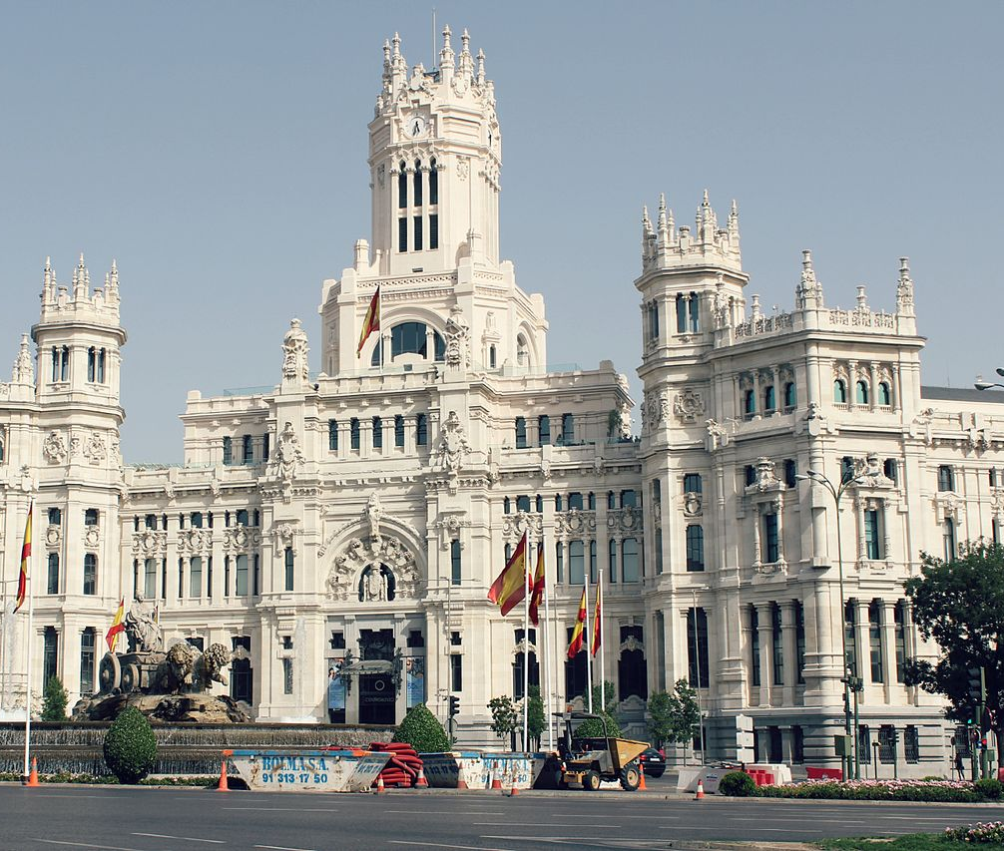
PREDICTION OF BICYCLE USERS PER DAY IN MADRID
Victoria Bueno Perez

Slide 2
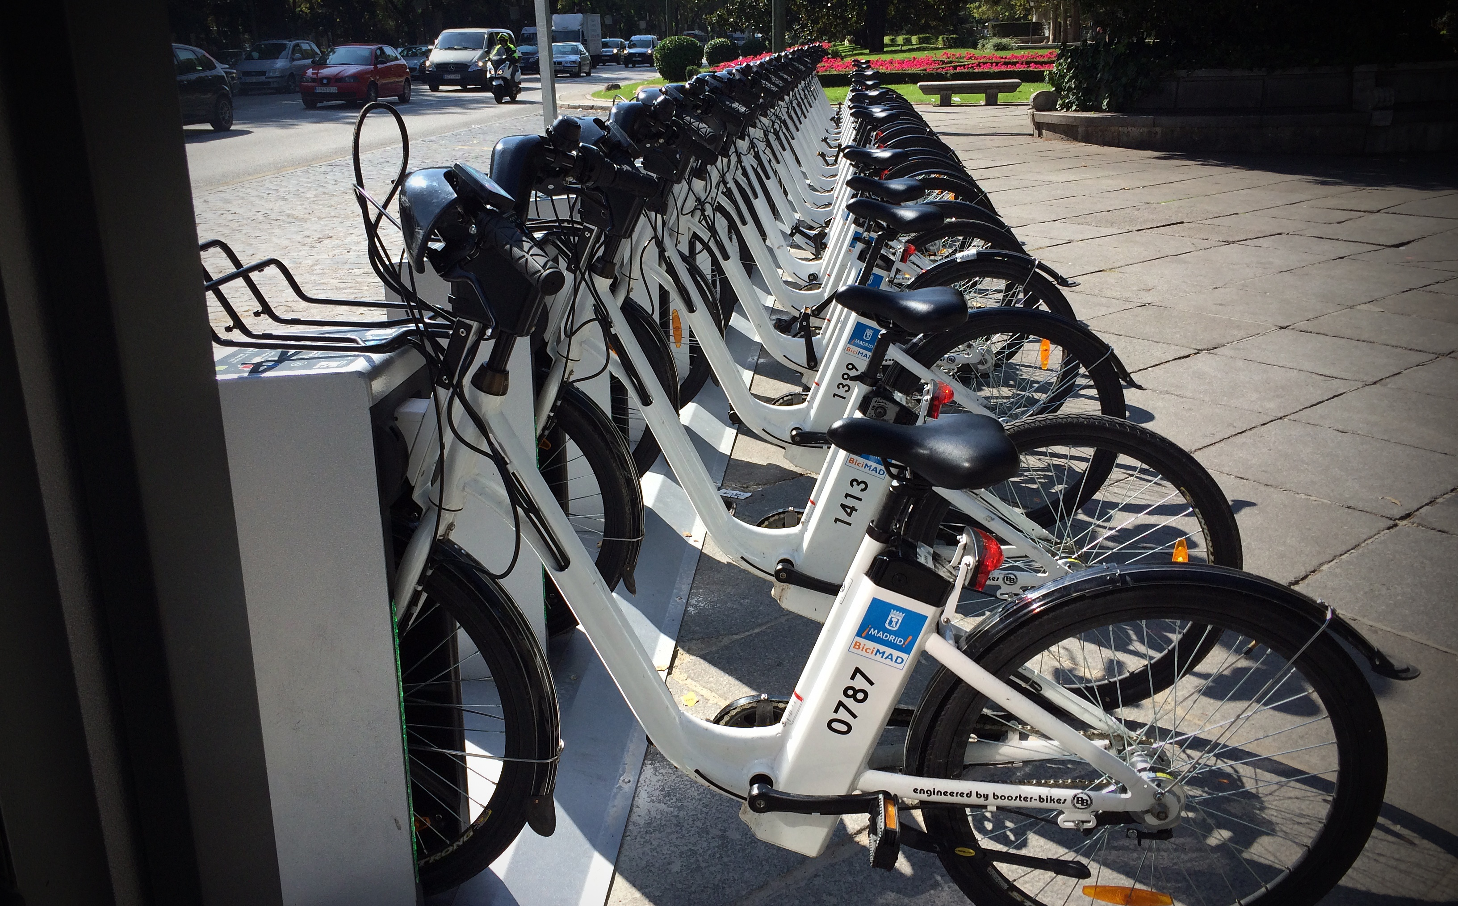
Problem to be solved
My purpose with this project is to see if I can predict the number of users that the public system of bicycles of Madrid’s city hall, called BiciMad, is going to have in one day depending on different features.

Slide 3
Features and dataset
Users per day
Number of active bonos (bicycle cards)
Available bicycles per day
Day of the week
Weekend or not
Temperature
Rain
I have created my own dataset with small datasets that I obtained from the open data portal of Madrid’s City Hall

Slide 4
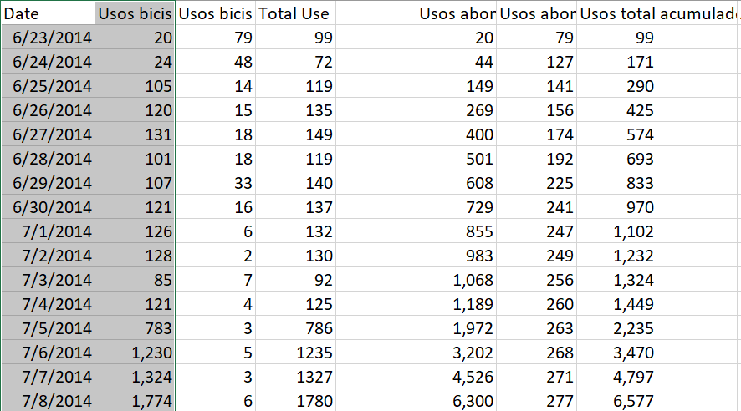
Data set: Users per day

Slide 5
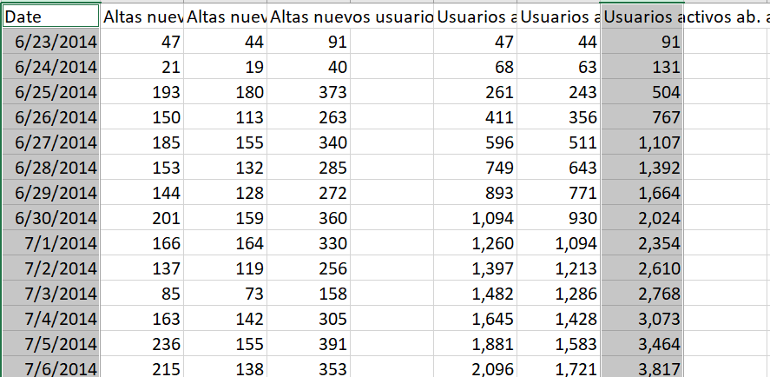
Dataset: Active bonos (cards) per day

Slide 6
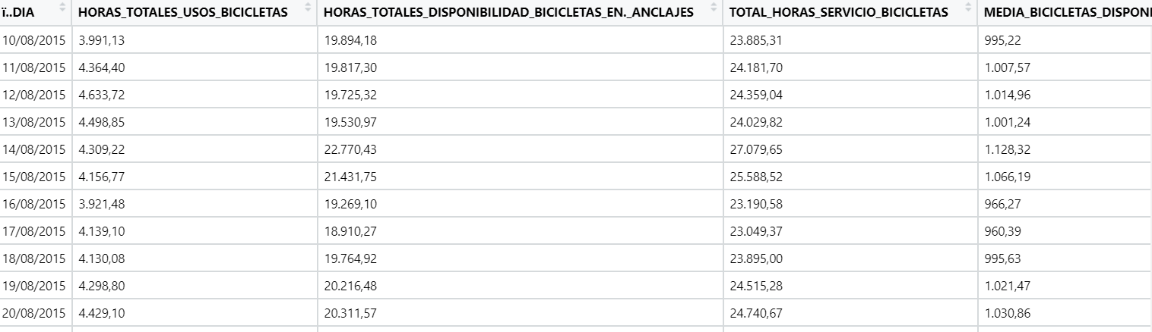
Dataset: Available bicycles per day
MEAN AVAILABLE BICYCLES = TOTAL SERVICE HOURS/24 = (USED HOURS + AVAILABILITY HOURS) / 24

Slide 7
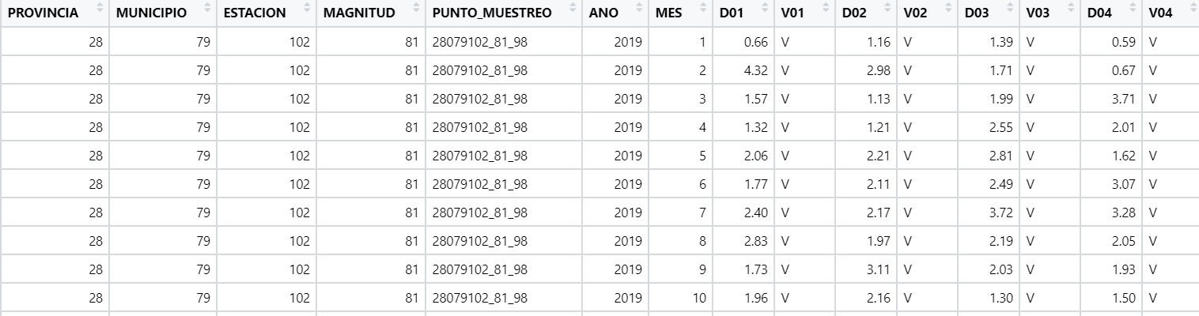
Dataset: Temperature and Rain
MAGNITUD = 83 -> TEMPERATURE
MAGNITUD = 89 -> RAIN

Slide 8
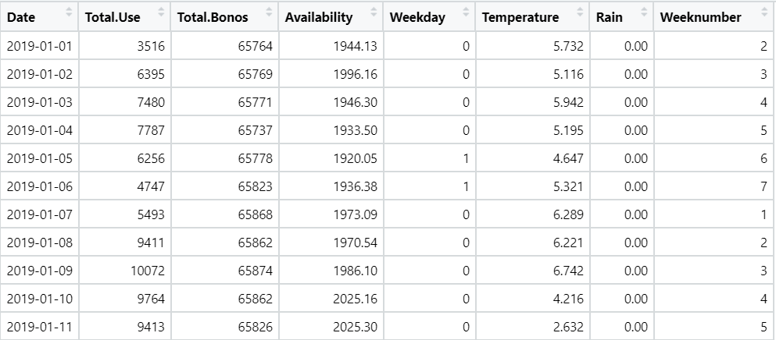
Final Dataset

Slide 9
Predictive Algorithm: Regression and model Tress
Training data 70%, Testing data 30%
Mean of Total Use is 10,105.1
Linear Regression Model (lm)
Multiple R-squared value of 0.5658
MAE: 2,013.413
Regression Tree Model (rpart)
MAE: 1,729.243
Model Tree (m5p)
MAE: 1,872.847

Slide 10
CONCLUSION
1) I need more data to perform better models
2) As I have created a dataset using many datasets, I have encountered the problem that some datasets collected users' data from 2014 but others like the temperature dataset only had data since 2019 so that has reduced a lot the total number of total observations
With the current total amount of data, I can estimate but not predict accurately the number of users in a day.

Slide 11
Used sources
1) Meteorological data:
https://datos.madrid.es/sites/v/index.jsp?vgnextoid=8d7357cec5efa610VgnVCM1000001d4a900aRCRD&vgnextchannel=374512b9ace9f310VgnVCM100000171f5a0aRCRD
2) Bicycles’ availability:
https://datos.madrid.es/sites/v/index.jsp?vgnextoid=7547ff52e4a4f410VgnVCM1000000b205a0aRCRD&vgnextchannel=374512b9ace9f310VgnVCM100000171f5a0aRCRD
3) Active users and uses per day:
https://datos.madrid.es/sites/v/index.jsp?vgnextoid=6d8bdae2be63c410VgnVCM1000000b205a0aRCRD&vgnextchannel=374512b9ace9f310VgnVCM100000171f5a0aRCRD

