Slide 1
Species Distribution Model Development and Validation
Victoria Chistolini
Honors Thesis
Department of Computer Science

Slide 2
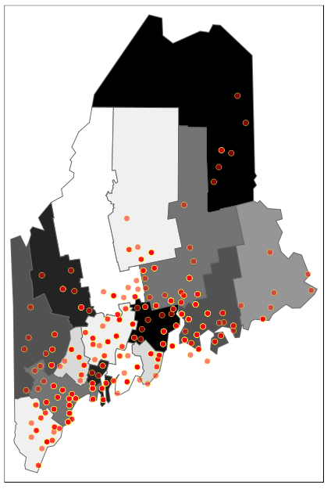
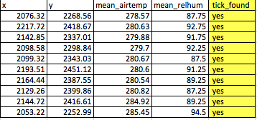
Ticks in Maine: A Species Distribution Modeling Problem?
Notes:
2006-2013 time period
Predictor vars, add list
MOTAVATION deer ticks, because they carry limes disease, at the weather forecast scale, daily, imagine when you check the weather, check ticks

Slide 3
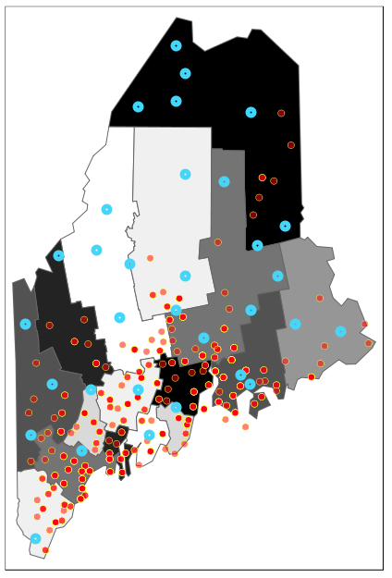
Maximum Entropy Models
Use what we know, make no assumptions about what what we don’t know
Background points (blue) and Presence points (red)

Slide 4
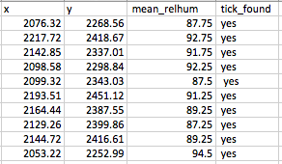
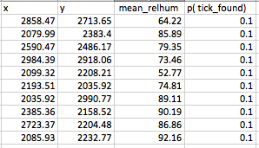
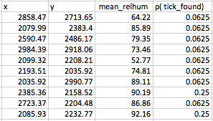
Maximum Entropy Example
2
Presence Points Data
1
Background Points Data
3
Background Points Data
Create Rule Based on Data:
p(mean_relhum > 90) = 0.5

Slide 5
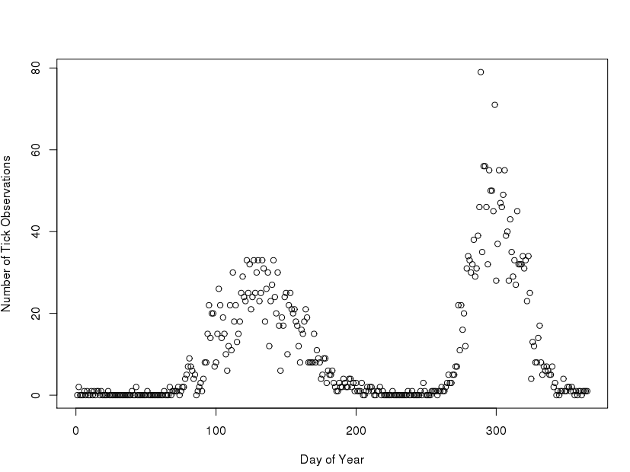
Ensemble Models in Forecasting
More models are better than one
Notes:
If you predict day 100 use data around day 100
empirical model, looking at patterns, looking at biology, we don’t expect one model well

Slide 6
Poisson Point Process Models
Predictor Selection Algorithm
for each day-window:
determine correlated predictors
model each subset of uncorrelated predictors
while z-scores.min() > -1.96 && z-score.min() < 1.96:
z-scores. remove(z-scores.min())

Slide 7
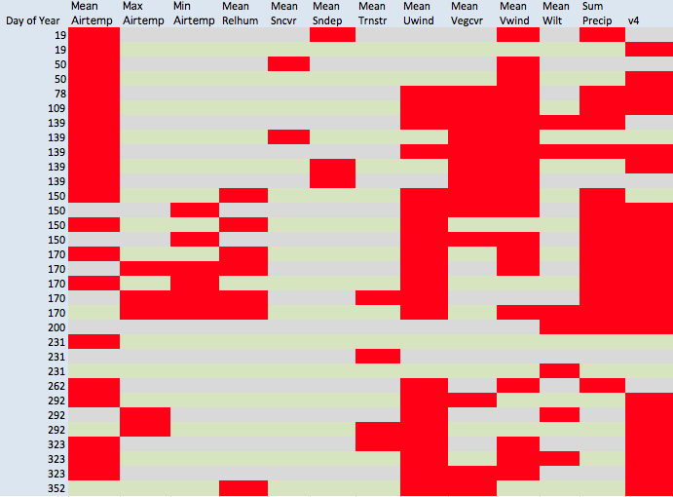
Ensemble Generation using Poisson Point Process Models
Notes:
Day of year on x axis

Slide 8
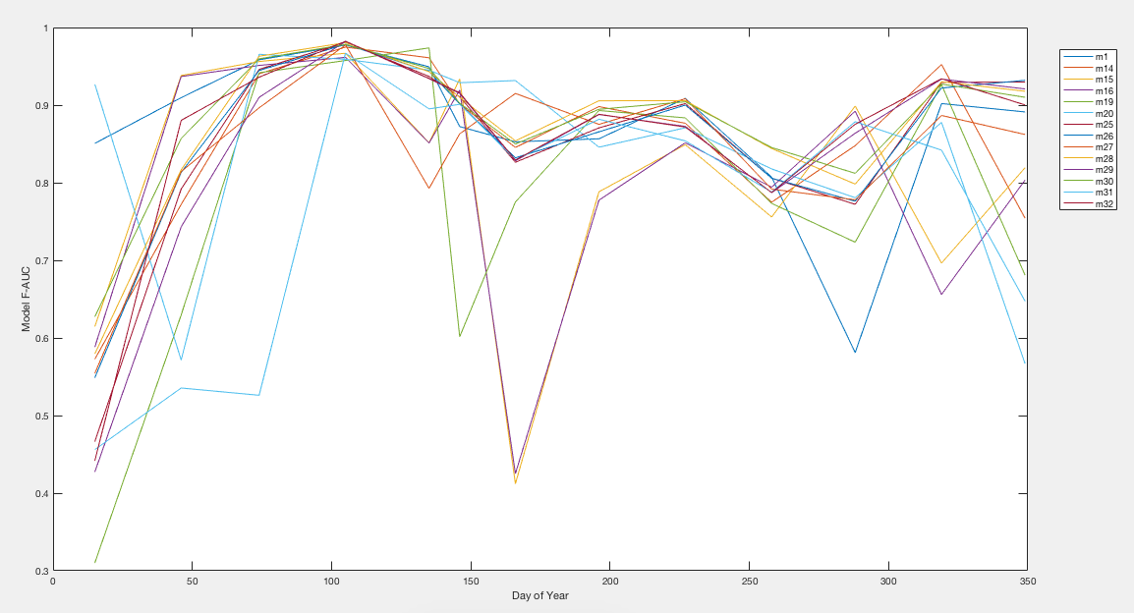
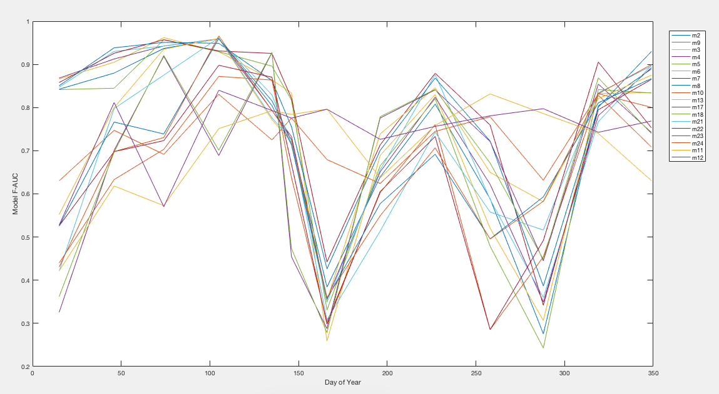
Ensemble Assessment

Slide 9
Future Directions
Build database for tracking the performance of ensemble members on future data
Use database to help calibrate ensembles

Slide 10
Thank You
Stephanie Taylor, Nick Record, Ben Tupper and Manny Gimond for the support and mentorship throughout my project.

Slide 11
Questions?

