Slide 1
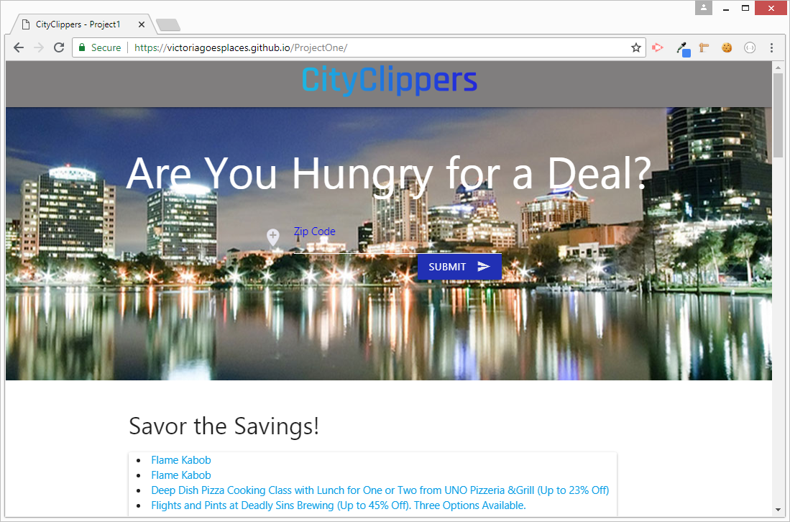
CityClippers A web application for finding the best dining deals
Developers
Victoria Gonzalez
Tyler Thomson
Rubens Cardoso
Adrian Robertson
Instructor
Graydon Scates
As of: July13th, 2018

Slide 2
Agenda
Background / Problem Statement / Motivation
Planning the Application
Minimum Viable Product (MVP)
Building the Application
Demonstration
Feature Enhancements
Notes:
2

Slide 3
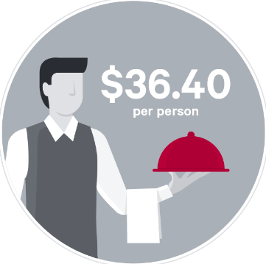
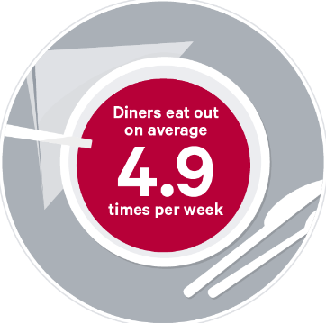
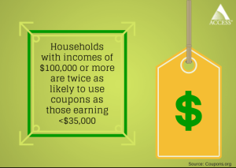
Background – Problem Statement
Restaurants comprise the most searched industry by consumers through both mobile applications and browsers (SinglePlatform)
96% of consumers use coupons (RetailMeNot)
90% of customers have looked for a restaurant deal at least once (RetailMeNot)
97% of consumers look for deals when they shop and 92% said they are always looking (Hawk Incentives)
40% of consumers said they feel smart when they can find the best deals (Hawk Incentives)
80% of millennials said they used coupon codes when shopping online (CouponFollow)
Zagat © 2018
People are spending a lot of money on food. They seek discounts to offset cost (and other reasons). An application that helps find deals will attract and maintain customers.
Notes:
3
Desire for savings crosses economic boundaries as well as age and gender boundaries.
Some of the statistics are directly related to the restaurant and food industry, while others are general shopping trends. However, they provide insight into customer demand and behavior.
BLUF: People use the internet to search for places to eat

Slide 4

Planning the Application
Brainstorming
Communication
Slack “DreamTeam” Channel
Trello web-based project management
Standup
Telephone
GitHub Merging and Branching Procedures
Duties and Responsibilities
Frontend Team (Adrian and Tyler)
Backend Team (Victoria and Rubens)
Notes:
4
Pre-existing applications

Slide 5
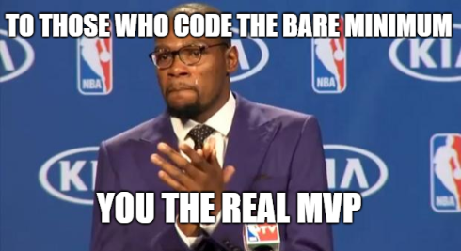
Minimum Viable Product (MVP)
Provide customers with:
the ability to input a US Zip Code
have the application find and present deals in proximity of the customer’s interest area
provide a map for geographic reference to the deal locations
capture and store user input (zip code and email information) in a database accessible by a site administrator
Two APIs: GoogleMaps API, Discount API
AJAX: Discount API used AJAX to pull data
New technology: Materialize and GoogleMaps API
Modals: Discussion video launches from modal
Repeating element: Admin table displaying Firebase stored user data
CSS Framework: MaterializeCSS
User Input Validation: Zip Code Field
Notes:
5

Slide 6
Demonstration
Notes:
6

Slide 7
Feature Enhancements
The ability to illustrate the zip code area as a shaded polygon on the map
Change the marker location icons to a custom site specific icon
Add div for sponsor information and advertising (the video modal also provides a good area)
“PokemonGo” style coupon search and discovery
Include customer rating information and menu recommendations
capture and store additional user input in a database accessible by a site administrator
Allows users to subscribe to emailed coupons
Notes:
7

Slide 8
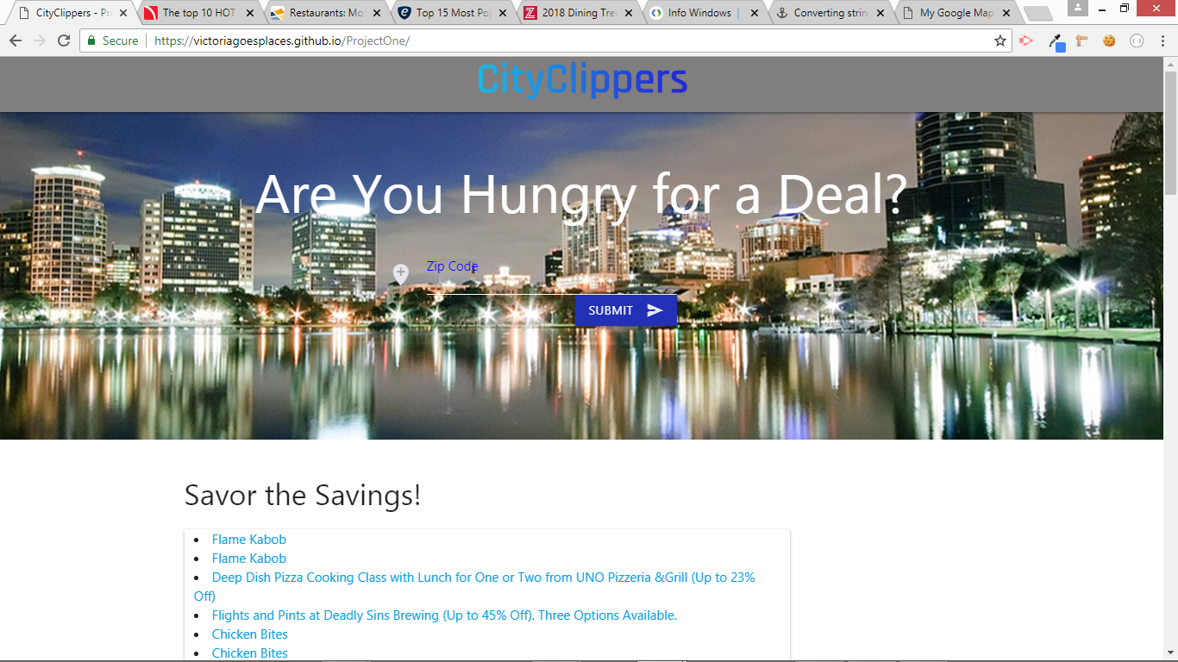
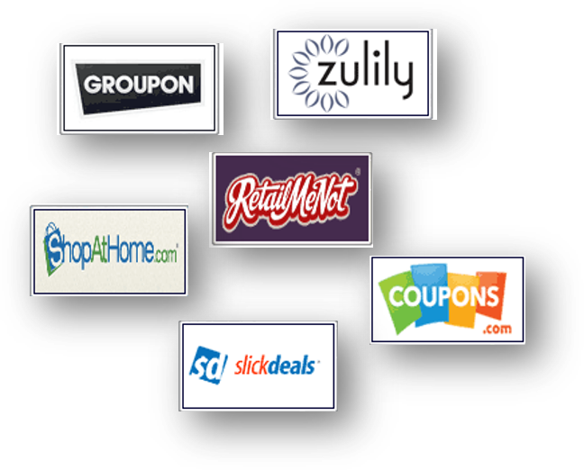
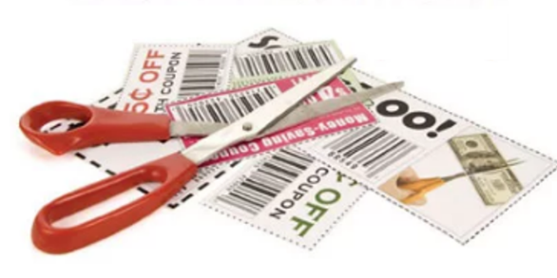
Competition
BACKUP
Notes:
8

