Slide 1

MSBD566 PREDICTIVE MODELING
LISA Clustering for Climate Justice Analysis
Spatial Patterns in California's Climate Stress
Victoria Love Franklin
Meharry Medical College
Midterm 2025

Slide 2
Problem Statement
Research Question
How can we identify statistically significant spatial clusters of climate stress and environmental justice burden to inform equitable infrastructure investment?
THE CHALLENGE
POLICY CONTEXT
Traditional approaches analyze counties independently
Ignores spatial dependencies between neighbors
Leads to inefficient resource allocation
Justice40 Initiative
40% of climate investment benefits must flow to disadvantaged communities
Requires evidence-based targeting of priority counties
Executive Order 14008 (2021)

Slide 3
Data Description
58
4
7
California Counties
Data Sources
Key Variables
KEY VARIABLES (0-1 SCALE)
DATA SOURCES
OBI - Outage Burden Index
Power outage frequency and severity
Dataset
Source
Variables
Climate Hazards
NOAA, CAL FIRE
Heat, Drought, Fire
EJBI - Environmental Justice Index
Pollution and socioeconomic vulnerability
Grid Reliability
EAGLE-I, CPUC
OBI, SAIDI
Environmental Justice
CalEnviroScreen 4.0
EJBI, Pollution
Heat Stress Index
Extreme heat exposure
Boundaries
US Census TIGER
County Polygons
Composite Risk
40% OBI + 30% EJBI + 30% Climate
Data Source: California Open Data Portal (data.ca.gov)

Slide 4
Method: LISA Clustering
What is LISA?
Why LISA?
Local Indicators of Spatial Association (Local Moran's I) detects statistically significant clusters by comparing each county's value to its neighbors.
Provides p-values for each cluster, identifies local patterns global methods miss, and maps directly to policy actions.
LISA CLUSTER CLASSIFICATION
HH
LL
HL
LH
NS
Hot Spot
Cold Spot
Spatial Outlier
Spatial Outlier
Not Significant
High value surrounded by high values
Low value surrounded by low values
High value surrounded by low values
Low value surrounded by high values
No significant spatial pattern (p > 0.05)
Priority Intervention
Resilient Area
Targeted Action
Best Practice Model
Insufficient Evidence
Anselin, L. (1995). Local Indicators of Spatial Association. Geographical Analysis, 27(2).

Slide 5
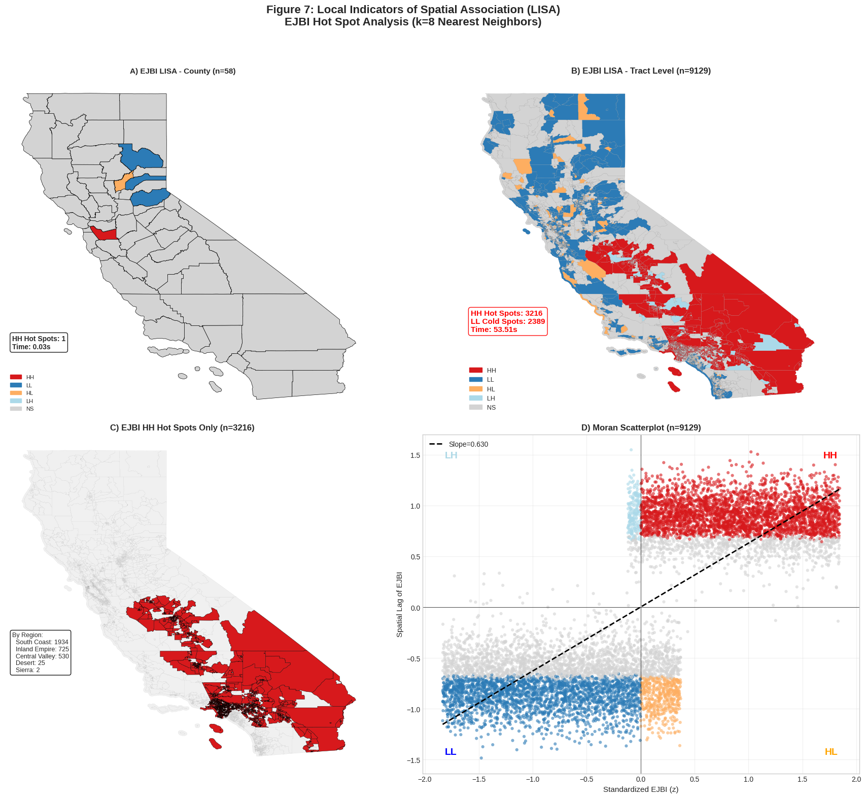
Results: LISA Cluster Maps
Figure 7
Figure 7: LISA Cluster Analysis – Local Indicators of Spatial Association: Four-panel choropleth maps showing LISA clusters for OBI, EJBI, Heat Stress, and Composite Risk. Red = Hot Spots (HH), Blue = Cold Spots (LL), Orange/Cyan = Spatial Outliers.
HH
LL
HL
LH
NS
OBI Clusters
EJBI Clusters
Heat Stress
Composite
8 HH | 12 LL | 6 Outliers
11 HH | 15 LL | 4 Outliers
14 HH | 18 LL | 3 Outliers
10 HH | 14 LL | 5 Outliers
Spatial weights: k-NN (k=8) | Significance: p < 0.05

Slide 6
Key Findings
1
Central Valley Hot Spots
Fresno, Kern, Tulare, Kings form contiguous HH clusters for heat stress (I = 0.887)
Priority Counties for Justice40
2
Coastal Cold Spots
CENTRAL VALLEY
Fresno, Kern, Tulare, Kings, Merced, Madera
SF, Marin, San Mateo, Santa Cruz form LL clusters - resilient areas
DESERT REGION
3
Imperial, Riverside, San Bernardino
EJ-Climate Alignment
11 HH counties for EJBI overlap with heat stress hot spots - compound burdens
LA BASIN
Los Angeles (portions)
4
Imperial County Outlier
HL outlier for OBI - high outage burden despite low-burden neighbors
All clusters significant at p < 0.05 using 999 permutations

Slide 7
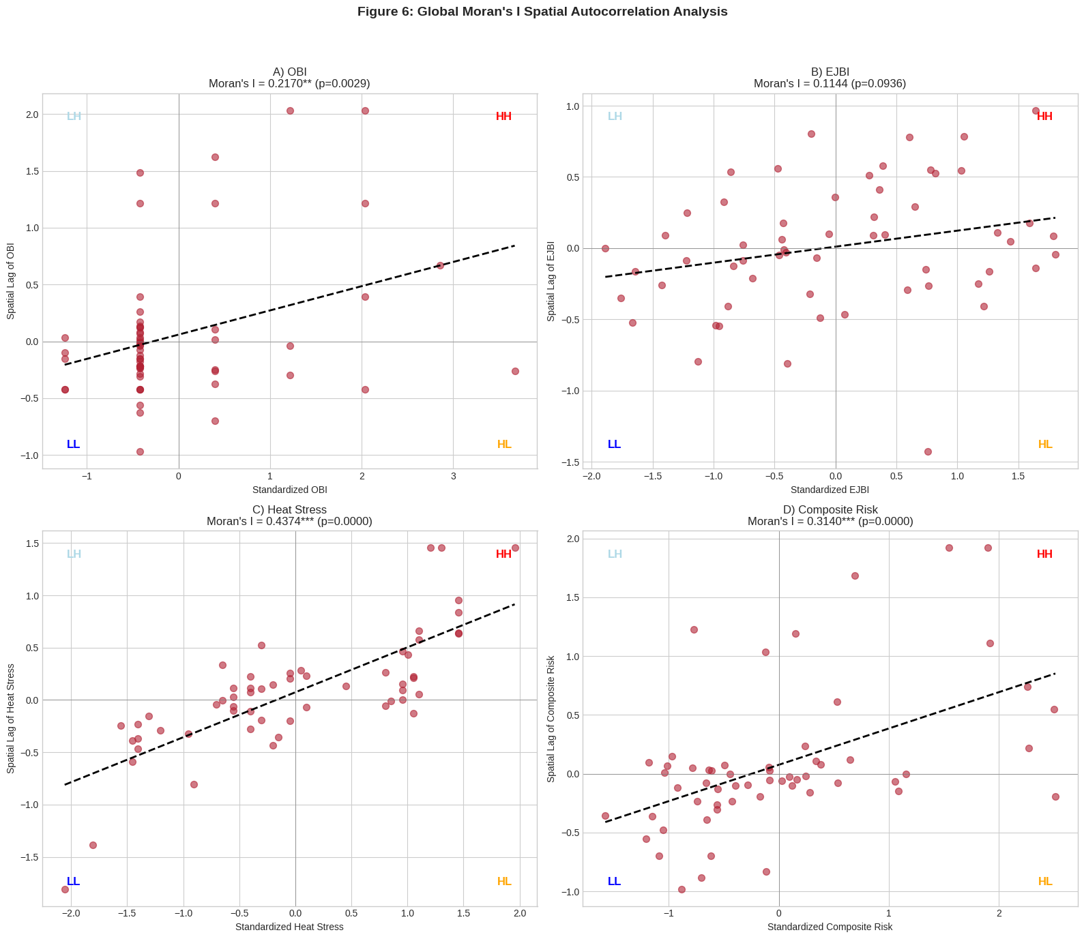
Evaluation: Global Moran's I
Figure 6
STATISTICAL RESULTS
Variable
Moran's I
Z-Score
p-value
OBI
0.417
4.23
EJBI
0.630
6.15
Heat Stress
0.887
8.54
Composite
0.512
5.02
Interpretation
All variables show significant positive spatial autocorrelation (p < 0.001). Heat Stress (I=0.887) shows very strong clustering.
Inference: 999 permutations | *** p < 0.001

Slide 8
Conclusion
LISA clustering effectively identifies statistically significant spatial patterns in climate stress and environmental justice burden. Disadvantaged communities are geographically clustered - not randomly distributed.
✓
Method Success
!
Priority Areas
→
Policy Impact
All 4 variables show significant clustering (p < 0.001). 43 statistically significant clusters identified.
Central Valley and desert regions emerge as consistent hot spots for climate-resilient infrastructure.
Results support targeted Justice40 interventions rather than uniform distribution of resources.
Victoria Love Franklin
GitHub: github.com/vlfranklin/segda
Meharry Medical College | MSBD566
Data: data.ca.gov

