Slide 1
Object detection: Faster R-CNN and SSD
Dr. Victoria Mazo
Jan 30, 2017

Slide 2
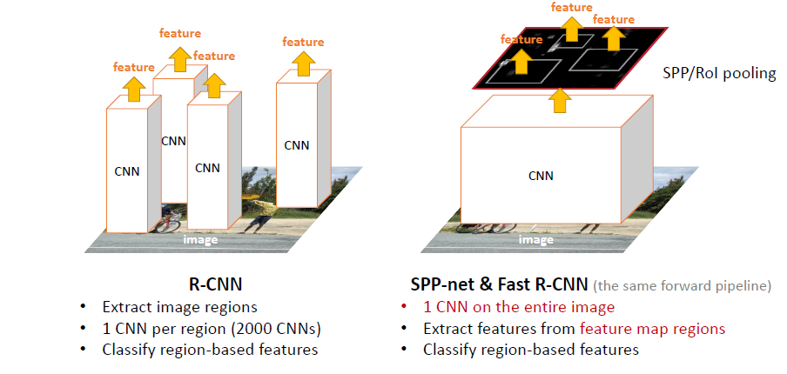
R-CNN Fast R-CNN

Slide 3
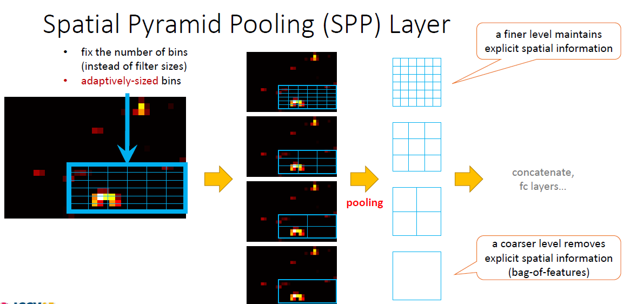
Fast R-CNN

Slide 4
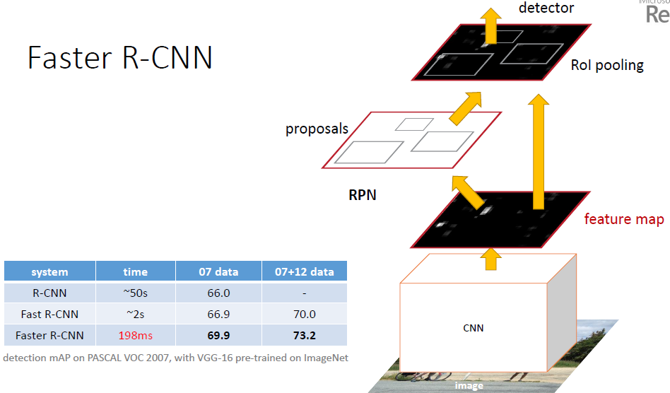
Faster R-CNN

Slide 5
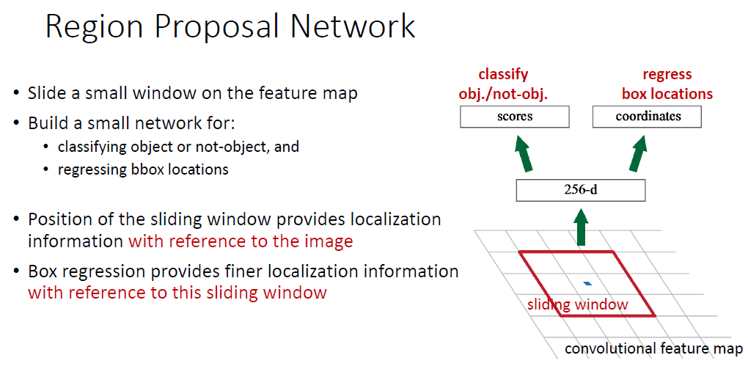
Faster R-CNN

Slide 6
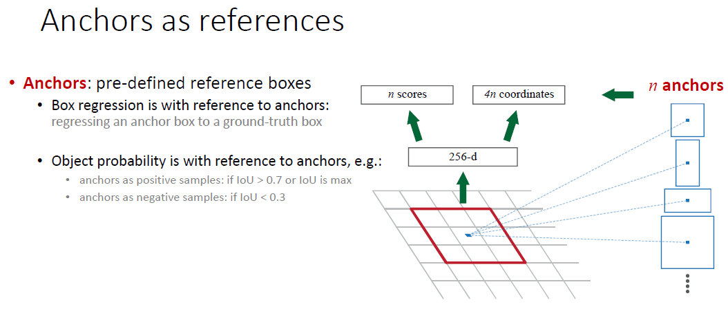
Faster R-CNN

Slide 7
Faster R-CNN

Slide 8
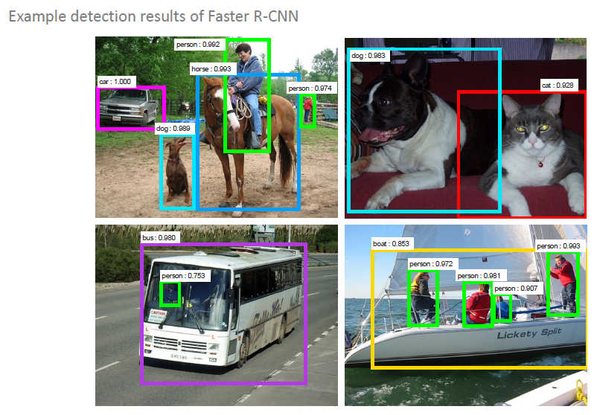

Slide 9
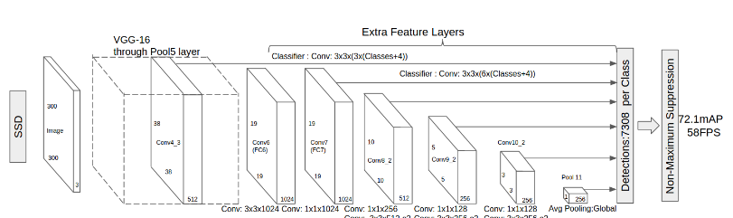
SSD: Single Shot MultiBox Detector

Slide 10
SSD: Single Shot MultiBox Detector
Multibox loss
prior boxes
g.t. boxes
confidence
location
…

Slide 11
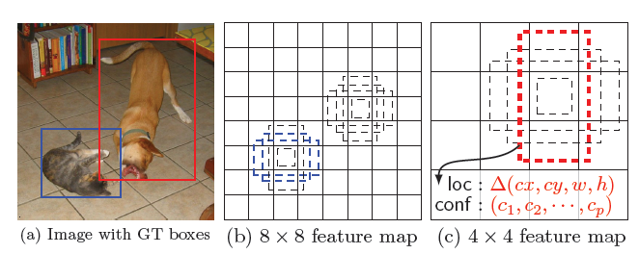
SSD evaluates a small set(e.g.4)of default boxes of different aspect ratios at each locations in several feature maps with different scales
Filters match these default boxes to the ground truth boxes and predict both the shape offsets and confidence for all object categories for each default box
The feed-forward convolutional network produces a fixed-size collection of bounding boxes and scores for the presence of object class in those boxes

Slide 12
Imposing different aspects ratios for the default boxes, and denote them as :
Negative mining - instead of using all the negative examples, SSD sorts them using the highest confidence for each default box and pick the top ones so that the ratio between the negatives and positives is at most 3:1——leading to faster optimization and more stable training

Slide 13
The overall objective loss function is a weighted sum of the localization loss and the confidence loss (conf)
- N: the number of matched default boxes
- l: predicted boxes
- g: the ground truth box
- x=1 denotes some certain default box is matched to a ground truth box

Slide 14
Data : VOC2007 and VOC2012 (train: 16551 images, test: 4952 images)
Basis network: VGG16, pre-trained on the ImageNet
learning rate for 40K iterations, then and continue training for another 20k iterations

Slide 15
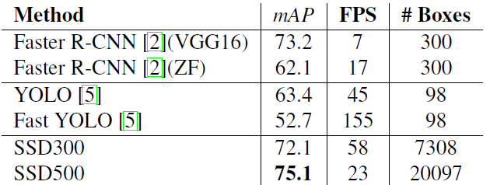
Detection Analysis Results on Pascal VOC2007 test
Faster R-CNN uses extra prediction layers for region proposals and requires feature resampling
SSD500 outperforms Faster R-CNN in both speed and accuracy
SSD actually make a balance between accuracy and speed compared to Faster R-CNN

Slide 16
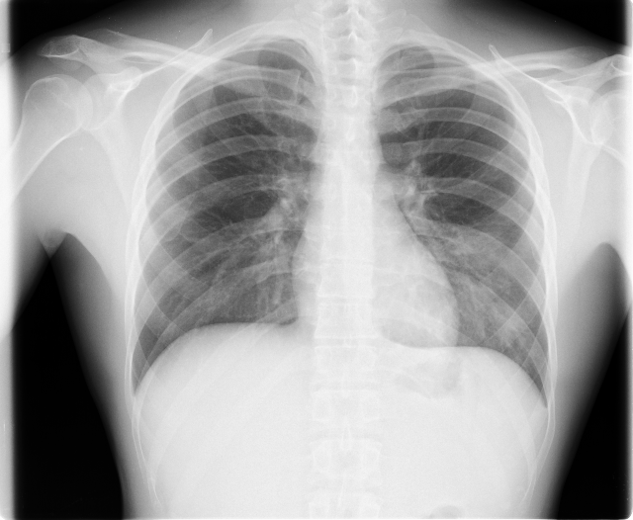
Lung Detection

Slide 17
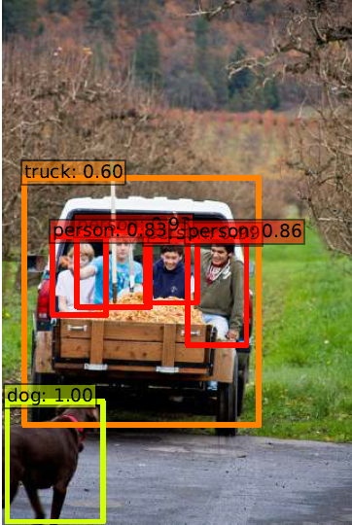
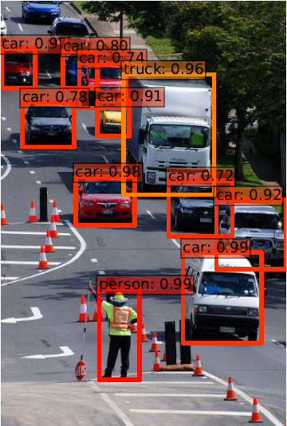

Slide 18
