Slide 1
Engineering update on mmn & eeg measures for schizophrenia(SZ) management
Emmanuel Olateju
Department of Electronic and Electrical Engineering

Slide 2
PRESENTATION LAYOUT
Introduction
Methodology (Engineering)
Progress Report
Takeaway

Slide 3
Introduction
Schizophrenia is a serious disorder that affects more than 1.7 million Nigerians.
An objective, simple and accurate diagnostic tool for the disorder would greatly reduce the overall cost-of-care for the disease, but the best candidates for such a test are not yet accurate enough for clinical use.
This project intends to develop new approaches and tools for the diagnosis and management of Schizophrenia.
We hope to combine some existing promising techniques within an overall framework that is unique

Slide 4
Long-Term Goals
To determine the neuropathological basis of schizophrenia which will help with identifying possible preventive measures against this very debilitating condition.
This project will also provide baseline data on MMN and ASSR among patients with schizophrenia in Nigeria.
Correlate subtypes of schizophrenia with prognosis

Slide 5
Specific Objectives
Determine the pattern and severity of symptoms of schizophrenia.
Develop an ensemble classifier combining mismatch negativity, Fuzzy entropy and ASSR
Acquire electroencephalography (EEG) data from a population of schizophrenia patients classified into subtypes and control subjects
Correlate the index developed in (2) with schizophrenia type and severity
Develop a prototype diagnostic system based on (4);
Assess the effectiveness of the developed system for the diagnosis of first-episode schizophrenia.

Slide 6
Overview
Methodology (Engineering)
Develop EEG signal acquisition system for protocol:
Arithmetic task
At rest
Audio stimuli
Develop signal preprocessing system
Develop and test power spectral density algorithm
Develop and test entropy algorithm
Develop and test mismatch negativity algorithm
Develop classifier
Test classifier
Implement detector on embedded device

Slide 7
Anticipated Workflow
Methodology (Engineering)
EEG acquisition
Arithmetic task
At rest
Audio stimuli
signal preprocessing
power spectral density computation
entropy computation
mismatch negativity computation
classification

Slide 8
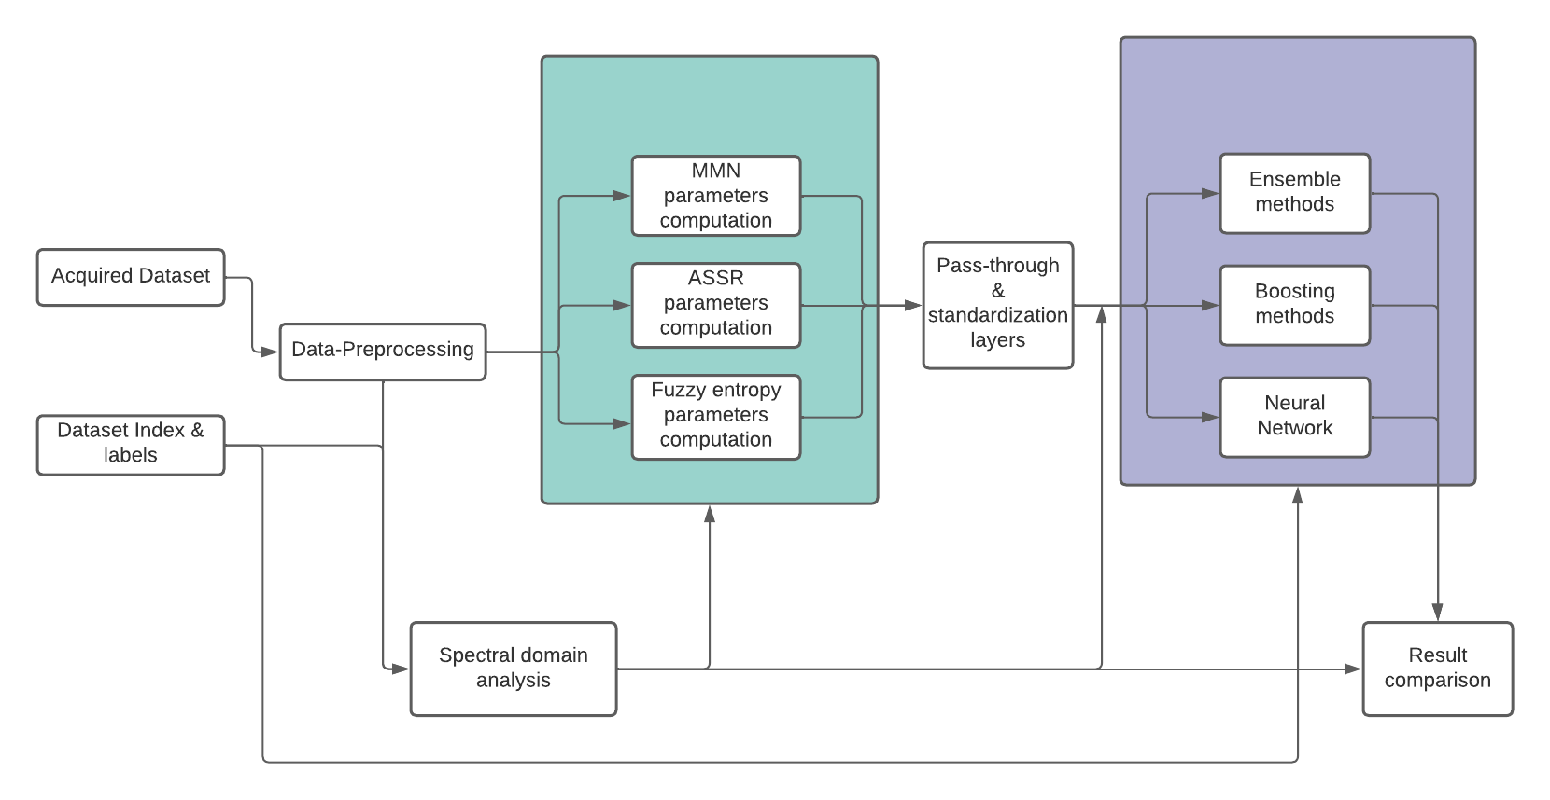
Workflow Architecture
Methodology (Engineering)

Slide 9
Progress Report
EEG device evaluation
Data format evaluation
Software tools selection
Preliminary work on setting up Neuropype pipeline
Preliminary results on
Data-preprocessing
Spectral-domain Analysis
BCI data

Slide 10
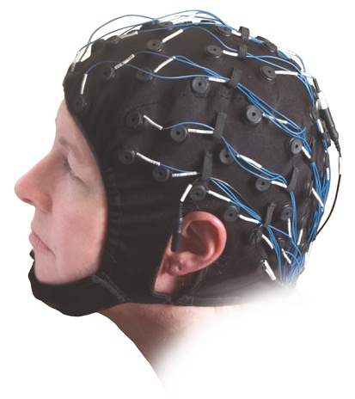
EEG Device Evaluation
Progress Report
Available device = Contec KT88-2400
24 channels
1000 samples per second
Input Impedance ≥ 10MΩ
CMRR ≥ 90dB
Based on preliminary data analysis, data from the device have sufficient signal-to-noise ratio
Question: do we want to consider rapid-wear electrode caps?

Slide 11
Data Format Evaluation
Progress Report
Data acquired consists of one EEG recording session.
16 channels of EEG data are used at a sampling rate of 500Hz.
Data acquired from the clinic were stored in the .edf format.
The .edf format is compact and yet explicit in storing information on EEG sessions.
The .edf format stores information on session parameters such as digitization points, sampling frequency, length of recording, stimulation channels, etc.
We have been able to store pre-processed .edf data in .xdf format as the latter is easier to process compared to the former.

Slide 12
Software tools selection
Progress Report
Software considered for processing the acquired signals include:
Python
MNE
MATLAB
EEGLAB
Neuropype
All of the options above except Neuropype follow a functional programming style which requires design of signal processing modules and classification modules from the base level.

Slide 13
Software tools selection
Progress Report
Neuropype offers a graphical pipeline flow programming style, with already designed signal processing and classification modules.
Neuropype is preferred to the other options
programming paradigm is simpler allowing us to focus on algorithm development rather than their coding
it offers readily designed modules for biological signals processing
allows for designing custom modules in quick and easy steps.
Ease of visualization, plotting and other existing modules also qualified the python language visualization tools for usage in certain case scenarios.

Slide 14
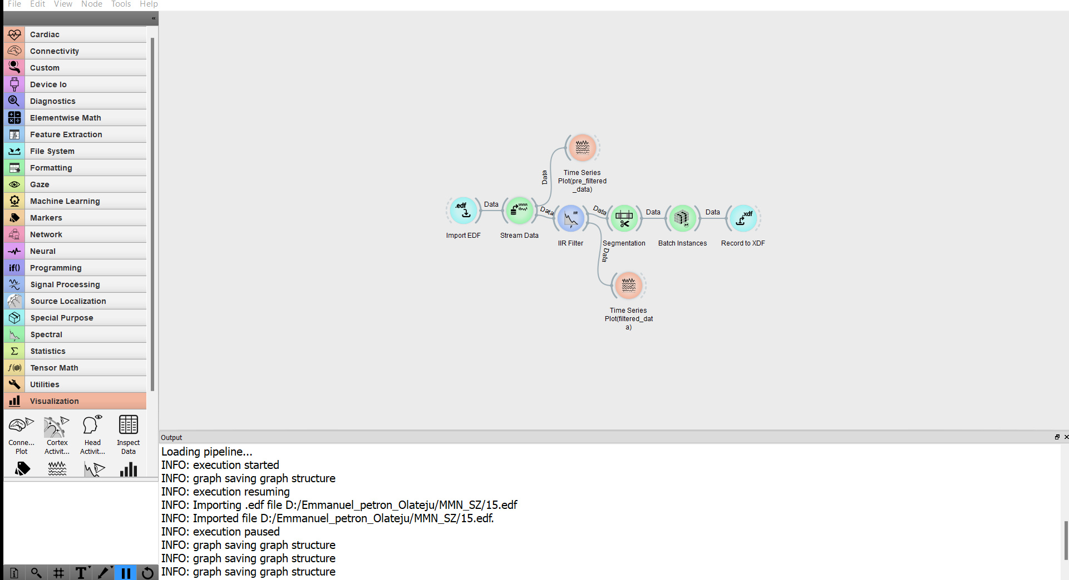
Preliminary work (Neuropype, Python)
Progress Report

Slide 15
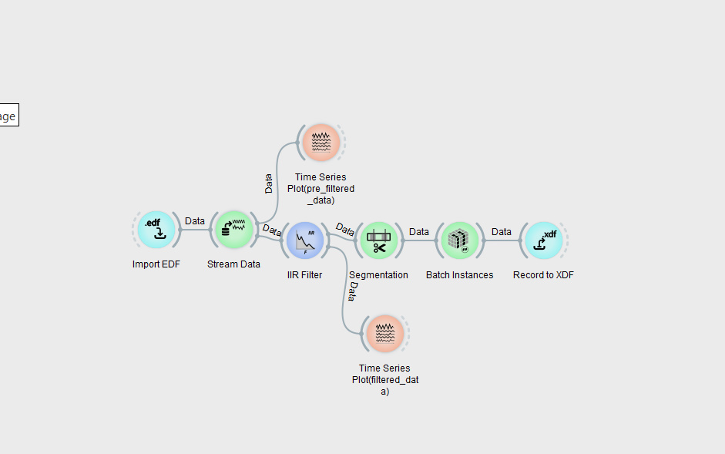
Data Preprocessing
Progress Report

Slide 16
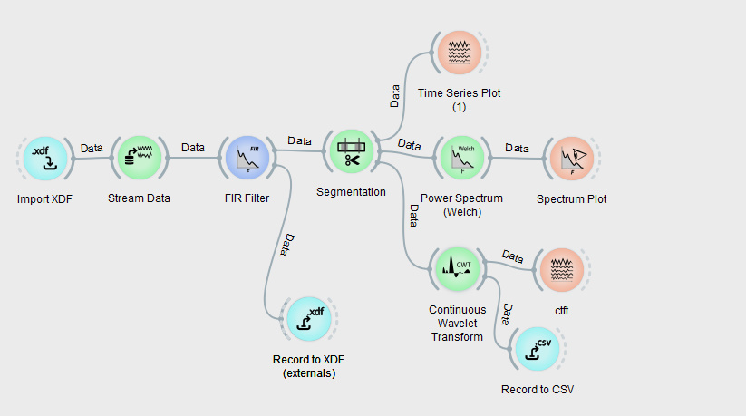
Spectral Domain Analysis
Progress Report

Slide 17
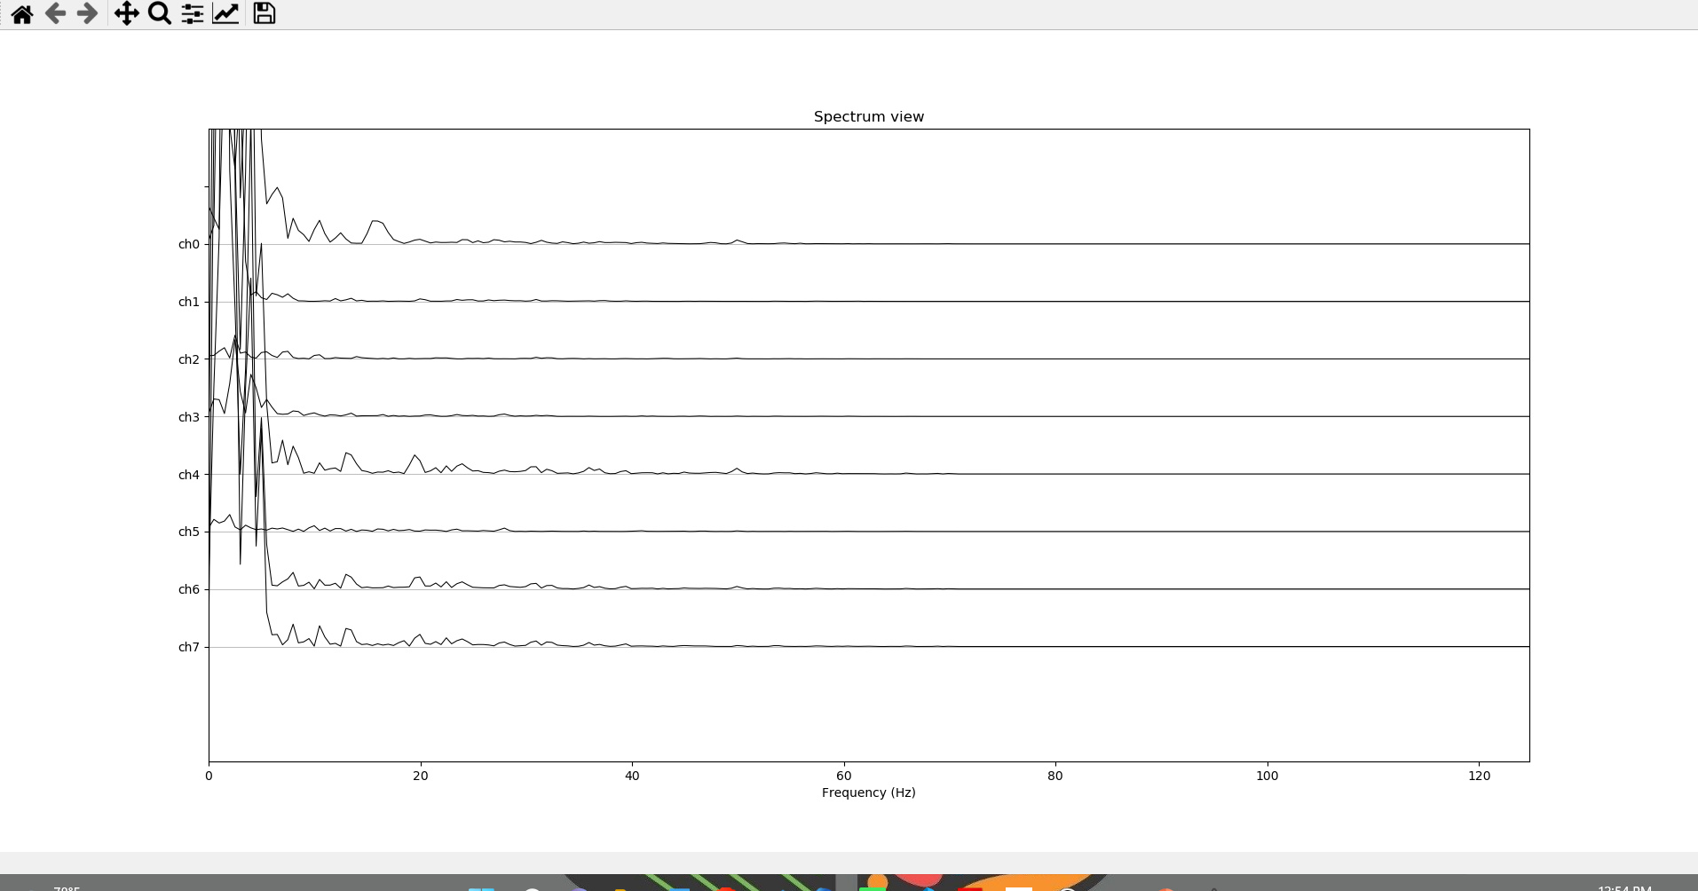
Spectral Domain Analysis
Progress Report
Welch PSD

Slide 18
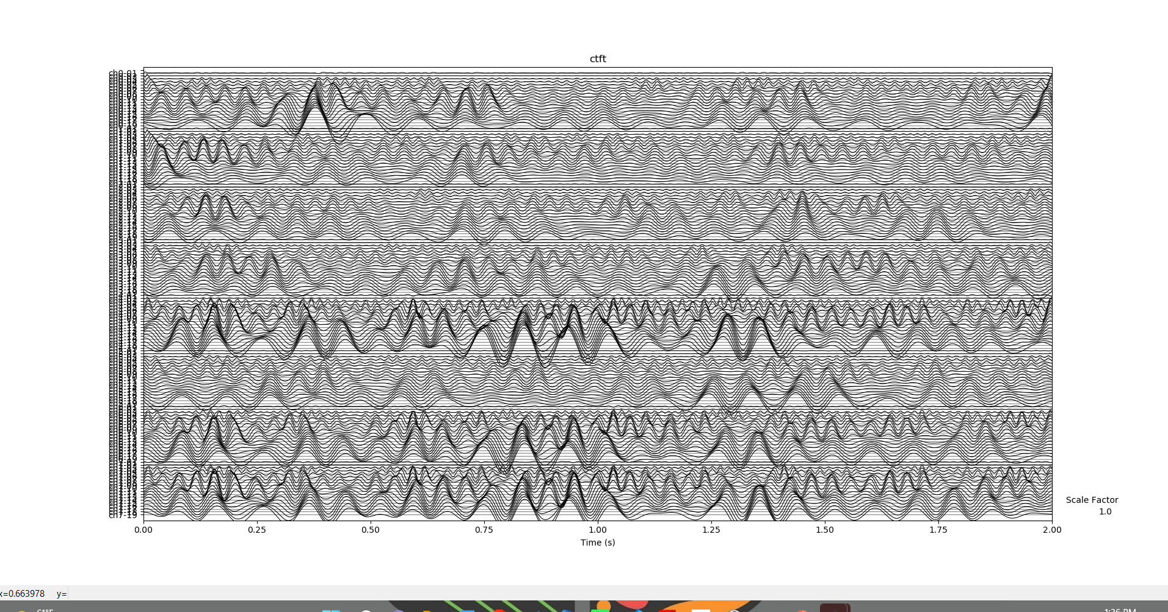
Spectral Domain Analysis
Progress Report
Neuropype CTWT plot

Slide 19
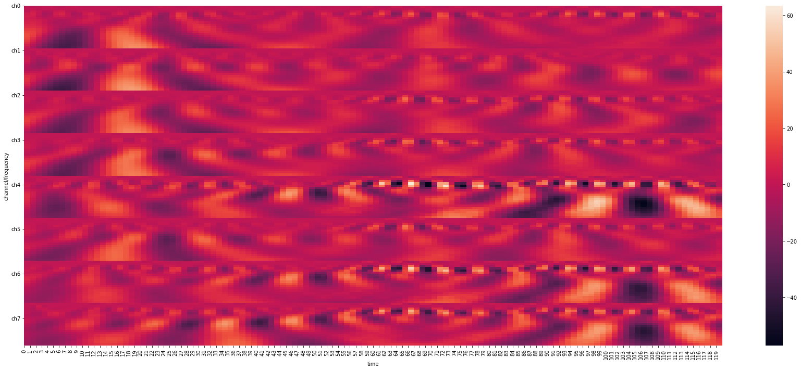
Spectral Domain Analysis
Progress Report
Python CTWT plot

Slide 20
Classifier Testing (using BCI)
Progress Report
Testing the performance of classifiers on BCI(Brain Computer Interfacing) acquired EEG data in edf / xdf formats in neuropype.
Additional EEG data were acquired using OpenBCI EEG hardware
EEG data was acquired across three subjects and contains 1000 instances equally distributed between the two target classes
EEG data is to be classified into either movement class dubbed class ‘1’ or rest class dubbed as class ‘0’
Classification results shown in the following slides

Slide 21
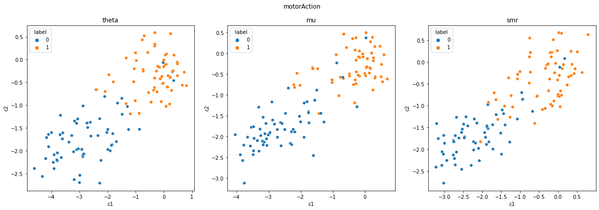
Classifier Testing (using BCI)
Progress Report

Slide 22
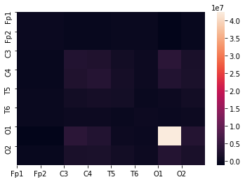
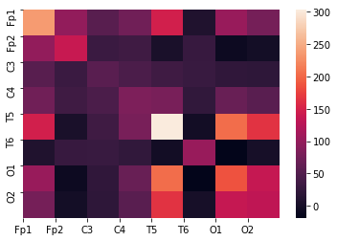
Classifier Testing (using BCI)
Progress Report
Class 1 covariance analysis
Class 0 covariance analysis

Slide 23
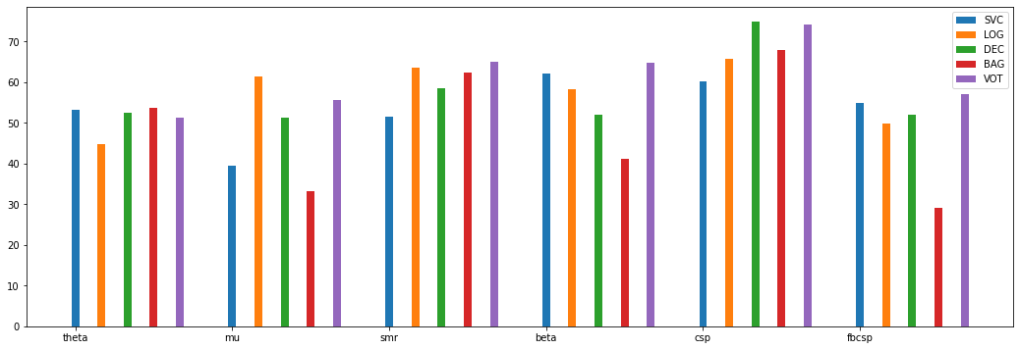
Classifier Testing (using BCI)
Progress Report

Slide 24
Takeaway
Software tools selected: Neuropype + python
Data acquisition tools verified: Contec, edf
Sample Neuroype pipelines built and tested
Power spectral density algorithm tested
Sample classifiers built and tested
Next steps: MMN and entropy implementation

Slide 25
THANK YOU

