Slide 1
Sentiment Analysis of Product Reviews Leveraging text data to predict customer sentiment and product success
Victoria X. Wang

Slide 2


Problem Statement & Business Relevance
Ecommerce platforms are tasked with the challenge of making data-driven decisions about how the customers feel about their brand, the services and product they offer.
Sentiment Analysis:
Customers: Decide if the product is what they want
Company: Decide if their products are serving customer needs
Product-Customer fit translates to increase sales and revenue.
Notes:
Pictures from google images:
https://www.google.com/imgres?q=customer%20review&imgurl=https%3A%2F%2Fcdn.pixabay.com%2Fphoto%2F2019%2F07%2F05%2F20%2F21%2Fcustomer-review-4319316_1280.png&imgrefurl=https%3A%2F%2Fpixabay.com%2Fillustrations%2Fcustomer-review-customer-rating-4319316%2F&docid=wevJJf_LI9vV3M&tbnid=VmowrSj7dtI57M&vet=12ahUKEwjw8ePq_rqJAxVXkokEHddJFrkQM3oECBcQAA..i&w=1280&h=471&hcb=2&ved=2ahUKEwjw8ePq_rqJAxVXkokEHddJFrkQM3oECBcQAA
https://www.google.com/url?sa=i&url=https%3A%2F%2Fwww.linkedin.com%2Fpulse%2F10-rules-perfect-ecommerce-product-sean-allan&psig=AOvVaw0kuqfxoqOtjhiGJvsQ2-Y6&ust=1730545434527000&source=images&cd=vfe&opi=89978449&ved=0CBQQjRxqFwoTCLCApqz-uokDFQAAAAAdAAAAABAd
Statistia Market Insights: https://www.statista.com/statistics/272391/us-retail-e-commerce-sales-forecast/

Slide 3
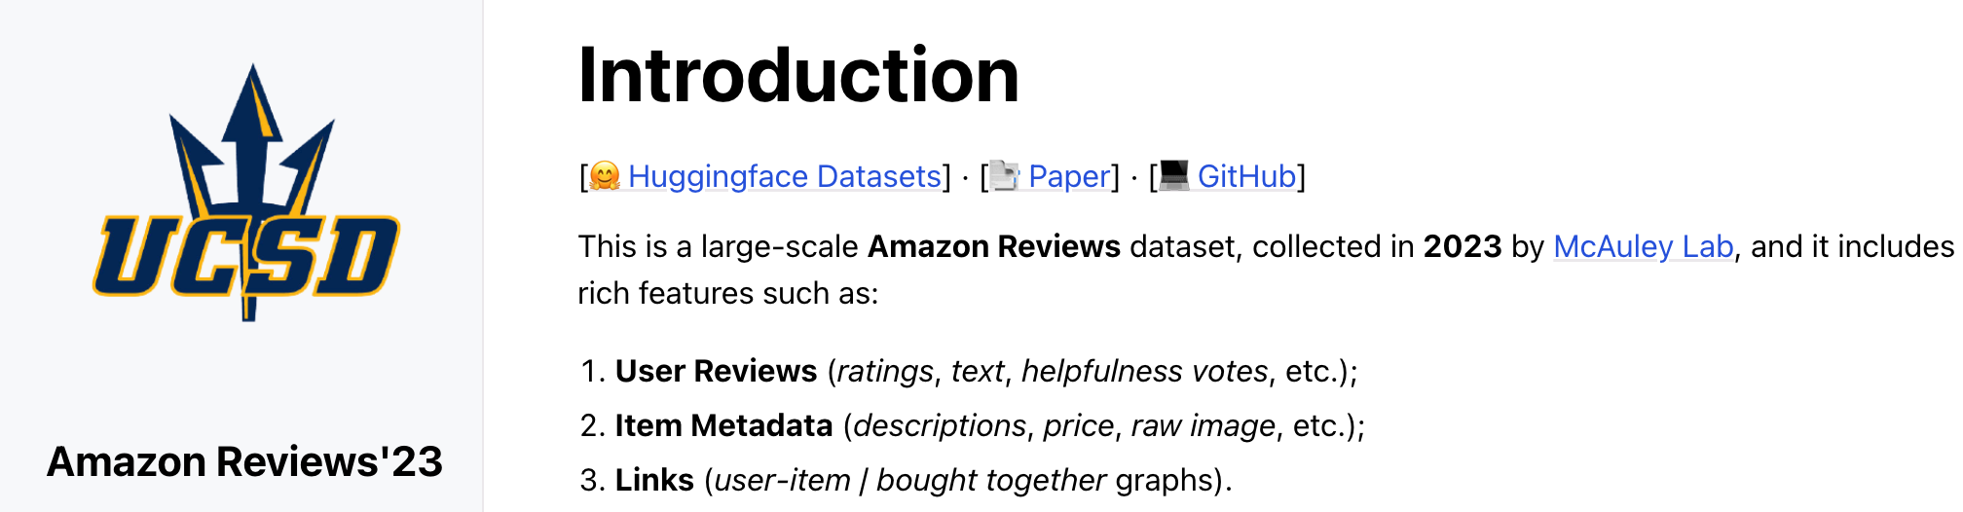
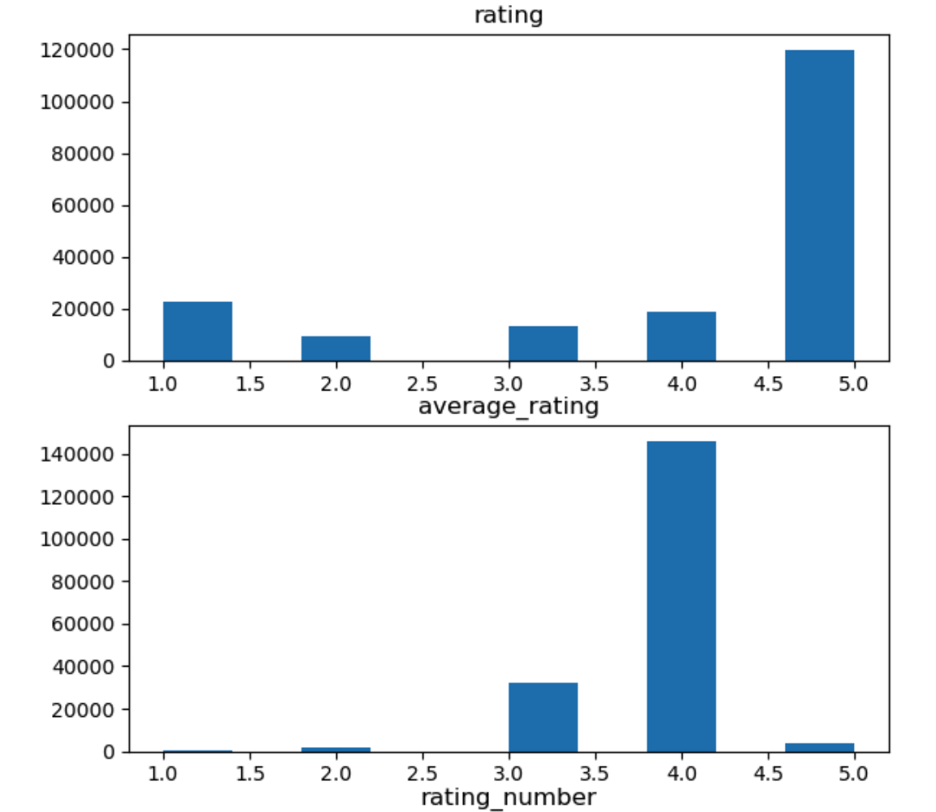
Exploratory Data Analysis
Rich dataset
Beauty Category for preliminary analysis
Basic EDA
Preliminary timeseries analysis
Preliminary text analysis
Bag of words/tokenization
Notes:
Graphs are from jupyter notebook
Amazon Data Set: https://amazon-reviews-2023.github.io/index.html#

Slide 4
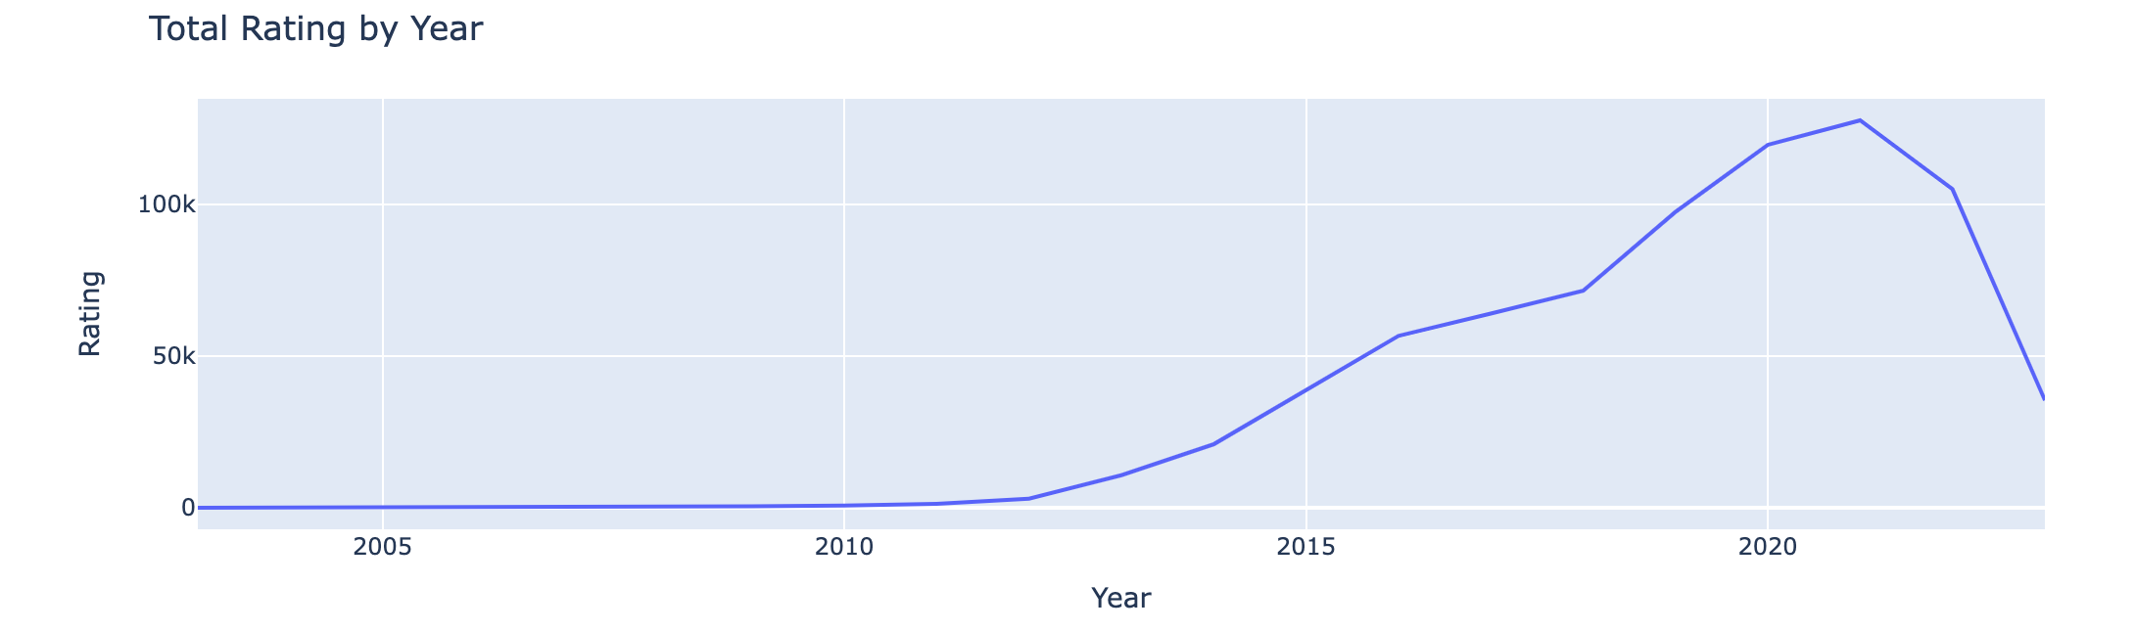
Preliminary timeseries analysis

Slide 5
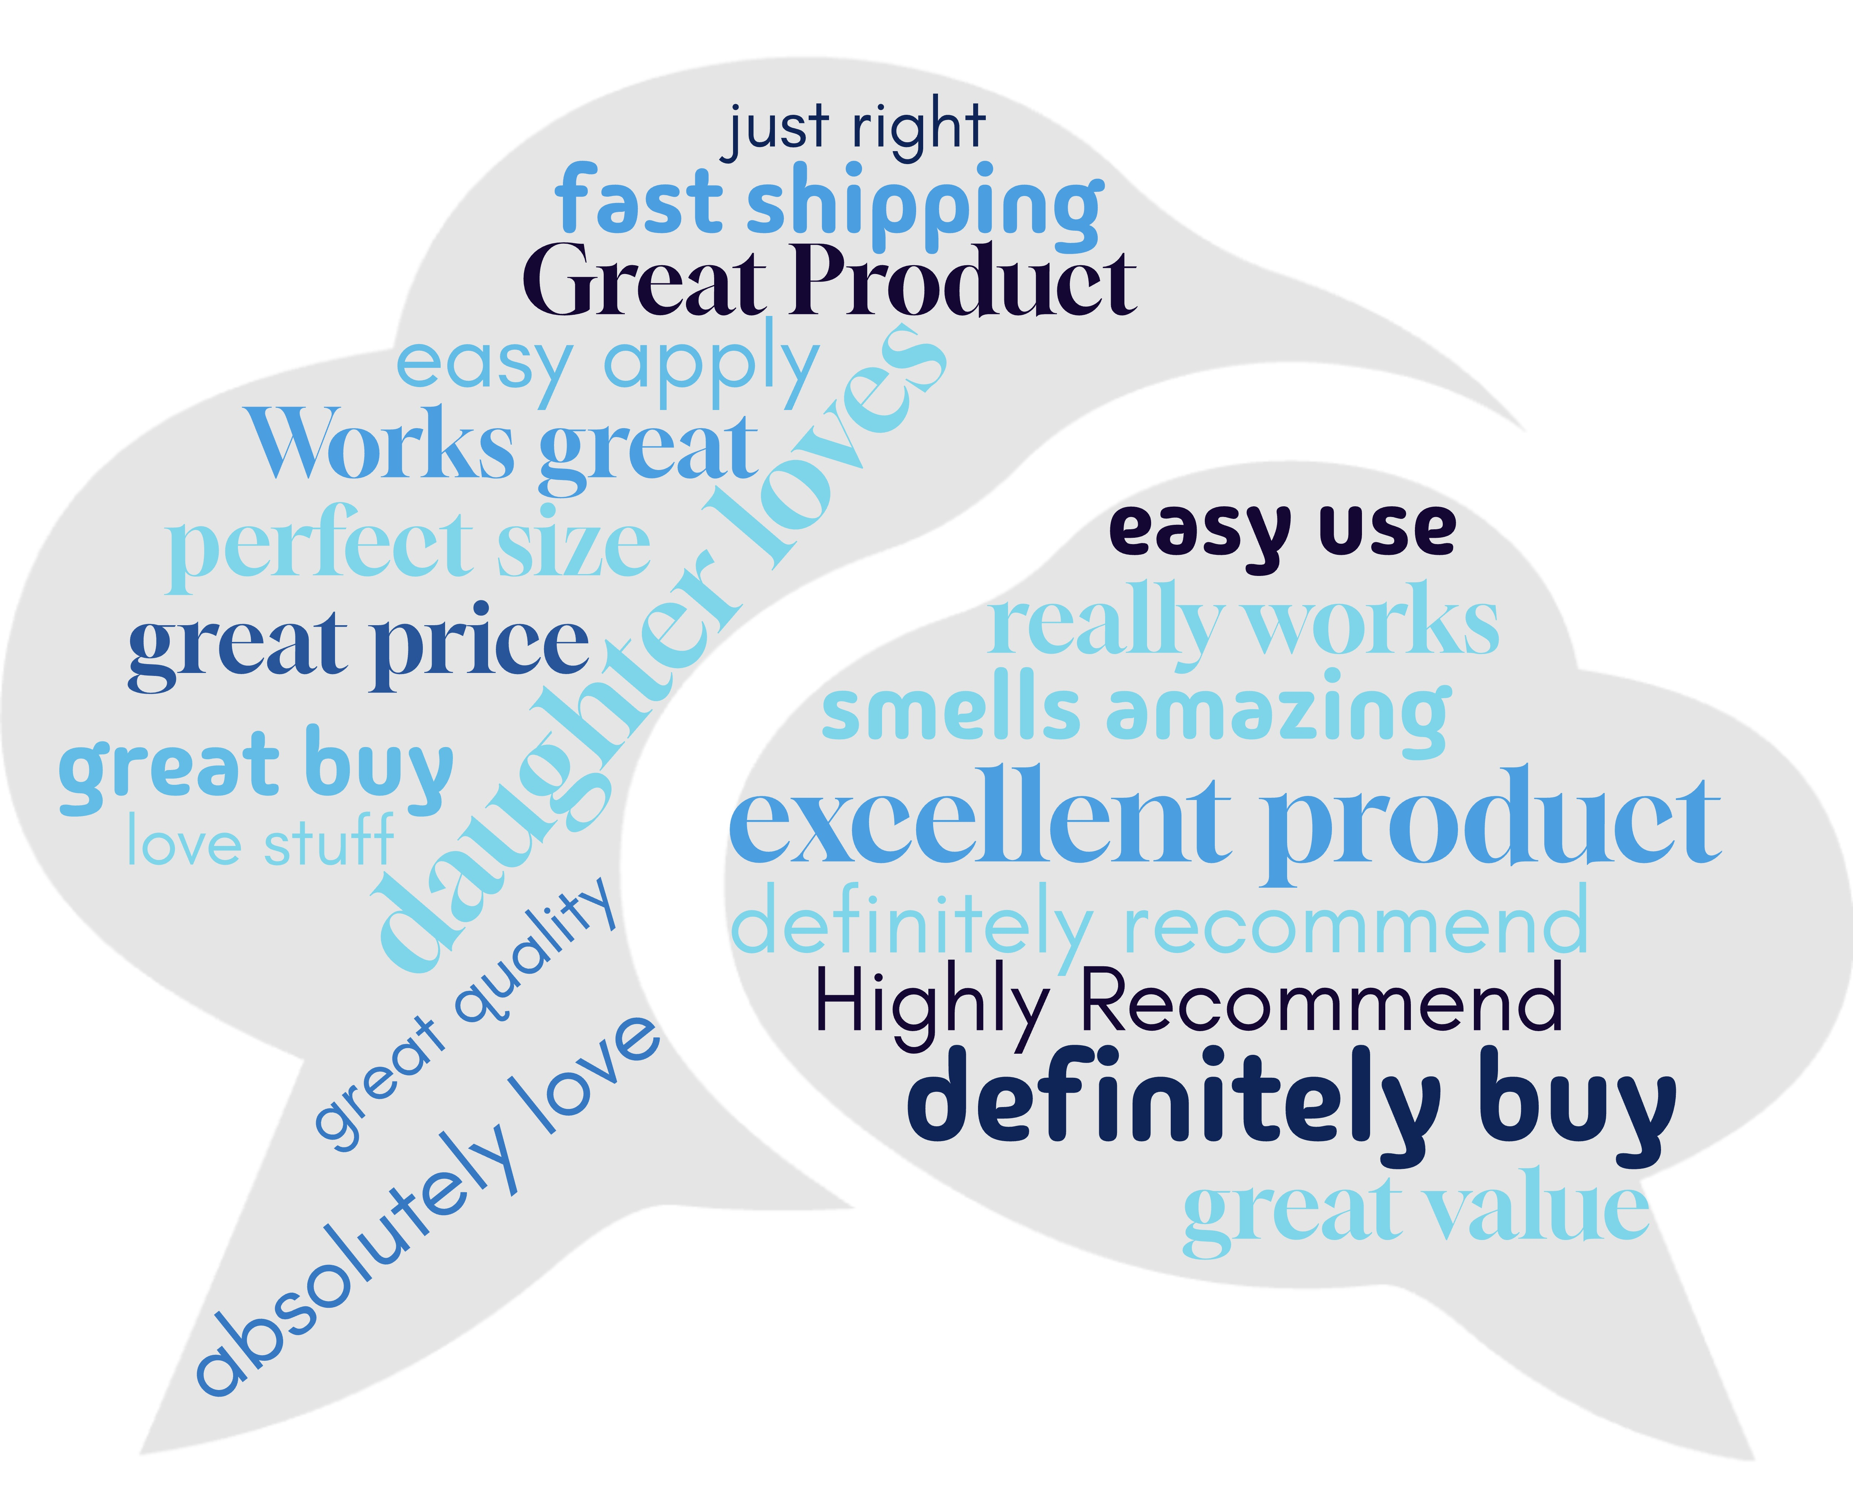
Top 20 positive sentiment in text reviews
Notes:
Word cloud is generated with top positive sentiment in text reviews extracted via text analysis from jupyter notebook.

Slide 6
Next Steps!
EDA on other categories from the Amazon Customer Review dataset
Distribution of user ratings
Top sentiment phrases
Increase the diversity of category training set
More in-depth text data analysis techniques such as:
Sentiment: counting sequence of words, n-grams
Word embeddings: create features that group similar words to handle synonyms
Natural Language Processing (NLP): extract meaning

Slide 7
Thank you! BrainStation Educators, especially Laura and Stephen!

