Slide 1
Enhancing Customer Satisfaction with Data-Driven Product Insights
Leveraging Sentiment Analysis and Similarity Search to Optimize Product offerings and success
Victoria X. Wang
December 2024

Slide 2
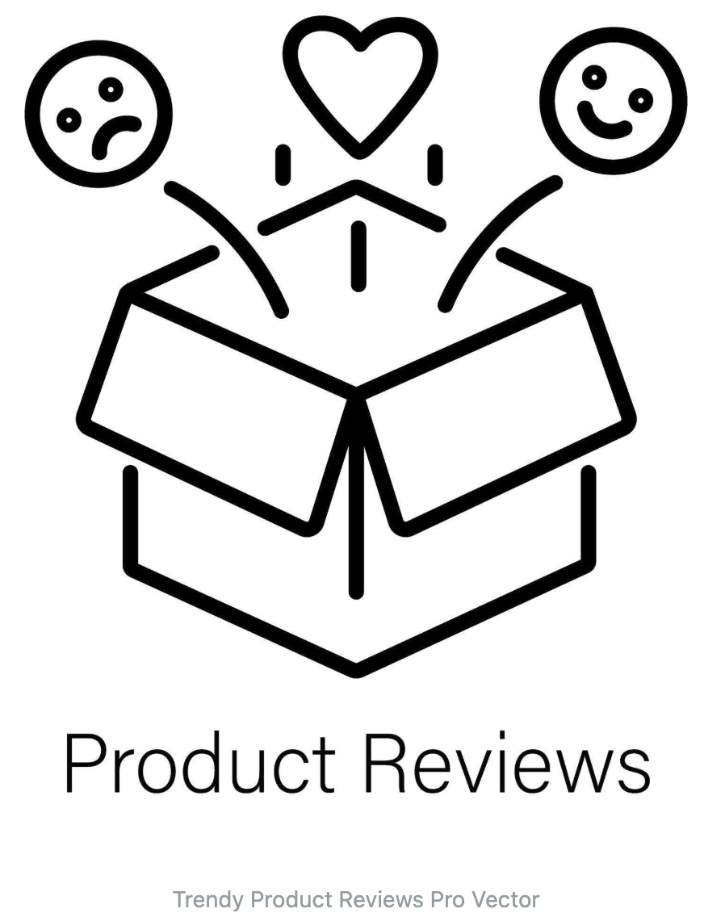
Problem Statement & Business Relevance
Statista: $1.9 trillion by 2029
How might we…
leverage user text reviews to identify product issues and prioritize features that customers value the most?
Solution
Machine learning and NLP to analyze customer sentiment and extract insights.
Notes:
Picture citation: https://www.vecteezy.com/vector-art/45999479-trendy-product-reviews
Statistia Market Insights: https://www.statista.com/statistics/272391/us-retail-e-commerce-sales-forecast/

Slide 3
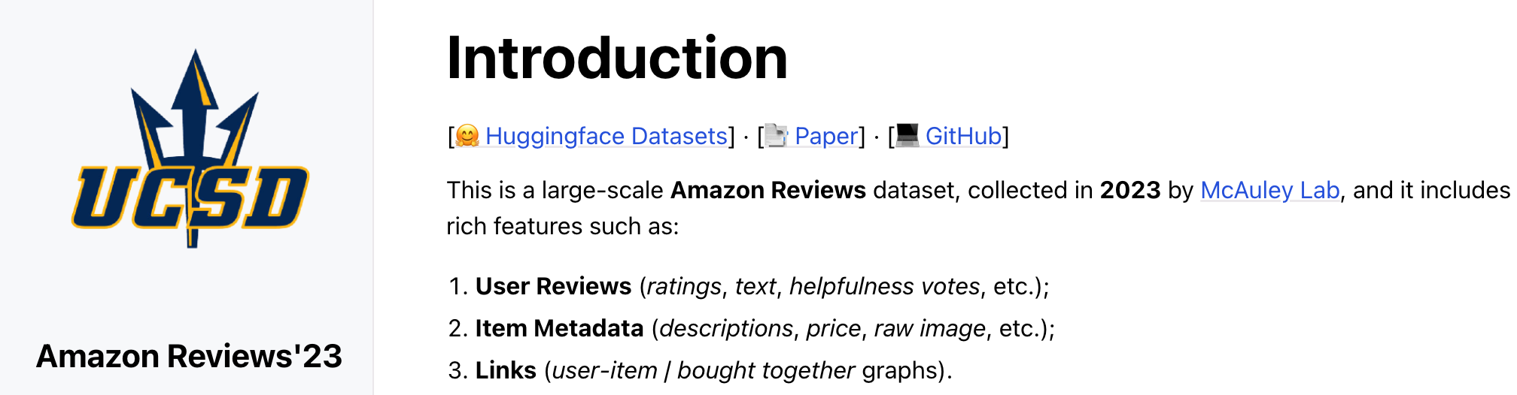
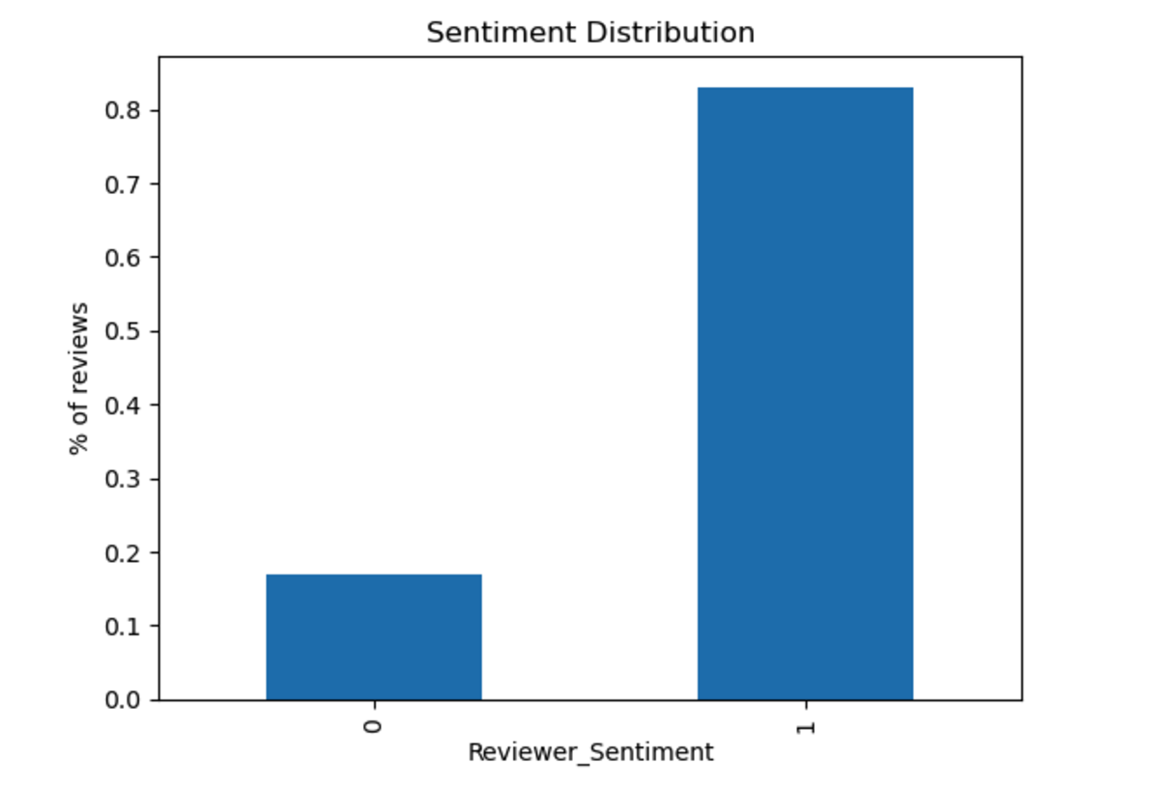
Data Analysis Strategy
Rich Dataset
Beauty and Personal Care Category (165674, 16)
X = text, y = sentiment (target)
Class imbalance
Metrics, Algorithm-level techniques
Text Review Analysis
Text Preprocessing:
CountVectorizer
TFIDF w/ SVD
Sentence Transformer (‘all-MiniLM-L6-v2’, 384 dimensions)
Binary Classification:
Logistic Regression
XGBoost
Random Forest Classifier
Citation: "Sentence-BERT (all-MiniLM-L6-v2 model)"
Notes:
Graphs are from jupyter notebook
Amazon Data Set: https://amazon-reviews-2023.github.io/index.html#
Beauty and Personal Care Category, profitable: https://www.statista.com/statistics/1400287/amazon-most-profitable-sellers-category/#:~:text=A%202024%20survey%20found%20that,with%2027%20percent%20of%20sellers.)

Slide 4
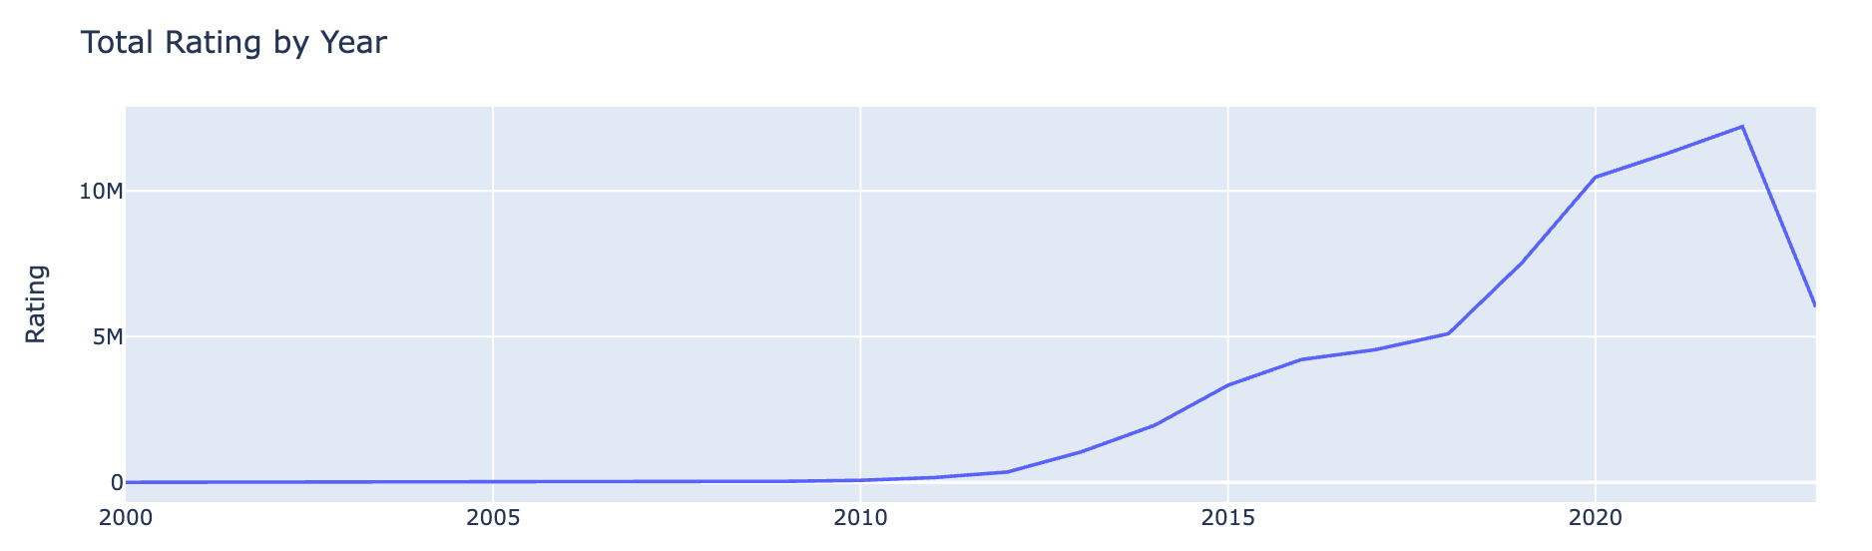
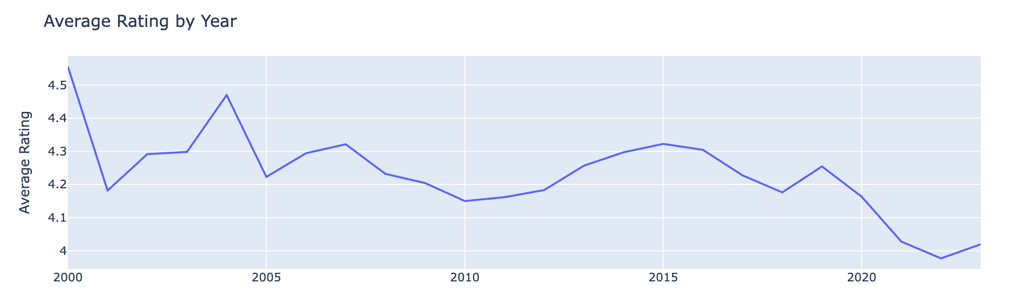
Timeseries analysis
Notes:
Graphs are from jupyter notebook

Slide 5
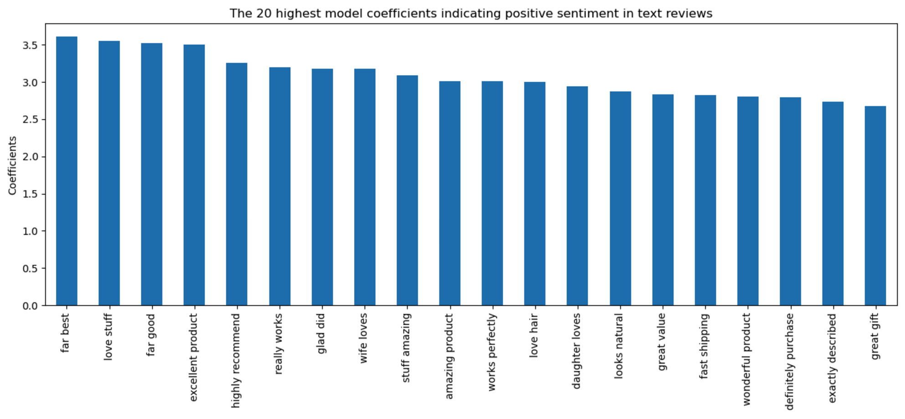
Top 20 word pairs with Positive Sentiment
Notes:
Graphs are from jupyter notebook

Slide 6
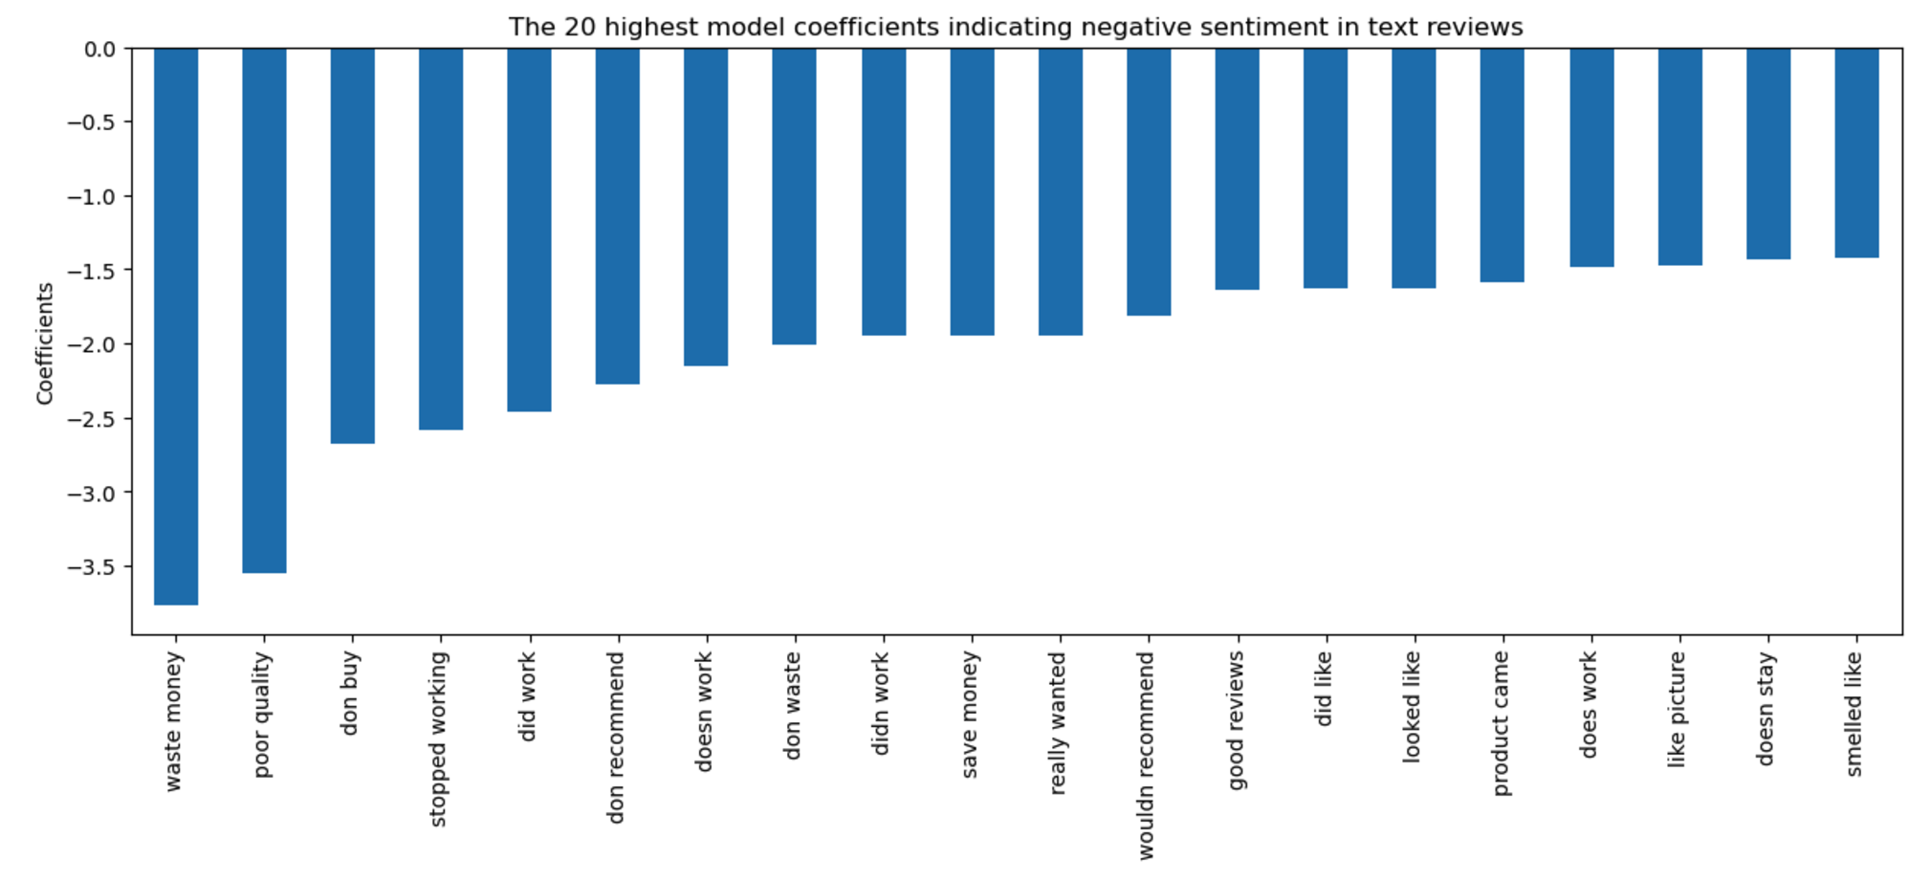
Top 20 word pairs with Negative Sentiment
Notes:
Graphs are from jupyter notebook

Slide 7
Classification Models and AUC scores
Binary Classification Models
CountVectorizer
Logistic Regression (88.97%)
Random Forest (88.02%)
XGBoost (89.41%)
TFIDF w/ SVD
Logistic Regression (76.10%)
Random Forest (82.22%)
XGBoost (83.00%)
Sentence Transformer: Mapping text to 384-dimension embeddings
Logistic Regression (91.83%)
Random Forest (88.52%)
XGBoost (91.25%)
Citation: "Sentence-BERT (all-MiniLM-L6-v2 model)"

Slide 8
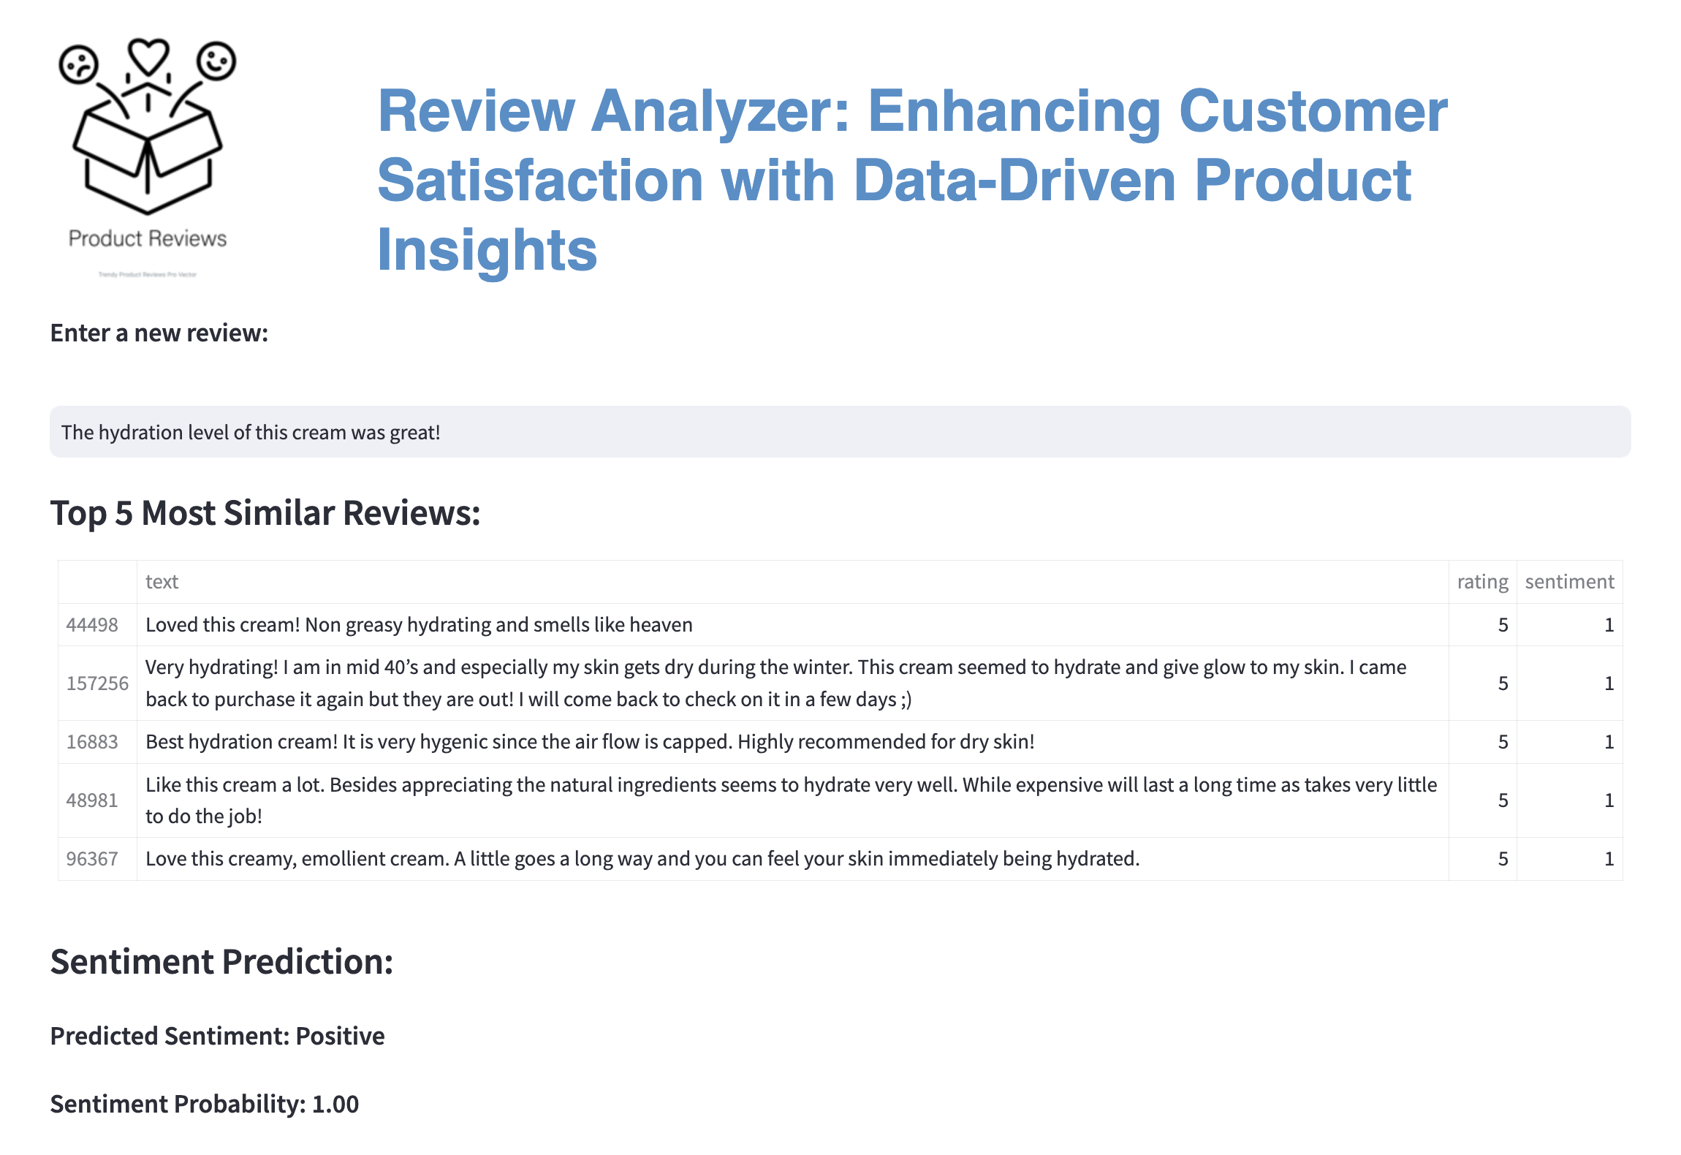
Notes:
Demo screenshot using StreamLit App

Slide 9
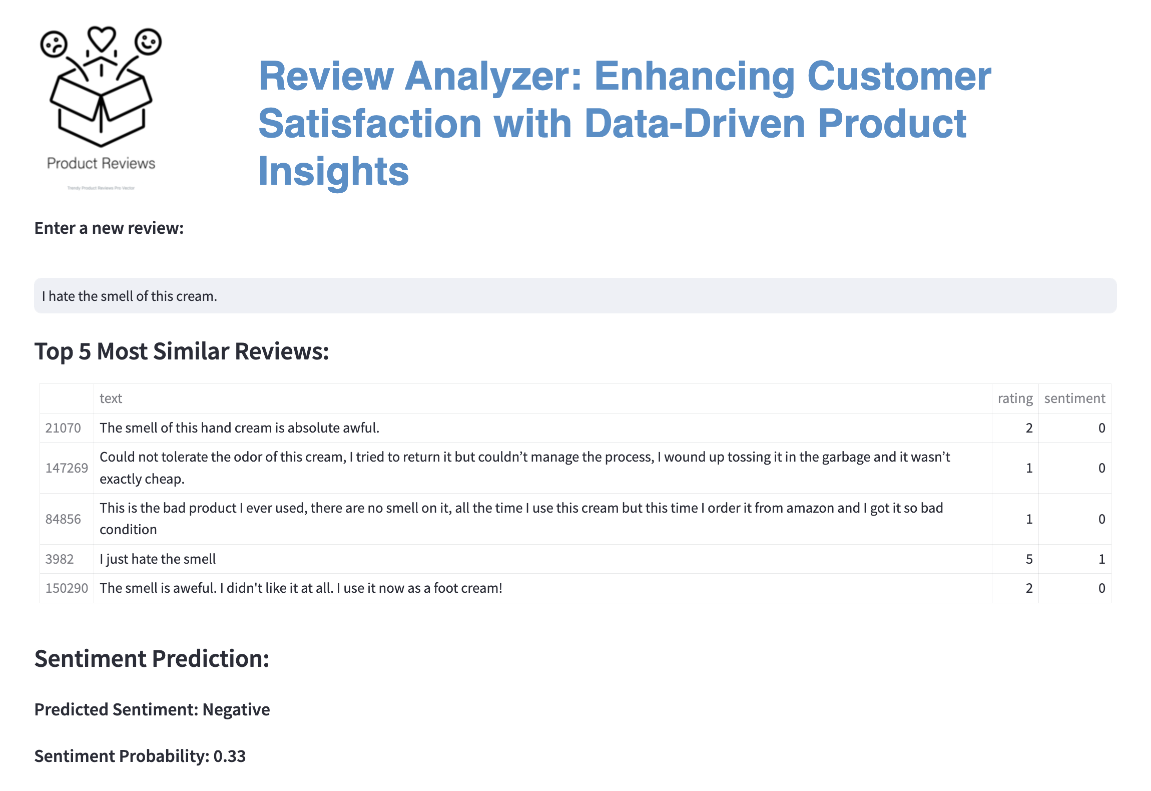
Notes:
Demo screenshot using StreamLit App

Slide 10
Future Direction
Conclusion:
This toolkit will empower stakeholders to gain actionable insights that can be used to improve product-market fit, outperform competitors, and drive revenue growth.
Similarity Search:
Resolving the edge cases
Optimizing embedding transformation and similarity calculations
Extract additional insights via other modeling techniques:
Cluster analysis, Sequential Neural Network via Keras, Topic Modeling

Slide 11


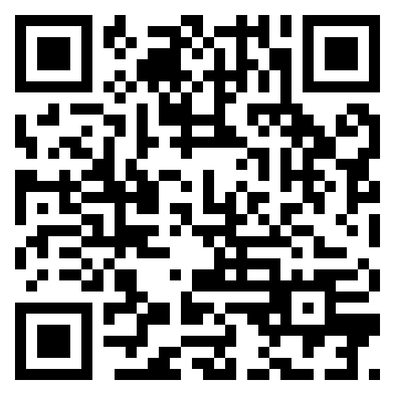

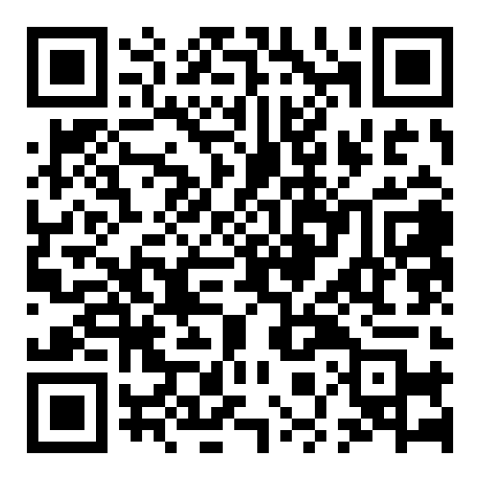

Thank you!
Data Set Citation: McAuley Lab Amazon Reviews'23
@article{hou2024bridging, title={Bridging Language and Items for Retrieval and Recommendation}, author={Hou, Yupeng and Li, Jiacheng and He, Zhankui and Yan, An and Chen, Xiusi and McAuley, Julian}, journal={arXiv preprint arXiv:2403.03952}, year={2024} }
https://amazon-reviews-2023.github.io/index.html#
SentenceTransformer Library Citation: "Sentence-BERT (all-MiniLM-L6-v2 model)”:
Reimert, N., & Kiela, P. (2019). Sentence-BERT: Sentence Embeddings using Siamese Networks and Triplet Loss. In Proceedings of the 57th Conference on Empirical Methods in Natural Language Processing (EMNLP) (pp. 4500–4510). Association for Computational Linguistics. (https://aclanthology.org/D19-1410/)

