Slide 1
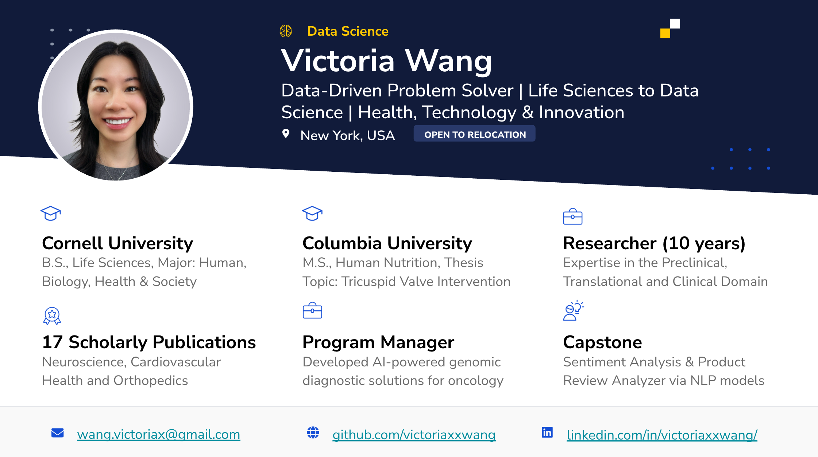
Notes:
As a former researcher and biotech program manager, I'm eager to apply my problem-solving, and team-building skills to drive data-driven solutions.
I am transitioning into data science because I am excited about using data to build innovative products that solve complex problems.

Slide 2

Enhancing Customer Satisfaction with Data-Driven Product Insights
Leveraging sentiment Analysis and similarity search to optimize product offerings and success
Victoria X. Wang
December 2024

Slide 3
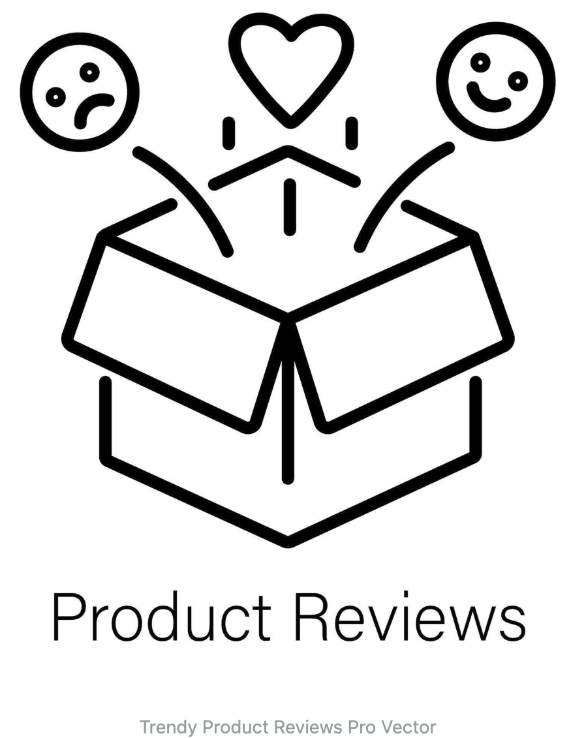
Business Value
Statista: $1.9 trillion by 2029
How might we…
leverage user text reviews to identify product issues and prioritize features that customers value the most?
Solution
Machine learning and NLP to analyze customer text review via sentiment analysis and build a Product Review Analyzer application.
McAuley Lab Amazon Reviews’23

Slide 4
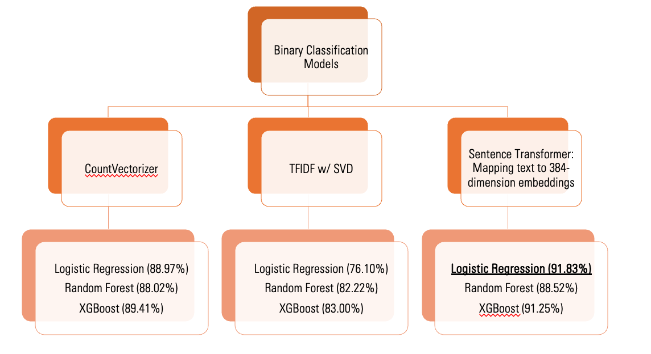
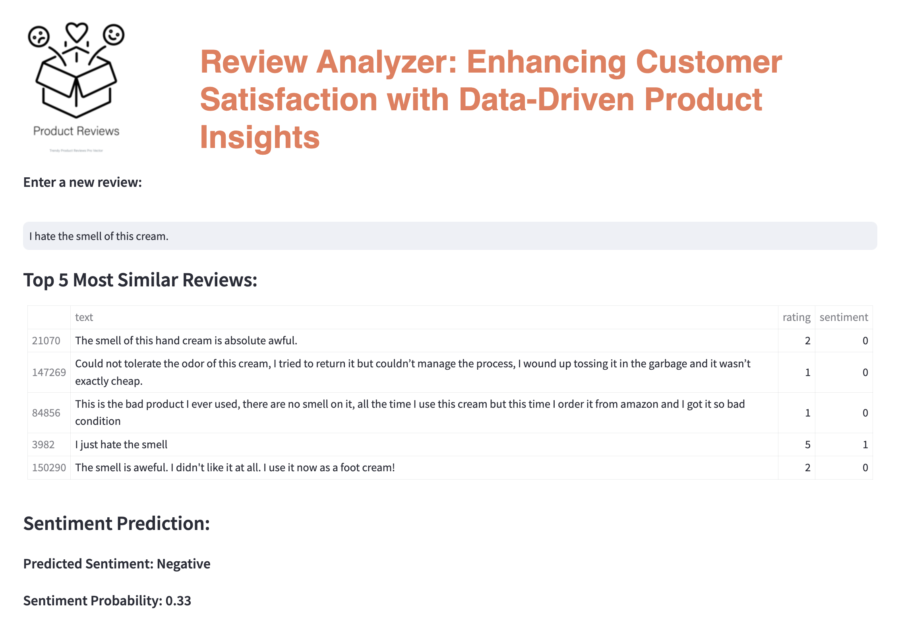
Data Pipeline
EDA, Text Data Preprocessing
Modeling
Product Review Analyzer Application
"Sentence-BERT (all-MiniLM-L6-v2 model)”

Slide 5
Future Direction
Conclusion:
This application will empower stakeholders to gain actionable insights to improve customer-product fit and profits.
Product Review Analyzer Application:
Resolving the edge cases
Optimizing the embedding transformations

Slide 6
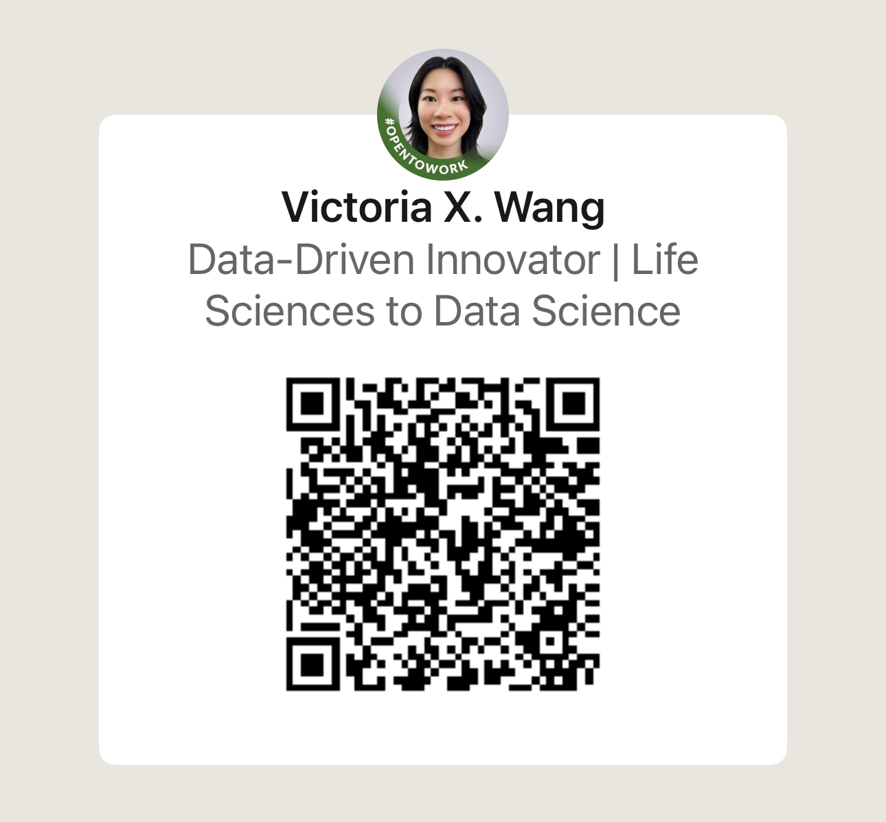

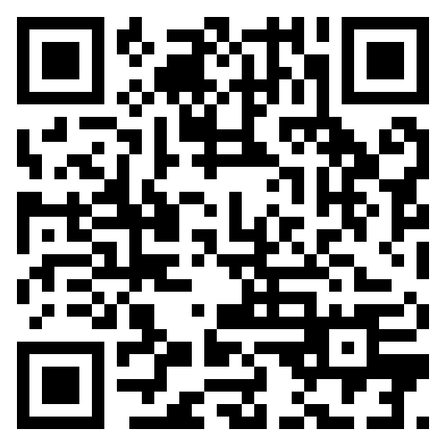



Thank you!
Notes:
Thank you! I would love to connect to explore the potential of data together.

