Slide 1
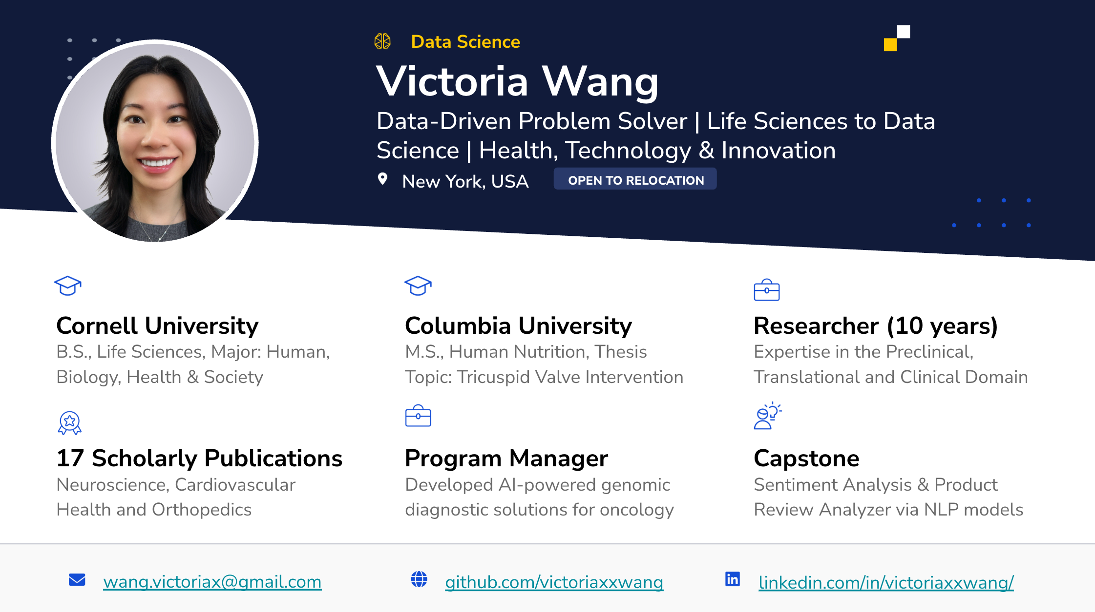
Notes:
Hi everyone, my name is Victoria
As a former researcher and biotech program manager, I'm eager to apply my problem-solving, and team-building skills to drive data-driven solutions.
I am transitioning into data analytics because I am excited about using data to build innovative products that solve complex problems.
At the core of any amazing product is the ability to empathize with the user, to improve user-product fit.

Slide 2

Enhancing Customer Satisfaction with Data-Driven Product Insights
Leveraging sentiment Analysis and similarity search to optimize product offerings and success
Victoria X. Wang
December 2024
Notes:
Hi everyone, my name is Victoria
As a former researcher and biotech program manager, I'm eager to apply my problem-solving, and team-building skills to drive data-driven solutions.
I am transitioning into data analytics because I am excited about using data to build innovative products that solve complex problems.
--
At the core of any amazing product is the ability to empathize with the user, to improve user-product fit.
Hence, my capstone project is focused on analyzing customer sentiment towards beauty and personal care products using the Amazon review datasets.

Slide 3
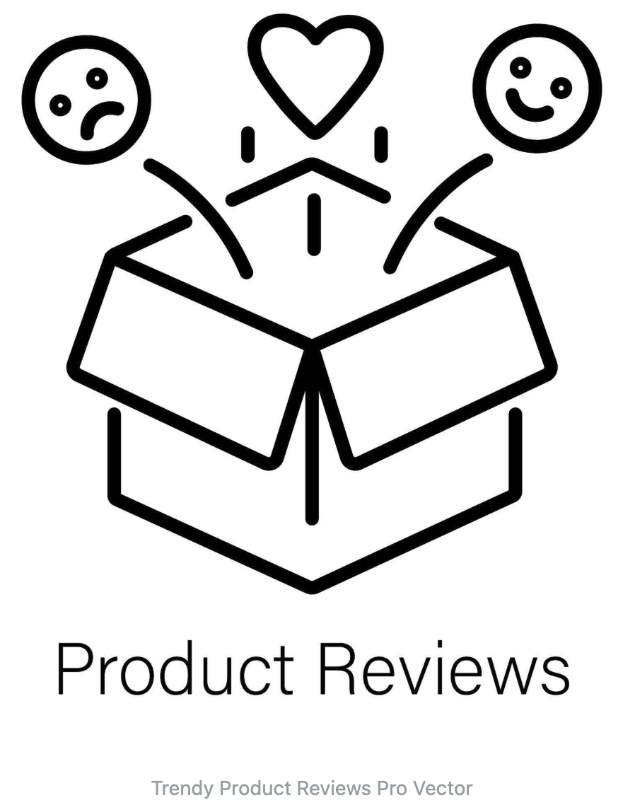
Business Value
Statista: $1.9 trillion by 2029
How might we…
leverage user text reviews to identify product issues and prioritize features that customers value the most?
Solution
Machine learning and NLP to analyze customer text review via sentiment analysis and build a Product Review Analyzer application.
McAuley Lab Amazon Reviews’23
Notes:
While the U.S. e-commerce market is projected to reach $1.9 trillion by 2029, businesses must prioritize customer insights to maintain a competitive edge.
Hence, how might we… leverage user text reviews to identify product issues and prioritize features that customers value the most?
My solution is to use machine learning and NLP to analyze customer text review via sentiment analysis and building a Product Review Analyzer application.

Slide 4
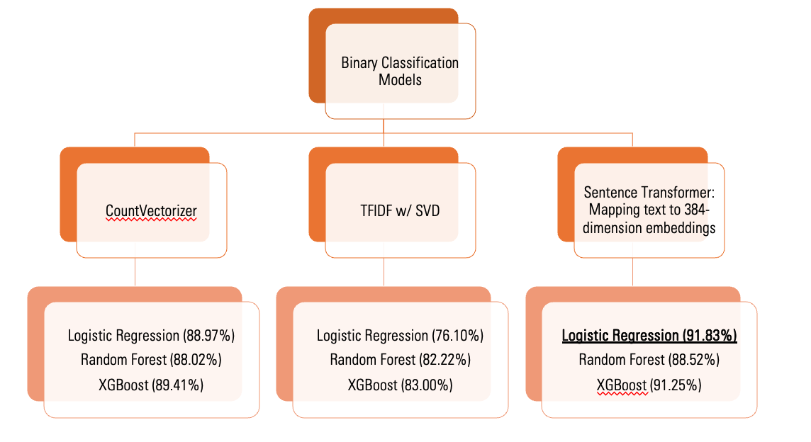
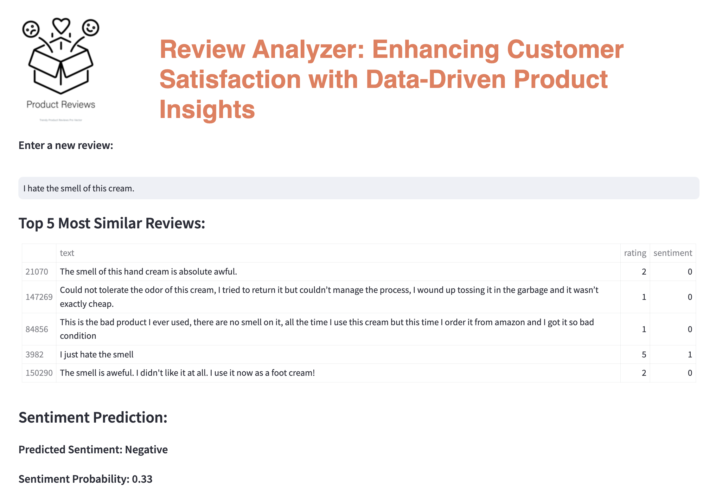
Data Pipeline
EDA, Text Data Preprocessing
Modeling
Product Review Analyzer Application
"Sentence-BERT (all-MiniLM-L6-v2 model)”
Notes:
Let’s review the data pipeline and then dive into the demo.
The text data were preprocessed in 3 different ways and ran through various classification models.
The model with highest score, utilized the SBert sentence transformer, was used in the application.
Let’s see how this works!

Slide 5
Future Direction
Conclusion:
This application will empower stakeholders to gain actionable insights to improve customer-product fit and profits.
Product Review Analyzer Application:
Resolving the edge cases
Optimizing the embedding transformations
Notes:
That was fun! It challenged me to think creatively on how best to extract business insights from text data.
This application will empower stakeholders to gain actionable insights to improve user-product fit and profits.
From here, I would improve it by resolving the edge cases and optimizing the embedding transformations

Slide 6
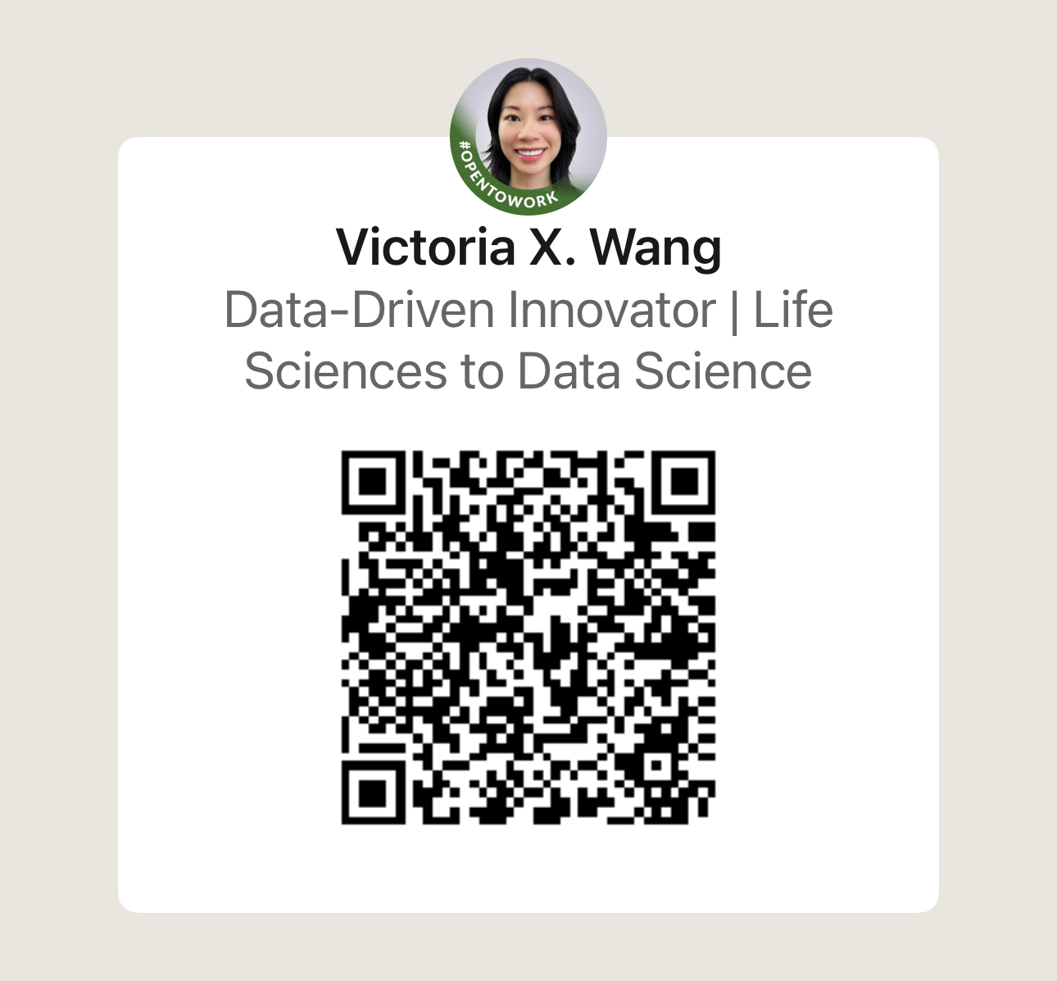





Thank you!
Notes:
Lastly, thank you! I would love to connect to explore the potential of data together.

