Slide 1
Data studio report
KuznecovaVV for module 2 DataLearn

Slide 2
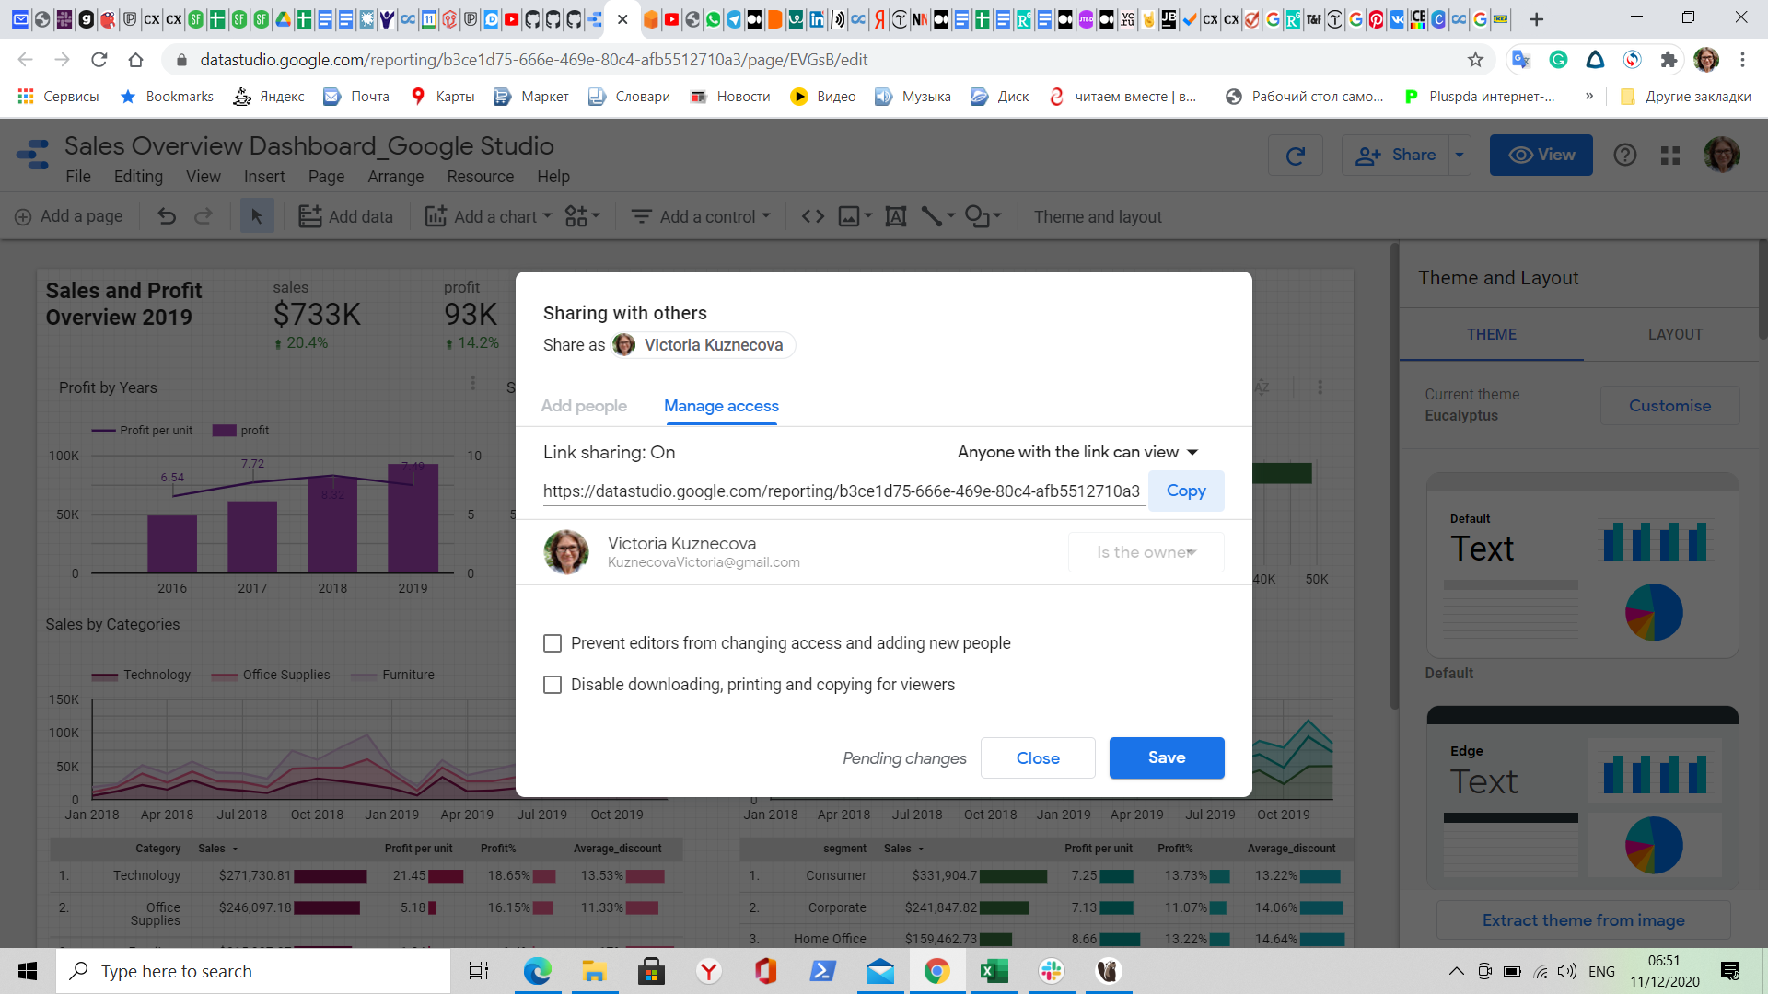
Report links
https://datastudio.google.com/reporting/b3ce1d75-666e-469e-80c4-afb5512710a3
https://datastudio.google.com/embed/reporting/b3ce1d75-666e-469e-80c4-afb5512710a3/page/EVGsB

Slide 3
