Slide 1

NumPy

Slide 2

NumPy – huh, yeah – what’s it good for?
Introduces new data structure: the array
Great for storing homogeneous data, where every element has the same meaning. E.g. images, sound, time series
Q: How is it better than a list-of-lists?
An array is a regular, N-dimensional grid of data of the same type, typically numerical data

Slide 3

Efficient machine-native implementation
Data is stored in a contiguous chunk of memory, using machine-native data types
Separate metadata tells numpy how to interpret that memory as an array
Memory block storage
0 | 1 | 2 | 3 | 4 | 5 | 6 | 7 | 8
int64
8 bytes
NumPy view
0 | 1 | 2
3 | 4 | 5
6 | 7 | 8
NumPy array metadata
dtype | int64
ndim | 2
shape | (3, 3)
strides | (24, 8)
This is a reminder from the architecture class
Notes:
The standard Python implementation is written in C. This means that every Python object is simply a cleverly-disguised C structure, which contains not only its value, but metadata as well
a C integer is essentially a label for a position in memory whose bytes encode an integer value. A Python integer is a pointer to a position in memory containing all the Python object information, including the bytes that contain the integer value
NumPy handles looping over array elements near-optimally—for example, taking strides into consideration to best utilize the computer’s fast cache memory
NumPy array - single pointer to one contiguous block of data
The Python list, on the other hand, contains a pointer to a block of pointers, each of which in turn points to a full Python object

Slide 4

Is NumPy any better than a list-of-lists?
Notes:
The standard Python implementation is written in C. This means that every Python object is simply a cleverly-disguised C structure, which contains not only its value, but metadata as well
a C integer is essentially a label for a position in memory whose bytes encode an integer value. A Python integer is a pointer to a position in memory containing all the Python object information, including the bytes that contain the integer value
NumPy handles looping over array elements near-optimally—for example, taking strides into consideration to best utilize the computer’s fast cache memory
NumPy array - single pointer to one contiguous block of data
The Python list, on the other hand, contains a pointer to a block of pointers, each of which in turn points to a full Python object

Slide 5
Is NumPy any better than a list-of-lists?
The machine-nativeness of the data storage means that common operations and algorithms can be implemented in C and Fortran, making them faster than a Python list-of- lists
Faster in what sense?
Big-O complexity is the same. E.g., square matrix multiplication is still O(n^3)*
It’s not going to scale any better than list-of-lists
Much faster for fixed-size problems
This speed advantage strictly depends on operations being made in C and Fortran. Avoid Python for-loops and use existing NumPy and SciPy algorithm!
* The best matrix multiplication algorithm as of 2025 scales as O(n^2.371339). However, out-of-the-box NumPy packages usually use a Fortran library called OpenBLAS that implements a naïve O(n^3) algorithm
Notes:
The standard Python implementation is written in C. This means that every Python object is simply a cleverly-disguised C structure, which contains not only its value, but metadata as well
a C integer is essentially a label for a position in memory whose bytes encode an integer value. A Python integer is a pointer to a position in memory containing all the Python object information, including the bytes that contain the integer value
NumPy handles looping over array elements near-optimally—for example, taking strides into consideration to best utilize the computer’s fast cache memory
NumPy array - single pointer to one contiguous block of data
The Python list, on the other hand, contains a pointer to a block of pointers, each of which in turn points to a full Python object

Slide 6
Same data, different views
Memory block storage
0 | 1 | 2 | 3 | 4 | 5 | 6 | 7 | 8
int64
8 bytes
NumPy view
NumPy array metadata
0 | 1 | 2
3 | 4 | 5
6 | 7 | 8
dtype | int64
ndim | 2
shape | (3, 3)
strides | (24, 8)
Notes:
The standard Python implementation is written in C. This means that every Python object is simply a cleverly-disguised C structure, which contains not only its value, but metadata as well
a C integer is essentially a label for a position in memory whose bytes encode an integer value. A Python integer is a pointer to a position in memory containing all the Python object information, including the bytes that contain the integer value
NumPy handles looping over array elements near-optimally—for example, taking strides into consideration to best utilize the computer’s fast cache memory
NumPy array - single pointer to one contiguous block of data
The Python list, on the other hand, contains a pointer to a block of pointers, each of which in turn points to a full Python object

Slide 7
Same data, different views
Memory block storage
0 | 1 | 2 | 3 | 4 | 5 | 6 | 7 | 8
int64
8 bytes
NumPy array metadata
dtype | int64
ndim | 1
shape | (9,)
strides | (8,)
NumPy view
0 | 1 | 2 | 3 | 4 | 5 | 6 | 7 | 8
Notes:
The standard Python implementation is written in C. This means that every Python object is simply a cleverly-disguised C structure, which contains not only its value, but metadata as well
a C integer is essentially a label for a position in memory whose bytes encode an integer value. A Python integer is a pointer to a position in memory containing all the Python object information, including the bytes that contain the integer value
NumPy handles looping over array elements near-optimally—for example, taking strides into consideration to best utilize the computer’s fast cache memory
NumPy array - single pointer to one contiguous block of data
The Python list, on the other hand, contains a pointer to a block of pointers, each of which in turn points to a full Python object

Slide 8
O(1) operations in NumPy
When NumPy can execute a command by just changing the metadata, it does.
The result is a new view of the same data in memory
Memory block
0 | 1 | 2 | 3 | 4 | 5 | 6 | 7 | 8
NumPy operation
NumPy array metadata
NumPy view
x
dtype | int64
ndim | 2
shape | (3, 3)
strides | (24, 8)
0 | 1 | 2
3 | 4 | 5
6 | 7 | 8
x.ravel()
dtype | int64
ndim | 1
shape | (9,)
strides | (8,)
0 | 1 | 2 | 3 | 4 | 5 | 6 | 7 | 8
x.T
dtype | int64
ndim | 2
shape | (3, 3)
strides | (8, 24)
0 | 3 | 6
1 | 4 | 7
2 | 5 | 8

Slide 9
O(1) operations in NumPy
Memory block
The same memory block can be interpreted in many ways
0 | 1 | 2 | 3 | 4 | 5 | 6 | 7 | 8
NumPy operation
NumPy array metadata
NumPy view
dtype | int64
ndim | 2
shape | (3, 3)
strides | (24, 8)
0 | 1 | 2
3 | 4 | 5
6 | 7 | 8
x
dtype | int64
ndim | 1
shape | (9,)
strides | (8,)
x.ravel()
0 | 1 | 2 | 3 | 4 | 5 | 6 | 7 | 8
dtype | int64
ndim | 2
shape | (3, 3)
strides | (8, 24)
0 | 3 | 6
1 | 4 | 7
2 | 5 | 8
x.T
dtype | int64
ndim | 2
shape | (2, 2)
strides | (48, 16)
0 | 2
6 | 8
x[::2, ::2]

Slide 10
View vs copies
exercise: guess
here have 2x reshape operations, one that returns a view and one a copy

Slide 11
View vs copies in indexing operations

Slide 12
Memory block
0 | 1 | 2 | 3 | 4 | 5 | 6 | 7 | 8
The same memory block can be interpreted in many ways
NumPy operation
NumPy view
0 | 1 | 2
3 | 4 | 5
6 | 7 | 8
x
x.ravel()
0 | 1 | 2 | 3 | 4 | 5 | 6 | 7 | 8
0 | 3 | 6
1 | 4 | 7
2 | 5 | 8
x.T
0 | 2
6 | 8
x[::2, ::2]
Notes:
The same memory block can be interpreted in many ways → that means that there are operations that cost nothing because they only change the metadata
NumPy view and operations
Operations that require no time at all because noting is changing , only the metadata
Any operation that only needs to change the metadata. NumPy very efficient
Every time it can, it can only change thet metadata
Operations that can only change the metadata → return a view (introduce new concept)

Slide 13
Memory block
0 | 1 | 2 | 3 | 4 | 5 | 6 | 7 | 8
The same memory block can be interpreted in many ways
NumPy operation
NumPy view
0 | 1 | 2
3 | 4 | 5
6 | 7 | 8
x
x.ravel()
0 | 1 | 2 | 3 | 4 | 5 | 6 | 7 | 8
0 | 3 | 6
1 | 4 | 7
2 | 5 | 8
x.T
0 | 2
6 | 8
x[::2, ::2]
Notes:
The same memory block can be interpreted in many ways → that means that there are operations that cost nothing because they only change the metadata
NumPy view and operations
Operations that require no time at all because noting is changing , only the metadata
Any operation that only needs to change the metadata. NumPy very efficient
Every time it can, it can only change thet metadata
Operations that can only change the metadata → return a view (introduce new concept)

Slide 14
Memory block
0 | 1 | 2 | 3 | 4 | 5 | 6 | 7 | 8
The same memory block can be interpreted in many ways
NumPy operation
NumPy array metadata
NumPy view
dtype | int64
ndim | 2
shape | (3, 3)
strides | (24, 8)
0 | 1 | 2
3 | 4 | 5
6 | 7 | 8
x
dtype | int64
ndim | 1
shape | (9,)
strides | (8,)
x.ravel()
0 | 1 | 2 | 3 | 4 | 5 | 6 | 7 | 8
dtype | int64
ndim | 2
shape | (3, 3)
strides | (8, 24)
0 | 3 | 6
1 | 4 | 7
2 | 5 | 8
x.T
dtype | int64
ndim | 2
shape | (2, 2)
strides | (48, 16)
0 | 2
6 | 8
x[::2, ::2]
Notes:
The same memory block can be interpreted in many ways → that means that there are operations that cost nothing because they only change the metadata
NumPy view and operations
Operations that require no time at all because noting is changing , only the metadata
Any operation that only needs to change the metadata. NumPy very efficient
Every time it can, it can only change thet metadata
Operations that can only change the metadata → return a view (introduce new concept)

Slide 15
Memory block
0 | 1 | 2 | 3 | 4 | 5 | 6 | 7 | 8
There are NumPy operations that can be performed just by changing the metadata
NumPy operation
NumPy array metadata
NumPy view
very efficient --> O(1)
dtype | int64
ndim | 2
shape | (3, 3)
strides | (24, 8)
0 | 1 | 2
3 | 4 | 5
6 | 7 | 8
x
dtype | int64
ndim | 1
shape | (9,)
strides | (8,)
x.ravel()
0 | 1 | 2 | 3 | 4 | 5 | 6 | 7 | 8
dtype | int64
ndim | 2
shape | (3, 3)
strides | (8, 24)
0 | 3 | 6
1 | 4 | 7
2 | 5 | 8
x.T
dtype | int64
ndim | 2
shape | (2, 2)
strides | (48, 16)
0 | 2
6 | 8
x[::2, ::2]
Notes:
The same memory block can be interpreted in many ways → that means that there are operations that cost nothing because they only change the metadata
NumPy view and operations
Operations that require no time at all because noting is changing , only the metadata
Any operation that only needs to change the metadata. NumPy very efficient
Every time it can, it can only change thet metadata
Operations that can only change the metadata → return a view (introduce new concept)

Slide 16
Memory block
0 | 1 | 2 | 3 | 4 | 5 | 6 | 7 | 8
NumPy operation
NumPy array metadata
NumPy view
dtype | int64
ndim | 2
shape | (3, 3)
strides | (24, 8)
0 | 1 | 2
3 | 4 | 5
6 | 7 | 8
x
What’s the output?
x[ [0, 1, 2], [1, 0, 1] ]
Notes:
The same memory block can be interpreted in many ways → that means that there are operations that cost nothing because they only change the metadata
NumPy view and operations
Operations that require no time at all because noting is changing , only the metadata
Any operation that only needs to change the metadata. NumPy very efficient
Every time it can, it can only change thet metadata
Operations that can only change the metadata → return a view (introduce new concept)

Slide 17
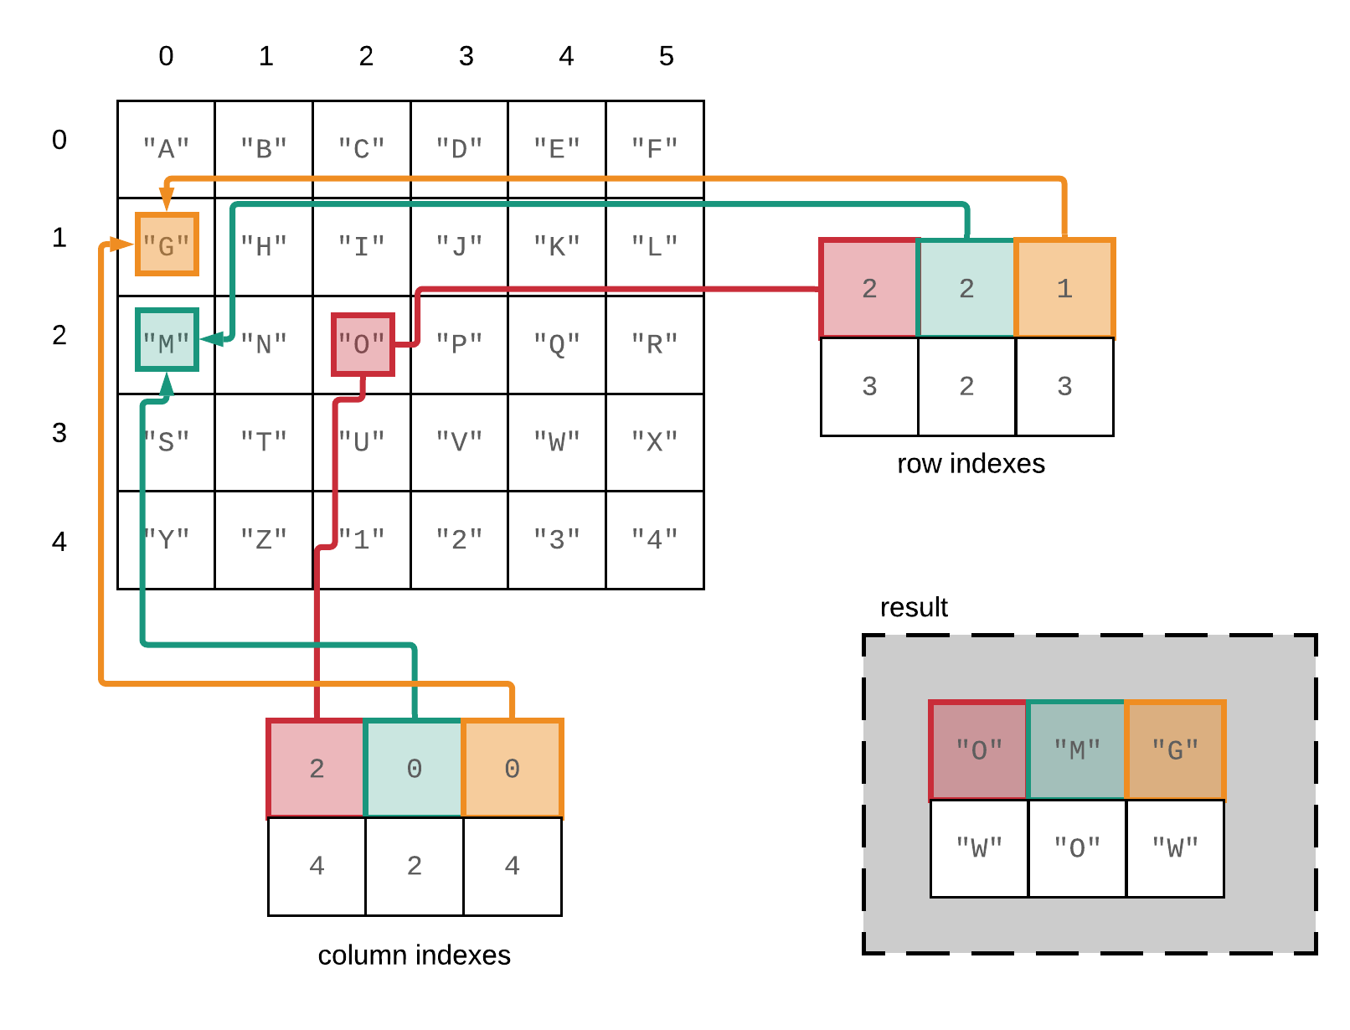
Fancy indexing in NumPy – reference slide
A[[2, 2, 1], [2, 0, 0]]

Slide 18
Memory block
0 | 1 | 2 | 3 | 4 | 5 | 6 | 7 | 8
The same memory block can be interpreted in many ways
NumPy operation
NumPy array metadata
NumPy view
dtype | int64
ndim | 2
shape | (3, 3)
strides | (24, 8)
0 | 1 | 2
3 | 4 | 5
6 | 7 | 8
x
How does the metadata look in this case?
dtype
ndim
shape
strides
x[ [0, 1, 2], [1, 0, 1] ]
1 | 3 | 7
Notes:
The same memory block can be interpreted in many ways → that means that there are operations that cost nothing because they only change the metadata
NumPy view and operations
Operations that require no time at all because noting is changing , only the metadata
Any operation that only needs to change the metadata. NumPy very efficient
Every time it can, it can only change thet metadata
Operations that can only change the metadata → return a view (introduce new concept)

Slide 19
Memory block
0 | 1 | 2 | 3 | 4 | 5 | 6 | 7 | 8
The same memory block can be interpreted in many ways
NumPy operation
NumPy array metadata
NumPy view
dtype | int64
ndim | 2
shape | (3, 3)
strides | (24, 8)
0 | 1 | 2
3 | 4 | 5
6 | 7 | 8
x
In this case new memory needs to be allocated
Another memory block
1 | 3 | 7
dtype | Int 64
ndim | 1
shape | (3,)
strides | (8,)
x[ [0, 1, 2], [1, 0, 1] ]
1 | 3 | 7
Notes:
The same memory block can be interpreted in many ways → that means that there are operations that cost nothing because they only change the metadata
NumPy view and operations
Operations that require no time at all because noting is changing , only the metadata
Any operation that only needs to change the metadata. NumPy very efficient
Every time it can, it can only change thet metadata
Operations that can only change the metadata → return a view (introduce new concept)

Slide 20

Operations that only change the metadata return a “view “ of the original memory block, otherwise a new memory block needs to be allocated, returning a “copy”
Notes:
Two sets of operations
1.Only change metadata
2. New memory block is allocated → return a copy (in NumPy we say)

Slide 21

Operations that only change the metadata return a “view “ of the original memory block, otherwise a new memory block needs to be allocated, returning a “copy”
Live Coding
notebooks/NumPy/NumPy_views_and_copies.ipynb
Notes:
Two sets of operations
1.Only change metadata
2. New memory block is allocated → return a copy (we say)

Slide 22
NumPy views and copies
Live Coding
notebooks/NumPy/NumPy_views_and_copies.ipynb
View
accessing the array without changing the memory block
slicing gives views
in-place operations modify the memory block and all of its views
Copy
when a copy of an array needs to be created, it allocates a separate memory block and associates it with a new metadata
fancy indexing always gives copies
a copy can be forced by method .copy()

Slide 23
NumPy views and copies
View
accessing the array without changing the memory block
slicing gives views
in-place operations modify the memory block and all of its views
Copy
when a copy of an array needs to be created, it allocates a separate memory block and associates it with a new metadata
fancy indexing always gives copies
a copy can be forced by method .copy()
Exercise
exercises/view_or_copy/view_or_copy.ipynb

Slide 24
A special kind of view: broadcasting operations
Memory block
0 | 1 | 2 | 3 | 4 | 5 | 6 | 7 | 8
NumPy array metadata
dtype | int64
ndim | 2
shape | (4, 9)
strides | (0, 8)
The shape says we have 4 rows and 9 columns
A stride of 0 means that for each new row, we don’t move in memory
Notes:
Special case, when one of the strides is 0 → duplicates without occupying more memory
Transition, other operations that can
Braodcasting
Imagine what happens if we have a stride of 0
It allows us to replicate the sae row without allocating extra memory
What happens when it’s a 0?

Slide 25
A special kind of view: broadcasting operations
Memory block
As a result, we obtain a view with duplicated rows, without using extra memory!
0 | 1 | 2 | 3 | 4 | 5 | 6 | 7 | 8
NumPy array metadata
NumPy view
dtype | int64
ndim | 2
shape | (4, 9)
strides | (0, 8)
The shape says we have 4 rows and 9 columns
0 | 1 | 2 | 3 | 4 | 5 | 6 | 7 | 8
0 | 1 | 2 | 3 | 4 | 5 | 6 | 7 | 8
0 | 1 | 2 | 3 | 4 | 5 | 6 | 7 | 8
0 | 1 | 2 | 3 | 4 | 5 | 6 | 7 | 8
A stride of 0 means that for each new row, we don’t move in memory
Notes:
Stride == 0 → then we are not actually moving in memory, same memory, we are looping over the same thing

Slide 26
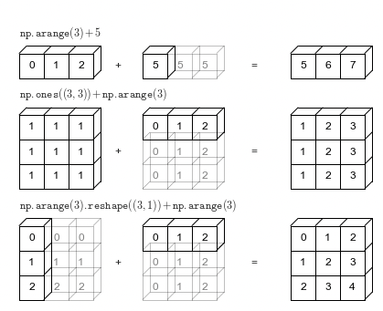
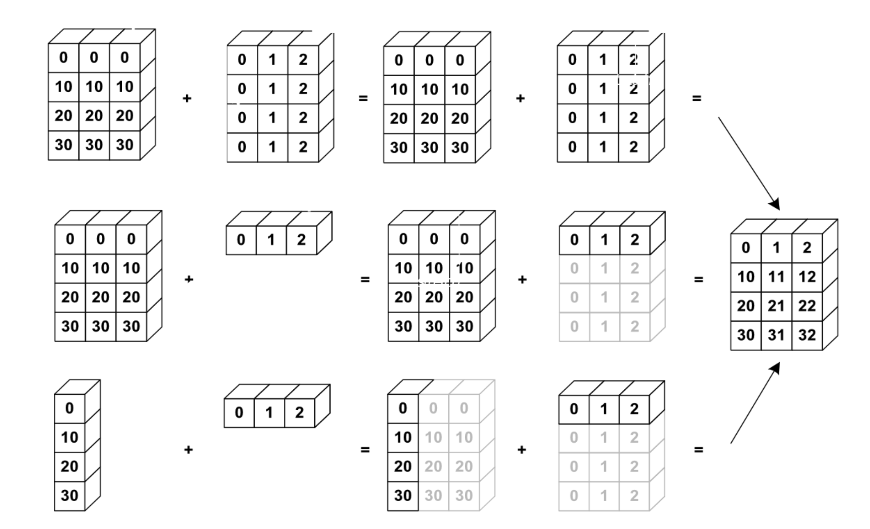
NumPy uses broadcasting to perform operation on arrays of different shape without having to allocate extra memory
Notes:
Again the kaleidoscope metaphor, it’s an aritifical way to replicate something

Slide 27
Broadcasting notebook summary
Dive in Broadcastig
notebooks/NumPy/broadcasting.ipynb
how NumPy treats arrays with different shapes during arithmetic operations
Rules of broadcasting
1: If the two arrays differ in their number of dimensions, the shape of the one with fewer dimensions is padded with ones on its leading (left) side.
2: If the shape of the two arrays does not match in any dimension, the array with shape equal to 1 in that dimension is stretched to match the other shape.
3: If in any dimension the sizes disagree and neither is equal to 1, an error is raised.
Notes:
Show 1,2 examples and the notebook with the rules/ their implementation

Slide 28
Up next: Tabular Data

