Slide 1

NumPy

Slide 2

NumPy – huh, yeah – what’s it good for?
NumPy introduces a new data structure: the array
Great for storing homogeneous data, where every element in the array has the same meaning. E.g. images, sound, time series
An array is a regular, N-dimensional grid of data of the same type, typically numerical data

Slide 3

Efficient machine-native implementation
This is a reminder from the architecture class
Data is stored in a contiguous chunk of memory, using machine-native data types
Separate metadata tells numpy how to interpret that memory as an array
Memory block storage
0 | 1 | 2 | 3 | 4 | 5 | 6 | 7 | 8
int64
8 bytes
NumPy view
0 | 1 | 2
3 | 4 | 5
6 | 7 | 8
NumPy array metadata
dtype | int64
ndim | 2
shape | (3, 3)
strides | (24, 8)
Notes:
The standard Python implementation is written in C. This means that every Python object is simply a cleverly-disguised C structure, which contains not only its value, but metadata as well
a C integer is essentially a label for a position in memory whose bytes encode an integer value. A Python integer is a pointer to a position in memory containing all the Python object information, including the bytes that contain the integer value
NumPy handles looping over array elements near-optimally—for example, taking strides into consideration to best utilize the computer’s fast cache memory
NumPy array - single pointer to one contiguous block of data
The Python list, on the other hand, contains a pointer to a block of pointers, each of which in turn points to a full Python object

Slide 4

Is NumPy any better than a list-of-lists?
Notes:
The standard Python implementation is written in C. This means that every Python object is simply a cleverly-disguised C structure, which contains not only its value, but metadata as well
a C integer is essentially a label for a position in memory whose bytes encode an integer value. A Python integer is a pointer to a position in memory containing all the Python object information, including the bytes that contain the integer value
NumPy handles looping over array elements near-optimally—for example, taking strides into consideration to best utilize the computer’s fast cache memory
NumPy array - single pointer to one contiguous block of data
The Python list, on the other hand, contains a pointer to a block of pointers, each of which in turn points to a full Python object

Slide 5
Is NumPy any better than a list-of-lists?
The machine-nativeness of the data storage means that common operations and algorithms can be implemented in C and Fortran, making them faster than a Python list-of- lists
Faster in what sense?
Big-O complexity is the same. E.g., square matrix multiplication is still O(n^3)*
It’s not going to scale any better than list-of-lists
Much faster for fixed-size problems
This speed advantage strictly depends on operations being made in C and Fortran. Avoid Python for-loops and use existing NumPy and SciPy functionality!
* The best matrix multiplication algorithm as of 2025 scales as O(n^2.371339). However, out-of-the-box NumPy packages usually use a Fortran library called OpenBLAS that implements a O(n^3) algorithm
Notes:
The standard Python implementation is written in C. This means that every Python object is simply a cleverly-disguised C structure, which contains not only its value, but metadata as well
a C integer is essentially a label for a position in memory whose bytes encode an integer value. A Python integer is a pointer to a position in memory containing all the Python object information, including the bytes that contain the integer value
NumPy handles looping over array elements near-optimally—for example, taking strides into consideration to best utilize the computer’s fast cache memory
NumPy array - single pointer to one contiguous block of data
The Python list, on the other hand, contains a pointer to a block of pointers, each of which in turn points to a full Python object

Slide 6
Same data, different views
Memory block storage
0 | 1 | 2 | 3 | 4 | 5 | 6 | 7 | 8
int64
8 bytes
NumPy view
NumPy array metadata
0 | 1 | 2
3 | 4 | 5
6 | 7 | 8
dtype | int64
ndim | 2
shape | (3, 3)
strides | (24, 8)
Notes:
The standard Python implementation is written in C. This means that every Python object is simply a cleverly-disguised C structure, which contains not only its value, but metadata as well
a C integer is essentially a label for a position in memory whose bytes encode an integer value. A Python integer is a pointer to a position in memory containing all the Python object information, including the bytes that contain the integer value
NumPy handles looping over array elements near-optimally—for example, taking strides into consideration to best utilize the computer’s fast cache memory
NumPy array - single pointer to one contiguous block of data
The Python list, on the other hand, contains a pointer to a block of pointers, each of which in turn points to a full Python object

Slide 7
Same data, different views
Memory block storage
0 | 1 | 2 | 3 | 4 | 5 | 6 | 7 | 8
int64
8 bytes
NumPy array metadata
dtype | int64
ndim | 1
shape | (9,)
strides | (8,)
NumPy view
0 | 1 | 2 | 3 | 4 | 5 | 6 | 7 | 8
Notes:
The standard Python implementation is written in C. This means that every Python object is simply a cleverly-disguised C structure, which contains not only its value, but metadata as well
a C integer is essentially a label for a position in memory whose bytes encode an integer value. A Python integer is a pointer to a position in memory containing all the Python object information, including the bytes that contain the integer value
NumPy handles looping over array elements near-optimally—for example, taking strides into consideration to best utilize the computer’s fast cache memory
NumPy array - single pointer to one contiguous block of data
The Python list, on the other hand, contains a pointer to a block of pointers, each of which in turn points to a full Python object

Slide 8
O(1) operations in NumPy
When NumPy can execute a command by just changing the metadata, it does.
The result is a new view of the same data in memory
Memory block
0 | 1 | 2 | 3 | 4 | 5 | 6 | 7 | 8 | 9 | 10 | 11 | 12
NumPy operation
NumPy array metadata
NumPy view
x
ndim | 2
shape | (4, 3)
strides | (24, 8)
0 | 1 | 2
3 | 4 | 5
6 | 7 | 8
9 | 10 | 11
Point to make: there are a number of array operations that take no time at all!
x.ravel()
ndim | 1
shape | (12,)
strides | (8,)
0 | 1 | 2 | 3 | 4 | 5 | 6 | 7 | 8 | 9 | 10 | 11
x.T
ndim | 2
shape | (3, 4)
strides | (8, 24)
0 | 3 | 6 | 9
1 | 4 | 7 | 10
2 | 5 | 8 | 11
x.reshape((2, 6))
ndim | 2
shape | (2, 6)
strides | (48, 8)
0 | 1 | 2 | 3 | 4 | 5
6 | 7 | 8 | 9 | 10 | 11

Slide 9
The golden rule of NumPy
you can always a copy explicitly with .copy()
Operations that can be executed by only changing the metadata return a “view “ of the original data memory block
In all other cases, it creates a “copy” with a new data memory block

Slide 10
View vs copies in indexing operations
How does the golden rule apply to indexing operations?
slices vs fancy indexing
Memory block
0 | 1 | 2 | 3 | 4 | 5 | 6 | 7 | 8 | 9 | 10 | 11 | 12
NumPy operation
NumPy array metadata
x
dtype | int64
ndim | 2
shape | (4, 3)
strides | (24, 8)
0 | 1 | 2
3 | 4 | 5
6 | 7 | 8
9 | 10 | 11
Slicing
dtype
ndim
shape
strides
Can this operation be done just by changing the metadata?
x[::3, ::2]
0 | 2
9 | 11

Slide 11
View vs copies in indexing operations
Memory block
0 | 1 | 2 | 3 | 4 | 5 | 6 | 7 | 8 | 9 | 10 | 11 | 12
NumPy operation
NumPy array metadata
x
dtype | int64
ndim | 2
shape | (4, 3)
strides | (24, 8)
0 | 1 | 2
3 | 4 | 5
6 | 7 | 8
9 | 10 | 11
Slicing
dtype | int64
ndim | 2
shape | (2, 2)
strides | (72, 16)
Can this operation be done just by changing the metadata?
YES!
x[::3, ::2]
0 | 2
9 | 11
Can it be done for all slicing operations?

Slide 12
View vs copies in indexing operations
Memory block
0 | 1 | 2 | 3 | 4 | 5 | 6 | 7 | 8 | 9 | 10 | 11 | 12
NumPy operation
NumPy array metadata
x
dtype | int64
ndim | 2
shape | (4, 3)
strides | (24, 8)
0 | 1 | 2
3 | 4 | 5
6 | 7 | 8
9 | 10 | 11
Slicing always returns a view of the original array
Slicing
dtype | int64
ndim | 2
shape | (2, 2)
strides | (72, 16)
Can this operation be done just by changing the metadata?
YES!
x[::3, ::2]
0 | 2
9 | 11
Can it be done for all slicing operations?
YES!

Slide 13
View vs copies in indexing operations
Memory block
0 | 1 | 2 | 3 | 4 | 5 | 6 | 7 | 8 | 9 | 10 | 11 | 12
NumPy operation
NumPy array metadata
x
dtype | int64
ndim | 2
shape | (4, 3)
strides | (24, 8)
0 | 1 | 2
3 | 4 | 5
6 | 7 | 8
9 | 10 | 11
Fancy indexing
dtype
ndim
shape
strides
Can this operation be done just by changing the metadata?
x[[0, 2, 3], [1, 2, 1]]
1 | 10 | 8
row indices
column indices

Slide 14
View vs copies in indexing operations
Memory block
0 | 1 | 2 | 3 | 4 | 5 | 6 | 7 | 8 | 9 | 10 | 11 | 12
NumPy operation
NumPy array metadata
x
dtype | int64
ndim | 2
shape | (4, 3)
strides | (24, 8)
0 | 1 | 2
3 | 4 | 5
6 | 7 | 8
9 | 10 | 11
Fancy indexing always returns a copy of the original array
Fancy indexing
dtype | int64
ndim | 1
shape | (3,)
strides | ???
Can this operation be done just by changing the metadata?
NO!
x[[0, 2, 3], [1, 2, 1]]
1 | 10 | 8
row indices
column indices

Slide 15
View or copy? Quiz
Exercise
exercises/view_or_copy/ view_or_copy_interactive.ipynb

Slide 16
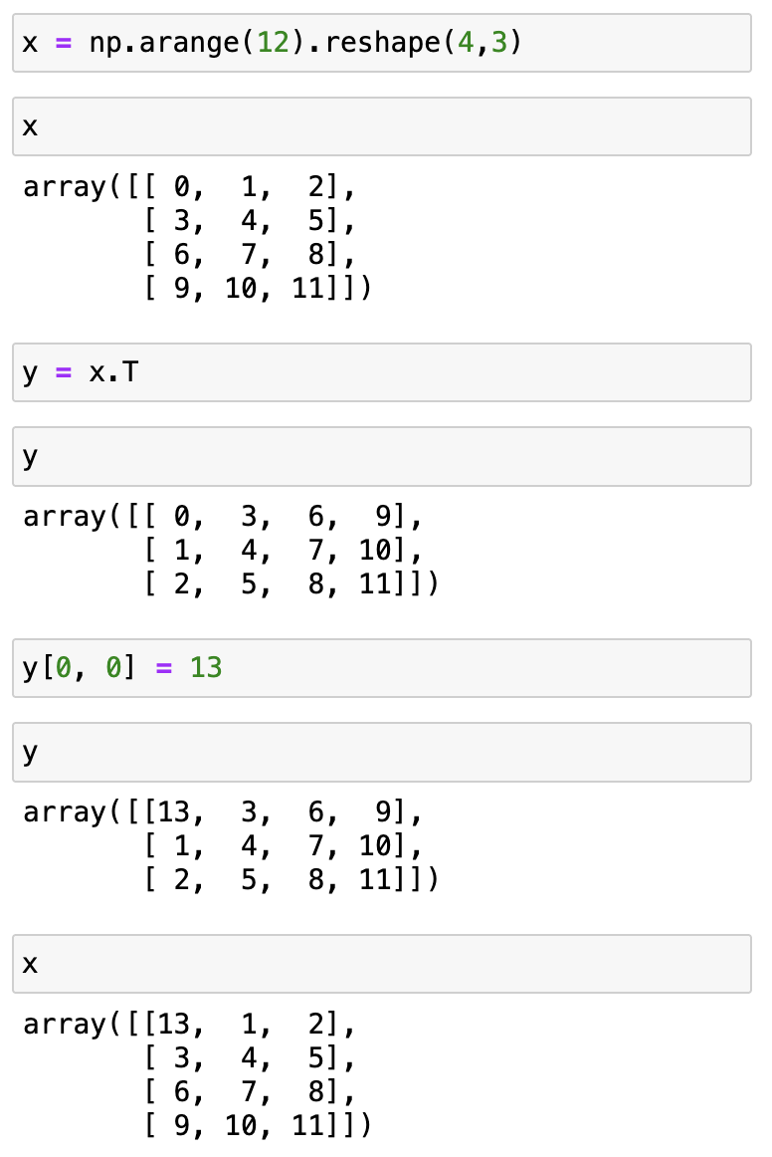
Changing one view changes them all
0 | 1 | 2 | 3 | 4 | 5 | 6 | 7 | 8 | 9 | 10 | 11 | 12
data
dtype | int64
ndim | 2
shape | (4, 3)
strides | (24, 8)
data
dtype | int64
ndim | 2
shape | (3, 4)
strides | (8, 24)
x
y

Slide 17
Changing one view changes them all
0 | 1 | 2 | 3 | 4 | 5 | 6 | 7 | 8 | 9 | 10 | 11 | 12
data
dtype | int64
ndim | 2
shape | (4, 3)
strides | (24, 8)
data
dtype | int64
ndim | 2
shape | (3, 4)
strides | (8, 24)
x
y

Slide 18
Changing one view changes them all
13 | 1 | 2 | 3 | 4 | 5 | 6 | 7 | 8 | 9 | 10 | 11 | 12
data
dtype | int64
ndim | 2
shape | (4, 3)
strides | (24, 8)
data
dtype | int64
ndim | 2
shape | (3, 4)
strides | (8, 24)
x
y

Slide 19
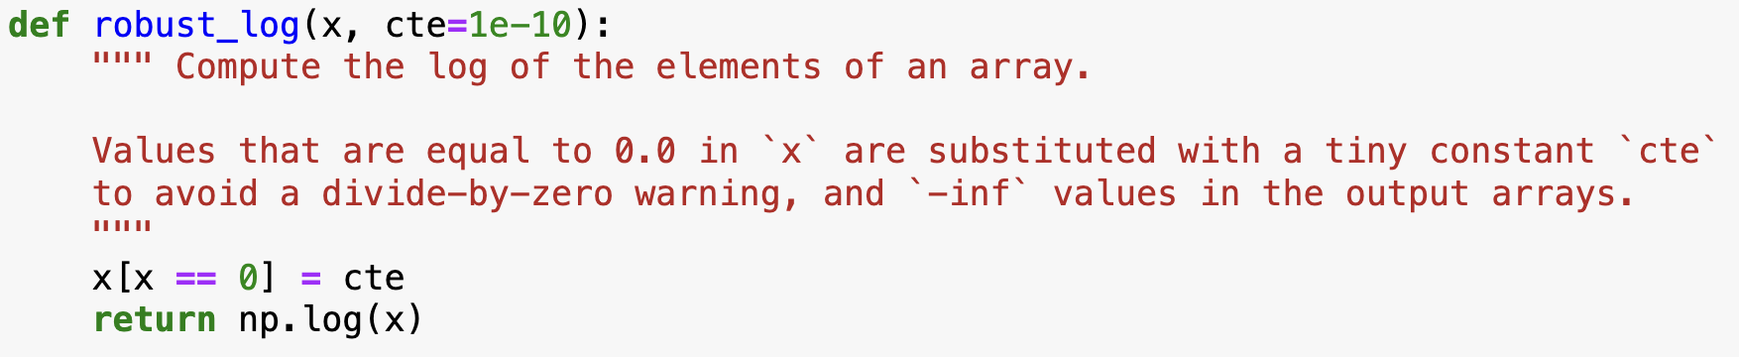
Careful with your functions

Slide 20
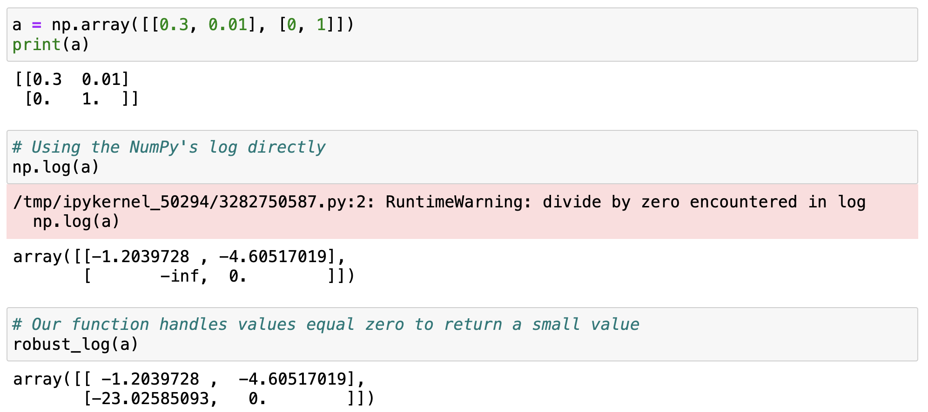
Careful with your functions
Example of usage
what can go wrong with this function?

Slide 21
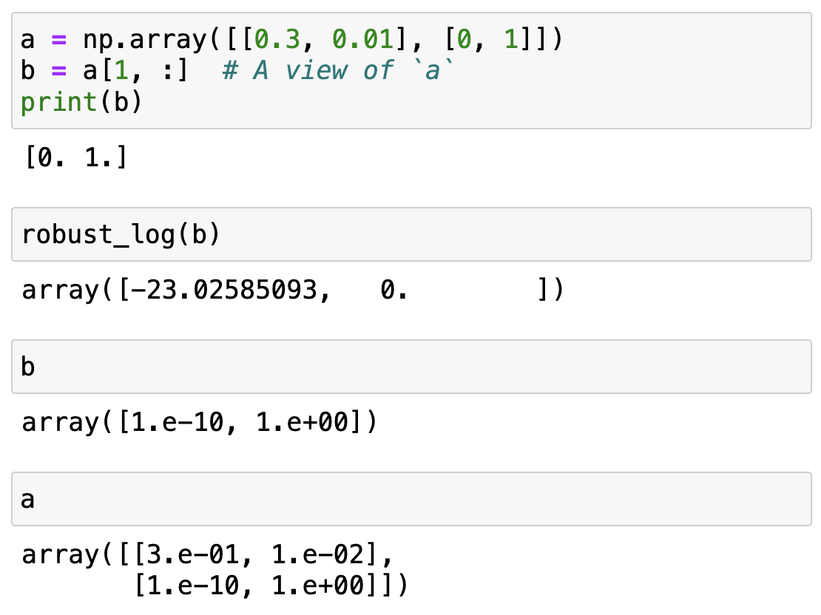
Careful with your functions
The input array has been modified!
… and so have all other views of the same data!

Slide 22
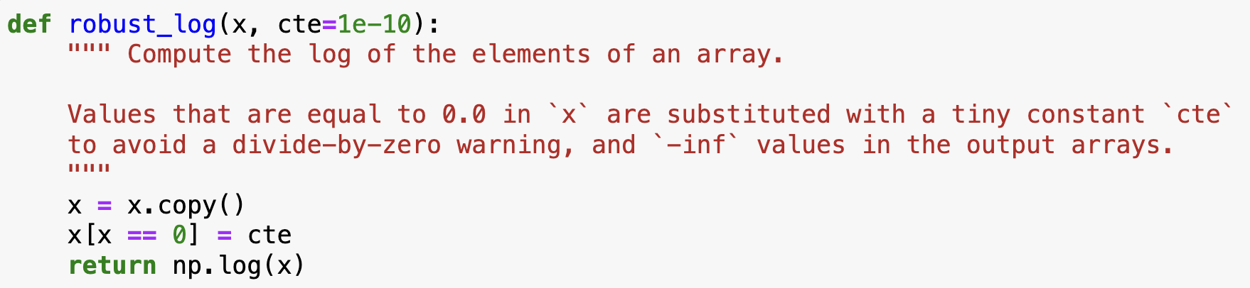
Careful with your functions
Best practice: functions that take an array as an input should avoid modifying it in place!
Always make a copy or be super extra clear in the docstring
Discuss pro and cons with them

Slide 23
NumPy views and copies summary
View
There can be multiple views of the same memory block, interpreted as different arrays
Slicing returns a view
In-place operations on a view modify the memory block and all of its views
Copy
When a copy of an array needs to be created, it allocates a separate memory block and associates it with new metadata
Fancy indexing always returns copies
A copy can be forced with .copy()

Slide 24
A special kind of view: broadcasting operations
Memory block
0 | 1 | 2 | 3 | 4 | 5 | 6 | 7 | 8
NumPy array metadata
dtype | int64
ndim | 2
shape | (4, 9)
strides | (0, 8)
The shape says we have 4 rows and 9 columns
A stride of 0 means that for each new row, we don’t move in memory
Notes:
Special case, when one of the strides is 0 → duplicates without occupying more memory
Transition, other operations that can
Braodcasting
Imagine what happens if we have a stride of 0
It allows us to replicate the sae row without allocating extra memory
What happens when it’s a 0?

Slide 25
A special kind of view: broadcasting operations
Memory block
As a result, we obtain a view with duplicated rows, without using extra memory!
0 | 1 | 2 | 3 | 4 | 5 | 6 | 7 | 8
NumPy array metadata
NumPy view
dtype | int64
ndim | 2
shape | (4, 9)
strides | (0, 8)
The shape says we have 4 rows and 9 columns
0 | 1 | 2 | 3 | 4 | 5 | 6 | 7 | 8
0 | 1 | 2 | 3 | 4 | 5 | 6 | 7 | 8
0 | 1 | 2 | 3 | 4 | 5 | 6 | 7 | 8
0 | 1 | 2 | 3 | 4 | 5 | 6 | 7 | 8
A stride of 0 means that for each new row, we don’t move in memory
Notes:
Stride == 0 → then we are not actually moving in memory, same memory, we are looping over the same thing

Slide 26
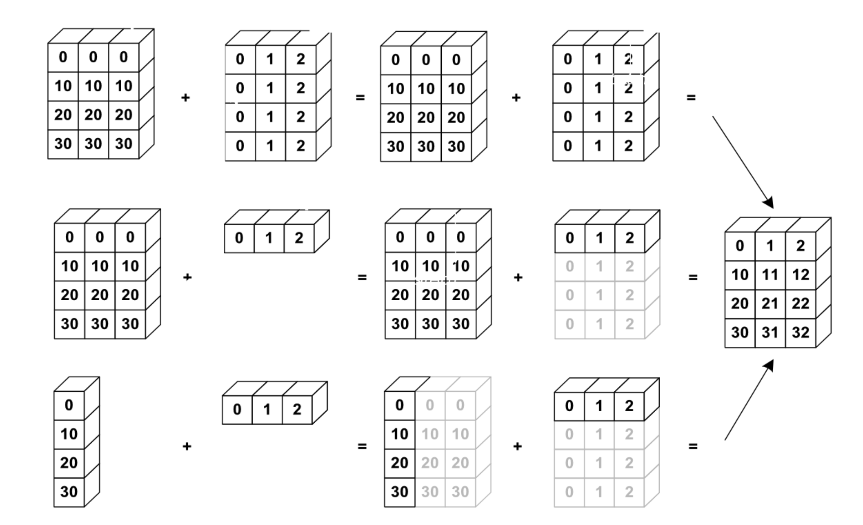
NumPy uses broadcasting to perform operation on arrays of different shape without having to allocate extra memory
Add dimension matching rules
[:, np.newaxis]?
element-wise multiplication (*)
vs matrix multiplication (@)
Notes:
Again the kaleidoscope metaphor, it’s an aritifical way to replicate something

Slide 27

Broadcasting notebook summary
Dive in Broadcasting
notebooks/NumPy/broadcasting.ipynb
how NumPy treats arrays with different shapes during arithmetic operations
Rules of broadcasting
1: If the two arrays differ in their number of dimensions, the shape of the one with fewer dimensions is padded with ones on its leading (left) side.
2: If the shape of the two arrays does not match in any dimension, the array with shape equal to 1 in that dimension is stretched to match the other shape.
3: If in any dimension the sizes disagree and neither is equal to 1, an error is raised.
NEED EXERCISE
Notes:
Show 1,2 examples and the notebook with the rules/ their implementation

Slide 28
Up next: Tabular Data

Slide 30
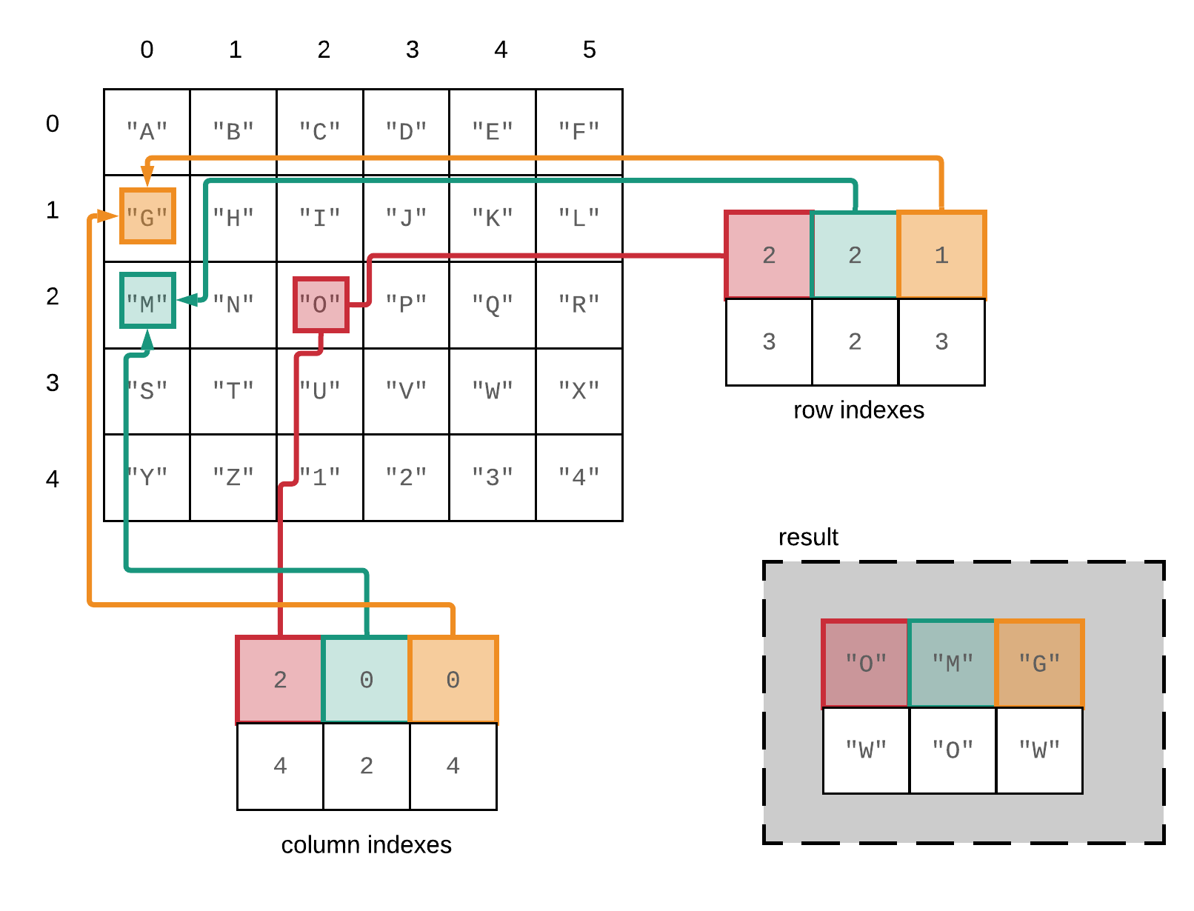
Fancy indexing in NumPy – reference slide
A[[2, 2, 1], [2, 0, 0]]

