Slide 1
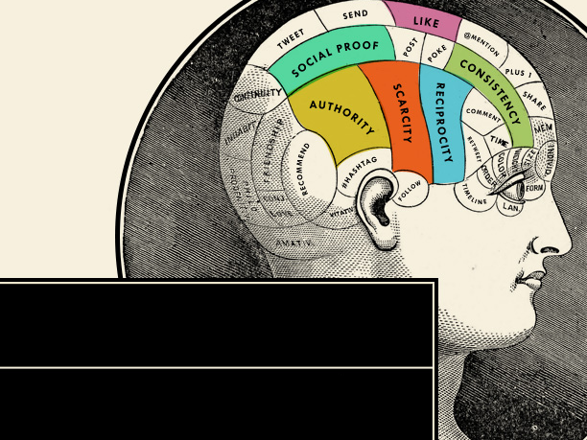
Introduction to NEUROMARKETING
OR
Some Psychological Methods that Can Help to Improve the Conversion Rate.

Slide 2
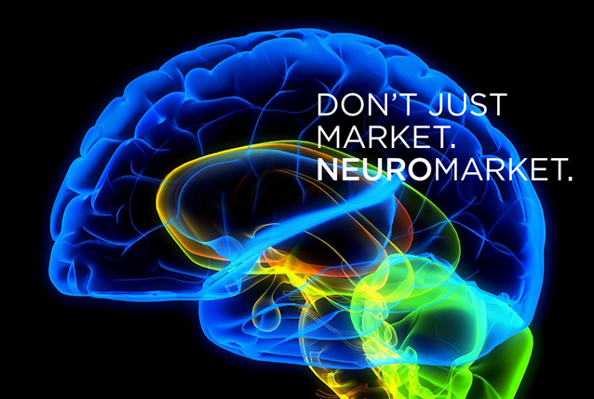
What is it?

Slide 3
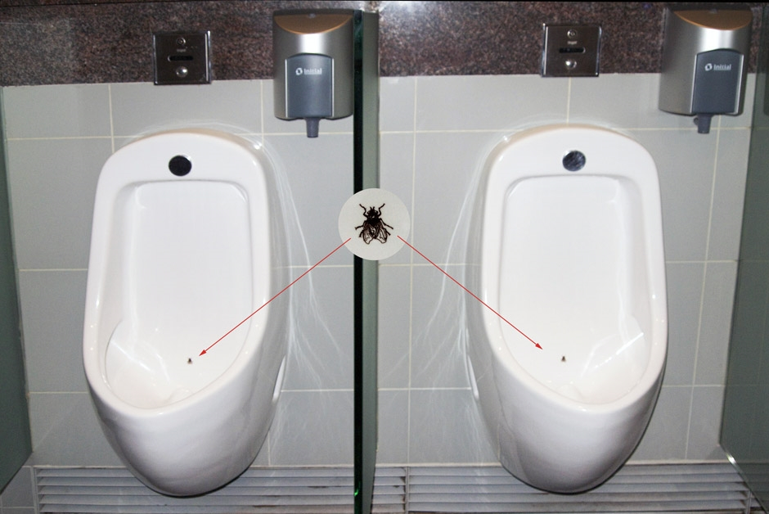
Researchers installed a ‘fly’ onto urinals across different airports around the world.
The presence of a fly in a urinal literally changes human behavior. How come? Apparently men have an instinct to aim. When flies were introduced at Schiphol Airport in Amsterdam, spillage rates dropped 80 percent (don’t want to know how they measured it).

Slide 4
NEUROMARKETING
It is a new field of marketing research that studies consumers‘ sensorimotor, cognitive, and affective response to marketing stimuli.
Researchers use different technologies to measure activity and changes in one's physiological state to learn why consumers make the decisions they do.
It employs the latest researches and methods of psychology of advertising, in particular, Social Commerce Psichology and NLP (Neuro-linguistic Programing).
In fact, certain companies, particularly those with large-scale goals, have invested in their own laboratories, science personnel and / or partnerships with academia.

Slide 5
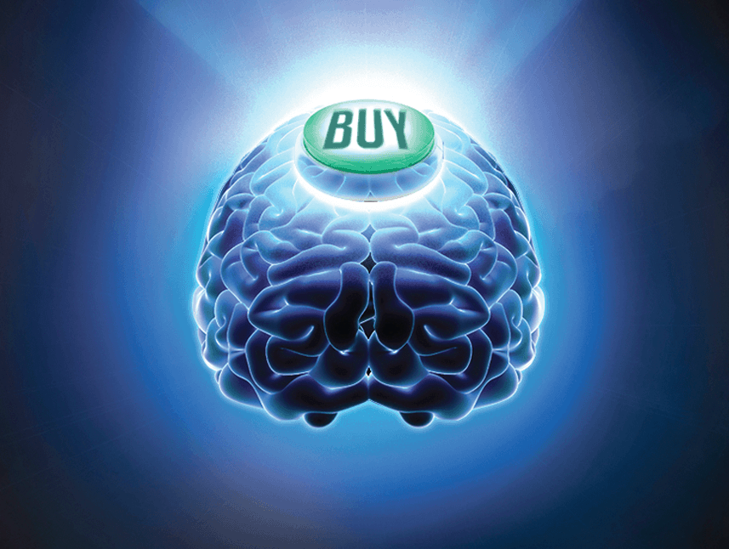
Some Psychological Techniques to convert more customers

Slide 6
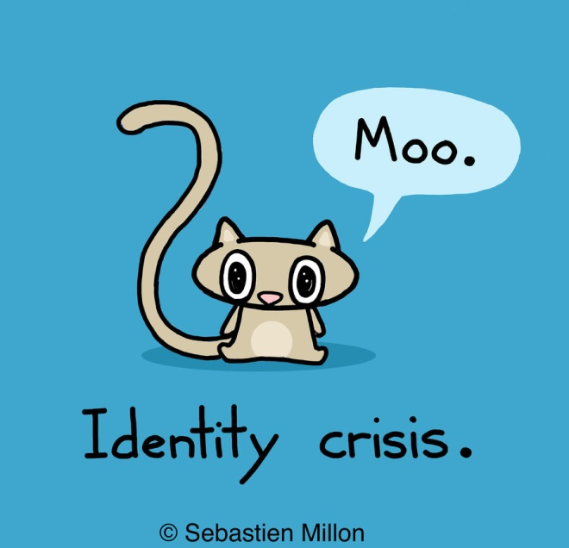
Appeal to Their Identity.
Who a person is and how they see themselves is an incredibly important influence tool, maybe the most important of them all.
If you can tie in what you want with what their identity would do in a similar situation, you’d have a very good chance of getting him or her to do it.

Slide 7

Appeal to Their Identity. Embrace the Power of Labels.
Another use of the Appeal to Their Identity is the use of Labels. We are suggesting you label your customers!
Research has shown that people like being labeled, and they are more inclined to participate in their “group’s” message if they feel included.

Slide 8
Appeal to Their Identity. Embrace the Power of Labels.
Here are a couple of examples I might use when selling to dog owners:
• Pet parents always serve their dogs Special-J Dog Food.
• Caring pet owners feed their dogs Special-J Dog Food.

Slide 9
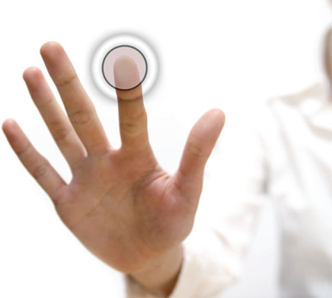
Combination of gift and personalization.
Combining a gift with personalization is like a power move. It feels like it's your birthday, that's got to be good!

Slide 10
Combination of gift and personalization.
Researches studdied the effect of offering a mint with the check in restaurant:
• Mints on way out is the baseline
• Mint with check +3.3% uplift in tip value.
• Waiter offers each customer a mint (personalisation) before check +14.1% uplift in tip value.
• Waiter offers each customer a mint, (personalisation) then as he walks away he stops, returns, and offers an extra 'generous afterthought' mint to each customer (double personalisation). +23% uplift.

Slide 11

Use Their Hierarchy of Values.
People place a value on practically everything. And that includes time, goods, ideas, people, etc. But they do have priorities.
Some of the fairly universal values (at least here in the west) are these: love, health, attractiveness, security, safety of family, pleasure, impressing others, happiness.

Slide 12
Use Their Hierarchy of Values.
How can you tie in what you’re offering with one or more of their highest values?
An example:
What’s more important to you, saving a few bucks or your dog’s health?

Slide 13
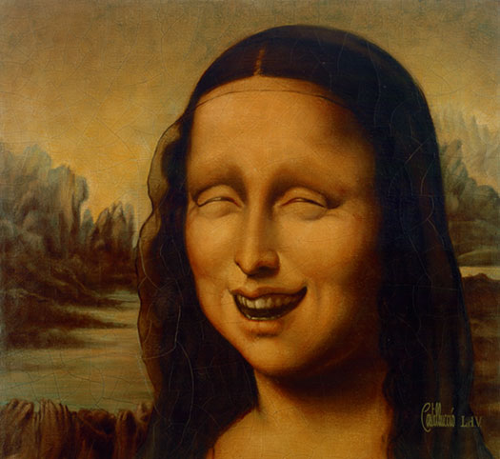
Invoke Emotions
You sell something by getting the prospective customers’ emotions involved.
Positive emotions like hope, anticipation, love, and negative emotions like anger, loneliness, disgust can spur people into action.

Slide 14
Invoke Emotions
You also need to use emotionally charged words that add impact to your writing.
An example:
Show the love for your dog that he or she shows you.

Slide 15

Motivate Your Reader.
Why should they do what you ask them?
What’s in it for your reader?
What do they get?
What’s the incentive?
What are the major benefits of doing what you are asking them to do?

Slide 16
Motivate Your Reader.
Here’s an example: When you feed your dog Special-J Dog Food, you’ll notice your dog will :
Be more content and happier
Sleep better
Have a shinier, healthier coat
Be less likely to get sick
Recover from injuries faster
Have cleaner breath

Slide 17
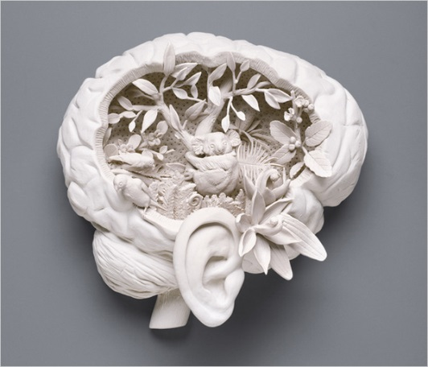
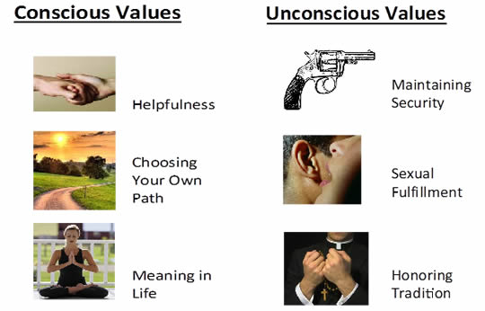
Unconscious Motivators. What we say vs. what we really think.

Slide 18
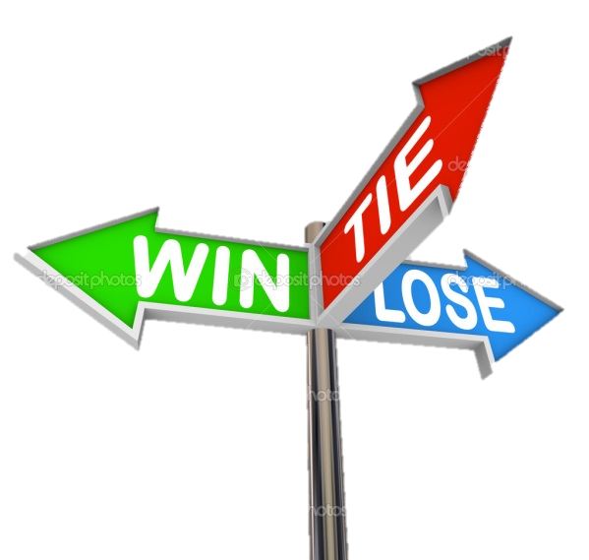
Show Them the Consequences.
How will your readers lose out by not doing what you suggest? Paint a word picture for them. What pain will they experience if they don’t do as you ask.

Slide 19
Show Them the Consequences.
An example:
Many dog foods are not nutritionally balanced, especially imported dog food. The last thing you need is for your dog to get sick, start losing his or her hair, becoming listless, just because you have been serving your dog canned food that isn’t as healthy.

Slide 20
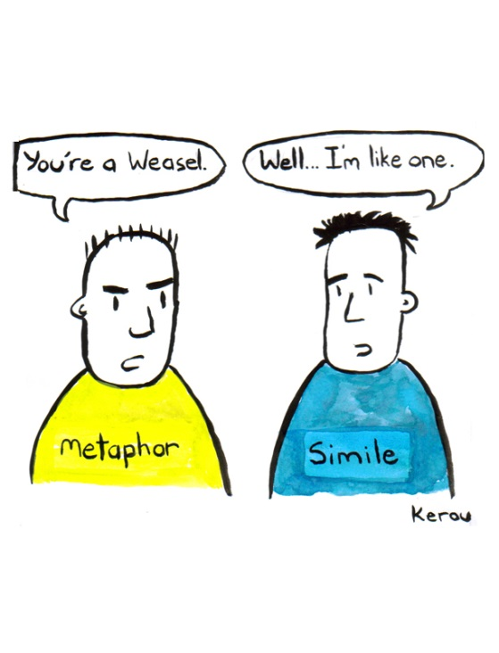
Employ Metaphor.
If you are selling a product, how is your product like something else very desirable?
Here are some examples:
Special-J Dog Food is like an immunity booster shot for your dog.
ABC is the Rolls-Royce of printer inks.

Slide 21
Show No Gray Area
Point out to your readers that there really isn’t any choice in what you have to offer.
They have only a very positive outcome if they do as you say or a very negative one if they don’t. Which one are you going to choose?

Slide 22
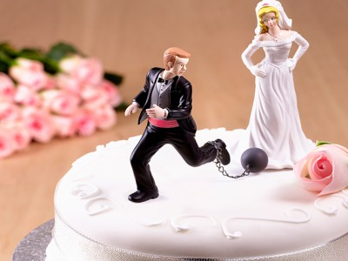
Have Them Make a Commitment.
When people make a commitment to an idea, they tend to find it very difficult to change their minds without creating conflict or anxiety (called, Cognitive Dissonance).
For an advertisement, You would first ask your readers a question where they would most likely say yes. Then you’d continue with your writing. Finally, you’d remind them of what they said yes to and connect this to your offer.

Slide 23
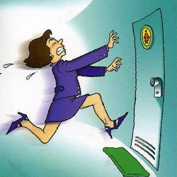
Overcome Inertia Use Urgency
The first rule here is to simplify the steps they need to take.
+
Creating a sense of urgency in your copy is one of the oldest tricks in the book ... and still one of the smartest.
=
Invoking urgency had much more noticeable effect when follow-up instructions were given.

Slide 24
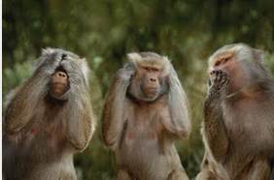
Add Presuppositions.
These are compelling ways to put thoughts into people’s heads without even verbalizing the thought.
Example:
Do you know of any other dog food that makes your dog healthier than Special-J Dog Food?
(NOTE: Whether they answer yes or no, by answering the question they imply that Special-J Dog Food will make their dog healthy.)

Slide 25


LITERATURE The sources you have to read
10 Ways to convert more customers
17 of The World’s Most Powerful Written Persuasion Techniques
13 Neuromarketing Lead Generation Tactics and One That Isn't.
5 Psychological Studies on Pricing That You Absolutely MUST Read
Sex, Lies, and Our Secret Motivators
NLP Copywriting Tips: Using Linguistic Binds in Your Ads
Persuade with Silky Smooth Copy
5 Principles of Persuasive Web Design
Also see:
NLP Language Patterns for Advertizing (Blog)
NeuroMarketing (Blog)
NLP copyriting (Blog) and (YouTube channel)

