Slide 1






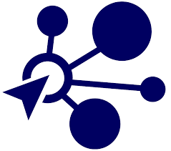
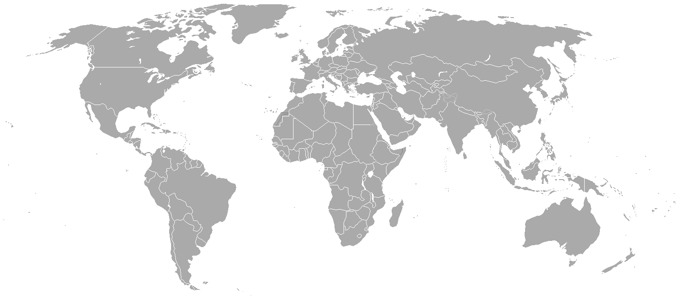

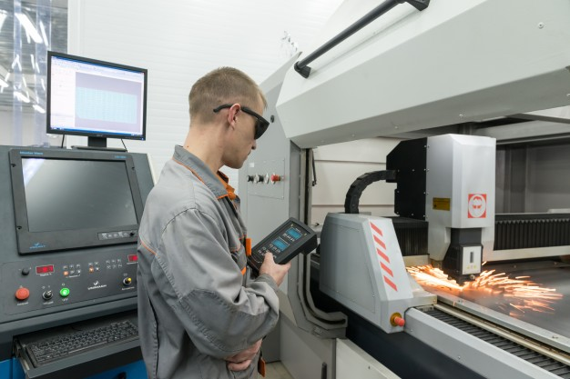
About
Partners
Resources
Login
Contact
Create, innovate, and build now. Your idea today is a product tomorrow.
Creators and Designers
Enterprises
For the innovative thinkers, ambitious creators, and thoughtful designers seeking to make an impact on the world, here is your chance. We will connect you and your product with leading manufacturers and distributors to make your vision turn into reality.
For businesses seeking to expand their production capacity or widen their distribution channels, our partners are there to help. Through our platform, you can manage your product’s supply chain.
Propose
Manufacture
Distribute
Have a prototype or design you want to start producing? Submit a proposal to manufacturers in our streamlined process.
Once a proposal is accepted, keep track of your product with our real time tracker. You can regularly check in with your manufacturer to ensure everything is running smoothly.
Sell your product in the market with our network of distributors—and earn money as it is being sold!
Our Major Manufacturing Partners
Munich, Germany

