Slide 1


provides turn-key microgrid solutions for farming industry
Facility

Slide 2
High Growth Potential for Renewable Energy
($B)
In the US, an average daily installation of 550 megawatt-hours (MWh) is required to achieve 100% renewable energy by 2050.
Energy storage capacity and efficiency are the key enablers for the renewable transformation; BESS is the system of choice.
Global battery storage market reaches $5.4B in 2023 with a compound annual growth rate (CAGR) of 26.8% to 2032.

Slide 3
Bring Solution and Value to Farmers
Our Position:
Leading Microgrid Innovation in Farming.
Advanced Battery Energy Storage (BESS) Solutions
Driven by Innovative Battery Management Systems
Our Values:
Technical Excellence: Extending Energy Storage System Lifespans, Reducing Costs, and Lowering Carbon Footprints through Proprietary Active Balancing Technology.
Market Relevance: Addressing Global Warming and Smart Agriculture's Growth with Renewable Energy.
Strong Team: Combining North American Market Expertise with China’s Supply Chain Strengths.
Problem:
High Cost for Energy and Storage
Limitation on Grid Energy Usage
Time Restriction
Lack of Energy Storage Results in Low Production
No Customized Solution for Farming Industry
Values to Customers:
Cost Benefit
Carbon Footprint Reduction
US Government Incentives
Electricity Arbitrage
Grid Stability and Resiliency

Slide 4
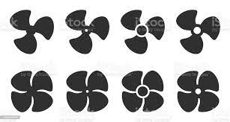





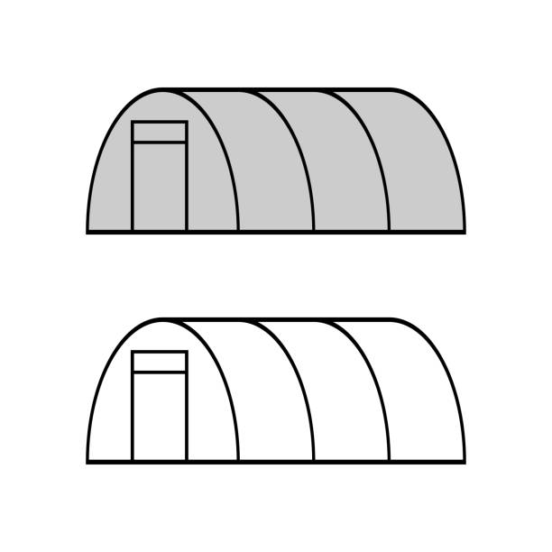
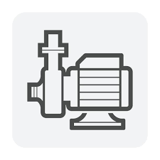
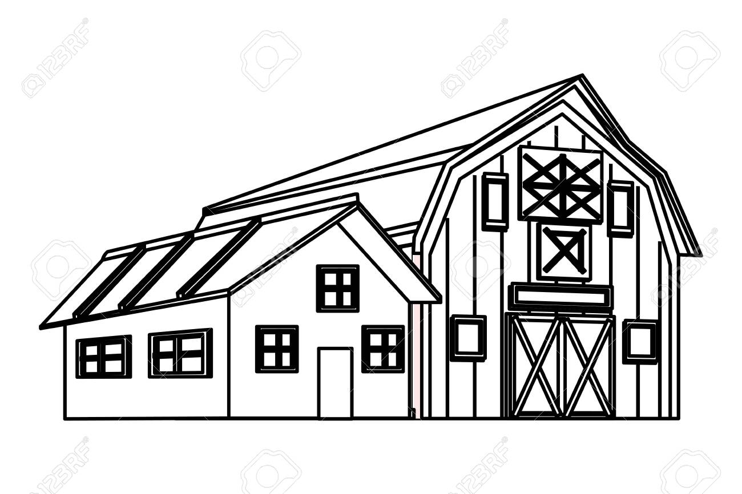
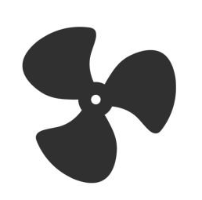




Indoor and Outdoor Farming Application
Reshine Empowers Farm Net Zero
Greenhouses
Temperature control
LED lighting
Water pump
Waste Management
Machinery
Traction
Facility
Indoor Farming
Outdoor Farming
Facility

Slide 5
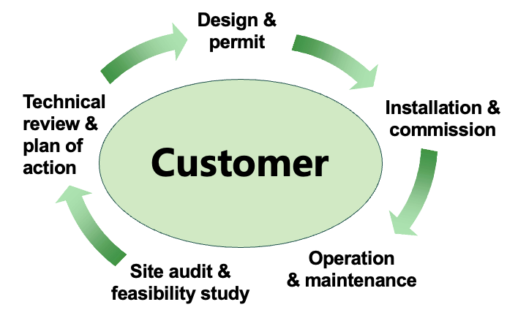
Why Us?
Microgrid Total Solutions
Advanced BESS Technology
15 yrs Life Span
300%
LFP BESS
5 yrs Life Span
Today’s Technology
Passive Balancing
Reshine Active Balancing
Lifespan with Minimum Added Costs
Turn-key Solution
Customer Centered Product and Service
Advanced Microgrid Technologies
BESS with Longer Life-span and Lower Cost
Agricultural Support from our Agriculture Advisors
Financing Service from our partners (EaaS)
Long Term Partnership
Reshine’s BMS & Active Battery Balancing Technologies Increase BESS Lifespan for 3 Times
Facility

Slide 6


Products and Services - 1
Microgrid Solution
Smart and integrated BMS, PCS, and EMS systems with user friendly software and mobile app control
State-of-the-Art power electronics, high efficiency DCDC and DCAC conversion and coupling, advanced air and liquid cooling solutions
High quality tier-1 batteries, advanced Reshine BMS with active balancing technology
High quality and high efficiency solar energy solutions
High efficiency, multi-color LED farming solutions

Slide 7
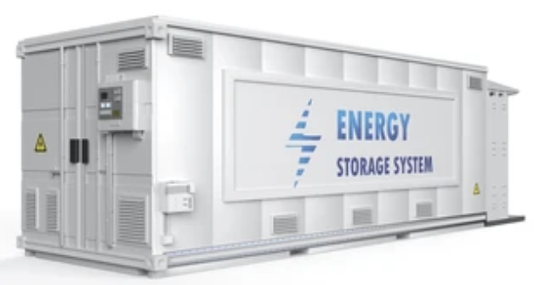


Products and Services - 2
BESS
Solar
LEDs
Long battery lifetime (>12000 cycles)
High energy density (3.44MWh, 20 feet container)
Advanced Reshine BMS technology with active battery balancing
Enhanced safety and water-proof optional
50% reduction in installation and PCS DCDC compatible
Modular design enables easy capacity expansion upgrade
LCOE > 50% reduction
Bifacial technology enables additional energy harvesting from the rear side (up to 25%).
Excellent low irradiance performance
Better light trapping and current collection to improve module power output and reliability
Industry leading lowest thermal coefficient of power.
Optimized electrical design and lower operating current for reduced hot spot loss and better temperature coefficient. Certified to withstand: wind load (2400 Pa) and snow load (5400 Pa).
100% triple EL test enables remarkable reduction of module hidden crack rate.
Horticultural lighting is revolutionizing the future of farming enabling farmers to sustainably grow vegetables and fruit all year-round.
It makes it possible to grow faster, using less land, less water, less fertilizers and zero pesticides.
High efficiency, multi-color LED farming solutions
LED fixtures designed for most efficient horticultural lighting.
Relays, interconnects, and control system provide the right amount and type of lighting to plants to keep them healthy.
Easy to use, reliable, harsh environment interconnects to minimize installation time and ensure routine operation.

Slide 8
Please Contact Us
Deli Wang
deli@reshine-re.com
(1)(858)449-1069
(86)18844591896
John Wang
john@reshine-re.com
(1)(626)922-5658
Facility

