Slide 1
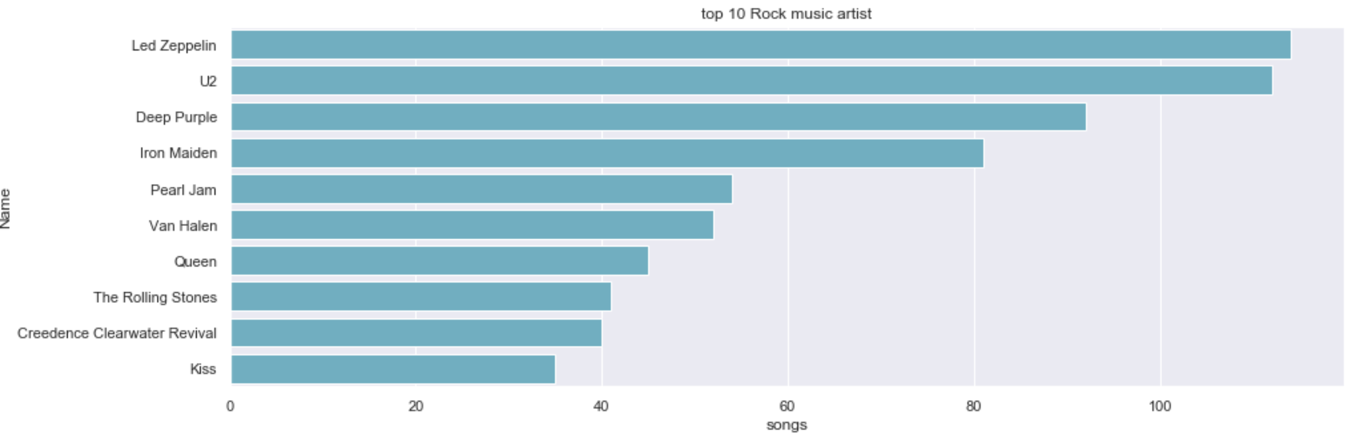
Who is writing the rock music?
From here we see Artist name and total track count of the top 10 rock bands.
Led Zeppelin and U2 hadover 100 songs and Kiss had less than 40
Notes:
/* Q1/
--Who is writing the rock music?
select a.artistid, a.name, COUNT(*) songs
FROM Artist a, Album al, Track t
join Genre g
on t.genreid = g.GenreId
WHERE a.ArtistId= al.artistid and al.albumid= t.albumid and g.name = 'Rock'
GROUP BY 1,2
ORDER BY 3 DESC
LIMIT 10;

Slide 2
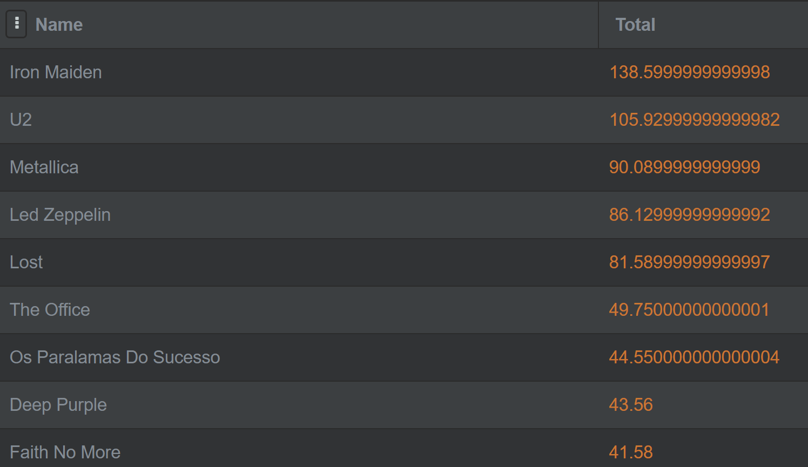
who earned the most?
From here we see Iron Maiden made the most, this will be one of our constrain for the next query
Notes:
SELECT a.name, SUM(il.unitprice*il.quantity) total
from Artist a
join Album al
on a.artistid= al.ArtistId
join Track t
on al.albumid = t.albumid
join InvoiceLine il
on t.trackid= il.trackid
group by 1
ORDER BY 2 DESC

Slide 3
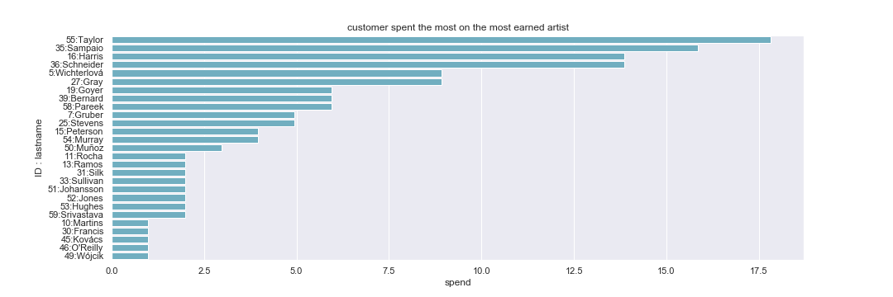
how much did customer spent the most on the most earned artist?
With the query we generated we can get a result table as shown on the left. We can easily find out Tayloy (ID: 55) spend the most.
Notes:
/*Q2/
--First, find which artist has earned the most according to the InvoiceLines?
--Now use this artist to find which customer spent the most on this artist.
-- pickout all the Artist if they have the same amount of sales
WITH T1 AS (SELECT a.name, il.trackid, SUM(il.unitprice*il.quantity)OVER(PARTITION BY A.ArtistId) index1
from Artist a
join Album al
on a.artistid= al.ArtistId
join Track t
on al.albumid = t.albumid
join InvoiceLine il
on t.trackid= il.trackid
ORDER BY 3 DESC),
t2 as (select name,index1
from t1
where index1 = (select max(index1) from t1))
SELECT a.name,SUM(il.unitprice*il.quantity) spend, c.customerid, c.firstname, c.lastname
FROM Artist a
join Album al
on a.artistid= al.artistid
join Track t
on al.albumid= t.albumid
join InvoiceLine il
on t.trackid= il.trackid
join Invoice i
on il.invoiceid= i.InvoiceId
join Customer c
on i.customerid= c.customerid
where a.name = (select name from t2)
group by 1,3,4,5
order by 2 desc, 3

Slide 4
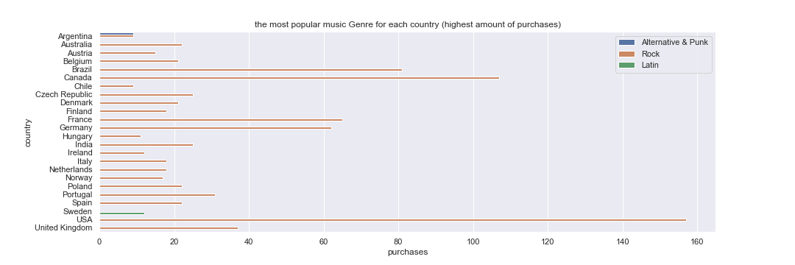
the most popular music Genre for each country
As the plot shows, Argentina have noth rock and Alternative & Punk as most popular music and Sweden has Latin as most popular music. Rock seems to be really popular worldwide.
Notes:
/*Q3/
--We want to find out the most popular music Genre for each country. We determine the most popular g
--enre as the genre with the highest amount of purchases. Write a query that returns
--each country along with the top Genre. For countries where the maximum number of purchases
--is shared return all Genres.
WITH T1 AS (SELECT COUNT(total) purchases, billingcountry country, g.name, g.genreid
FROM Invoice i, InvoiceLine il, Track t
join Genre g
on t.genreid = g.GenreId
WHERE i.invoiceid=il.invoiceid and il.trackid = t.trackid
GROUP BY 2,3,4
order by 1 desc)
SELECT purchases, country,name, genreid
FROM (SELECT purchases, country,name, genreid,
DENSE_RANK()OVER(PARTITION BY country ORDER BY purchases DESC) INDEX1
FROM T1) T2
WHERE INDEX1 =1

Slide 5
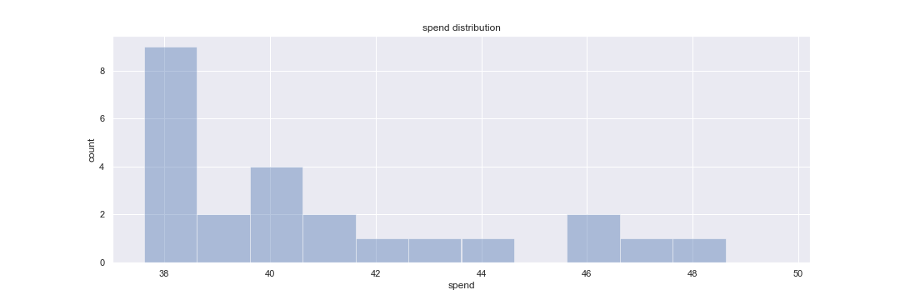
customer that has spent the most on music for each country (spend distribution)
As we can see from the histogram, most customer spend around 35 to 45 while there are some exceptions.
Notes:
/*Q4/
--Write a query that determines the customer that has spent the most on music for each country.
--Write a query that returns the country along with the top customer and how much they spent.
--For countries where the top amount spent is shared, provide all customers who spent this amount.
WITH T1 AS(SELECT billingcountry, c.customerid, firstname,lastname, SUM(total) spend
FROM Customer C
join Invoice I
on C.CustomerId= I.customerid
GROUP BY 1,2)
SELECT billingcountry, spend, firstname,lastname,customerid
FROM (SELECT billingcountry, customerid, firstname,lastname, spend,
DENSE_RANK()OVER(PARTITION BY billingcountry ORDER BY SPEND DESC) INDEX1
FROM T1) T2
WHERE INDEX1 =1
ORDER BY 1

Slide 6
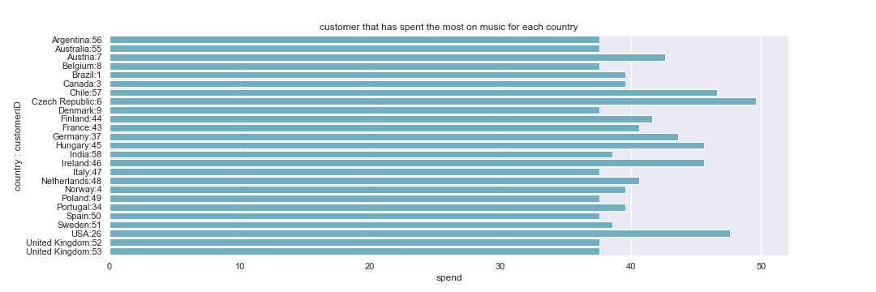
customer that has spent the most on music for each country
This plot shows us the spend difference between each country. As we saw in the previous slid, most countries's customers spend between 35 to 45, while Chile with customer id 57 spend the most.
Notes:
/*Q4/
--Write a query that determines the customer that has spent the most on music for each country.
--Write a query that returns the country along with the top customer and how much they spent.
--For countries where the top amount spent is shared, provide all customers who spent this amount.
WITH T1 AS(SELECT billingcountry, c.customerid, firstname,lastname, SUM(total) spend
FROM Customer C
join Invoice I
on C.CustomerId= I.customerid
GROUP BY 1,2)
SELECT billingcountry, spend, firstname,lastname,customerid
FROM (SELECT billingcountry, customerid, firstname,lastname, spend,
DENSE_RANK()OVER(PARTITION BY billingcountry ORDER BY SPEND DESC) INDEX1
FROM T1) T2
WHERE INDEX1 =1
ORDER BY 1

