Slide 1
Naïve Bayes classifiers
Terence Parr
MSDS program University of San Francisco

Slide 2


Common problem: detect spam tweets
Q. Is the following tweet spam or ham (not spam)?
Without knowledge of content, what’s the best we can do?
SPAM at big package store

Slide 3
Common problem: detect spam tweets
Q. Is the following tweet spam or ham (not spam)?
Without knowledge of content, what’s the best we can do?
Use prior knowledge about relative likelihoods of spam/ham
If a priori, we know 75% of tweets are spam, always guess spam
(Note: this is solving same problem as, say, article topic classification)

Slide 4
Our base model
If 75% of tweets are spam, always guessing spam gives us a baseline of 75% accuracy (which we hope to surpass)
Accuracy has formal definition: % correctly-identified tweets
A superior model must do better than 75% accuracy
What if a priori spam rate was 99%? Model has 99% accuracy
That hints that accuracy can be very misleading by itself and for imbalanced datasets[1]
How can we do better than just the a priori probabilities?
[1] The Relationship Between Precision-Recall and ROC Curves
https://www.biostat.wisc.edu/~page/rocpr.pdf

Slide 5
Better model using knowledge of content
If we can see tweet words, we have more to go on; e.g.,
Given “Viagra sale”, how do you know it’s spam? Because we know: P(spam | Viagra ∩ sale) > P(ham | Viagra ∩ sale)
We know that (partially) because “Viagra sale” is much more likely to appear in spam emails than in ham emails: P(Viagra ∩ sale | spam) is high P(Viagra ∩ sale | ham) is low
Likewise, we know “Buy catfood” is unlikely to occur in spam email
Viagra sale
Buy catfood

Slide 6
Model based upon tweet likelihoods
Predict spam if: P(Viagra ∩ sale | spam) P(Viagra ∩ sale | ham)
Predict ham if: P(Viagra ∩ sale | spam) P(Viagra ∩ sale | ham)
This model works great but makes an assumption by not taking into consideration what knowledge?
>
<
The a priori probabilities; assumes equal priors

Slide 7
Model combining priors and content info
Predict spam if: P(spam)P(Viagra ∩ sale | spam) P(ham)P(Viagra ∩ sale | ham)
Predict ham if: P(spam)P(Viagra ∩ sale | spam) P(ham)P(Viagra ∩ sale | ham)
We are weighting the content likelihoods by prior overall spam rate
If spam-to-ham priors are .5-to-.5 the prior terms cancel out
>
<

Slide 8
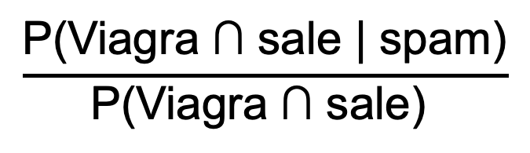
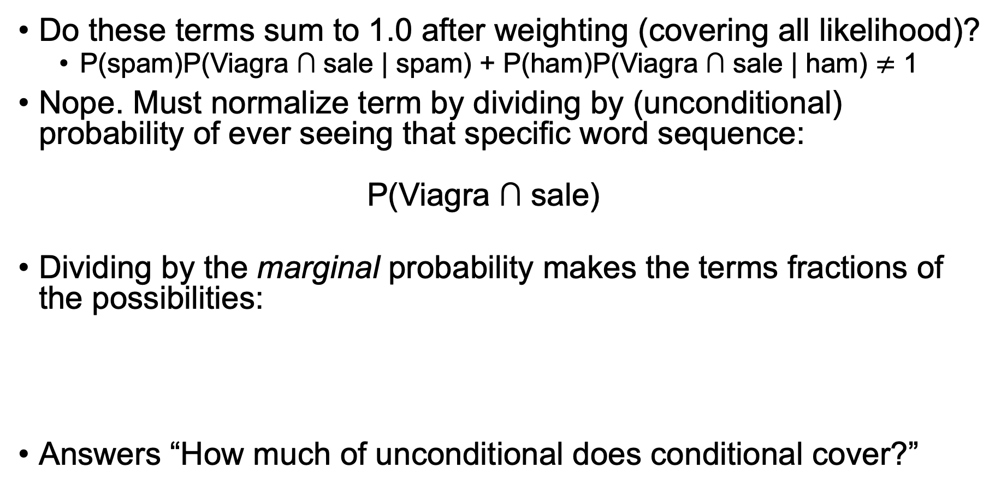
Are these computations probabilities?
Do these terms sum to 1.0 after weighting (covering all likelihood)?
P(spam)P(Viagra ∩ sale | spam) + P(ham)P(Viagra ∩ sale | ham) $≠$ 1
Nope. Must normalize term by dividing by (unconditional) probability of ever seeing that specific word sequence: $\text{P}\text{(}\text{Viagra}\text{ ∩ }\text{sale}\text{)}$
Dividing by the marginal probability makes the terms fractions of the possibilities:
Answers “How much of unconditional does conditional cover?”
Imagine P(spam) = P(ham) = 0.5 and .7 for conditional probabilities, sum is 0.7!=1
$$\frac{\text{P}\text{(}\text{Viagra}\text{ ∩ }\text{sale}\text{ | }\text{spam}\text{)}}{\text{P}\text{(}\text{Viagra}\text{ ∩ }\text{sale}\text{) }}$$

Slide 9
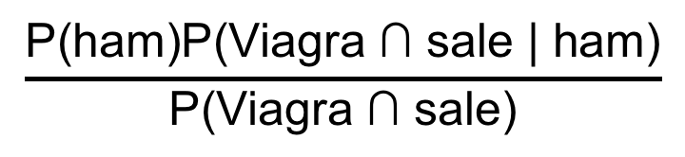
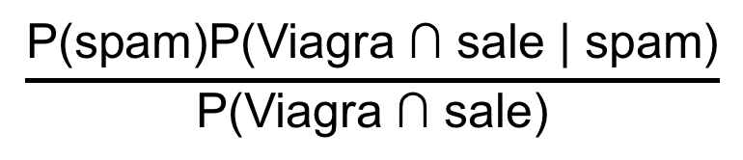
Yay! You’ve just reinvented Bayes Theorem
Normalized likelihood decision rule:
Says how to adjust a priori knowledge of spam rate with tweet content evidence
$$\frac{\text{P}\text{(}\text{spam}\text{)}\text{P}\text{(}\text{Viagra}\text{ ∩ }\text{sale}\text{ | }\text{spam}\text{)}}{\text{P}\text{(}\text{Viagra}\text{ ∩ }\text{sale}\text{)}}$$
>
$$\frac{\text{P}\text{(}\text{ham}\text{)}\text{P}\text{(}\text{Viagra}\text{ ∩ }\text{sale}\text{ | }\text{ham}\text{)}}{\text{P}\text{(}\text{Viagra}\text{ ∩ }\text{sale}\text{)}}$$
<

Slide 10
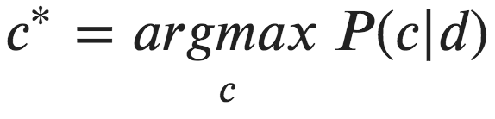
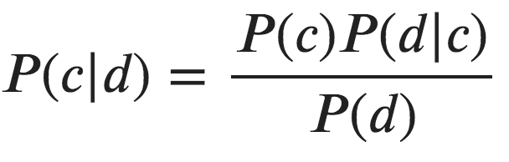
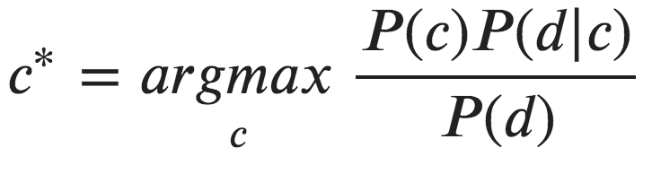
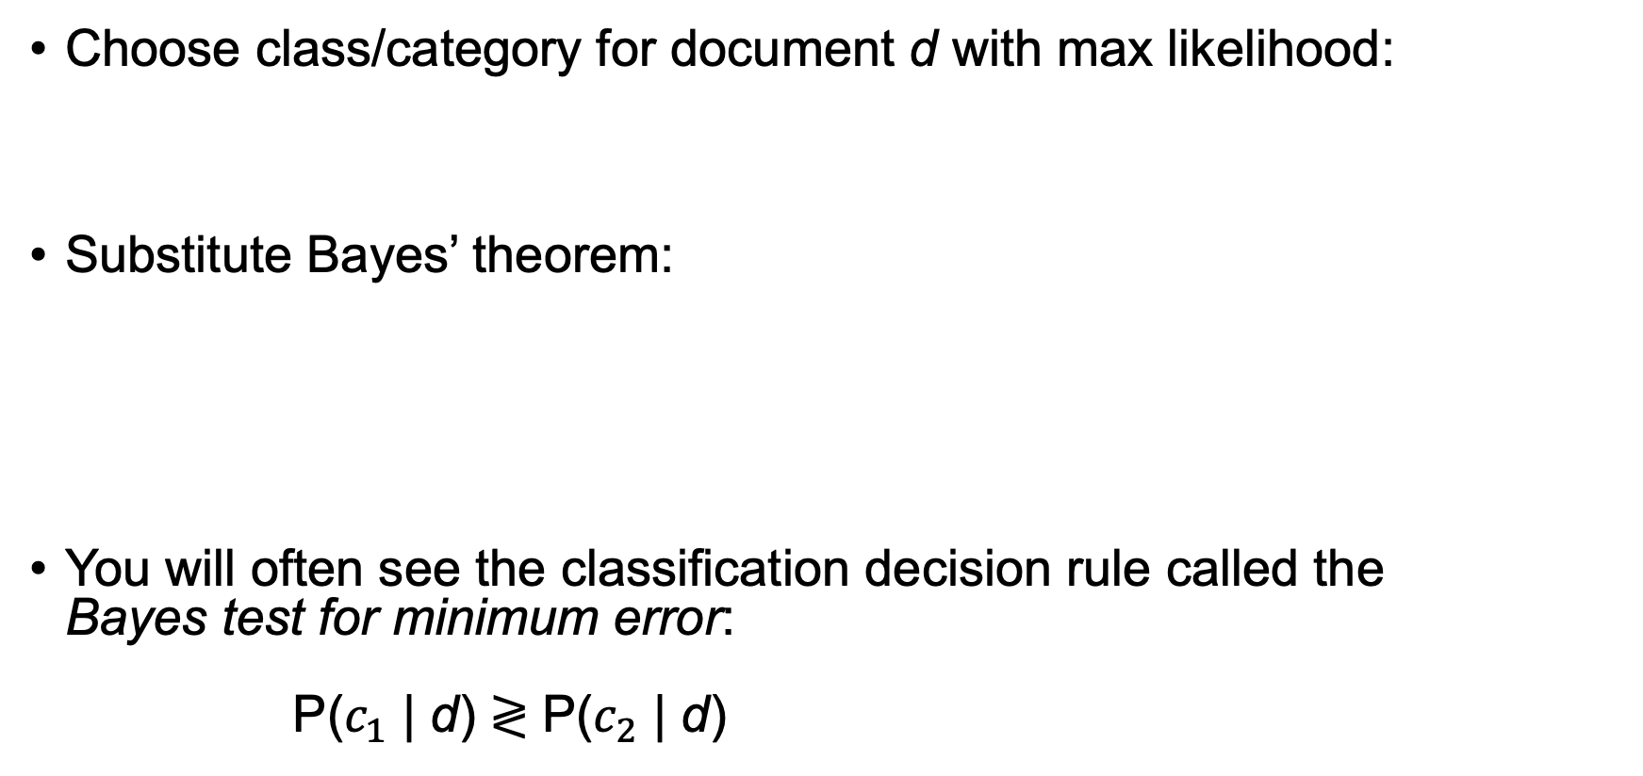
Maximum a posteriori classifier
Choose class/category for document d with max likelihood:
Substitute Bayes’ theorem:
You will often see the classification decision rule called the Bayes test for minimum error: P($c_{1}$ | d) ≷ P($c_{2}$ | d)
Bayes’ theorem

Slide 11
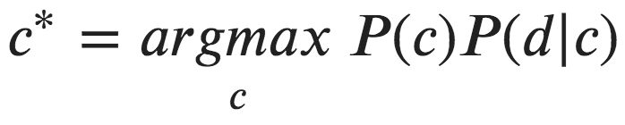
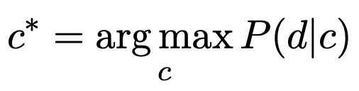
Simplifying the classifier
P(d) is constant on both sides so we can drop it for classification:
If P(c) is same for all c OR we don't know P(c), we drop that too:

Slide 12
Training the classifier
We need to estimate P(c) and P(d | c) for all c and d
Estimating P(c)? The number of documents in class c divided by the total number of documents; e.g., frequency of spam docs
Estimating P(d | c)? E.g., we need P(Viagra ∩ sale | spam)
That means considering all 2-word combinations (bigrams); n-grams grow exponentially with length n!
For 10 word tweet we need to estimate probability of a 10-gram; considering all 10-grams is intractable

Slide 13
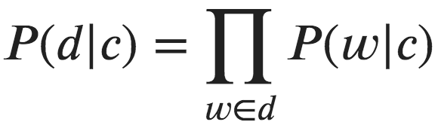
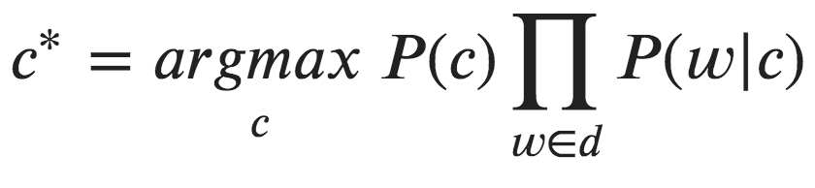
The naïve assumption
Naïve assumption: conditional independence; Estimate P(Viagra ∩ sale | ham) as P(Viagra | ham) x P(sale | ham)
So, our classifier becomes
where w is each word in d with repeats, not V (vocabulary words)

Slide 14
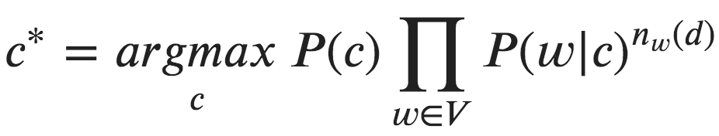
Fixed-length word-count vectors
Rather than arbitrary-length word vectors for each document d, it’s much easier to use fixed-length vectors of size |V| with word counts:
becomes:
(If w not present in document, exponent goes to 0, which drops out P(w|c) for that w)

Slide 15
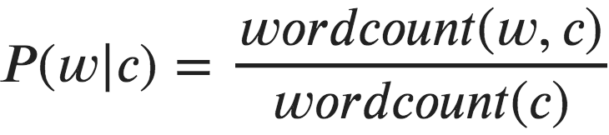
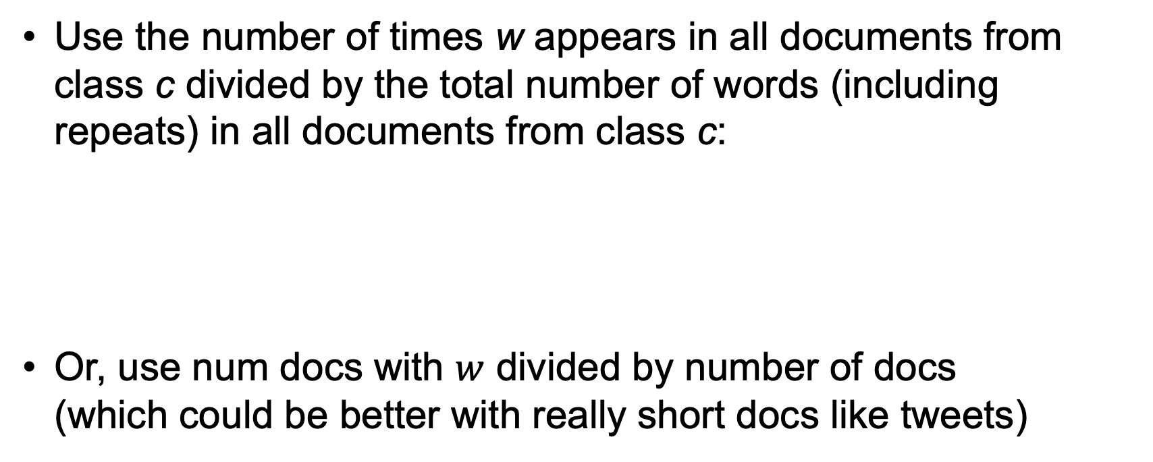
Estimating P(w | c)
Use the number of times w appears in all documents from class c divided by the total number of words (including repeats) in all documents from class c:
Or, use num docs with $w$ divided by number of docs (which could be better with really short docs like tweets)

Slide 16
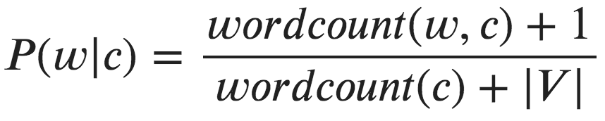
What if w never used in docs of class c? Laplace smoothing
If P(w | c) = 0 then the entire product goes to zero. Ooops!
To avoid, add 1 to each word count in numerator and compensate by adding |V| to denominator (to keep a probability)
(We have added +1 to each word count in V and there are |V| words in each word-count vector)

Slide 17
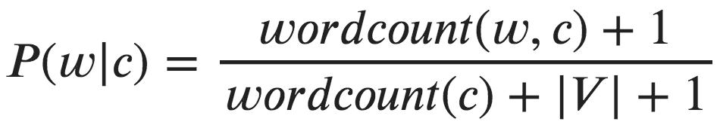
Dealing with “mispeled” or unknown words
Laplace smoothing deals with w that is in the vocabulary V but not in class c: i.e., when P(w | c) = 0 such as P(viagra|ham)=0
What should wordcount(w,c) be for a word not in V when classifying new doc? Zero doesn’t seem right; OTOH, if wordcount(w,c)=0 for all classes, classifier is not biased
Instead: map all unknown w to a wildcard word in V so then wordcount(unknown,c)=0 is ok but |V| is 1 word longer
Likely not a huge factor…
Store count of unknown words in word vector at index 0; the wordcount(unknown,c) is same for all c so not biased
Likelihood of any unknown word is small: 1 / (wordcount(c) + |V| + 1)

Slide 18
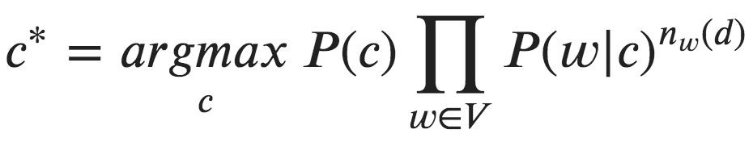
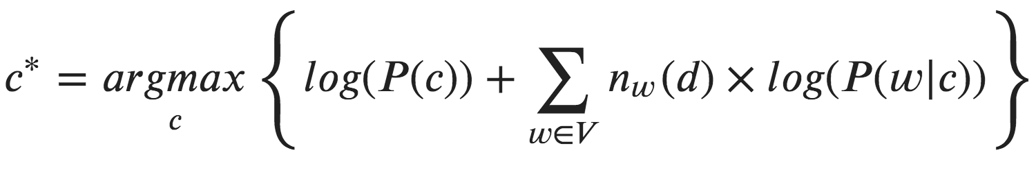
Avoiding floating point underflow
In practice, multiplying lots of probabilities in [0,1] range tends to get too small to represent with finite floating-point numbers
Take log (a monotonic function) and product becomes summation

Slide 19
An example

Slide 20
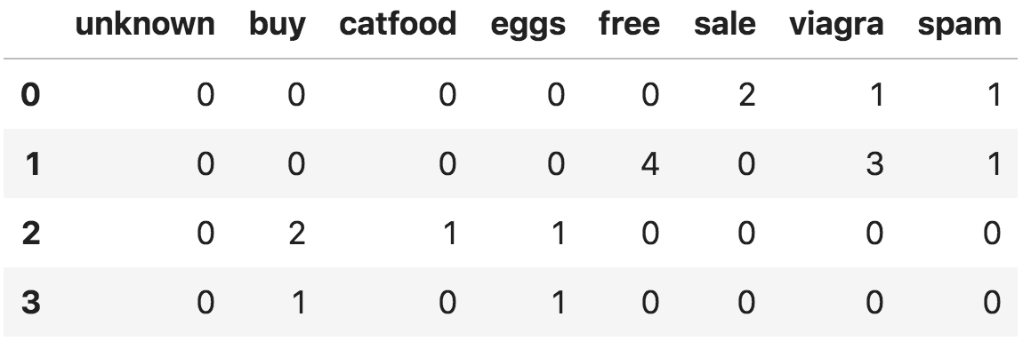
Documents as word-count vectors
One column per vocab word, one row per document
d1 = "sale viagra sale"
d2 = "free viagra free viagra free viagra free"
d3 = "buy catfood, buy eggs"
d4 = "buy eggs"
Priors: P(spam) = 2/4
P(ham) = 2/4
column for
unknown
words
X matrix
spam or ham
Note: |V|=6
+1 for unknown
Document

Slide 21
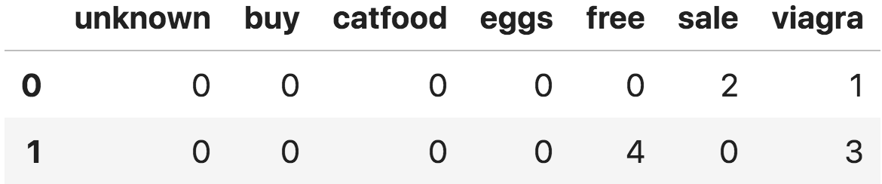
Estimating probabilities: P(w | spam)
1st, get total word count in spam category: sum across rows or cols then sum that result
wordcount(spam) =
spam.sum(axis=1).sum()
spam
3
7
wordcount(spam) =
10

Slide 22
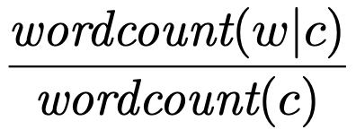
Estimating probabilities: P(w | spam)
2nd, get total count for each word in spam docs, wordcount(w,spam)
spam
0 0 0 4 2 4
10
10
10
10
10
10

Slide 23
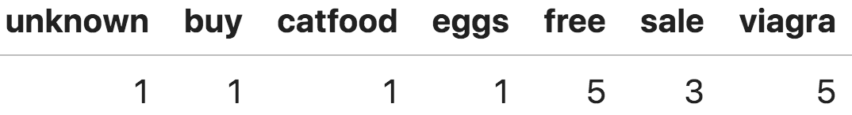
Estimating probabilities: P(w | spam)
3rd, compute P(w|spam) w/smoothing & unknown word adjustment
wordcount(w,spam) + 1 =
wordcount(spam)+|V|+1 = 10+6+1=17
P(w | spam) →

Slide 24
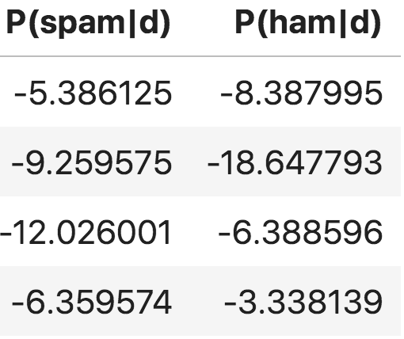
Estimate P(c|w) w/o P(d) normalization
Dot product of X matrix with log of P(w|c) vector, add log(P(c))
log(0.5) + 1*log(0.294118) + 2*log(0.176471)
d1 = "sale viagra sale”
d2 = "free viagra free viagra free viagra free"
d3 = "buy catfood and buy eggs"
d4 = "buy eggs"

Slide 25
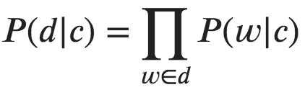
Key takeaways
Naïve bayes is classifier applied to text classification; e.g., spam/ham, topic labeling, etc…
Less often used these days with rise of deep learning
Fixed-length "bag of words" vectors are the feature vector per doc
Bayes theorem gives formula for P(c|d)
Naïve assumption is conditional independence
Training estimates P(c), P(w|c) for each w and c
P(c) is ratio of docs in c to overall number of docs
P(w|c) is ratio of word count of w in c to total word count in c
Classifier:

Slide 26
Implementation takeaways
Avoid vanishing floating-point values from product; take log:
Avoid P(w|c)=0 via Laplace smoothing
add 1 to all word counts
adjust P(w|c) denominator with |V| since every doc now has every word
this is for missing words where w not in c but in V
Treat test doc words w not in V, unknown words, as likelihood: 1 / (wordcount(c) + |V| + 1)

Slide 27
Lab time
Exploring Naïve Bayes https://github.com/parrt/msds621/blob/master/labs/bayes/naive-bayes.ipynb

