Slide 1
Intro to non-parametric machine learning models
Terence Parr
MSDS program University of San Francisco

Slide 2
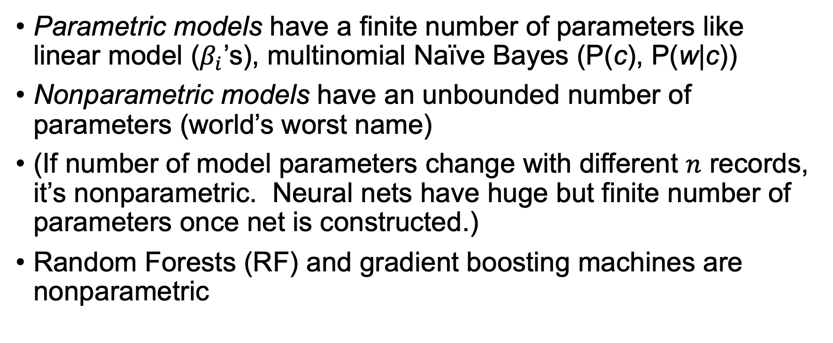
We’ve been studying parametric models
Parametric models have a finite number of parameters like linear model ($β_{i}$’s), multinomial Naïve Bayes (P(c), P(w|c))
Nonparametric models have an unbounded number of parameters (world’s worst name)
(If number of model parameters change with different $n$ records, it’s nonparametric. Neural nets have huge but finite number of parameters once net is constructed.)
Random Forests (RF) and gradient boosting machines are nonparametric
🤪

Slide 3
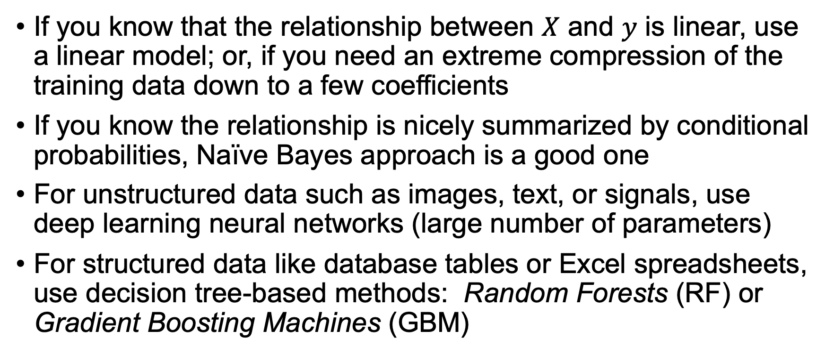
General advice for choosing a model
If you know that the relationship between $X$ and $y$ is linear, use a linear model; or, if you need an extreme compression of the training data down to a few coefficients
If you know the relationship is nicely summarized by conditional probabilities, Naïve Bayes approach is a good one
For unstructured data such as images, text, or signals, use deep learning neural networks (large number of parameters)
For structured data like database tables or Excel spreadsheets, use decision tree-based methods: Random Forests (RF) or Gradient Boosting Machines (GBM)

Slide 4
Some basic structured data modeling advice
That “choosing model” advice is solid in practice and reduces the number of models you need to study and understand (e.g., you can ignore SVM, …)
Remember: good features matter way more than the model
Pick a decent model and then focus on feature engineering
Know the strengths/weaknesses of your model; e.g., random forests don’t extrapolate outside of support region but parametric models tend to extrapolate
Compare your model to a weaker model
Sometimes a simpler model (e.g., linear model) is just as good
Gives a good lower bound on accuracy
Helps identify bugs in your code; e.g., when weaker model is better

Slide 5
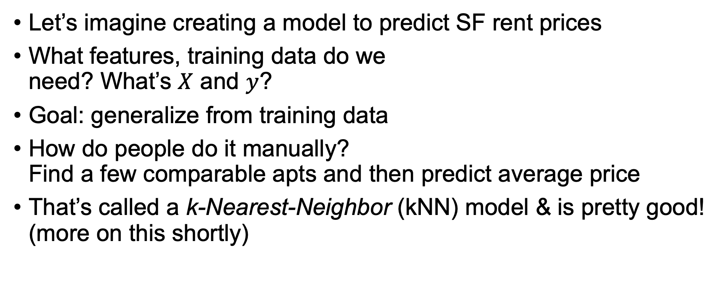
Reinventing machine learning models
Let’s imagine creating a model to predict SF rent prices
What features, training data do we need? What’s $X$ and $y$?
Goal: generalize from training data
How do people do it manually? Find a few comparable apts and then predict average price
That’s called a k-Nearest-Neighbor (kNN) model & is pretty good! (more on this shortly)
See https://mlbook.explained.ai/intro.html

Slide 6
Starting with extreme models
Recall our goal: to build an accurate model without being overly specific to training data
What if we simply memorized the training set? How could we use such a dictionary method to make predictions?
The other extreme would be to compute the average rent price from all apt data, ignoring all features, and make that our sole prediction
How would you describe the differences / tradeoffs between them?
Dictionary has no bias (very accurate) but is not general (only works for training data)
Average is inaccurate (biased) but is very general (applies to any apartment)
Bias-generality tradeoff (bias-variance trade-off)
dict
mean
overfitting = not general

Slide 7
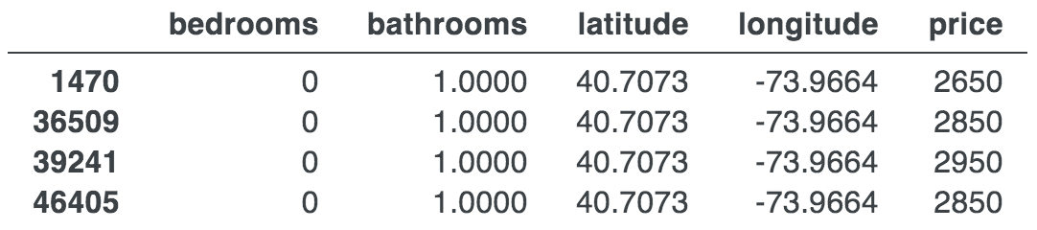
Dealing with uncertainty in target (prices)
Aside from overfitting, what’s wrong with the dictionary method?
It can’t handle multiple prices for identical apt feature vectors
But, prices fluctuate from noise, errors, or exogenous features like square footage, view, proximity to BART, etc…
Which/what price should our decent model return for data below?
Merge identical records, recording mean(y) for prototype

Slide 8
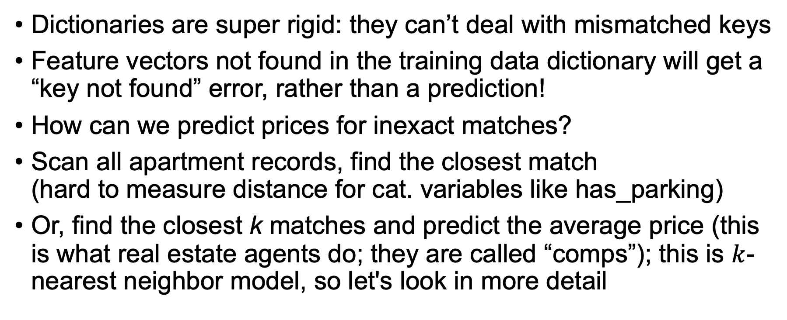
Dealing with inexact feature matches
Dictionaries are super rigid: they can’t deal with mismatched keys
Feature vectors not found in the training data dictionary will get a “key not found” error, rather than a prediction!
How can we predict prices for inexact matches?
Scan all apartment records, find the closest match (hard to measure distance for cat. variables like has_parking)
Or, find the closest k matches and predict the average price (this is what real estate agents do; they are called “comps”); this is $k$-nearest neighbor model, so let's look in more detail

Slide 9
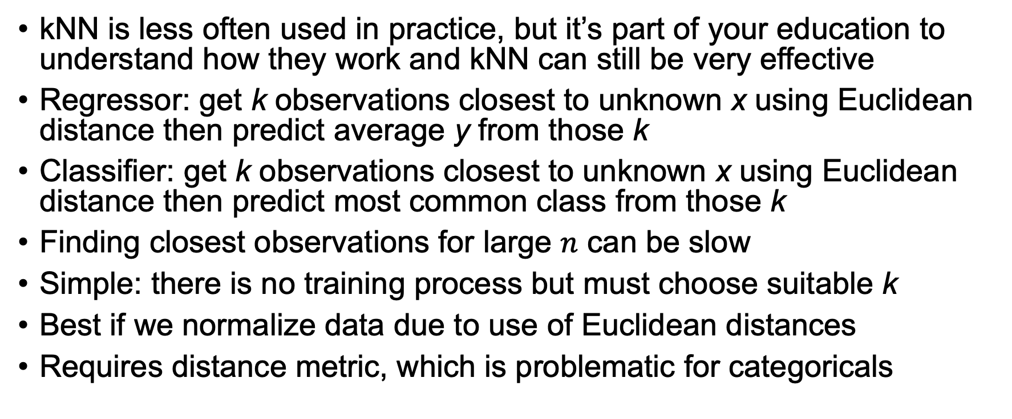
Detour: k-nearest neighbors (kNN)
kNN is less often used in practice, but it’s part of your education to understand how they work and kNN can still be very effective
Regressor: get k observations closest to unknown x using Euclidean distance then predict average y from those k
Classifier: get k observations closest to unknown x using Euclidean distance then predict most common class from those k
Finding closest observations for large $n$ can be slow
Simple: there is no training process but must choose suitable k
Best if we normalize data due to use of Euclidean distances
Requires distance metric, which is problematic for categoricals
See p14 in ESLII book

Slide 10
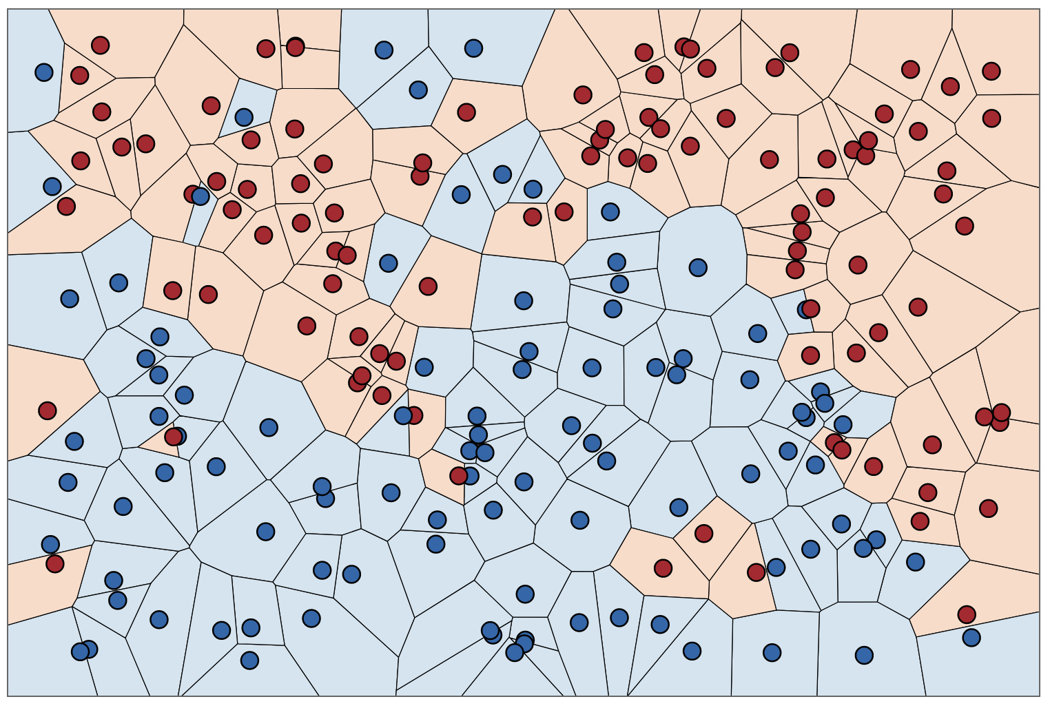
Sample kNN models
1D k=3 regressor
2D k=1 classifier
Classifier image credit: http://scott.fortmann-roe.com/docs/BiasVariance.html
Note: kNN regressors can’t extrapolate

Slide 11
From kNN to decision trees

Slide 12
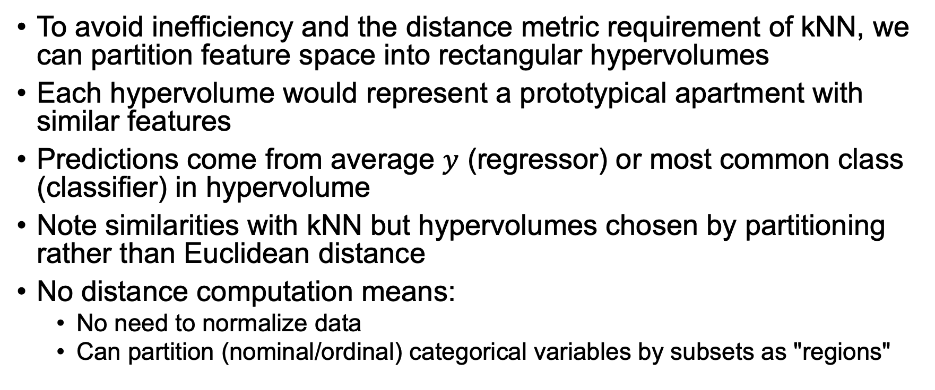
Feature space partitioning in rectangular hypervolumes not distance
To avoid inefficiency and the distance metric requirement of kNN, we can partition feature space into rectangular hypervolumes
Each hypervolume would represent a prototypical apartment with similar features
Predictions come from average $y$ (regressor) or most common class (classifier) in hypervolume
Note similarities with kNN but hypervolumes chosen by partitioning rather than Euclidean distance
No distance computation means:
No need to normalize data
Can partition (nominal/ordinal) categorical variables by subsets as "regions"

Slide 13
Example partitioning rules
The goal is to split each feature into as many ranges as necessary to get accuracy but w/o creating so many tight regions we kill generality by overfitting to training data
Rules for partitioning might look like:
if bedrooms == 1 and bathrooms == 1.0 and \
latitude >= 40.6661 and latitude <= 40.6663 and \
longitude >= -73.9882 and longitude <= -73.9402:
price = 2143 # average of apts in that range
if bedrooms == 2 and bathrooms == 1.0 and \
latitude >= 40.6661 and latitude <= 40.6663 and \
longitude >= -73.9882 and longitude <= -73.9402:
price = 2462 # average of apts in that range
Predict by testing rules until we find a match and get a price

Slide 14
Partitioning rules--prediction efficiency
Unlike a dictionary, partitioning rules automatically:
handle multiple identical apartments with different prices
can make predictions for previously unseen feature combinations
The number of feature ranges or “splits” tested by the model are a kind of a bias-generality “knob” we can turn up or down
Potentially it’s very slow walking through many partitioning rules, so factor / nest the IF-rules to avoid redundant tests
if bathrooms == 1.0:
if latitude >= 40.6661 and latitude <= 40.6663 and \
longitude >= -73.9882 and longitude <= -73.9402:
if bedrooms == 1:
price = 2143
elif bedrooms == 2:
price = 2462
if …

Slide 15
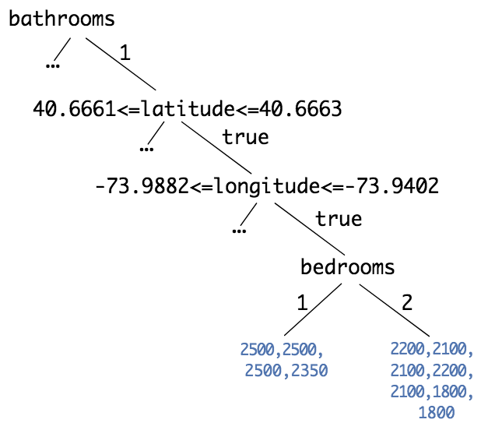
Encoding partitioning rules as a tree
Can encode those nested rules as tree data structure
Internal nodes perform feature comparisons, leaves make predictions
Leaves contain prices for all apts fitting criteria on path from root down to that leaf
Leaves represent feature-hypervolumes
These are called decision trees
By testing same feature many times, can carve up feature space arbitrarily tightly
Training finds feature & value to test in each decision node (and when to stop splitting feature space)

Slide 16
From decision trees to random forests

Slide 17
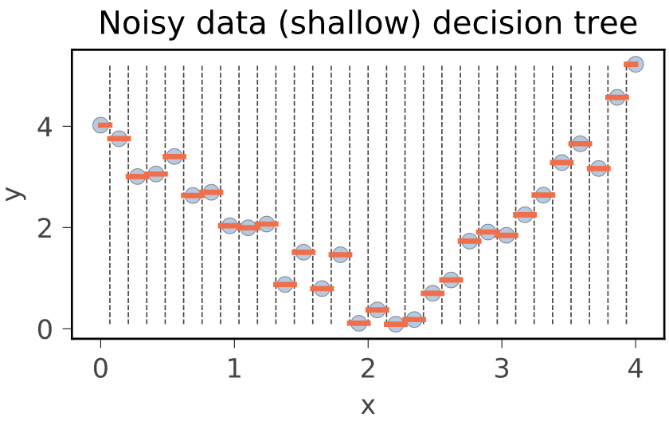
The problem with decision trees
Decision trees overfit like crazy to the training data
By default, they split feature space until each leaf has a single observation (apartment in this case); that is precise like dictionary but does not generalize very well
We can control overfitting partially by requiring a min number of observations for leaf or restricting tree height
A single-node decision tree degenerates to our extreme model that predicts the mean

Slide 18
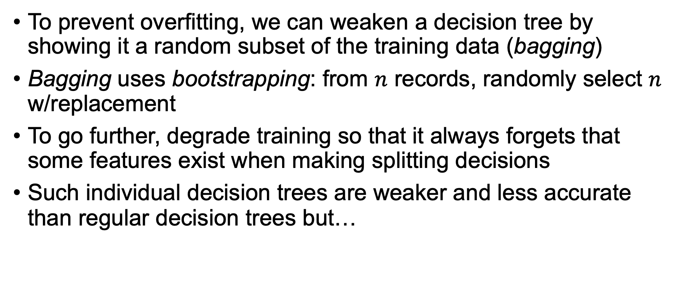
Randomness is your friend
To prevent overfitting, we can weaken a decision tree by showing it a random subset of the training data (bagging)
Bagging uses bootstrapping: from $n$ records, randomly select $n$ w/replacement
To go further, degrade training so that it always forgets that some features exist when making splitting decisions
Such individual decision trees are weaker and less accurate than regular decision trees but…

Slide 19
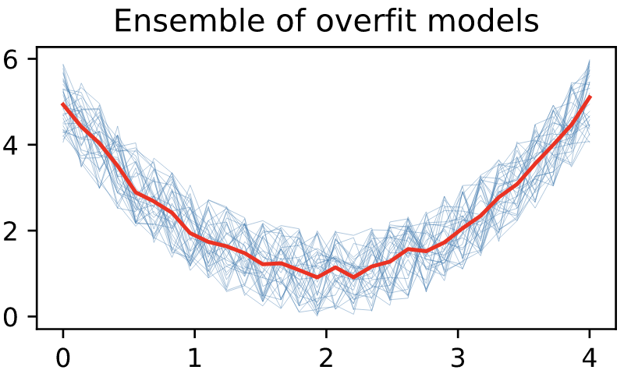
Random Forest (RF) regressors
To compensate for weaker learners, we can create lots of them
Take the average of their predictions to get overall prediction
This is called ensemble learning and is an excellent technique to increase accuracy without a tendency to overfit
RFs are crowd-sourcers; analogous to group of real estate agents looking for comparable apartments, and cooperating to estimate apartment price
During training, agents independently select and visit apts
Randomize to avoid visiting, say, only 1-bedroom apts
Agents find different apt subsets with some overlap

Slide 20
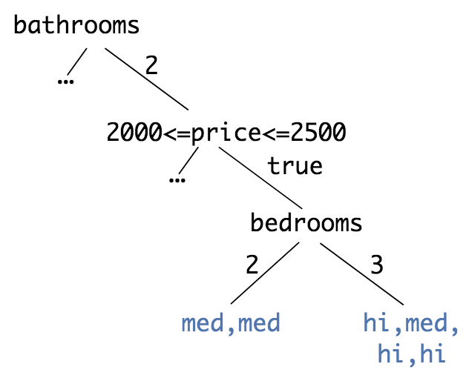
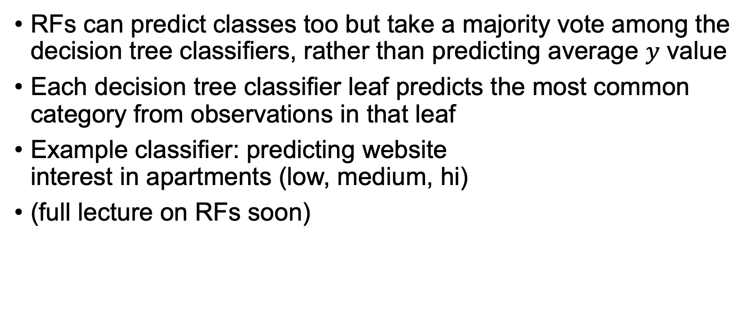
RF classifiers
RFs can predict classes too but take a majority vote among the decision tree classifiers, rather than predicting average $y$ value
Each decision tree classifier leaf predicts the most common category from observations in that leaf
Example classifier: predicting website interest in apartments (low, medium, hi)
(full lecture on RFs soon)

Slide 21
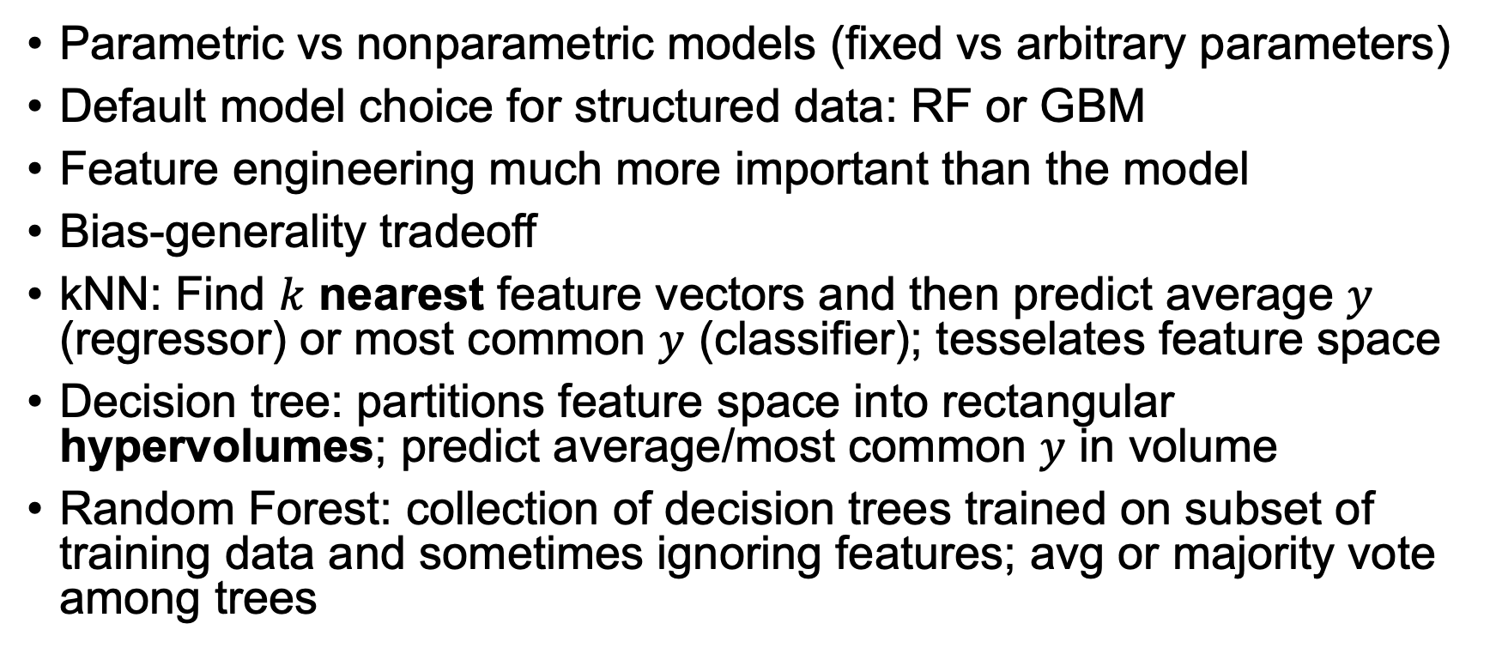
Key takeaways
Parametric vs nonparametric models (fixed vs arbitrary parameters)
Default model choice for structured data: RF or GBM
Feature engineering much more important than the model
Bias-generality tradeoff
kNN: Find $k$ nearest feature vectors and then predict average $y$ (regressor) or most common $y$ (classifier); tesselates feature space
Decision tree: partitions feature space into rectangular hypervolumes; predict average/most common $y$ in volume
Random Forest: collection of decision trees trained on subset of training data and sometimes ignoring features; avg or majority vote among trees

