Slide 1
Fundamentals of deep learning
Crash course in using PyTorch to train models
Terence Parr
MSDS program University of San Francisco

Slide 2
Deep learning regressors

Slide 3
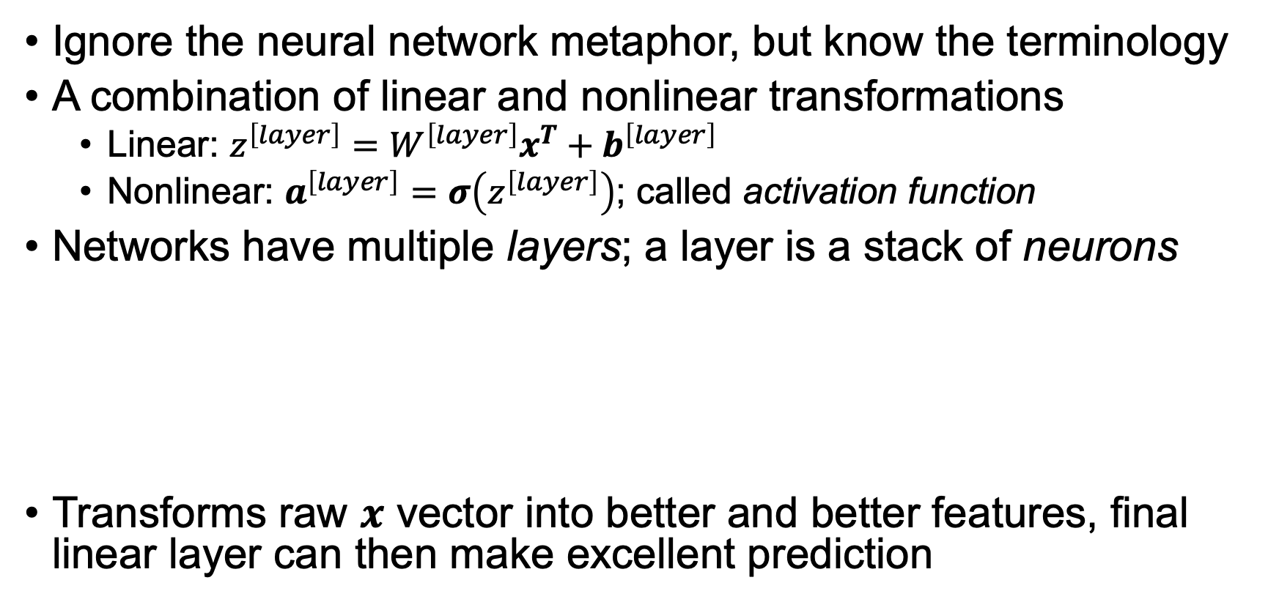
What's a neural network?
Ignore the neural network metaphor, but know the terminology
A combination of linear and nonlinear transformations
Linear: $z^{\left[layer\right]}=W^{\left[layer\right]}x^{T}+b^{\left[layer\right]}$
Nonlinear: $a^{\left[layer\right]}=σ\left(z^{\left[layer\right]}\right)$; called activation function
Networks have multiple layers; a layer is a stack of neurons
Transforms raw $x$ vector into better and better features, final linear layer can then make excellent prediction

Slide 4


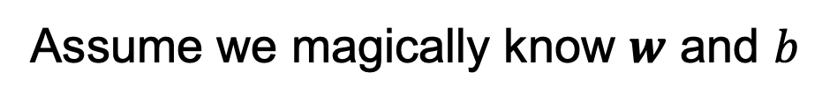
DL Building blocks
linear
sigmoid
ReLU (rectified linear unit)
$\hat{y}=w_{1}x_{1}+w_{2}x_{2}+ …+w_{m}x_{m}+b=wx^{T}+b$ for $n$ x $m$ dim $X$
Linear/logistic regression equivalents (one $x$ instance):
$m=1$ case
Regressor
Regressor
Two-class Classifier
Underfitting a bit here
(need more of a quadratic)
Assume we magically know $w$ and $b$
(For simplicity, I'm using proper $wx^{T}$ in math but omitting transpose in diagrams)

Slide 5


Try adding layers to get more power
But, sequence of linear models is just a linear model ($w′$ is scalar since $wx^{T}+b$ is scalar)
PyTorch code
$m=1$ case
model = nn.Sequential(
nn.Linear(m, 1), # m features
nn.Linear(1, 1)
)
Still just a line

Slide 6
Must introduce nonlinearity
model = nn.Sequential(
nn.Linear(m, 1),
nn.ReLU(),
nn.Linear(1, 1)
)
ReLU idea here: Draw two lines then clip at intersection

Slide 7



Stack linear models (neurons) for more power
Stack gives layer: $W$ matrix and $b$
$a^{\left[1\right]}=relu\left(W^{\left[1\right]}x^{T}+b^{\left[1\right]}\right)$
$ŷ={a^{\left[2\right]}=W}^{[2]}a^{\left[1\right]}+b^{[2]}$
model = nn.Sequential(
nn.Linear(m, 5),
nn.ReLU(),
nn.Linear(5, 1)
)
All those $w$ and $b$ are different
$W^{\left[1\right]}$ means $W$ for layer 1

Slide 8
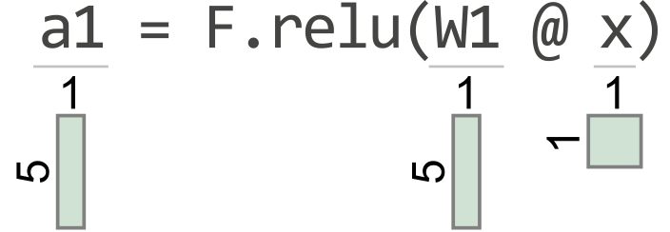
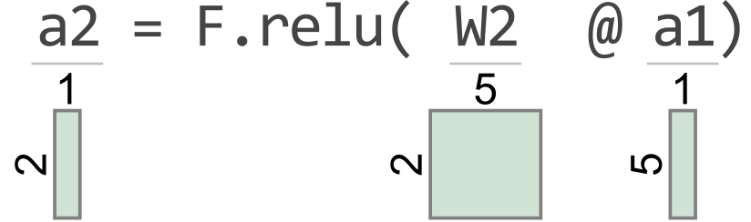
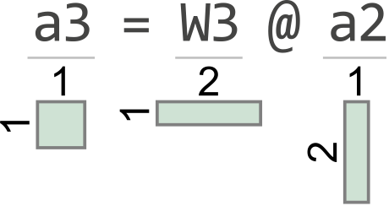

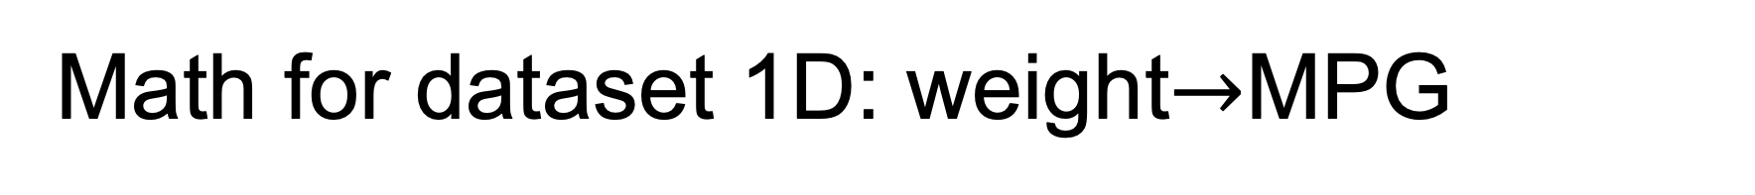

Math for dataset 1D: weight$→$MPG
(leaving out $b$'s)
$m=1$ case
model = nn.Sequential(
nn.Linear(1, 5),
nn.ReLU(),
nn.Linear(5, 2),
nn.ReLU(),
nn.Linear(2, 1)
)
(courtesy of TensorSensor)
https://explained.ai/tensor-sensor/index.html

Slide 9
Too much strength can lead to overfitting
Models with too many parameters will overfit easily, if we train a long time
We'll look at regularization later
model = nn.Sequential(
nn.Linear(1, 1000),
nn.ReLU(),
nn.Linear(1000, 1)
)

Slide 10
Classifiers

Slide 11
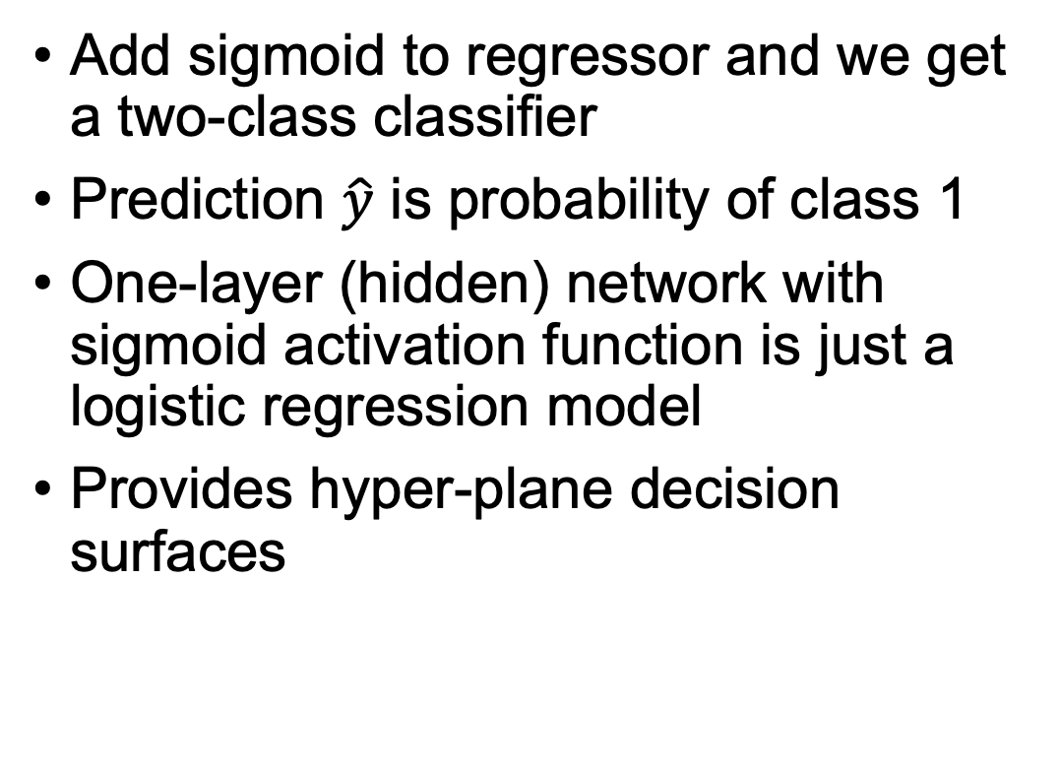

Binary classifiers
Add sigmoid to regressor and we get a two-class classifier
Prediction $\hat{y}$ is probability of class 1
One-layer (hidden) network with sigmoid activation function is just a logistic regression model
Provides hyper-plane decision surfaces
$m=2$ case
# 2 input vars: proline, alcohol model = nn.Sequential(
nn.Linear(2, 1),
nn.Sigmoid(),
)
Probability surface plot courtesy of https://github.com/parrt/dtreeviz

Slide 12
Stack neurons and add layer
See https://github.com/parrt/msds621/blob/master/notebooks/deep-learning/4.binary-classifier-wine.ipynb
We get a nonlinear decision surface
model = nn.Sequential(
nn.Linear(2, 3),
nn.Sigmoid(),
nn.Linear(3, 1),
nn.Sigmoid()
)
All those $w$ and $b$ are different

Slide 13
More neurons: more complex decision surface
model = nn.Sequential(
nn.Linear(2, 10),
nn.Sigmoid(),
nn.Linear(10, 1),
nn.Sigmoid()
)
Likely overfit
Not only more complex than hyperplane but non-contiguous regions!

Slide 14
Even ReLUs can get "curvy" surfaces
model = nn.Sequential(
nn.Linear(2, 10),
nn.ReLU(),
nn.Linear(10, 10),
nn.ReLU(),
nn.Linear(10, 1),
nn.Sigmoid()
)
(Last activation function still must be sigmoid for classifier)

Slide 15
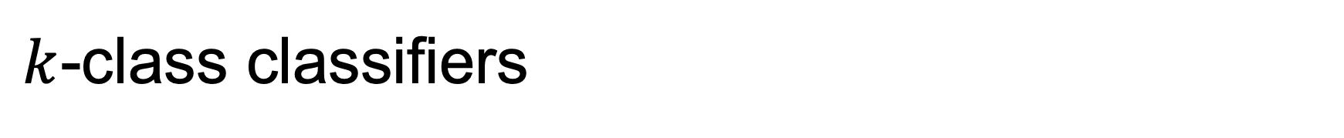
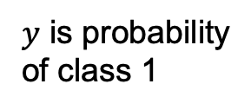
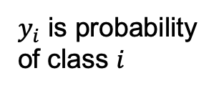
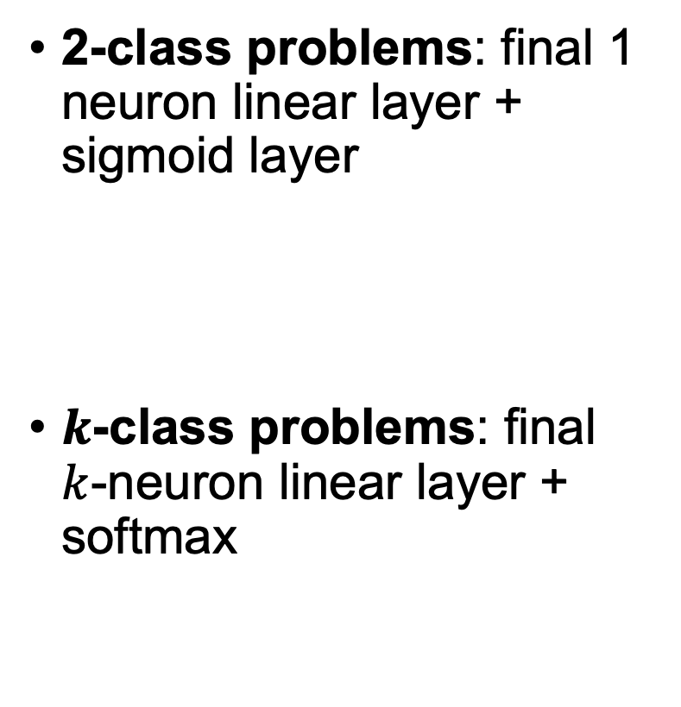
$k$-class classifiers
$y$ is probability
of class 1
2-class problems: final 1 neuron linear layer + sigmoid layer
$k$-class problems: final $k$-neuron linear layer + softmax
$y_{i}$ is probability
of class $i$

Slide 16
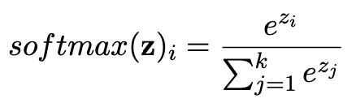
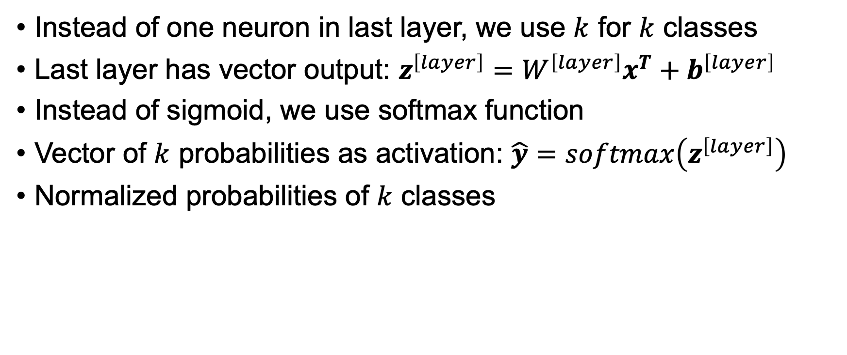
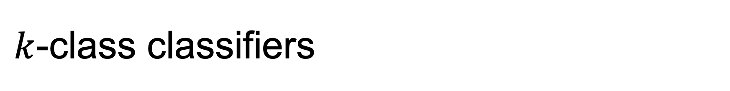
$k$-class classifiers
Instead of one neuron in last layer, we use $k$ for $k$ classes
Last layer has vector output: $z^{\left[layer\right]}=W^{\left[layer\right]}x^{T}+b^{\left[layer\right]}$
Instead of sigmoid, we use softmax function
Vector of $k$ probabilities as activation: $\hat{y}=softmax\left(z^{\left[layer\right]}\right)$
Normalized probabilities of $k$ classes

Slide 17
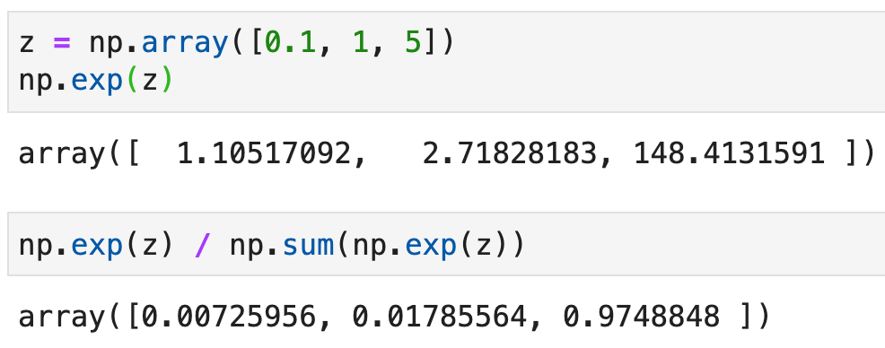

Sample softmax computation
For layer output vector $z$:

Slide 18
Training deep learning networks

Slide 19
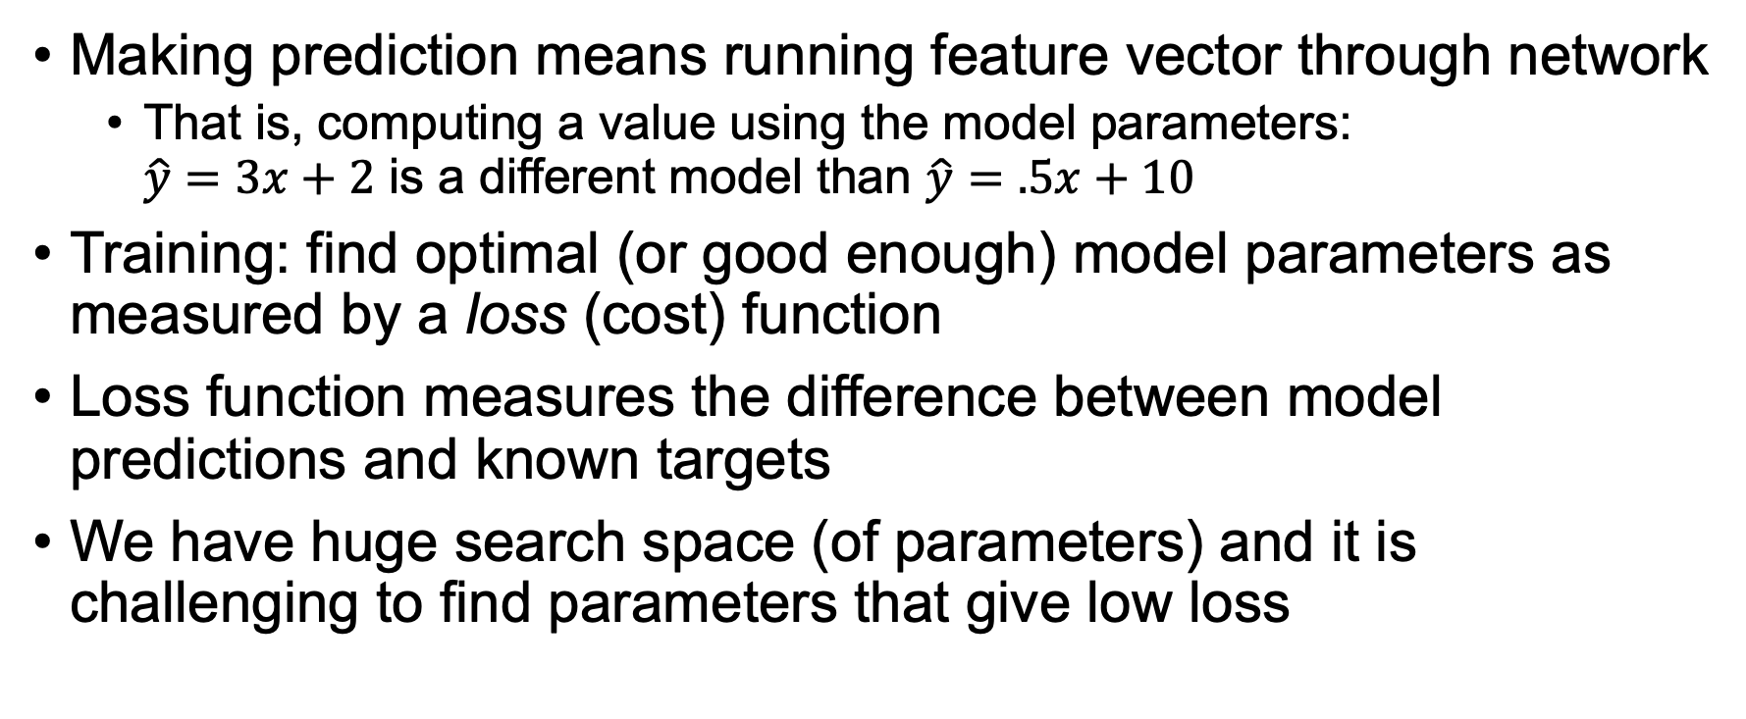
What does training mean?
Making prediction means running feature vector through network
That is, computing a value using the model parameters: $\hat{y}=3x+2$ is a different model than $\hat{y}=.5x+10$
Training: find optimal (or good enough) model parameters as measured by a loss (cost) function
Loss function measures the difference between model predictions and known targets
We have huge search space (of parameters) and it is challenging to find parameters that give low loss

Slide 20
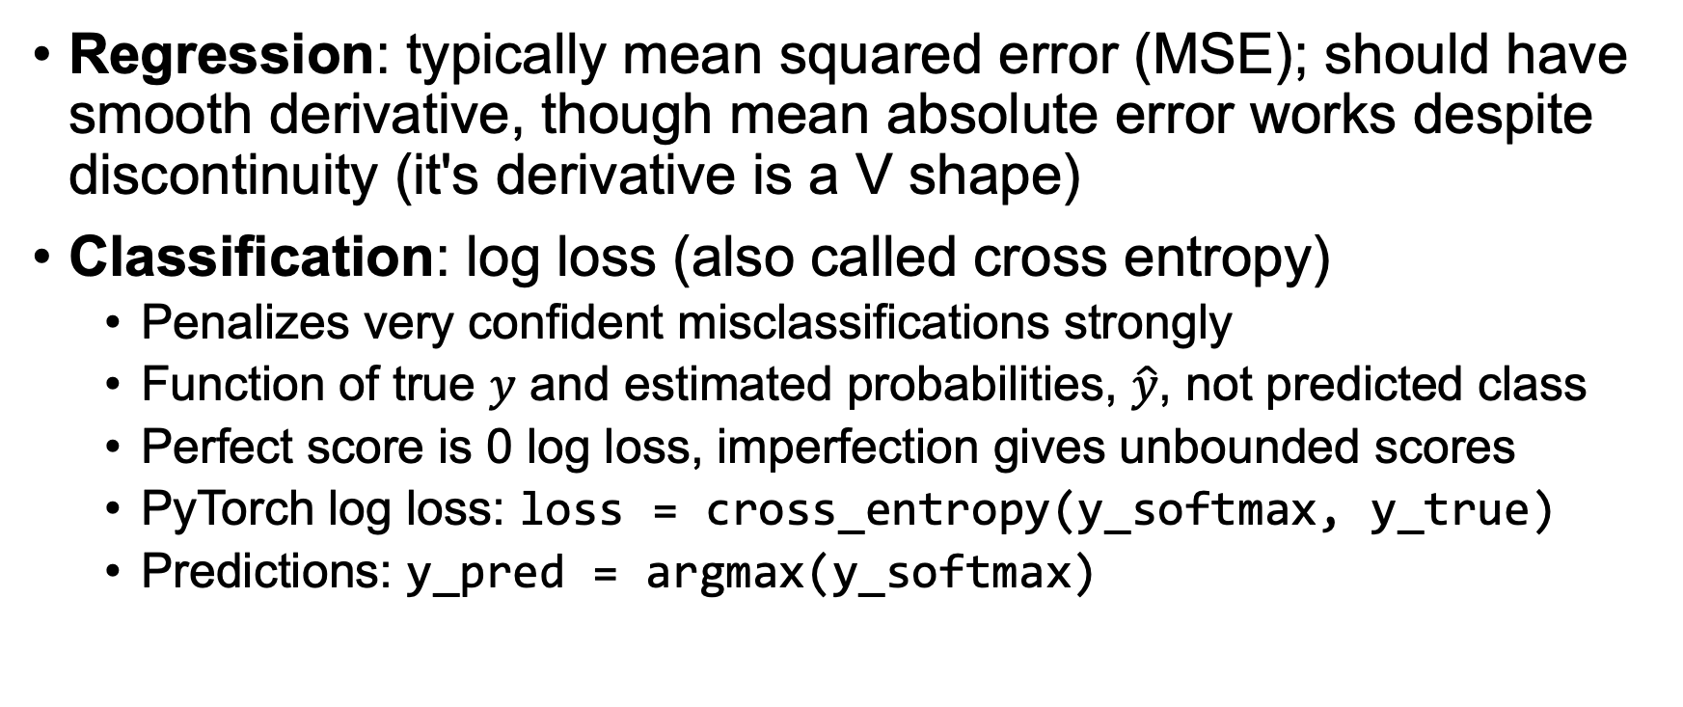
Refresher: Loss functions
Regression: typically mean squared error (MSE); should have smooth derivative, though mean absolute error works despite discontinuity (it's derivative is a V shape)
Classification: log loss (also called cross entropy)
Penalizes very confident misclassifications strongly
Function of true $y$ and estimated probabilities, $\hat{y}$, not predicted class
Perfect score is 0 log loss, imperfection gives unbounded scores
PyTorch log loss: loss = cross_entropy(y_softmax, y_true)
Predictions: y_pred = argmax(y_softmax)

Slide 21
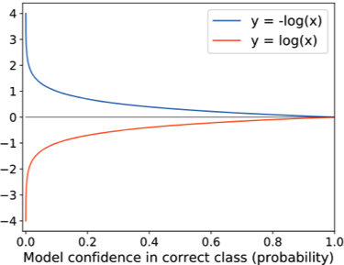
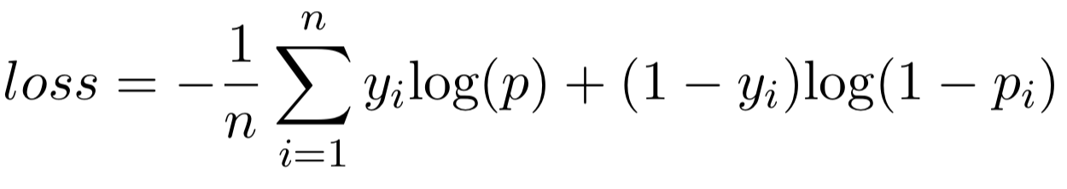

Log loss
penalty(p)
Let p be predicted probability that y=1
loss = penalty(p) if $y$=1 else penalty(1– p)
Let penalty(p) = -log(p)
Two-class log loss:
So log loss is average penalty; penalty is very high
for confidence in wrong answer

Slide 22
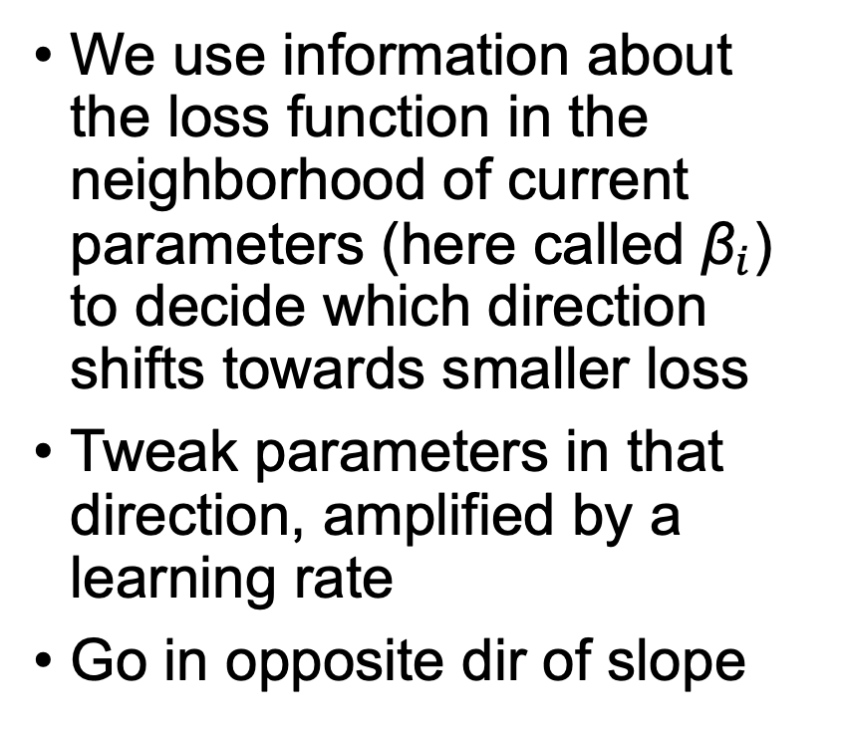
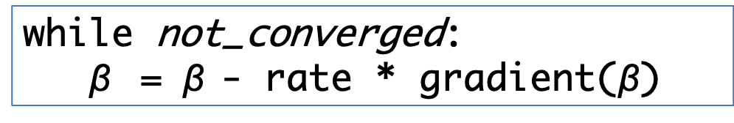
Refresher: Minimize loss with Gradient descent
while not_converged:
$\text{β}$ = $\text{β}$- rate * gradient($\text{β}$)
We use information about the loss function in the neighborhood of current parameters (here called ${\text{β}}_{i}$) to decide which direction shifts towards smaller loss
Tweak parameters in that direction, amplified by a learning rate
Go in opposite dir of slope

Slide 23
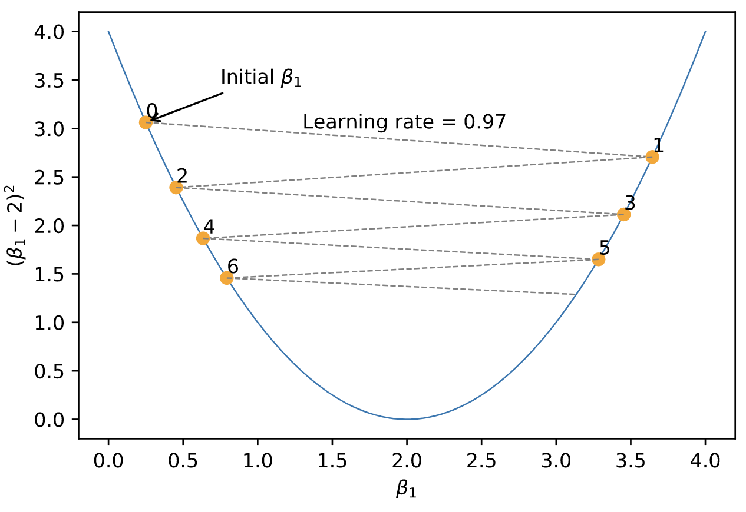
If learning rate is too high?
We oscillate across valleys
It can even diverge, exploding
If too small, we don’t make progress to min

Slide 24
Training process
Prepare data
normalize numeric variables
onehot vars for categoricals
conjure up values for missing values
Split out at least a validation set from training set
Choose network architecture, appropriate loss function
Choose hyper-parameters, such as dropout rate
Choose a learning rate, number of epochs (passes through data)
Run training loop (until validation error goes up or num epochs)
Goto 3, 4, or 5 to tweak; iterate until good enough

Slide 25
Training loop
Regression
Vectorized forward network pass
(send in all instances at once)
for epoch in range(nepochs):
y_train_pred = model(X_train)
loss = MSE(y_train_pred, y_train)
update model parameters in direction of lower loss
Classification
for epoch in range(nepochs):
y_train_pred = model(X_train) # assume softmax final layer
loss = cross_entropy(y_train_pred, y_train)
update model parameters in direction of lower loss

Slide 26
Common train vs validation loss behavior
DL networks have so many parameters, we can often get training error down to zero!
But, we care about generalization
Unfortunately, validation error often tracks away from training error as the number of epochs increases
This model is clearly overfitting
Need to use regularization to improve validation loss

Slide 27
Regularization techniques
Get more training data; can try augmentation techniques (more data is likely to represent population distribution better)
Reduce number of model parameters (i.e., simplify it) (reduce power/ability to fit the noise)
Add drop out layers (randomly kill some neurons)
Weight decay (L2 regularization on model parameters, restrict model parameter search space)
Early stopping, when validation error starts to go up (generally we choose model that yields the best validation error)
Batch normalization has some small regularization effect (Force layer activation distributions to be 0-mean, variance 1)
Stochastic gradient descent tends to land on better generalizations

Slide 28
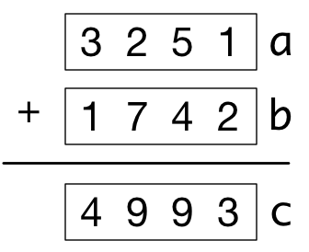
Aside: What is vectorization?
Use vectors not loops
For torch/numpy arrays, we can use vector math instead of a loop: c = a + b
Gives an opportunity to execute vector addition in parallel
for i in range(len(a)):
c[i] = a[i] + b[i]

Slide 29
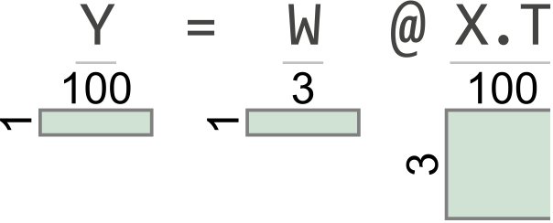
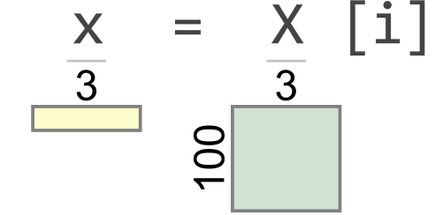
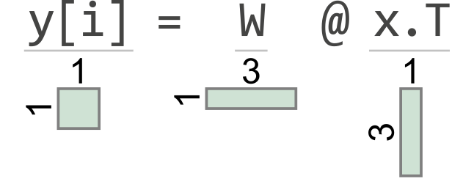

Vectorization in training loop
Running one instance through network is how we think about it
In practice, we send a subset or all $X$ instances through the network in one go and compare all $\hat{y}$ predictions to all $y$
Instead of looping through instances, we pass $X$ through to use matrix-matrix multiplies instead of matrix-vector multiplies
for epoch in range(nepochs):
for i in range(n):
x = X[i]
y[i] = model(x)
…
for epoch in range(nepochs):
Y = model(X)
…
Get 100
answers
Assume n=100, m=3, n_neurons=1 in 1x3 weight matrix W

Slide 30
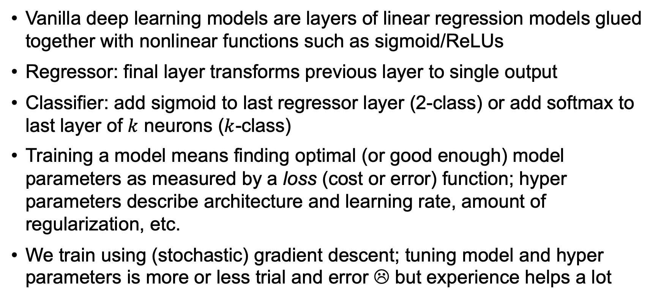
Summary
Vanilla deep learning models are layers of linear regression models glued together with nonlinear functions such as sigmoid/ReLUs
Regressor: final layer transforms previous layer to single output
Classifier: add sigmoid to last regressor layer (2-class) or add softmax to last layer of $k$ neurons ($k$-class)
Training a model means finding optimal (or good enough) model parameters as measured by a loss (cost or error) function; hyper parameters describe architecture and learning rate, amount of regularization, etc.
We train using (stochastic) gradient descent; tuning model and hyper parameters is more or less trial and error ☹ but experience helps a lot

