Slide 1
Song Title Generation
Billy, Fan

Slide 2
Contents
1
Project Goal
2
Approach
3
General Workflow
4
Model Evaluation
5
Edge Cases
6
Lessons Learnt

Slide 3
Project Goals
NLP Summarization:
Build NLG model that generates song titles based on lyrics

Slide 4
Approach
Model 1:
Fine-tuned T5 Transformer Model.
Model 2:
HuggingFace Autotrain Model.

Slide 5
General Workflow
Generate Title
Input data
Pre-processing
Connecting pretrained T5 model head
Training
Architecture
Evaluation
Metric (log loss)

Slide 6
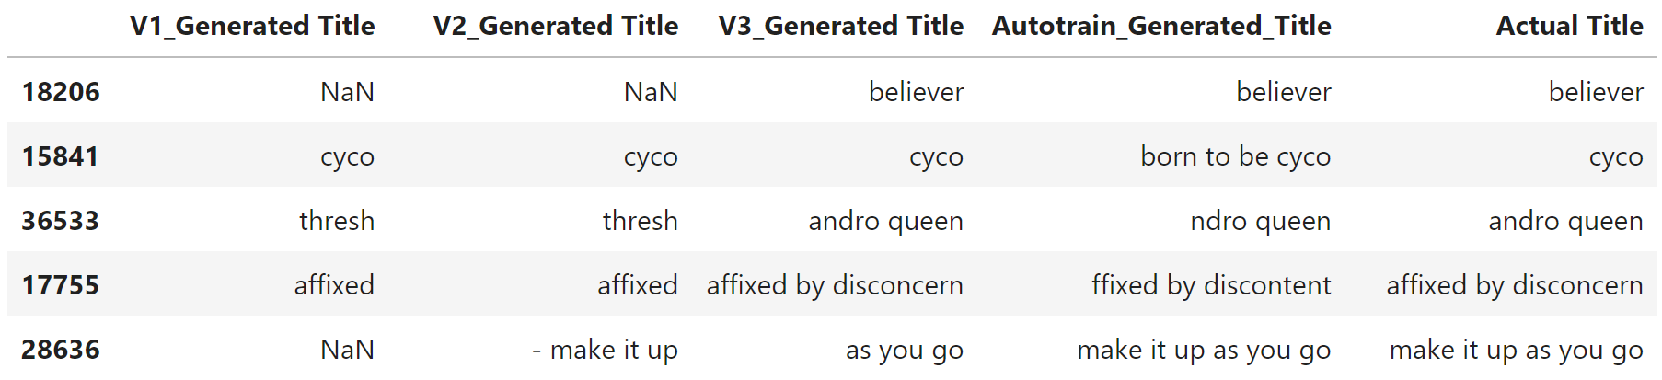
Model Evaluation
1
2
3
4
Fine Tuned T5 Version 1:
Average Fuzzy Wuzzy Score: 29.46.
Fine Tuned T5 Version 2:
Average Fuzzy Wuzzy Score: 40.47.
Fine Tuned T5 Version 3:
Average Fuzzy Wuzzy Score: 59.83.
Hugging Face Autotrain:
Average Fuzzy Wuzzy Score: 67.87.

Slide 7
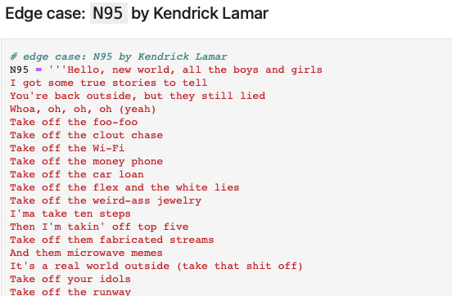
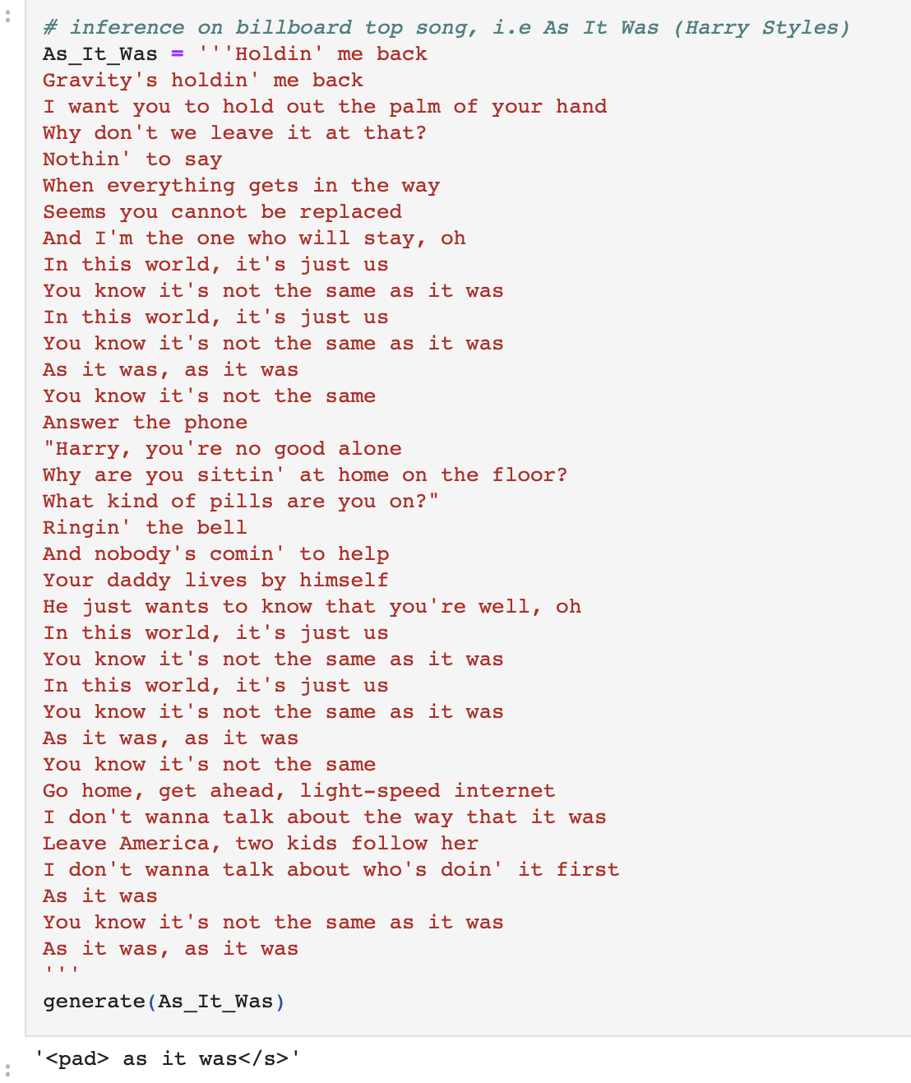
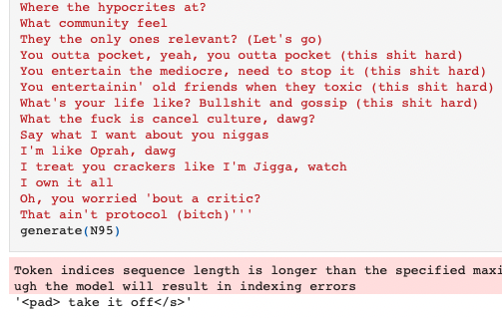
Edge Cases

Slide 8
Lessons Learnt
What Went Well:
Overall results were very promising.
Autotrain Hugging Face Model gave us the best results and was very user friendly.
Problems Faced:
We found it difficult to fine tune our own model (eg. finding the critical parameters with the optimal rate), leading to results which weren’t as good.
Difficulty dealing with edge cases where the song title is not related to the lyrics.

Slide 9
Thank You!

