Slide 1
Song Title Generation
Billy, Fan

Slide 2
Contents
1
Project Goal
2
Approach
3
General Workflow
4
Model Evaluation
5
Edge Cases
6
Lessons Learnt

Slide 3
Project Goals
Task
Build NLG model that generates song titles based on lyrics

Slide 4
Approach
Model 1:
HungingFace Autotrain Model.
Model 2:
Finetuned T5 Transformer Model.

Slide 5
General Workflow
Predict Title
Input data
Pre-processing
Word
Embedding
Training
Architecture
Evaluation
Metric

Slide 6
Model Evaluation
1
2
3
Average Fuzzy Wuzzy Score: 39.09.
35.6% NaN results.
Average Fuzzy Wuzzy Score: 55.19.
6.33% NaN results.
Average Fuzzy Wuzzy Score: 85.11.
0.2% NaN results.

Slide 7
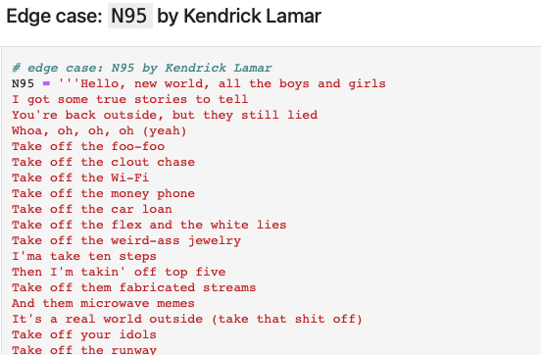
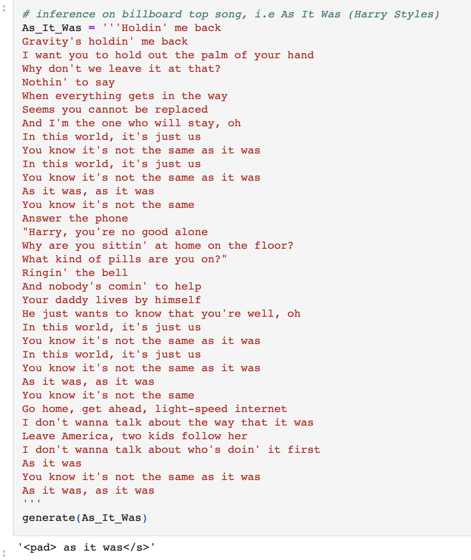
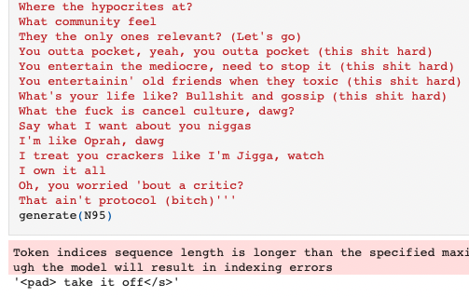
Edge Cases

Slide 8
Lessons Learnt
What Went Well:
Good Results using the Autotrain-Hugging Face Model.
Problems Faced:
We found it difficult to fine tune our own model, leading to results which weren’t as good.

Slide 9
Icons-1

Slide 10
Icons-2

Slide 11
Icons-3

Slide 12
TITLE HERE
At the first God made the heaven and the earth
And the earth was waste and without form; and it was dark on the face of the deep: and the Spirit of God was moving on the face of the waters
And God said, Let there be light: and there was light
At the first God made the heaven and the earth
And the earth was waste and without form; and it was dark on the face of the deep: and the Spirit of God was moving on the face of the waters
And God said, Let there be light: and there was light

Slide 13

TITLE HERE
At the first God made the heaven and the earth
And the earth was waste and without form; and it was dark on the face of the deep: and the Spirit of God was moving on the face of the waters
And God said, Let there be light: and there was light
At the first God made the heaven and the earth
And the earth was waste and without form; and it was dark on the face of the deep: and the Spirit of God was moving on the face of the waters
And God said, Let there be light: and there was light
And the earth was waste and without form; and it was dark on the face of the deep: and the Spirit of God was moving on the face of the waters

Slide 14
TITLE HERE
TEXTHERE
TEXT
TEXT
TEXT
TEXT
And the earth was waste and without form; and it was dark on the face of the deep: and the Spirit of God was moving on the face of the waters
TEXT
And the earth was waste and without form; and it was dark on the face of the deep: and the Spirit of God was moving on the face of the waters

Slide 15
TITLE HERE
TEXT
And God said, Let there be light: and there was light
TEXT
TEXT
And God said, Let there be light: and there was light

Slide 16
TITLE HERE
TEXT
TEXT
And the earth was waste and without form; and it was dark on the face of the deep: and the Spirit of God was moving on the face of the waters
TEXT
And the earth was waste and without form; and it was dark on the face of the deep: and the Spirit of God was moving on the face of the waters
TEXT

Slide 17
TITLE HERE
TEXT
TEXT
And the earth was waste and without form; and it was dark on the face of the deep: and the Spirit of God was moving on the face of the waters
TEXT
And the earth was waste and without form; and it was dark on the face of the deep: and the Spirit of God was moving on the face of the waters
TEXT

Slide 18
TITLE HERE
TEXT
And God said, Let there be light: and there was light
TEXT
And God said, Let there be light: and there was light
TEXT
And God said, Let there be light: and there was light
TEXT
TEXT
And God said, Let there be light: and there was light

Slide 19
TITLE HERE
TEXT
And God said, Let there be light: and there was light
TEXT
TEXT
And God said, Let there be light: and there was light
TEXT
TEXT
And God said, Let there be light: and there was light
TEXT

Slide 20
TITLE HERE
TEXT
And the earth was waste and without form; and it was dark on the face of the deep: and the Spirit of God was moving on the face of the waters
TEXT
And the earth was waste and without form; and it was dark on the face of the deep: and the Spirit of God was moving on the face of the waters

Slide 21
TITLE HERE
Text
TEXT
And the earth was waste and without form; and it was dark on the face of the deep: and the Spirit of God was moving on the face of the waters
TEXT
And the earth was waste and without form; and it was dark on the face of the deep: and the Spirit of God was moving on the face of the waters
TEXT
And the earth was waste and without form; and it was dark on the face of the deep: and the Spirit of God was moving on the face of the waters

Slide 22
TITLE HERE
And God said, Let there be light: and there was light
And God said, Let there be light: and there was light
And God said, Let there be light: and there was light
TEXT
TEXT
And the earth was waste and without form; and it was dark on the face of the deep: and the Spirit of God was moving on the face of the waters

Slide 23
TITLE HERE
TEXT
And God said, Let there be light: and there was light
1
2
TEXT
And God said, Let there be light: and there was light
TEXT
And God said, Let there be light: and there was light
3
4
TEXT
And God said, Let there be light: and there was light

Slide 24
TITLE HERE
TEXT
1
2
TEXT
TEXT
3
4
TEXT

Slide 25
TITLE HERE
TEXT
TEXT
TEXT
TEXT
TEXT
TEXT
TEXT
And God said, Let there be light: and there was light
TEXT
And God said, Let there be light: and there was light
TEXT
And God said, Let there be light: and there was light
TEXT
And God said, Let there be light: and there was light
TEXT
And God said, Let there be light: and there was light

Slide 26
TITLE HERE
TEXT
And God said, Let there be light: and there was light
TEXT
TEXT
And God said, Let there be light: and there was light

Slide 27
TITLE HERE
TEXTHERE
TEXT
TEXT
TEXT
And the earth was waste and without form; and it was dark on the face of the deep: and the Spirit of God was moving on the face of the waters
TEXT
And the earth was waste and without form; and it was dark on the face of the deep: and the Spirit of God was moving on the face of the waters

Slide 28
TITLE HERE
TEXT
And God said, Let there be light: and there was light
TEXT
TEXT
TEXT
And the earth was waste and without form; and it was dark on the face of the deep: and the Spirit of God was moving on the face of the waters

Slide 29
TITLE HERE
TEXT
And God said, Let there be light: and there was light
TEXT
And God said, Let there be light: and there was light
TEXT
And God said, Let there be light: and there was light
TEXT
TEXT
And God said, Let there be light: and there was light
TEXT
And God said, Let there be light: and there was light
TEXT
And God said, Let there be light: and there was light

Slide 30
TITLE HERE
TEXT
And God said, Let there be light: and there was light
TEXT
And God said, Let there be light: and there was light
TEXT
TEXT
TEXT
And God said, Let there be light: and there was light
TEXT
And God said, Let there be light: and there was light

Slide 31
TITLE HERE
1
2
3
At the first God made the heaven and the earth
And the earth was waste and without form; and it was dark on the face of the deep: and the Spirit of God was moving on the face of the waters
And God said, Let there be light: and there was light
At the first God made the heaven and the earth
And the earth was waste and without form; and it was dark on the face of the deep: and the Spirit of God was moving on the face of the waters
And God said, Let there be light: and there was light
At the first God made the heaven and the earth
And the earth was waste and without form; and it was dark on the face of the deep: and the Spirit of God was moving on the face of the waters
And God said, Let there be light: and there was light

Slide 32
TITLE HERE
TEXT
And God said, Let there be light: and there was light
TEXT
And God said, Let there be light: and there was light
TEXT
And God said, Let there be light: and there was light
TEXT
TEXT
And God said, Let there be light: and there was light

Slide 33
TITLE HERE
TEXT
And the earth was waste and without form; and it was dark on the face of the deep: and the Spirit of God was moving on the face of the waters
TEXT
And God said, Let there be light: and there was light
TEXT
And God said, Let there be light: and there was light
TEXT
And God said, Let there be light: and there was light
TEXT
And God said, Let there be light: and there was light

Slide 34
TITLE HERE
At the first God made
the heaven
and the earth
And the earth was waste and without form; and it was dark on the face of the deep: and the Spirit of God was moving on the face of the waters
And the earth was waste and without form; and it was dark on the face of the deep: and the Spirit of God was moving on the face of the waters
At the first God made the heaven
and the earth
At the first God made the heaven
and the earth
At the first God
made the heaven
and the earth

Slide 35
TITLE HERE
At the first God made the heaven and the earth
At the first God made the heaven and the earth
At the first God made the heaven and the earth
Text
Text
Text
At the first God made the heaven and the earth
At the first God made the heaven and the earth
At the first God made the heaven and the earth
Text
Text
Text

Slide 36
TITLE HERE
TEXT
And God said, Let there be light: and there was light
TEXT
And God said, Let there be light: and there was light
TEXT
TEXT
TEXT
And God said, Let there be light: and there was light
TEXT
And God said, Let there be light: and there was light
TEXT
TEXT
TEXT

Slide 37
TITLE HERE
Text
At the first God made the heaven and the earth
At the first God made the heaven and the earth
Text
Text
At the first God made the heaven and the earth

Slide 38
TITLE HERE
TEXT
And the earth was waste and without form; and it was dark on the face of the deep: and the Spirit of God was moving on the face of the waters
And the earth was waste and without form; and it was dark on the face of the deep: and the Spirit of God was moving on the face of the waters
And God said, Let there be light: and there was light
TEXT
TEXT
And the earth was waste and without form; and it was dark on the face of the deep: and the Spirit of God was moving on the face of the waters

Slide 39
TITLE HERE
TEXT
And God said, Let there be light: and there was light
TEXT
TEXT
And God said, Let there be light: and there was light
TEXT
And God said, Let there be light: and there was light
TEXT
TEXT
TEXT

Slide 40
TITLE HERE
TEXT
And God said, Let there be light: and there was light
TEXT
And God said, Let there be light: and there was light

Slide 41
TITLE HERE
TEXT
And God said, Let there be light: and there was light
TEXT
And God said, Let there be light: and there was light

Slide 42
TITLE HERE
TEXT
And God said, Let there be light: and there was light
TEXT
And God said, Let there be light: and there was light
TEXT
And God said, Let there be light: and there was light

Slide 43
TITLE HERE
TEXT
And God said, Let there be light: and there was light
TEXT
And God said, Let there be light: and there was light
TEXT
And God said, Let there be light: and there was light
TEXT
And God said, Let there be light: and there was light

Slide 44
TITLE HERE
TEXT
And God said, Let there be light: and there was light
TEXT
And God said, Let there be light: and there was light
TEXT
TEXT
And God said, Let there be light: and there was light
TEXT
And God said, Let there be light: and there was light

Slide 45
TITLE HERE
TEXT
TEXT
TEXT
TEXT
TEXT
TEXT
TEXT
And God said, Let there be light: and there was light
TEXT
And God said, Let there be light: and there was light
TEXT
And God said, Let there be light: and there was light
TEXT
And God said, Let there be light: and there was light
TEXT
And God said, Let there be light: and there was light

Slide 46
TITLE HERE
TEXT
And the earth was waste and without form; and it was dark on the face of the deep: and the Spirit of God was moving on the face of the waters
TEXT
And the earth was waste and without form; and it was dark on the face of the deep: and the Spirit of God was moving on the face of the waters
TEXT
And the earth was waste and without form; and it was dark on the face of the deep: and the Spirit of God was moving on the face of the waters
TEXT
And the earth was waste and without form; and it was dark on the face of the deep: and the Spirit of God was moving on the face of the waters

Slide 47
TITLE HERE
TEXT
And God said, Let there be light: and there was light
TEXT
And God said, Let there be light: and there was light
TEXT
And God said, Let there be light: and there was light

Slide 48
TITLE HERE
TEXT
And God said, Let there be light: and there was light
TEXT
And God said, Let there be light: and there was light
TEXT
And God said, Let there be light: and there was light
TEXT
And God said, Let there be light: and there was light

Slide 49
TITLE HERE
TEXT
And God said, Let there be light: and there was light
TEXT
And God said, Let there be light: and there was light
TEXT
And God said, Let there be light: and there was light

Slide 50
TITLE HERE
TEXT
And God said, Let there be light: and there was light
TEXT
And God said, Let there be light: and there was light
1
2
3
4
5
TEXT
And God said, Let there be light: and there was light
TEXT
And God said, Let there be light: and there was light
TEXT
And God said, Let there be light: and there was light

Slide 51
TITLE HERE
TEXT
And God said, Let there be light: and there was light
TEXT
TEXT
And God said, Let there be light: and there was light
TEXT

Slide 52
TITLE HERE
TEXT
And God said, Let there be light: and there was light
TEXT
And God said, Let there be light: and there was light
TEXT
TEXT
TEXT
TEXT
TEXT
And God said, Let there be light: and there was light
TEXT
And God said, Let there be light: and there was light

Slide 53
TITLE HERE
TEXT
And God said, Let there be light: and there was light
1
TEXT
And God said, Let there be light: and there was light
2
TEXT
And God said, Let there be light: and there was light
6
TEXT
And God said, Let there be light: and there was light
3
TEXT
And God said, Let there be light: and there was light
5
4
TEXT
And God said, Let there be light: and there was light

Slide 54
TITLE HERE
And God said, Let there be light: and there was light
TEXT
And God said, Let there be light: and there was light
TEXT
TEXT
And God said, Let there be light: and there was light
TEXT
And God said, Let there be light: and there was light
TEXT
TEXT
And God said, Let there be light: and there was light
TEXT
And God said, Let there be light: and there was light

Slide 55
TITLE HERE
TEXT
TEXT
TEXT
TEXT
TEXT
TEXT
TEXT
TEXT

Slide 56
TITLE HERE
TEXT
TEXT
TEXT
TEXT
TEXT
TEXT
TEXT
TEXT
TEXT

Slide 57
TITLE HERE
TEXT
And the earth was waste and without form; and it was dark on the face of the deep: and the Spirit of God was moving on the face of the waters
TEXT
And the earth was waste and without form; and it was dark on the face of the deep: and the Spirit of God was moving on the face of the waters
TEXT
And the earth was waste and without form; and it was dark on the face of the deep: and the Spirit of God was moving on the face of the waters

Slide 58
TITLE HERE
TEXT
TEXT
And God said, Let there be light: and there was light
TEXT
And God said, Let there be light: and there was light
TEXT
TEXT
TEXT
TEXT

Slide 59
TITLE HERE
TEXT
TEXT
TEXT
TEXT
TEXT
TEXT
And God said, Let there be light: and there was light

Slide 60
TITLE HERE
TEXT
And God said, Let there be light: and there was light
TEXT
And God said, Let there be light: and there was light
TEXT
And God said, Let there be light: and there was light

Slide 61
TITLE HERE
TEXT
And God said, Let there be light: and there was light
TEXT
And God said, Let there be light: and there was light
S
W
O
T
TEXT
And God said, Let there be light: and there was light
TEXT
And God said, Let there be light: and there was light

Slide 62
The color guide
Color scheme
Light / Dark
Stroke
Fill 1
Fill 2
Fill 3
No access
Visited
Text / background
Fill
Hyperlink
Text / Fill style
Data chart
General text style
General text style
General text style
General text style
Text style
Hyperlink
Comment text style

Slide 63
Thanks

