Slide 1
“Mini” Search Engine
By Ron Gerschel & Victor Lora
Muhlenberg College
CSI-382: Natural Language Processing
Dr. Jorge Reyes

Slide 2
Introduction
Challenge:
Build a “mini” search engine using an inverted index, TF-IDF vector weights and cosine similarity
Our approach:
Web-Crawler
Grab a link from the URL stack
Save the website contents to documents on the file system
Parse html for other links and push them to the URL stack
Clean the document contents (Remove punctuation and stop words; Stemming)
Index the documents (i.e. Create inverted index)
Take a query
Calculate the relevant TF-IDF’s
Generate the vectors
Calculate the cosine similarities
Return the relevant documents

Slide 3
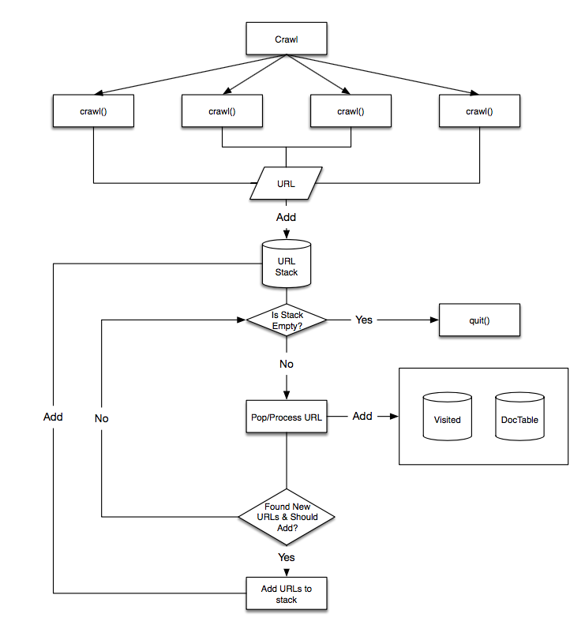
Crawler
Optimizations
Multi-threading
Crawl 50 Pages:
w/o threading: 13.64s
w/ multi-threading: 8.65s
Add error pages to a list so they’re not be visited more than once
Check links for validity before adding them to the stack
Difficulties
Redirecting pages
Lack of 404 Page
Pages took too long to load
Different threads tried to access the same file

Slide 4
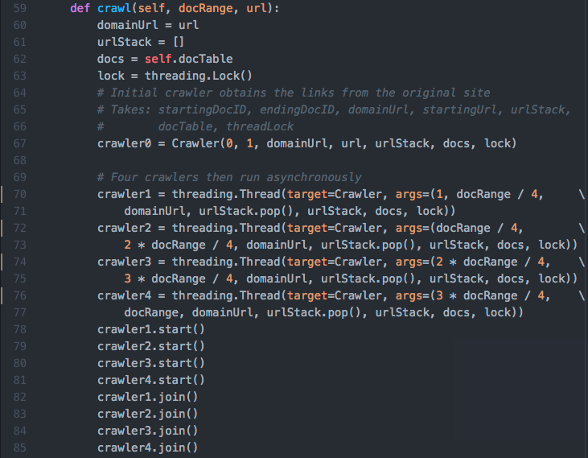

Slide 8
Crawler
Optimizations
Multi-threading
Crawl 50 Pages:
w/o threading: 13.64s
w/ multi-threading: 8.65s
Add error pages to a list so they’re not be visited more than once
Check links for validity before adding them to the stack
Difficulties
Redirecting pages
Lack of 404 Page
Pages took too long to load
Different threads tried to access the same file

Slide 9
Crawler: DocTable
Dictionary containing Document ID, Document URL, Maximum Word Frequency, Document Length
Created using a Document Parser class
Creates a histogram for the words in the document
Calculates document length and max word frequency in the document
{ DocID: [url, maxWordFreq, docLength],
1 : [muhlenberg.edu/jorge-reyes/is-great/, 25, 120],
…
N: [muhlenberg.edu/give-us/bonus-points/, 30, 140]
}

Slide 10
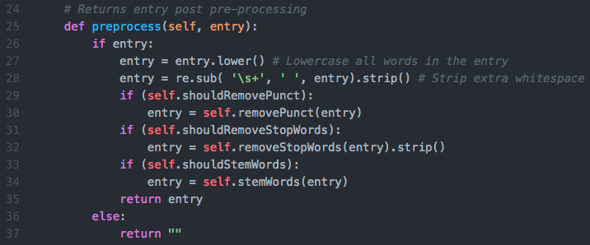
Preprocessing
Notes:
Lowercase everything in the document and stripped extra whitespace

Slide 11
Preprocessing
Notes:
Regex to remove punctuation

Slide 12
Preprocessing

Slide 13
Preprocessing
Notes:
NLTK SnowballStemmer to stem words

Slide 14
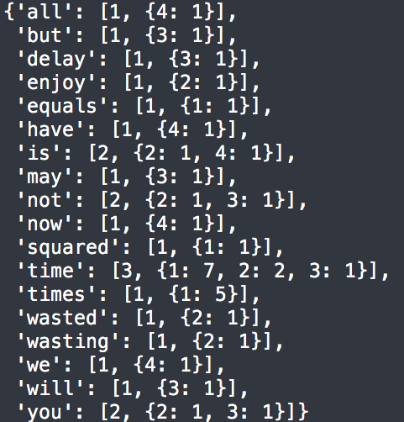
Inverted Index
Dictionary
Array
First item: Document Frequency
Second item: Dictionary
DocID
Word Frequency in Doc

Slide 15
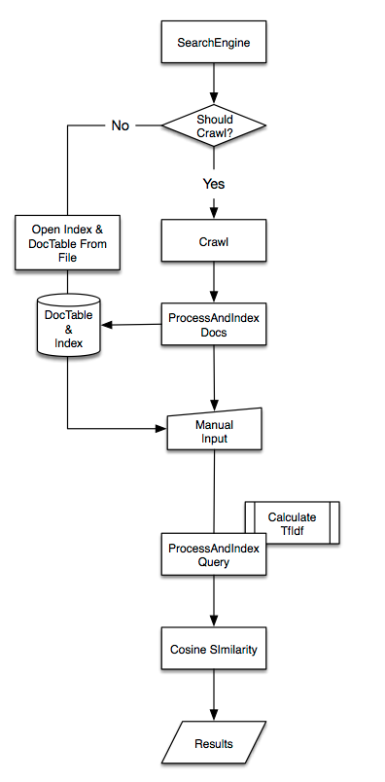
Search Engine
Optimizations
Saved DocTable and invertedIndex to file using Pickle
When returning relevant documents:
search engine pre-screens for all files greater than 0 and
greater than the average of the cosine similarities
Difficulties
Calculating idf weight
Deciding what normalization to use in order to optimize both precision and recall

Slide 16

Search Engine
TF-IDF
$TF= \frac{Term−Frequency in Doc}{\max\left\{Query term in Doc\right\}}$
$IDF=log10\left(\frac{Total Number of Documents}{Number of Documents containing the Term}\right)$
“is”: $IDF=log10\left(\frac{2}{2}\right)$ = 0
Implies two is irrelevant
“is”: $IDF=1+log10\left(\frac{2}{2+1}+1\right)$ = 0.2218

Slide 17
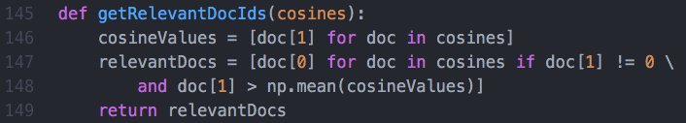
Analysis
Difficulties
In the file we received as “solutions” the author was calculating a weight for each relevant document and not including documents with low weights.
EX: 1 184 2
In our code we did not account for this weight and thus any file that was at all relevant would return, making our precision results very low and recall 100%
Solution? Average

Slide 18
Limiting Returned ID's to Average or Greater

Slide 19
if(haveQuestions()): print “Ask now.” else: print “Thank you!”

