Slide 1
Extract from: GeoAI for Scalable Systems
Level: MSc
Teacher: Dr. Victor Maus
Learning objectives long:
List and describe spatial data models and formats
Recall and explain the importance of treating spatial and temporal data adequately within ML workflows
Apply ML workflows to large spatial datasets
Use spatial cross validation for spatial
Design reliable spatial prediction workflows
Judge the value of large scale applications/maps
20 min demonstration lecture: Spatial Prediction Bias
Required knowledge: Understand spatial data models and formats and can apply ML workflows for spatial data
Learning objectives short lecture:
Recognize limitations on ML applications for mapping (Area of applicability)
Recall the origin of bias in ML spatial prediction (Spatial autocorrelation)
Notes:
I wanted to start with this figure because I was very impressed when I first saw it in a talk by Prof. Barbara Ryan back in 2015 at the EARSeL Symposium here at KTH
The graph shows the number of downloads of Landsat scenes growing exponentially -- since its open data policy implementation in 2008
Open data policy has also been adopted by the Copernicus Programme, for example, for Sentinel images
But the main reason I am showing this slide is that free access to EO data has been a major driver of science and technology development in geoinformatics

Slide 2
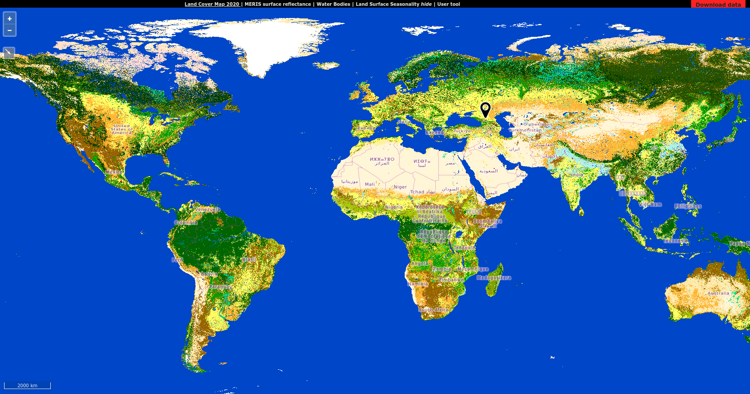
Global maps produced by ML are widely used for sustainability applications
How reliable are these global maps?
Notes:
I wanted to start with this figure because I was very impressed when I first saw it in a talk by Prof. Barbara Ryan back in 2015 at the EARSeL Symposium here at KTH
The graph shows the number of downloads of Landsat scenes growing exponentially -- since its open data policy implementation in 2008
Open data policy has also been adopted by the Copernicus Programme, for example, for Sentinel images
But the main reason I am showing this slide is that free access to EO data has been a major driver of science and technology development in geoinformatics

Slide 3
Recapping the ML workflow
Response variable
Reference
data
Model training
(CV)
Maps (predictions)
Validation and uncertainty
Predictors (EO)
What is the origin of many problems in spatial ML?
Notes:
I wanted to start with this figure because I was very impressed when I first saw it in a talk by Prof. Barbara Ryan back in 2015 at the EARSeL Symposium here at KTH
The graph shows the number of downloads of Landsat scenes growing exponentially -- since its open data policy implementation in 2008
Open data policy has also been adopted by the Copernicus Programme, for example, for Sentinel images
But the main reason I am showing this slide is that free access to EO data has been a major driver of science and technology development in geoinformatics

Slide 4
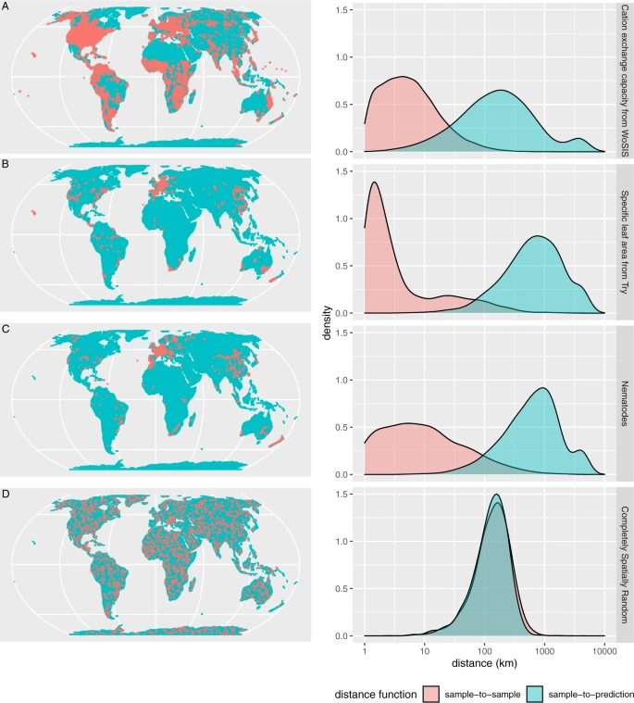
Meyer & Pebesma, 2022
Notes:
Many times we cannot measure the reliability of maps produced using ML
When training samples are spatially clustered, they usually do not cover well the predictors space and it becomes impossible to assess the accuracy of the predictions in locations that are distant from the training sets
To illustrate that, we can look at the three first maps in this slides. They show the spatial distribution of the training data used to produce maps in different domains. These are real data sets that are openly available.
And, the last map shows an ideal fictitious situation with samples distributed randomly across space.
Without going in much details, we can see that the curves of the spatial distribution of predictions, in blue, do not usually match the curve of the spatial distribution of the training samples in red color.
This is not a problem only for global maps. It also affects smaller scale applications when training samples are spatially clustered.
(NOT READ)
Exchange capacity in the soil used for global soil mapping
Specific leaf area important parameter to plant growth modelers
Soil nematode are important soil organisms

Slide 5
Distance from one sample to another is usually much smaller than the distance from samples to predictions.
ML models trained with
non-representative spatial distribution produce
unreliable results!
Why is this usually overlooked by data user and producers?
Meyer & Pebesma, 2022
Notes:
Many times we cannot measure the reliability of maps produced using ML
When training samples are spatially clustered, they usually do not cover well the predictors space and it becomes impossible to assess the accuracy of the predictions in locations that are distant from the training sets
To illustrate that, we can look at the three first maps in this slides. They show the spatial distribution of the training data used to produce maps in different domains. These are real data sets that are openly available.
And, the last map shows an ideal fictitious situation with samples distributed randomly across space.
Without going in much details, we can see that the curves of the spatial distribution of predictions, in blue, do not usually match the curve of the spatial distribution of the training samples in red color.
This is not a problem only for global maps. It also affects smaller scale applications when training samples are spatially clustered.
(NOT READ)
Exchange capacity in the soil used for global soil mapping
Specific leaf area important parameter to plant growth modelers
Soil nematode are important soil organisms

Slide 6
ML workflow
Data generation process
Response variable
Reference
data
Model training
Maps (predictions)
Validation and uncertainty
Predictors (EO)
Mitigation
Notes:
I wanted to start with this figure because I was very impressed when I first saw it in a talk by Prof. Barbara Ryan back in 2015 at the EARSeL Symposium here at KTH
The graph shows the number of downloads of Landsat scenes growing exponentially -- since its open data policy implementation in 2008
Open data policy has also been adopted by the Copernicus Programme, for example, for Sentinel images
But the main reason I am showing this slide is that free access to EO data has been a major driver of science and technology development in geoinformatics

Slide 7
Mitigation strategies and good practices
- Apply cross validation strategies for spatial data to provide estimates of map accuracy
- Apply methods to spatial feature selection to minimize the risk of overfitting
- Calculate the Area of Applicability (AOA) to identify where the estimated cross-validation performance may hold
- Calculate pixel-wise error estimation to inform potential users of the maps
Notes:
I wanted to start with this figure because I was very impressed when I first saw it in a talk by Prof. Barbara Ryan back in 2015 at the EARSeL Symposium here at KTH
The graph shows the number of downloads of Landsat scenes growing exponentially -- since its open data policy implementation in 2008
Open data policy has also been adopted by the Copernicus Programme, for example, for Sentinel images
But the main reason I am showing this slide is that free access to EO data has been a major driver of science and technology development in geoinformatics

