Slide 1
Søketek uke 5
Gruppe 1

Slide 2
Recap
Lecture 09.09
N-gram overlap
Jaccard coefficient
BSBI
SPIMI
Distributed indexing
Lecture 20.09
Heaps’ law
Zipf’s law
Dictionary compression
Front coding
Posting compression
Encoding: VB, Gamma, Rice, Golomb, Simple9

Slide 3
Lecture 09.09

Slide 4
N-gram overlap
Create n-grams of query and compare with other n-grams
Example: tri-gram of «november»:
nov, ove, vem, emb, mbe, ber
Can compare with tri-gram of «december»:
dec, ece, cem, emb, mbe, ber
Is there an overlap?

Slide 5
N-gram overlap
Create n-grams of query and compare with other n-grams
Example: tri-gram of «november»:
nov, ove, vem, emb, mbe, ber
Can compare with tri-gram of «december»:
dec, ece, cem, emb, mbe, ber
Is there an overlap?
Yes!
emb, mbe, and ber occur in both

Slide 6
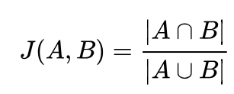
Jaccard coefficient
A way of measuring the overlap between two n-grams
Will be a number between 0 and 1
1 means full overlap, 0 means no overlap

Slide 7
Jaccard coefficient
Put the n-grams in separate sets
A = {nov, ove, vem, emb, mbe, ber}
B = {dec, ece, cem, emb, mbe, ber}

Slide 8
Jaccard coefficient
Put the n-grams in separate sets
A = {nov, ove, vem, emb, mbe, ber}
B = {dec, ece, cem, emb, mbe, ber}
Take the intersection of A and B, and the union of A and B
AB_intersection = {emb, mbe, ber}
AB_union = {nov, ove, vem, emb, mbe, ber, dec, ece, cem}

Slide 9
Jaccard coefficient
Put the n-grams in separate sets
A = {nov, ove, vem, emb, mbe, ber}
B = {dec, ece, cem, emb, mbe, ber}
Take the intersection of A and B, and the union of A and B
AB_intersection = {emb, mbe, ber}
AB_union = {nov, ove, vem, emb, mbe, ber, dec, ece, cem}
Divide the length of AB_intersection on the length of AB_union
jc = len(AB_intersection) / len(AB_union)
jc = 3 / 9
jc = 0.333…

Slide 10
Index construction
Problem 1: An inverted index is huge, so we can’t fit the entire thing in main memory
Problem 2: Disk seeks are expensive

Slide 11
Blocked sort-based indexing
Break corpus into blocks which can approximately fit in main memory

Slide 12
Blocked sort-based indexing
Read one block at a time

Slide 13
Blocked sort-based indexing
Tokenise the documents

Slide 14
Blocked sort-based indexing
Create postings from all terms, sort alphabetically
Term1, doc: 1
Term2, doc: 1
Term3, doc: 1
Term4, doc: 1
Term5, doc: 1
Term6, doc: 2
Term7, doc: 2
Term8, doc: 3

Slide 15
Blocked sort-based indexing
Write it back to disk

Slide 16
Blocked sort-based indexing
Start over with a new block

Slide 17
Blocked sort-based indexing
Continue until all blocks are converted

Slide 18
Blocked sort-based indexing
Read parts of blocks from disk

Slide 19
Blocked sort-based indexing
Merge them

Slide 20
Blocked sort-based indexing
Write them back to disk

Slide 21
Blocked sort-based indexing
Continue until all the postings are one big inverted index

Slide 22
Single-pass in-memory indexing
Given a huge corpus

Slide 23
Single-pass in-memory indexing
Break corpus into blocks which can approximately fit in main memory

Slide 24
Single-pass in-memory indexing
Read one block at a time
Doc 1
Doc 2
Doc 3
Doc 4
Doc 5
Doc 6
etc...

Slide 25
Single-pass in-memory indexing
Tokenise the documents
15 tokens
99 tokens
5 tokens
52 tokens
1 token
68 tokens
etc…

Slide 26
Single-pass in-memory indexing
Create an inverted index for the block
term, freq, posting_list
term, freq, posting_list
term, freq, posting_list
term, freq, posting_list
term, freq, posting_list
term, freq, posting_list
term, freq, posting_list

Slide 27
Single-pass in-memory indexing
Write the block/mini inverted index to disk

Slide 28
Single-pass in-memory indexing
Start over with a new block

Slide 29
Single-pass in-memory indexing
Continue until all blocks are converted

Slide 30
Single-pass in-memory indexing
Using a k-way merge, merge the blocks to a single inverted index

Slide 31
Single-pass in-memory indexing
We keep some of it in memory and store the rest on disk

Slide 32
Distributed indexing
Cannot rely on a single machine
Distribute the tasks
One master machine distributes work
Multiple parsers read from corpus and creates (term, document-ID) pairs
Multiple inverters sort pairs and read them to posting lists

Slide 33
Distributed indexing
Split corpus into blocks again
->

Slide 34
Distributed indexing
Master machine assigns random splits to random parsers
…
…
…
…

Slide 35
Distributed indexing
Parsers read one document at a time, and create (term, document-ID) pairs
…
…
…
…

Slide 36
Distributed indexing
Parsers read one document at a time, and create (term, document-ID) pairs
Informatics, 0
Group, 1
Informatics is fun
is, 0
1, 1
Group 1 is the best
fun, 0
is, 1
…
the, 1
…
best, 1

Slide 37

Distributed indexing
Parsers read one document at a time, and create (term, document-ID) pairs
Parsers write them to partitions
…
…
…
…
…

Slide 38
Distributed indexing
Parsers read one document at a time, and create (term, document-ID) pairs
Parsers write them to partitions
fun, 0
Informatics, 0
the, 1
best, 1
is, 0
Group, 1
is, 1
one, 1

Slide 39
Distributed indexing
Master machine assigns one partition to each inverter
a-f
…
…
g-p
…
…
q-z
…

Slide 40
Distributed indexing
Each inverter sorts their partition alphabetically
a-f
…
…
g-p
…
…
q-z
…

Slide 41
Distributed indexing
Each inverter sorts their partition alphabetically
g-p
Informatics, 0
Group, 1
is, 0
Informatics, 0
Group, 1
is, 0
is, 1
is, 1

Slide 42

Distributed indexing
... and merges them with an existing inverted index from their partition
g-p
Group, 1
->
Informatics, 0
is, 0
is, 1

Slide 43



Distributed indexing
And everyone is happy
a-f
…
…
g-p
…
…
q-z
…

Slide 44
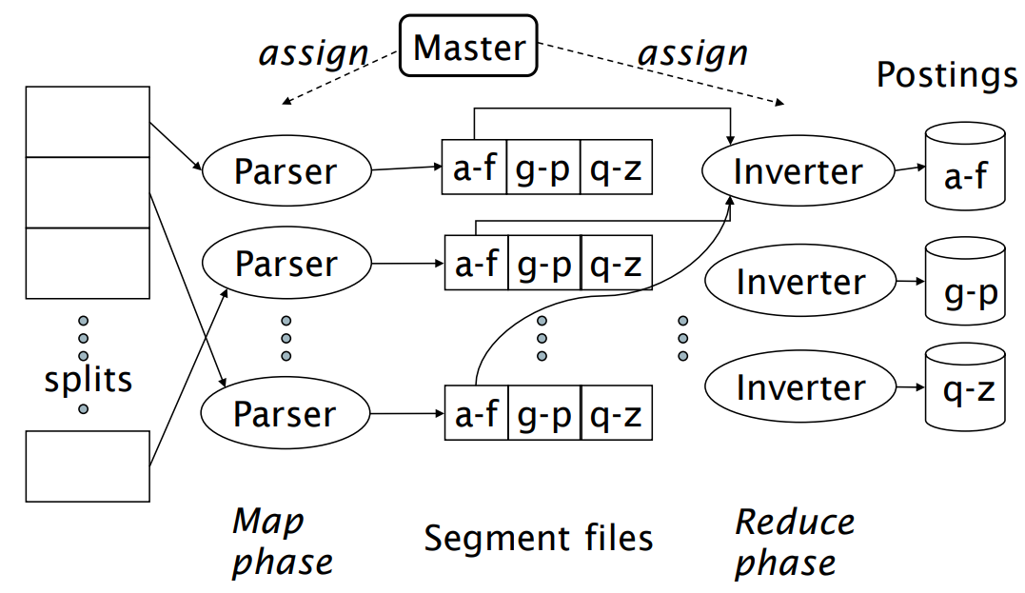
Distributed indexing

Slide 45
Lecture 20.09

Slide 46
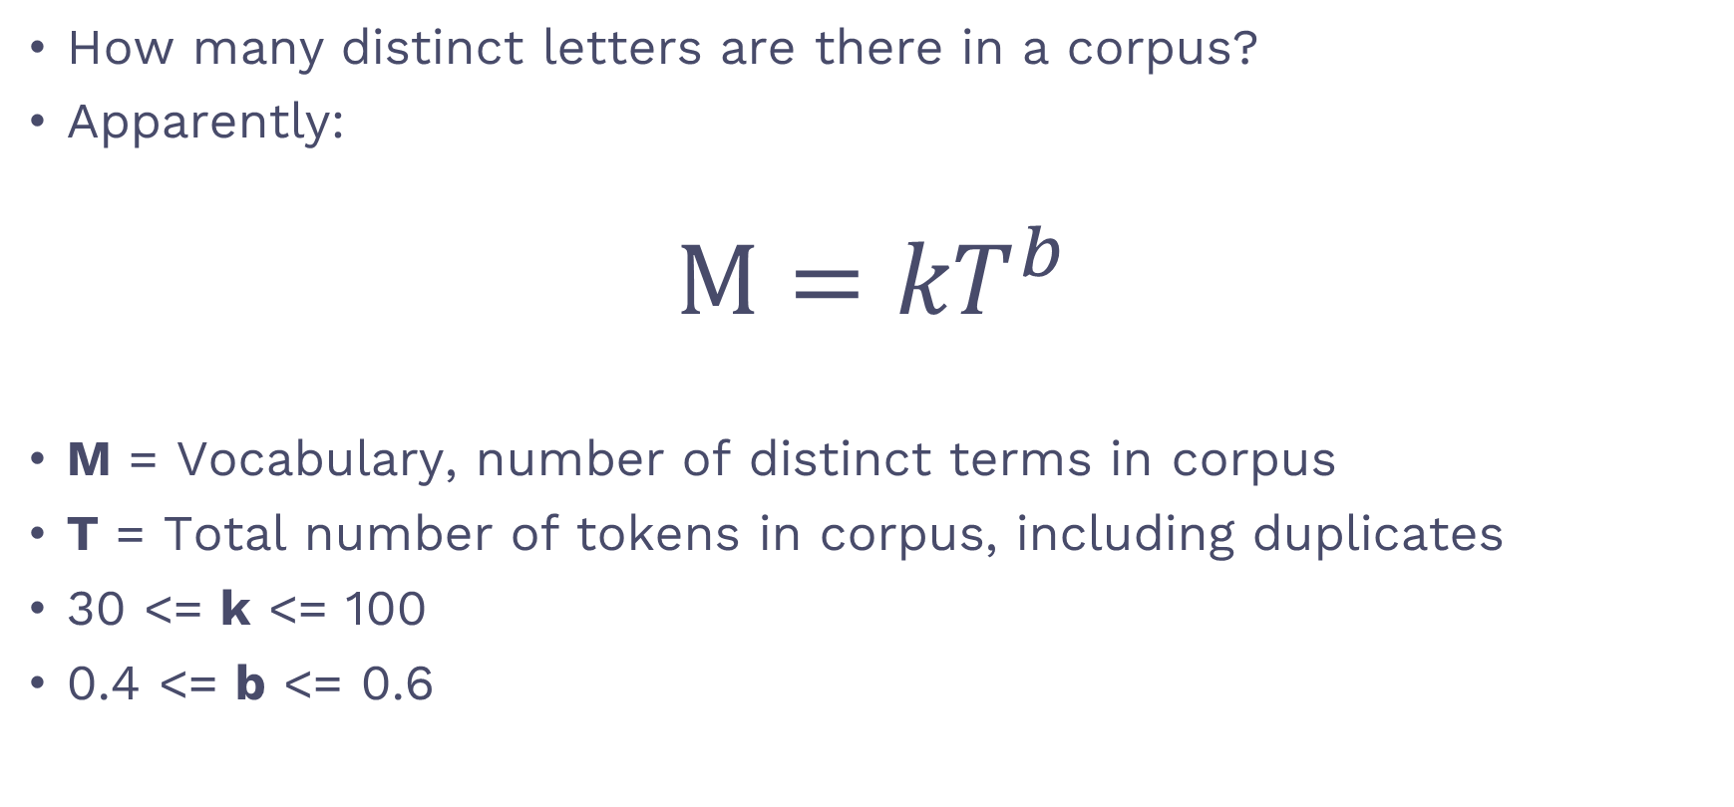
Heap’s law
How many distinct letters are there in a corpus?
Apparently:
$$M={kT}^{b}$$
M = Vocabulary, number of distinct terms in corpus
T = Total number of tokens in corpus, including duplicates
30 <= k <= 100
0.4 <= b <= 0.6

Slide 47

Heap’s law example
k = 30
b = 0.6
T = 1 000 000
${M=k∗T}^{b}$
${M=30∗1 000 000}^{0.6}$
${M=30∗3981}^{}$
${M=119 432}^{}$

Slide 48
The point of Heap’s law
Heap’s law suggests that the vocabulary growth slows as the size of the corpus increases
T = 1 000 000 M = 119 432
T = 2 000 000 M increases by 61 593
T = 3 000 000 M increases by 49 858
T = 4 000 000 M increases by 43 498
T = 5 000 000 M increases by 39 308

Slide 49
Zipf’s law
Shows distribution of terms in a corpus
Crazy scary formula on the slides and in the book
Basically
The second most frequent term occurs half as often as the most frequent term
Example
The 3 most frequent terms in "corpus X" are the, yes and hello.
"the" occurs 100 times, "yes" occurs 50 times, and "hello" 33 times

Slide 50
Dictionary compression
Search starts in the dictionary!
Want to keep as much as possible in main memory
dict = [
{ term: "I", freq: 105, postinglist_pointer },
{ term: "cant", freq: 82, postinglist_pointer },
...
]
Sooo tempting to compress!!

Slide 51
Dictionary-as-a-string
dictstring = "Icantwaittohearwhatthisweeksbookis"
dict = [
{ freq, postinglist_pointer, term_pointer },
{ freq, postinglist_pointer, term_pointer },
{ freq, postinglist_pointer, term_pointer },
...
]

Slide 52
Dictionary-as-a-string with blocking
dictstring = "1I4cant4wait2to4hear4what4this5weeks4book2is"
dict = [
{ freq, postinglist_pointer, term_pointer },
{ freq, postinglist_pointer },
{ freq, postinglist_pointer },
{ freq, postinglist_pointer, term_pointer },
...
]

Slide 53
Front coding
dictstring = "8automata8automate9automatic10automation"

Slide 54
Front coding
dictstring = "8automat*a1◊e2◊ic3◊ion"

Slide 55
Front coding breakdown
"8automat*a1◊e2◊ic3◊ion"
1. 8automat*: 8 chars, automat is a prefix
2. "a" is the first suffix
3. "1◊e": suffix of 1 char incoming! (e)
4. "2◊ic": suffix of 2 chars incoming! (ic)
5. "3◊ion": suffix of 2 chars incoming! (ion)

Slide 56
Front coding breakdown
"8automat* a 1◊e 2◊ic 3◊ion"
1. 8automat*: 8 chars, automat is a prefix
2. "a" is the first suffix
3. "1◊e": suffix of 1 char incoming! (e)
4. "2◊ic": suffix of 2 chars incoming! (ic)
5. "3◊ion": suffix of 2 chars incoming! (ion)

Slide 57
Front coding breakdown
8automat*a1◊e2◊ic3◊ion
«why no 1◊ in front of the first suffix?»

Slide 58

Front coding breakdown
8automat*a1◊e2◊ic3◊ion
«why no 1◊ in front of the first suffix?»
7automat*1◊a1◊e2◊ic3◊ion
Just spent 2 extra chars.. For nothing

Slide 59
Front coding with 2 prefixes
"8automat*a1◊e2◊ic3◊ion"
"6inter*n3◊nal3◊net5◊ested"
"8automat*a1◊e2◊ic3◊ion5inter*n3◊nal3◊net5◊ested"
"8automata8automate9automatic10automation6intern8internal8internet10interested"

Slide 60
Posting compression
Postings are larger than the dictionary!
More compression potential 🤤
Obs! For simplicity, a postings in this context is just a document ID

Slide 61
Gaps
computer: 33, 47, 154, 159, 202
=>
computer: 33, 47-33, 154–47, 159-154, 202-159
=>
computer: 33, 14, 107, 5, 43

Slide 62
Gaps (stop word example)
the: ..., 283042, 283043, 283044, 283045, ...
=>
the: ..., 1, 1, 1, 1, ...

Slide 63
VB codes encoding algorithm
Convert the document ID from decimal to binary
Divide the binary number into splits of at most 7 bits, from right to left
If the left-most number has length < 7, pad it with 0s
Prefix the right-most number with a 1, and the rest with a 0

Slide 64
VB codes encoding example
Example number = 300
Convert: 300 = 100101100
Divide: 10, 0101100
Pad: 0000010, 0101100
Add prefix: 00000010, 10101100
Final bit sequences: 00000010 10101100

Slide 65
VB codes decoding algorithm
Read bit sequences from left to right
If the first bit is 0, read the next bit sequence too
If the first bit is 1, stop when we’ve read the current byte
Remove the first bit of each sequence
Remove trailing 0s

Slide 66
VB codes decoding example
Read bit sequences 00000010 10101100
00000010 starts with a 0, continue
10101100 starts with a 1, finish reading and stop
Remove prefixes: 0000010, 0101100
Remove trailing 0s: 10 0101100
Converting back to decimal we get 300

Slide 67
Gamma encoding algorithm
Convert the document ID to binary
Remove the prefix bit
Take care of the length of the binary number in unary
Add a 0 at the end of the result of step 3
Concatenate the results of steps 3-4 and steps 1-2

Slide 68
Gamma encoding example
Example number = 13
Convert: 13 = 1101
Chop: 101
Length in unary: 111
Pad with 0: 1110
Concatenate: 1110 + 101 = 1110101
Final bit sequence: 1110101

Slide 69
Gamma decoding algorithm
Read N bits until we hit 0
Read the next N bits
Pad 1 to the result of step 2

Slide 70
Gamma decoding example
Read until we hit 0: 1110101
Read the next N bits: 101
Pad 1: 1101
Converting back to decimal we get 13

Slide 71
Delta encoding
The same as Gamma encoding, but we also Gamma encode the length!
Example
13 with Gamma encoding: 1110101
13 with Delta encoding: 110101
Difference: 110 prefix instead of 1110

Slide 72
Rice encoding
Dealing with the entire posting list

Slide 73
Rice encoding algorithm
computer: 34, 178, 291, 453
Convert IDs to gaps
Find the average
Round down to the avg’s closest power of two, call it b
For each gap_int in the posting list, get
(gap_int – 1) / b in unary
(gap_int – 1) % b in binary

Slide 74
Rice encoding example
computer: 34, 178, 291, 453
Convert to gaps: 34, 144, 113, 162
Find average: (34 + 144 + 113 + 162) / 4 = 113
Find b = 64 (because 2^7 = 128, 2^6 = 64)
Iterating our list:
(34 – 1) / 64 = 0
(34 – 1) % 64 = 100001
etc.

Slide 75
Rice encoding example
computer: 34, 178, 291, 453
In the end we end up with
computer: [0 100001, 110 001111, 10 110000, 110 100001]

Slide 76
Golomb encoding
Just like Rice coding, with 1 exception:
b is average * 0.69

Slide 77
Simple9 encoding
Uses a 32 bit word.
First 4 bits is a "selector"
Remaining 28 bits are integers
Selector tells us how the following ints are distributed
0000 = 1 int of 28 bits
0001 = 2 ints of 14 bits
0010 = 3 ints of 9 bits
…
1000 = 28 ints of 1 bit

Slide 78
Simple9 encoding example 1
Selector: 0000
The remaining 28 bits contain 1 integer, encoded in binary
Example decimal: 134 217 726
Encoded to binary: 11111111111111111111111110
Simple9 encoding: 0000 11111111111111111111111110

Slide 79
Simple9 encoding example 2
Selector: 0100
The remaining 28 bits contain 14 integers, encoded in binary
Example decimals: 1, 2, 2, 2, 3, 0, 1, 2, 2, 3, 0, 1, 2, 2, and 3
Encoded to binary: 01, 10, 10, 10, 11, 00, 01, 10, 10, 11, 00, 10, 10, 11
Simple9 encoding: 0100 0110101011000110101100101011

