Slide 1
Search technology week 8
Group 1

Slide 2
Agenda
Introduce Assignment D
Lecture repetition
Rocchio vs. Rocchio (1971)
kNN for classification
Weekly shoutout!
Individual work

Slide 3
Remember science fair groups!

Slide 4
Semester outline
23.10
My Science fair presentation, recap
30.10
Assignment E, Naive Bayes, recap
06.11
Final assignment push, final recap
13.11
Exam 2023 walkthrough
20.11
No plan, answer questions

Slide 5
Assignment d-1
ShingleGenerator: Make shingles to use in approximate matching (n-of-m matching)
BetterRanker: Ranker using tf-idf-weighting instead of only tf
SparseDocumentVector: Represent documents as vectors in a sparse space with useful methods

Slide 6
shinglegenerator
Make overlapping shingles of size self.__width from a buffer
For example the 3-shingles from "informatikk": "inf", "nfo", "for", "orm", "rma", "mat", "ati", "tik", "ikk"
If the buffer is shorter than the size of a shingle, make a single shorter-than-usual shingle

Slide 7
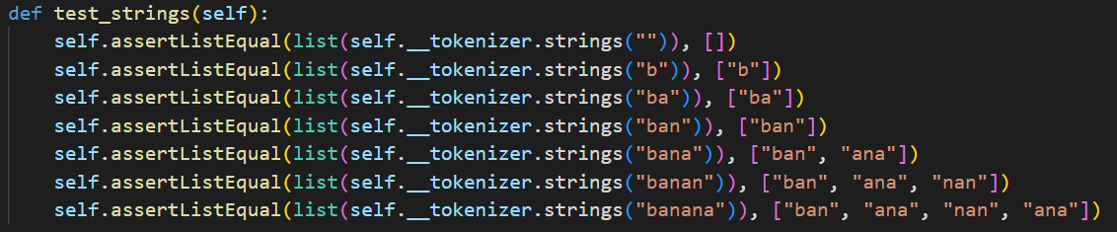
shinglegenerator

Slide 8
betterranker
SimpleRanker
A dead simple ranker, based on TF alone.
BetterRanker
A ranker that does traditional TF-IDF ranking, possibly combining it with a static document score (if present).
If tf-idf is confusing, check out uke06 in the repo
def get_document_frequency(self, term: str) -> int

Slide 9
sparsedocumentvector
New this year!
A dictionary mapping terms of a document to a float value
A dimension for each term, but only for dimensions not zero
Tip: remember to update self._length
What happens with the length of a vector when we normalize, scale, …

Slide 10
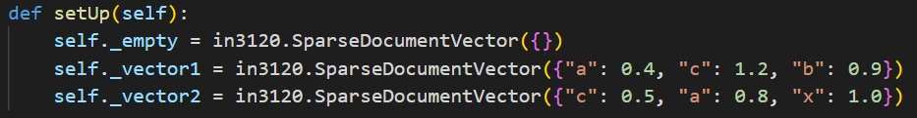
sparsedocumentvector

Slide 11
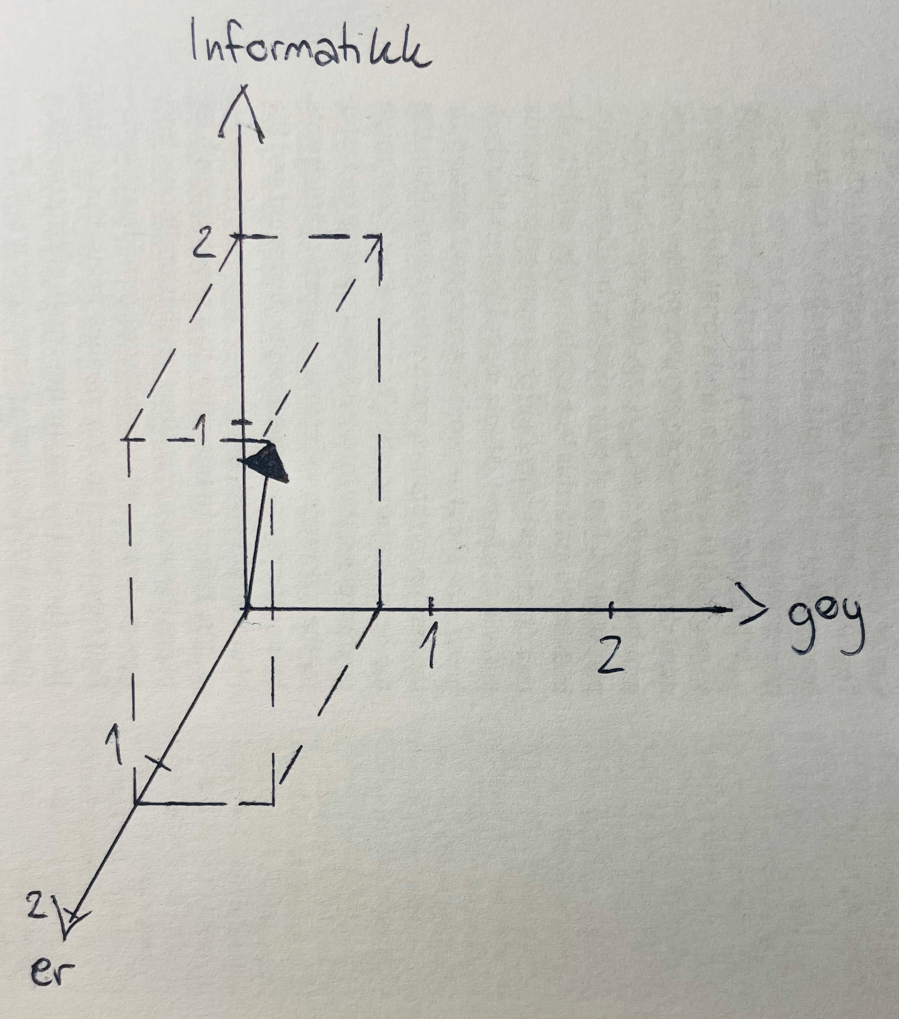
Example
doc = ({ “Informatikk": 2.0, “er": 1.25, “gøy": 0.75 })

Slide 12
Assignment d-2
Implement a compression algorithm of your choice!
Compare your results to the CompressedInMemoryPostingList from the precode
No test suite in assignments.py

Slide 13
Agenda
Introduce Assignment D
Lecture repetition
Rocchio vs. Rocchio (1971)
kNN for classification
Weekly shoutout!
Individual work

Slide 14
Rocchio 1971 (query expansion)
Used for document retrieval
Intuitively: We want to move our query vector towards relevant documents and away from irrelevant documents
We have a user query and partial knowledge of relevant and nonrelevant documents

Slide 15
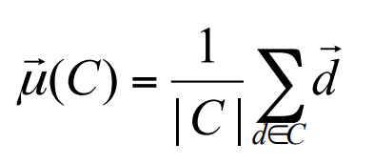
Centroid
The average of vectors
Sum of N vectors / N

Slide 16
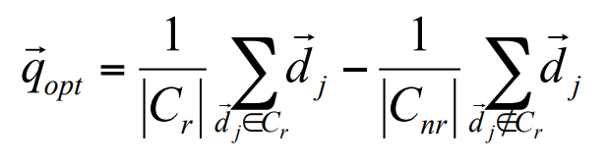
Rocchio formula
The centroid of relevant – centroid of nonrelevant documents

Slide 17
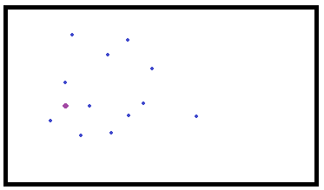
Example

Slide 18
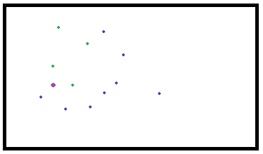
Example

Slide 19
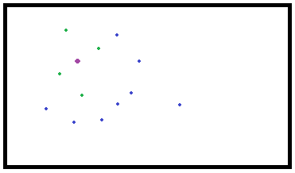
Example

Slide 20
Rocchio 1971 (query expansion)
The original query is ignored and we are shown documents close to the new vector

Slide 21
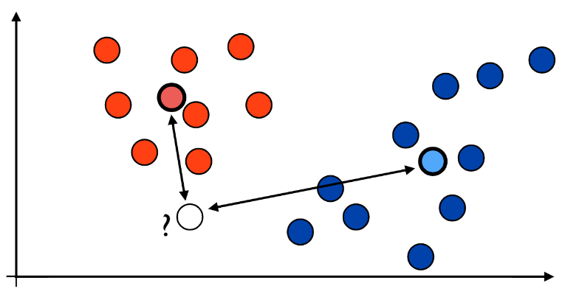
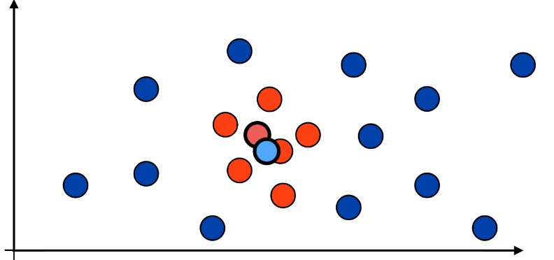
Rocchio (classification)
Calculate centroid for each class
New point x will be classified as whatever centroid is closest
Doesn’t work if classes can’t be separated easily

Slide 22
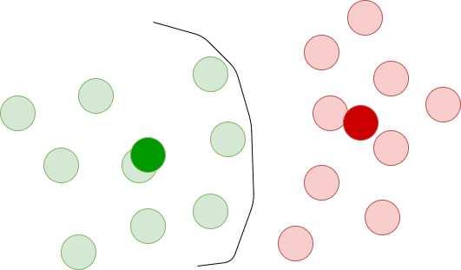
Example - Rocchio

Slide 23
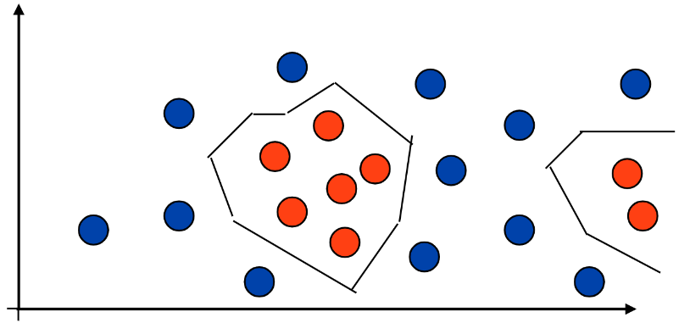
k Nearest Neighbours
What is the majority of my k closest neighbours?
No training required (but need to store data points and calculate many distances)
Handles complex decision boundaries

Slide 24
Example - classification
Since kNN makes local decisions, it’s less affected by nodes far away
Rocchio uses centroids (can be more affected by outliers)

Slide 25
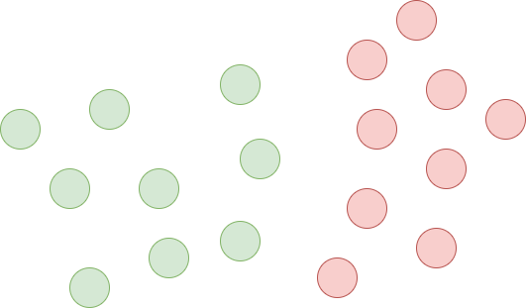
Example - classification

Slide 26
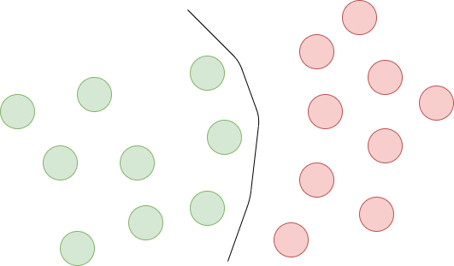
Example - kNN

Slide 27
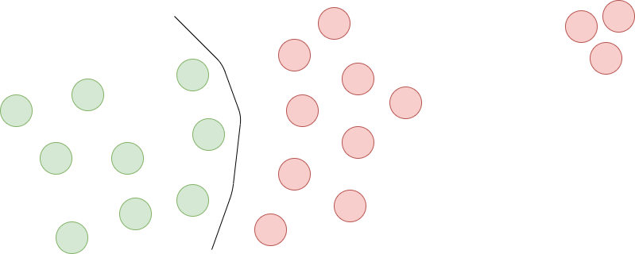
Example - kNN

Slide 28
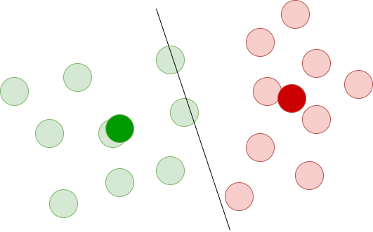
Example - Rocchio

Slide 29
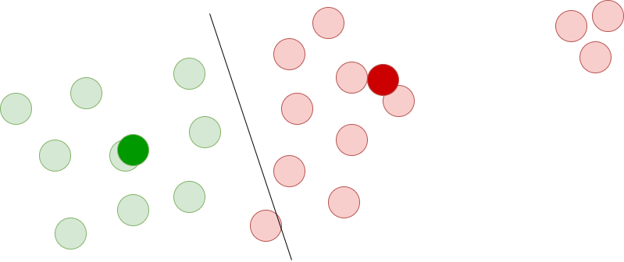
Example - Rocchio

Slide 30
Agenda
Introduce Assignment D
Lecture repetition
Rocchio vs. Rocchio (1971)
kNN for classification
Weekly shoutout!
Individual work

Slide 31

Shoutout of the week
True Detective S1
Maybe the best TV series (season) I’ve ever seen

Slide 32
15 min break
Individual work the rest of the session

