Slide 1


Slide 2
Victor Alves
2 º semestre de economia
Trabalho feito inteiramente no R com o auxílio de pacotes de análise de dados.
Foram criadas variáveis no dataset para auxiliar na análise.
Serão utilizados trabalhos externos para buscar possíveis relações causais, dada minha restrição de habilidades.

Slide 3
O nome de todas as variáveis foram passados para inglês.
Valores referentes ao sexo foram escritos por inteiro.
Foi criada uma variável para contabilizar a idade do cão, tomando 2017 como base.

Slide 4
Foram utilizados os seguintes papers:
Enikő Kubinyi , Borbála Turcsán & Ádám Miklósi - Dog and owner demographic characteristics and dog personality trait associations (Elsevier, 2009).
Jeremy N. V. Miles, Layla Parast, Susan H. Babey, Beth Ann Griffin & Jessica M. Saunders - A Propensity-Score-Weighted Population-Based Study of the Health Benefits of Dogs and Cats for Children (Anthrozoös, 2017).
Mieke Rijken & Sandra van Beek - About Cats and Dogs ... Reconsidering the Relationship Between Pet Ownership and Health Related Outcomes in Community-Dwelling Elderly (Springer, 2010).

Slide 5
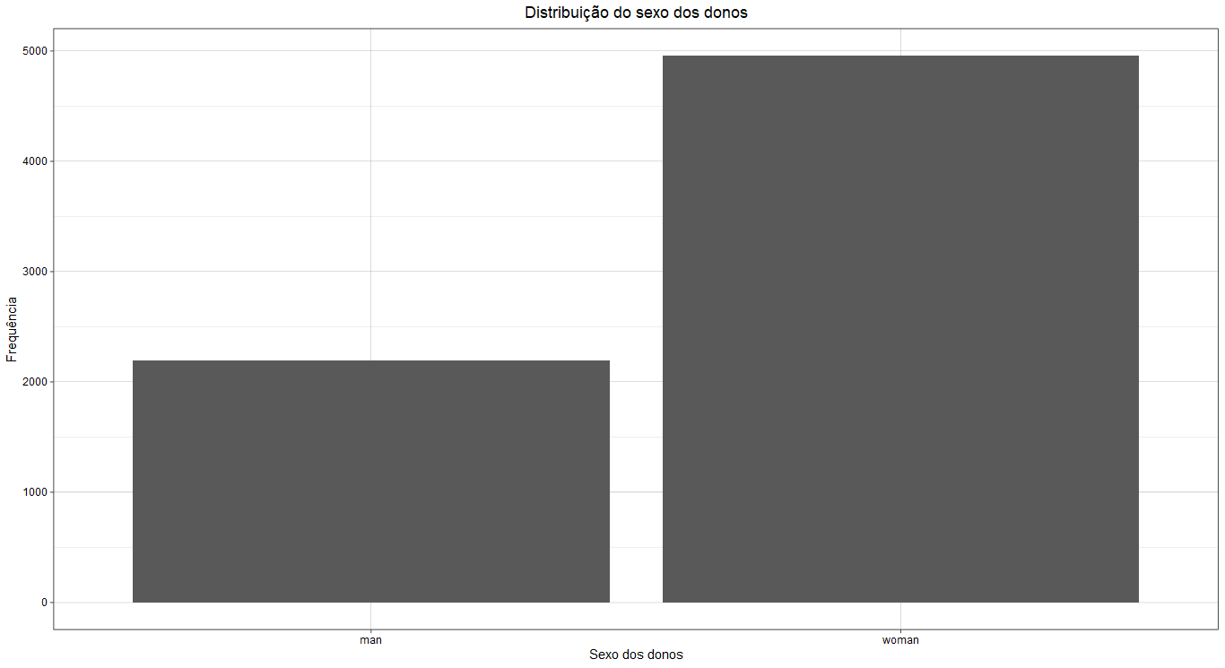

Slide 6
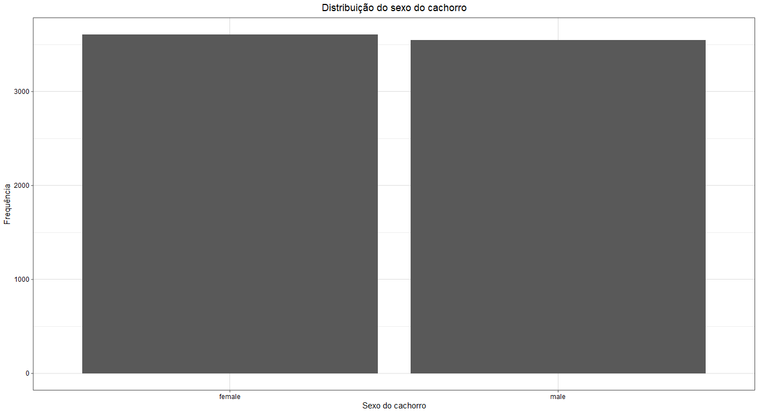

Slide 7
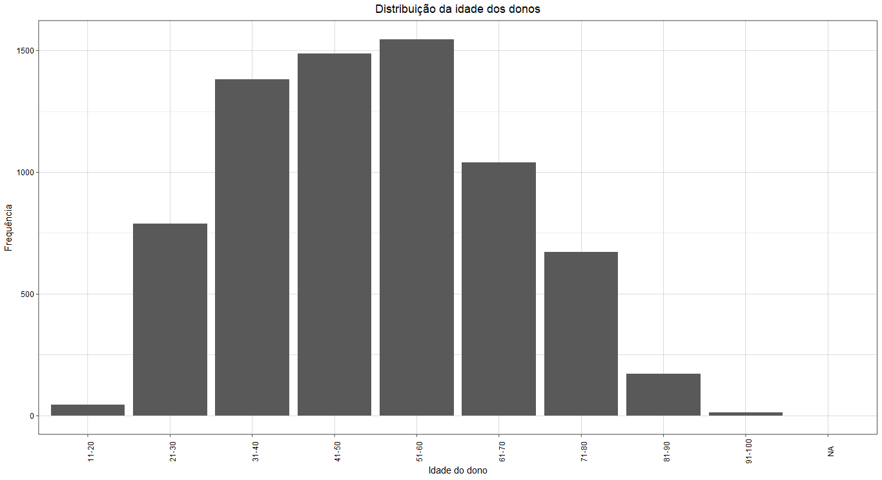

Slide 8
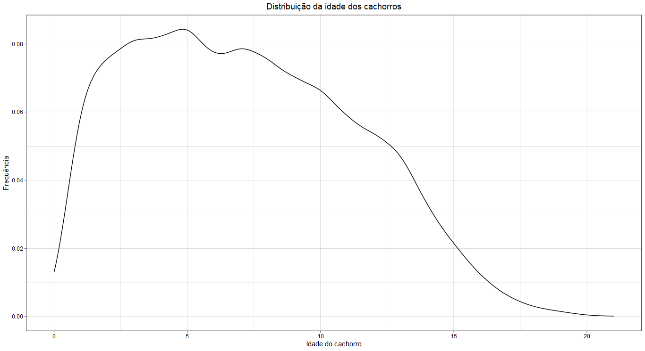

Slide 9
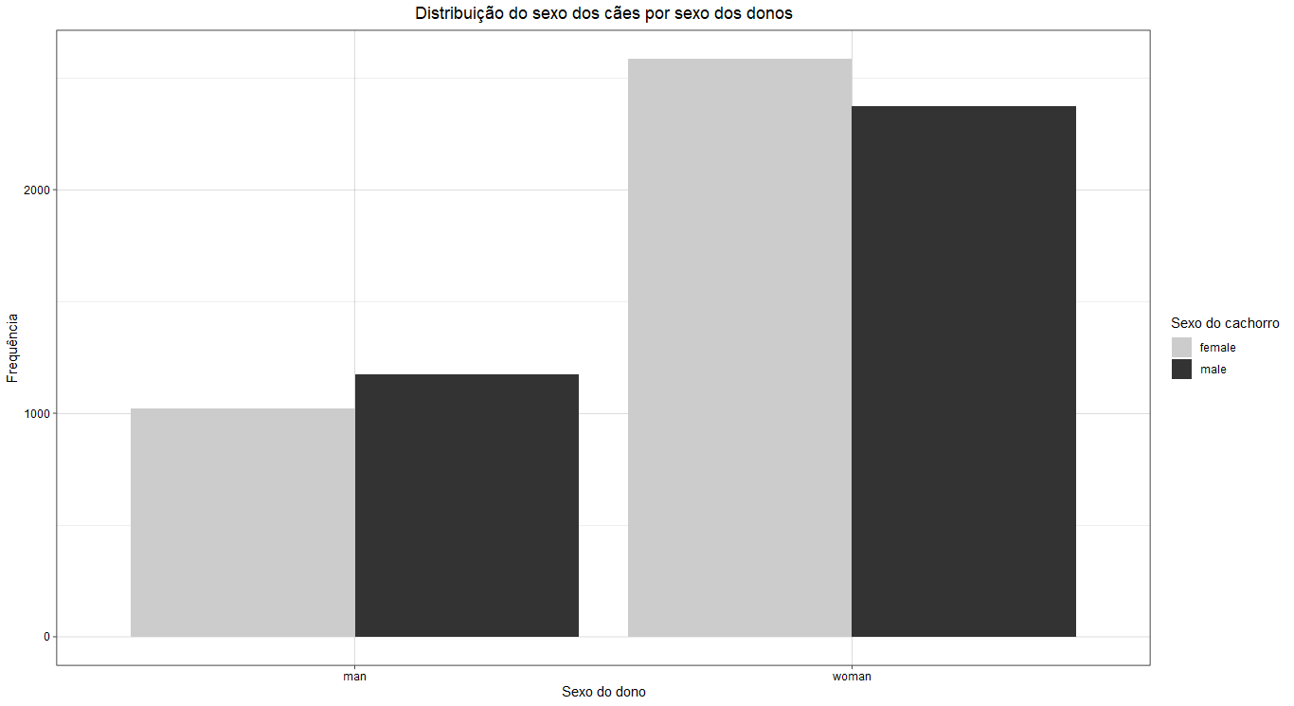

Slide 10
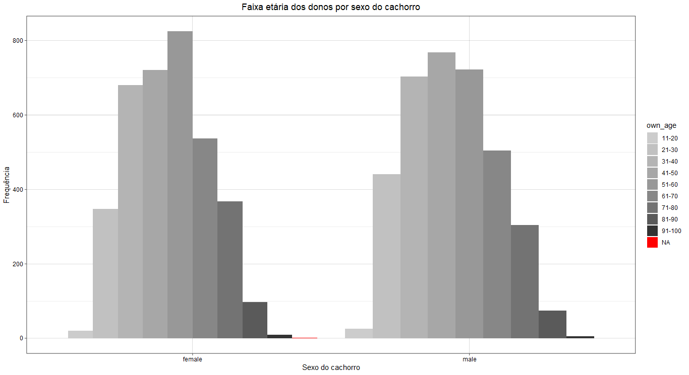

Slide 11
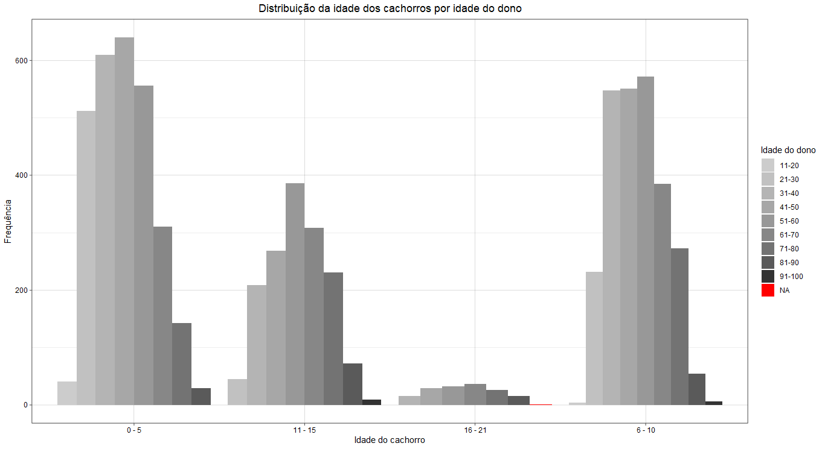

Slide 12
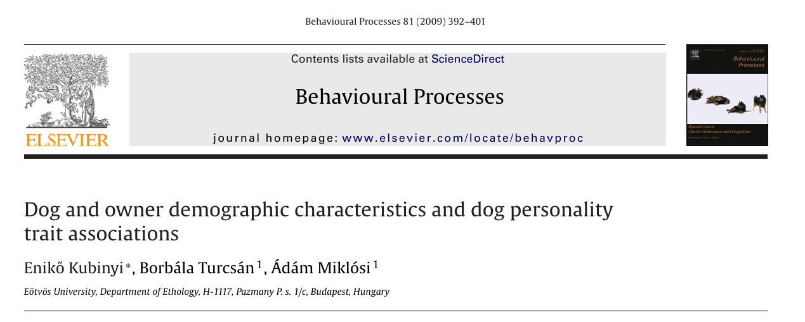

Slide 13
The least calm dogs were less than 2.5 years old, neutered and acquired after the first 12 weeks of age, while the calmest dogs were older than 6.9 years.
The most sociable dogs were less than 1.5 years old. Males were less sociable toward their conspecifics than females.
Dogs can be socialized much easier during the so-called sensitive period between 8 and 12 weeks of age.
We found that neutered females and intact males were reported to be more trainable compared to neutered males and intact females.
People aged between 19 and 30 years reported having the least calm dogs. The most trainable and sociable dogs could be found in the 31–60-year-old owner-group.
People living without children are more devoted to their dogs.
Dogs belonging to first-time dog owners were more likely to show behavior problems (Kobelt et al., 2003). Experienced owners had calmer dogs (Bennett and Rohlf, 2007).

Slide 14
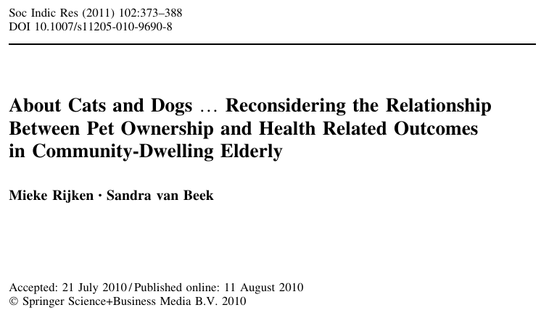

Slide 15
All respondents suffered from chronic illness or disability.
We could not find evidence that having a pet is beneficial to perceived health of the elderly.
Cats and dogs seem to have almost opposite effects on the physical activity level of their owners, with dogs increasing the chance of being healthy active and cats decreasing this chance.
Causal effects of pet ownership on health related outcomes could not be established.

Slide 16
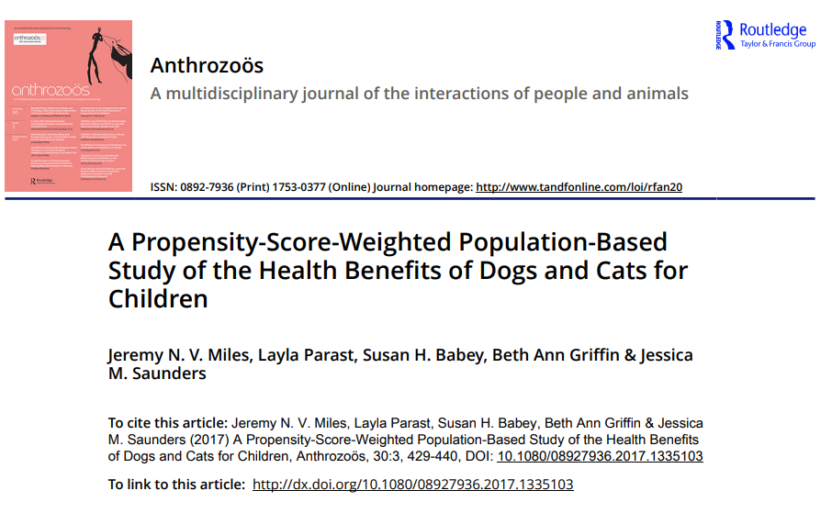

Slide 17
For psychological health, there is strong experimental evidence that interacting with dogs (and probably cats) provides social support and reduces stress and anxiety in children.

