Slide 1

Main Menu Features of DT-AVT

Slide 2
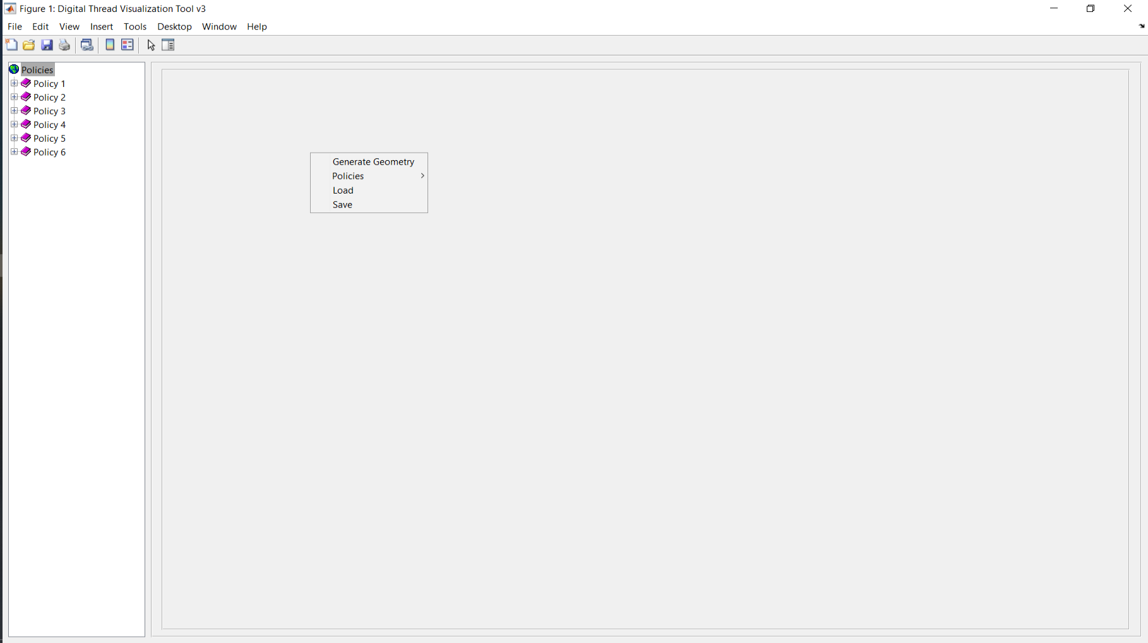
Main menu is accessed by right clicking on the gray pane

Slide 3
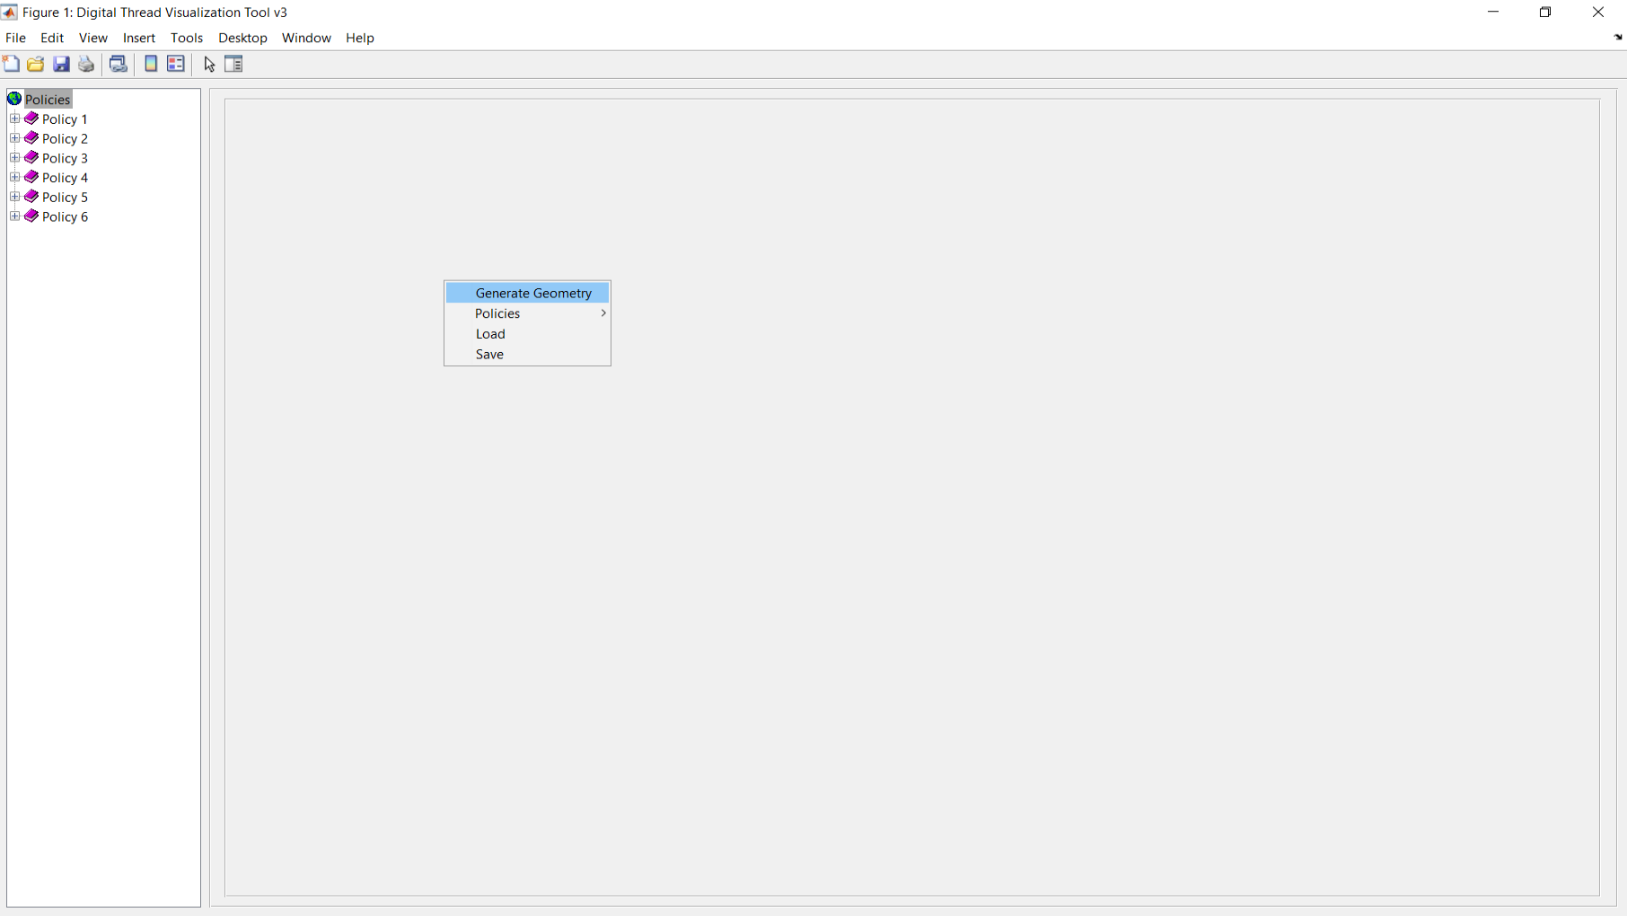
Generate geometry allows you to define the geometry and loads for the component

Slide 4
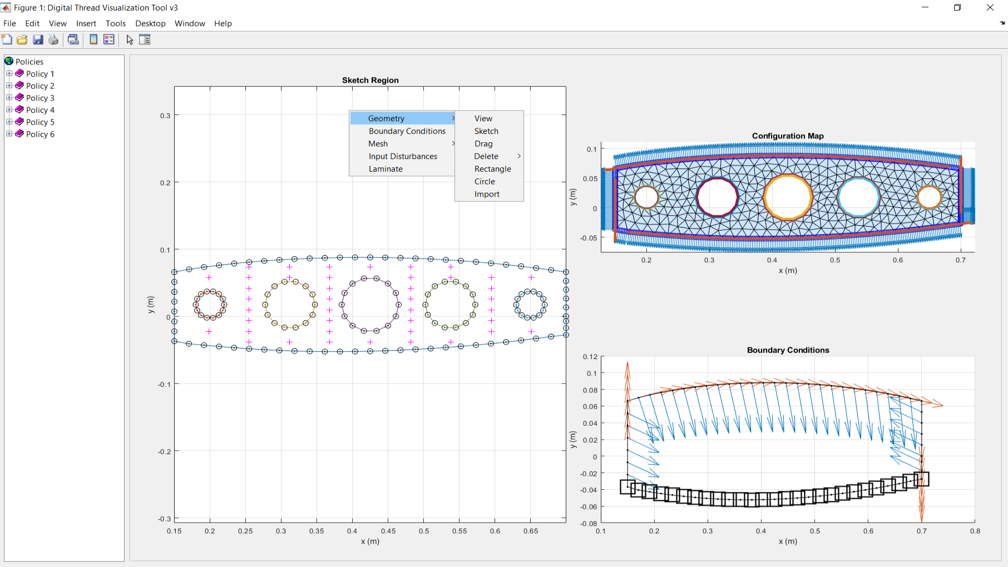
In the Generate Geometry pane, additional menus are available by right clicking in the plot area

Slide 5
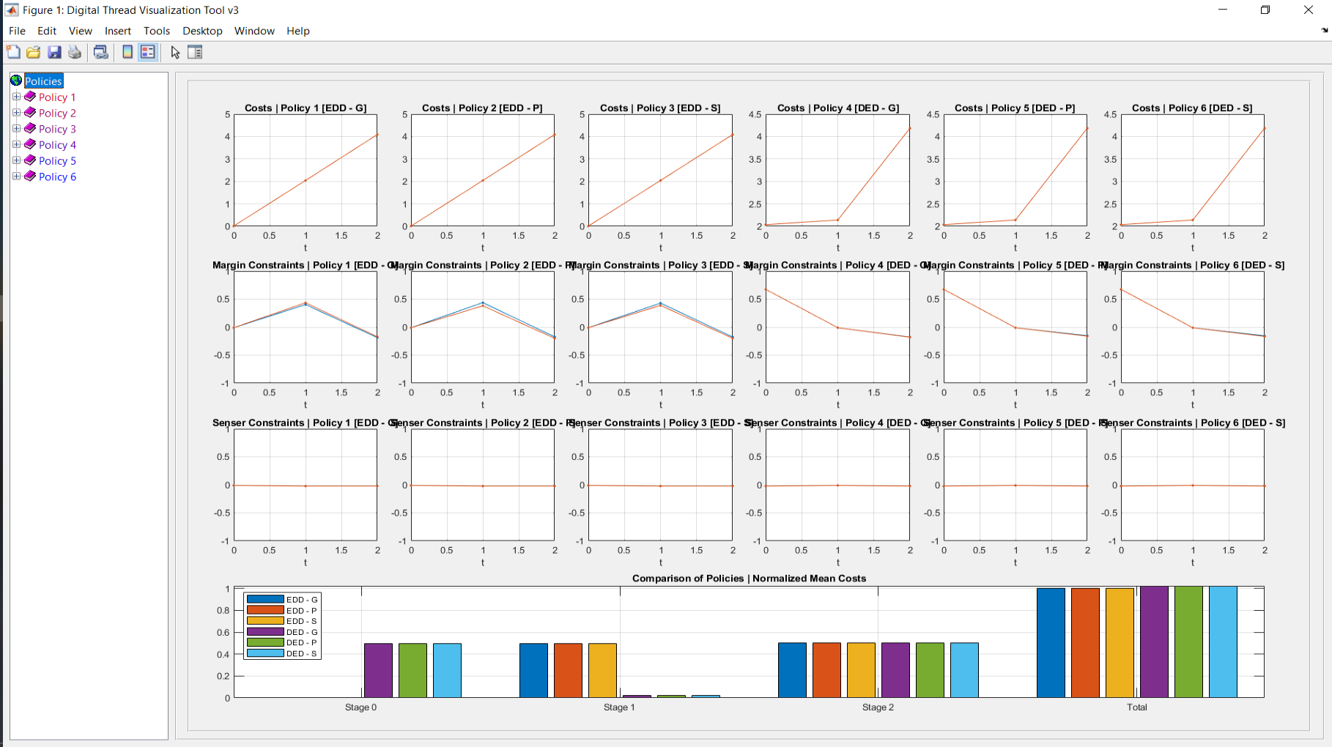
Left clicking Policies brings you to the policy comparison pane

Slide 6
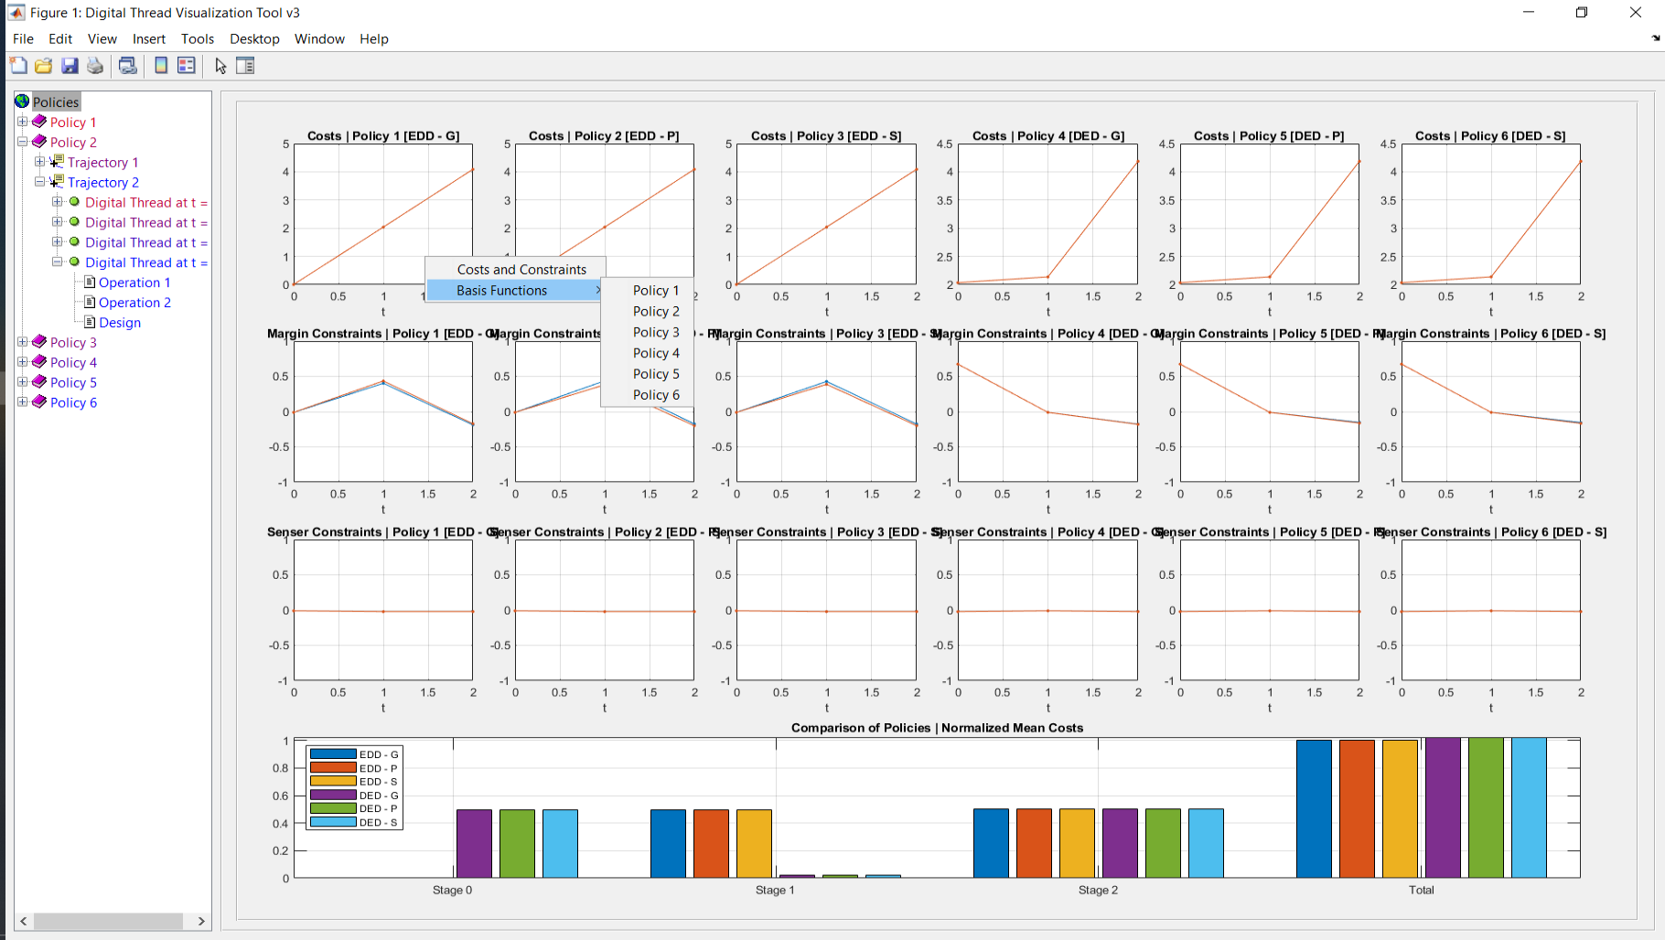
Right clicking in the plot area brings up additional views associated to the policy parameterizations

Slide 7
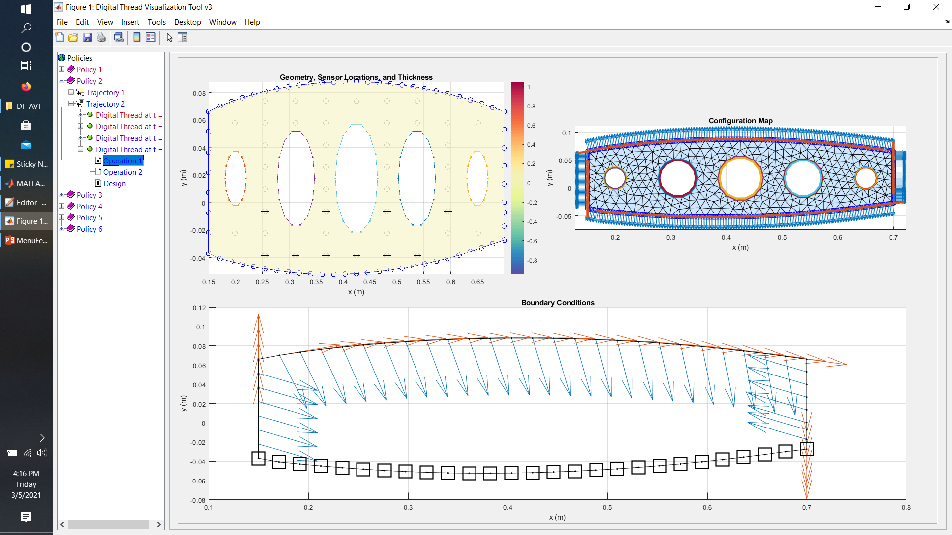
Selecting the lowest node brings up the Digital Twin for that stage

Slide 8
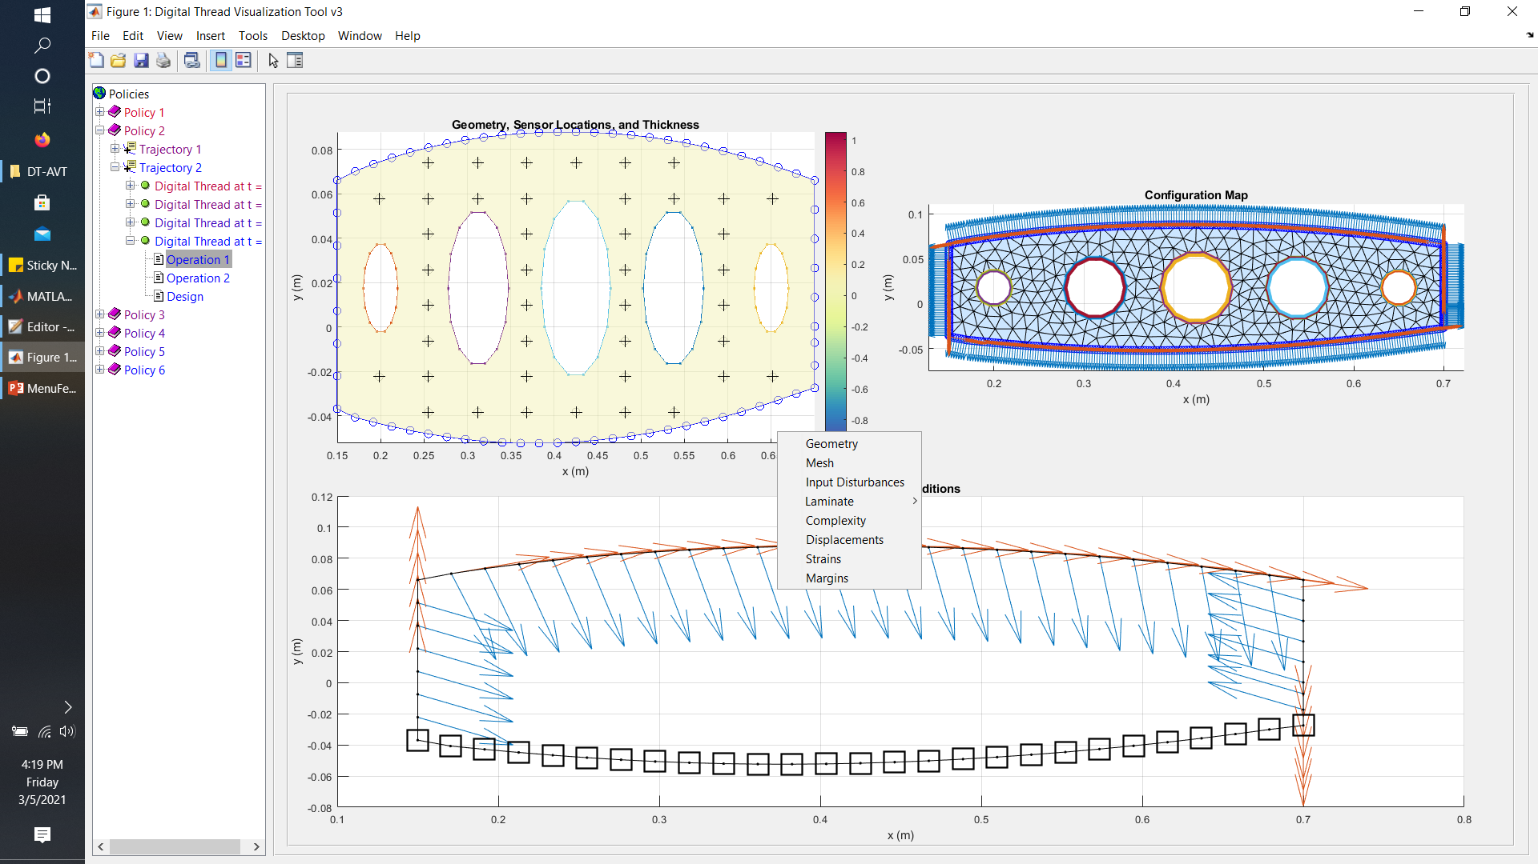
Right clicking in the top left plot area (not the gray pane) brings up additional views of the Digital Twin

