Slide 1
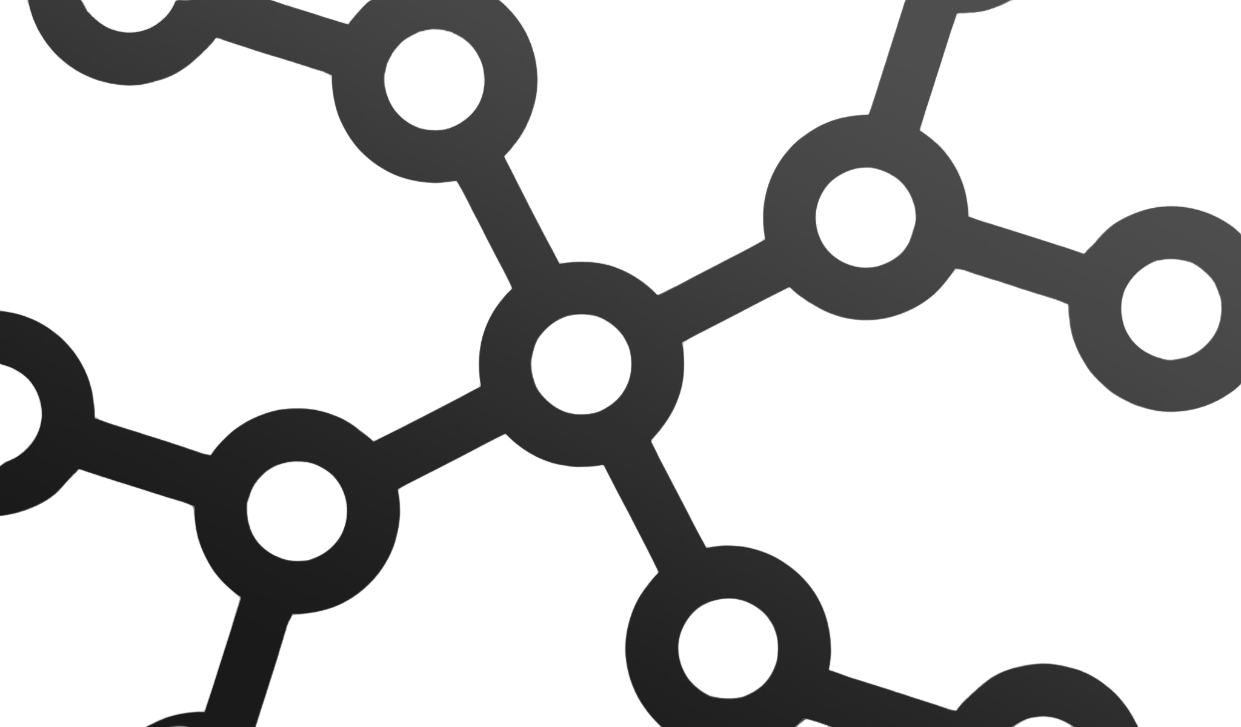





ACCREDITED BY THE AMERICAN COUNCIL OF TRAINING AND DEVELOPMENT
Automating the journey from code to production
Kubernetes Basics
Facilitator
Ojetokun Victor
DEVOPS ENGINEERING - WEEK 12

Slide 2
ACCREDITED BY THE AMERICAN COUNCIL OF TRAINING AND DEVELOPMENT
KUBERNETES BASICS
Learning Objectives
What is Kubernetes
Pods
Kubernetes Architecture
Deployments
The Declarative Model
Services
Key features and Use cases for Kubernetes

Slide 3
Kubernetes : The Orchestrator
ACCREDITED BY THE AMERICAN COUNCIL OF TRAINING AND DEVELOPMENT
Kubernetes (K8s) is an open-source container orchestration platform originally developed by Google and now maintained as part of the Cloud Native Computing Foundation (CNCF).
Kubernetes helps you deploy, manage, scale, and maintain containerized applications across multiple machines.
Think of Kubernetes as a Manager for Containers
Instead of manually managing containers on different servers, Kubernetes manages them for you.
A Kubernetes cluster is a group of machines called nodes that work together to run containerized applications. Kubernetes makes it possible to manage these machines and applications as one coordinated system.
Key Features of Kubernetes
1. Self-Healing
Kubernetes continuously monitors the applications running in the cluster.
If a Pod crashes or stops working, Kubernetes can automatically restart or replace it to maintain the desired number of running instances.
2. Auto-Scaling
Kubernetes can automatically increase or decrease the number of Pods based on resource usage or other defined metrics.
For example, the Horizontal Pod Autoscaler (HPA) can scale an application based on:
CPU utilization
Memory utilization
Custom or application metrics
Notes:
Compensation is one of the most powerful — and most misunderstood — levers in any organization.
Every business pays people. Very few businesses truly understand how or why they pay people the way they do.
This is where compensation analysis comes in.
Are we paying our people in a way that is fair, competitive, and sustainable for the business?

Slide 4
ACCREDITED BY THE AMERICAN COUNCIL OF TRAINING AND DEVELOPMENT
Kubernetes : The Orchestrator
3. Rolling Updates
Kubernetes can update an application gradually instead of stopping all existing Pods at once.
During a rolling update, old Pods are progressively replaced with new Pods.
4. Intelligent Scheduling
Kubernetes has a component called the Scheduler.
The Scheduler decides which node should run a Pod based on factors such as:
Available CPU and memory
Resource requests and limits
Node constraints
Affinity and anti-affinity rules
Taints and tolerations
Instead of manually deciding where every container should run, Kubernetes makes the scheduling decision based on the rules you provide.
5. Service Discovery and Load Balancing
Kubernetes Services provide a stable way for applications to communicate with Pods.
A Service can distribute network traffic across multiple healthy Pods running the same application.
Notes:
Compensation is one of the most powerful — and most misunderstood — levers in any organization.
Every business pays people. Very few businesses truly understand how or why they pay people the way they do.
This is where compensation analysis comes in.
Are we paying our people in a way that is fair, competitive, and sustainable for the business?

Slide 5
ACCREDITED BY THE AMERICAN COUNCIL OF TRAINING AND DEVELOPMENT
Container Orchestration Problem
The Container Orchestration Problem
Docker makes it easy to build, package, and run containers, but managing containers at scale becomes difficult.
Running a few containers manually is manageable. But imagine running 1,000 containers across 50 servers: manual management quickly becomes inefficient, error-prone, and difficult to maintain.
Limitations of Managing Docker Manually
No Automatic Self-Healing: A crashed container may remain down unless someone restarts it.
Manual Scaling: Increasing capacity requires manually starting additional containers.
Deployment Challenges: Updating hundreds of containers can cause service disruption if not carefully managed.
Traffic Management: Docker alone does not provide cluster-wide service discovery and load balancing.
Resource Management: Containers may be poorly distributed, leaving some servers overloaded while others remain underutilized.
The Solution: Container Orchestration
As containerized applications grew larger, organizations needed a system that could automatically deploy, scale, schedule, monitor, and recover containers across multiple servers.
This need led to container orchestration platforms such as Kubernetes, Docker runs containers. Kubernetes manages containers at scale.
Notes:
Compensation is one of the most powerful — and most misunderstood — levers in any organization.
Every business pays people. Very few businesses truly understand how or why they pay people the way they do.
This is where compensation analysis comes in.
Are we paying our people in a way that is fair, competitive, and sustainable for the business?

Slide 6
Docker Compose Vs Kubernetes
ACCREDITED BY THE AMERICAN COUNCIL OF TRAINING AND DEVELOPMENT
Area | Docker | Kubernetes
Main Purpose | Builds and runs containers | Manages and orchestrates containers at scale
Container Management | Manages containers on individual machines | Manages containers across multiple machines/nodes
Scaling | Usually requires manual configuration or additional tools | Supports automatic and manual scaling
Self-Healing | Can restart containers with configured restart policies | Automatically maintains the desired number of Pods
Deployment | Containers can be updated manually | Supports controlled deployments such as rolling updates
Scheduling | You generally decide where containers run | Scheduler determines suitable nodes for Pods
Load Balancing | Requires additional configuration/tools | Kubernetes Services provide service discovery and traffic distribution
Networking | Provides container networking | Provides cluster-level networking and Services
Resource Management | Basic container resource controls | Schedules workloads based on CPU, memory, and other constraints
High Availability | Requires additional setup | Designed to support highly available workloads
Desired State | Primarily command-based management | Declarative: you define the desired state
Best For | Building, packaging, and running containers | Managing containerized applications across a cluster
Notes:
Compensation is one of the most powerful — and most misunderstood — levers in any organization.
Every business pays people. Very few businesses truly understand how or why they pay people the way they do.
This is where compensation analysis comes in.
Are we paying our people in a way that is fair, competitive, and sustainable for the business?

Slide 7
ACCREDITED BY THE AMERICAN COUNCIL OF TRAINING AND DEVELOPMENT
Kubernetes Architecture
A Kubernetes cluster consists of two main areas:
Control Plane – Makes decisions and manages the overall cluster.
Worker Nodes – Run the application's Pods and containers.
The Kubernetes API Server acts as the central communication point between users, the Control Plane, and Worker Nodes.
Control Plane Components
API Server: The entry point to the cluster. Receives and processes Kubernetes requests.
etcd: Distributed key-value database that stores the cluster's configuration and state.
Scheduler: Determines which Worker Node should run newly created Pods.
Controller Manager: Continuously compares the desired state with the actual state and takes corrective action.
Worker Node Components
Kubelet: Agent running on each Worker Node that manages Pods and communicates their status to the API Server.
Kube-proxy: Helps implement Kubernetes Service networking and routes traffic to the appropriate Pods.
Container Runtime: Software such as containerd or CRI-O that actually runs the containers.
Notes:
Compensation is one of the most powerful — and most misunderstood — levers in any organization.
Every business pays people. Very few businesses truly understand how or why they pay people the way they do.
This is where compensation analysis comes in.
Are we paying our people in a way that is fair, competitive, and sustainable for the business?

Slide 8
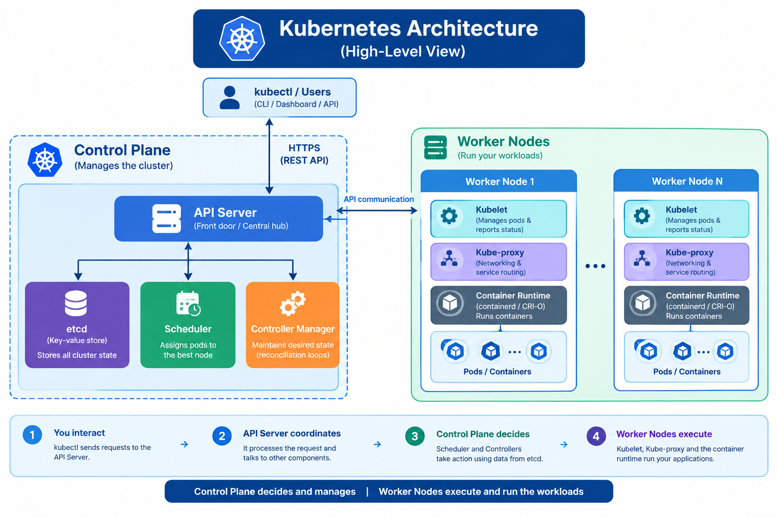
ACCREDITED BY THE AMERICAN COUNCIL OF TRAINING AND DEVELOPMENT
Notes:
Compensation is one of the most powerful — and most misunderstood — levers in any organization.
Every business pays people. Very few businesses truly understand how or why they pay people the way they do.
This is where compensation analysis comes in.
Are we paying our people in a way that is fair, competitive, and sustainable for the business?

Slide 9
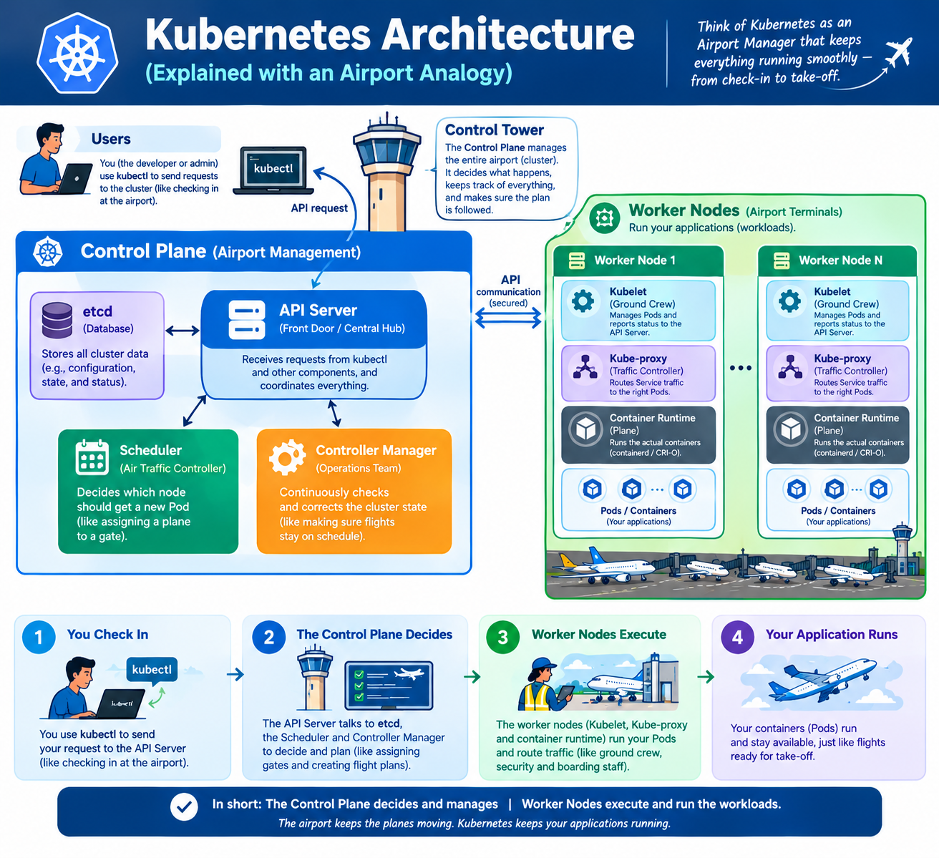
ACCREDITED BY THE AMERICAN COUNCIL OF TRAINING AND DEVELOPMENT
Picture Explainer

Slide 10
ACCREDITED BY THE AMERICAN COUNCIL OF TRAINING AND DEVELOPMENT
The Declarative Model — How K8s works
Kubernetes is declarative, not imperative.
Instead of telling Kubernetes how to perform each action, you declare the desired state, and Kubernetes continuously works to make the actual environment match it.
The Control Loop — Reconciliation
Desired State
↓
Observe Actual State
↓
Compare / Find Difference
↓
Take Corrective Action
↓
Desired State Achieved
↓
Repeat Continuously
Example
Imperative: Docker
docker run nginx
"Start an Nginx container now.“
Declarative — Kubernetes
kubectl apply -f deployment.yaml
replicas: 3
"I want 3 Nginx Pods running."
Kubernetes continuously monitors the cluster. If one Pod fails, Kubernetes detects the difference between the desired state (3) and actual state (2) and creates another Pod.
Notes:
Compensation is one of the most powerful — and most misunderstood — levers in any organization.
Every business pays people. Very few businesses truly understand how or why they pay people the way they do.
This is where compensation analysis comes in.
Are we paying our people in a way that is fair, competitive, and sustainable for the business?

Slide 11
ACCREDITED BY THE AMERICAN COUNCIL OF TRAINING AND DEVELOPMENT
Key Features: What Makes Kubernetes Powerful
Kubernetes is more than a tool for starting containers. It provides a production platform for automating, scaling, networking, and maintaining containerized applications.
What Makes Kubernetes Powerful?
Self-Healing: Automatically restarts failed Pods, replaces unhealthy Pods, and reschedules workloads when possible.
Horizontal Scaling: Automatically increases or decreases Pod replicas based on CPU, memory, or custom metrics using the Horizontal Pod Autoscaler (HPA).
Rolling Updates & Rollbacks: Gradually deploy new application versions while maintaining availability, with the ability to roll back to a previous version.
Service Discovery & Load Balancing: Kubernetes Services provide stable networking and distribute traffic across available Pods, while CoreDNS enables service discovery.
Storage Orchestration: Automatically provisions and mounts persistent storage through PersistentVolumes (PV) and PersistentVolumeClaims (PVCs), including cloud and network storage.
Configuration & Secrets Management: ConfigMaps store application configuration, while Secrets manage sensitive values such as credentials and tokens separately from container images.
Key Takeaway
Kubernetes combines automation, resilience, scalability, networking, storage, and configuration management to keep applications running reliably at scale.
Notes:
Compensation is one of the most powerful — and most misunderstood — levers in any organization.
Every business pays people. Very few businesses truly understand how or why they pay people the way they do.
This is where compensation analysis comes in.
Are we paying our people in a way that is fair, competitive, and sustainable for the business?

Slide 12
Kubernetes Use Cases — Where Is It Used?
ACCREDITED BY THE AMERICAN COUNCIL OF TRAINING AND DEVELOPMENT
Kubernetes has become a widely adopted platform for running and managing containerized workloads at scale. It is available across major cloud platforms and is used in many industries.
Where Is Kubernetes Used?
E-Commerce & Retail: Automatically scale applications during traffic spikes, such as Black Friday or major sales events.
Financial Services: Use Namespaces, RBAC, Secrets, and resource controls to isolate workloads and enforce access and security requirements.
Gaming & Streaming: Dynamically run and scale game servers or streaming workloads based on demand.
AI & Machine Learning: Schedule workloads across GPU-enabled nodes for model training and CPU-based resources for other workloads such as inference and APIs.
Healthcare & SaaS: Support multi-tenant applications by isolating customers or workloads using Namespaces, quotas, and access controls.
CI/CD Pipelines: Create temporary environments and test runners on demand, execute automated tests, and remove them when finished.
Notes:
Compensation is one of the most powerful — and most misunderstood — levers in any organization.
Every business pays people. Very few businesses truly understand how or why they pay people the way they do.
This is where compensation analysis comes in.
Are we paying our people in a way that is fair, competitive, and sustainable for the business?

Slide 13
Kubernetes Use Cases — Where Is It Used?
ACCREDITED BY THE AMERICAN COUNCIL OF TRAINING AND DEVELOPMENT
Why Organizations Use Kubernetes
Kubernetes helps organizations automate infrastructure management; scale applications based on demand, improve resource utilization, and deploy applications consistently.
Key Takeaway
Kubernetes can run anything from a small application to large-scale, distributed workloads across multiple environments.
Notes:
Compensation is one of the most powerful — and most misunderstood — levers in any organization.
Every business pays people. Very few businesses truly understand how or why they pay people the way they do.
This is where compensation analysis comes in.
Are we paying our people in a way that is fair, competitive, and sustainable for the business?

Slide 14
ACCREDITED BY THE AMERICAN COUNCIL OF TRAINING AND DEVELOPMENT
Kubernetes Pods: The Basic Deployment Unit
The smallest, most basic deployable object in Kubernetes
A Pod is the smallest deployable unit in Kubernetes. It represents one or more containers that are designed to run together as a single unit.
Think of a Pod as a small workspace that holds one or more closely related containers.
Key Features of a Pod
Shared Network: Containers inside the same Pod share the same IP address and network namespace. They can communicate with each other using localhost.
Shared Storage: Containers within a Pod can access the same shared volumes, allowing them to exchange files or data when required.
Co-Scheduled: All containers in a Pod are scheduled onto the same Worker Node and run together throughout the Pod's lifecycle.
Sidecar Pattern: A helper container can run alongside the main application to provide supporting functions such as logging, monitoring, proxying, or configuration synchronization.
Important Note
You rarely create Pods directly in production. Instead, Kubernetes controllers such as Deployments, StatefulSets, and DaemonSets create and manage Pods for you.
Key Takeaway: A Pod is the basic execution unit in Kubernetes. It provides a shared environment for one or more containers that need to run together.
Notes:
Compensation is one of the most powerful — and most misunderstood — levers in any organization.
Every business pays people. Very few businesses truly understand how or why they pay people the way they do.
This is where compensation analysis comes in.
Are we paying our people in a way that is fair, competitive, and sustainable for the business?

Slide 15
ACCREDITED BY THE AMERICAN COUNCIL OF TRAINING AND DEVELOPMENT
Pod Lifecycle
Understanding pod phases: pod states, restart policies, and health checking
A Kubernetes Pod is not simply "running" or "stopped." Kubernetes tracks the Pod through defined lifecycle phases that help you understand its current state and troubleshoot problems.
Pod Phases
Pending: The Pod has been accepted by Kubernetes but is not yet running. It may be waiting for scheduling, container image download, or other required resources.
Running: The Pod has been successfully scheduled, and at least one container is running or starting.
Succeeded: All containers in the Pod have completed successfully and exited with exit code 0.
Failed: All containers have terminated, and at least one container exited with a non-zero exit code or failed to complete successfully.
Unknown: Kubernetes cannot determine the Pod's current state, usually because it cannot communicate with the node where the Pod is running.
Why Pod Phases Matter
When troubleshooting, the Pod phase provides an initial indication of what is happening, but it is not enough by itself to identify the root cause.
Key Takeaway: Pod phases tell you the high-level lifecycle state of a Pod; use describe and logs to investigate why it is in that state.
Debug Commands
kubectl describe pod [pod-name] # events + config
kubectl logs [pod-name] # container stdout
kubectl logs [pod-name] -c sidecar # specific container
kubectl exec -it [pod-name] -- sh # shell into pod
Notes:
Compensation is one of the most powerful — and most misunderstood — levers in any organization.
Every business pays people. Very few businesses truly understand how or why they pay people the way they do.
This is where compensation analysis comes in.
Are we paying our people in a way that is fair, competitive, and sustainable for the business?

Slide 16
ACCREDITED BY THE AMERICAN COUNCIL OF TRAINING AND DEVELOPMENT
Pod Patterns: Working with Multiple Containers
Three proven patterns for running multiple containers in one Pod
Most Kubernetes Pods run one main application container. However, some applications benefit from additional containers that run alongside the main application and share the Pod's network and storage.
These supporting containers enable common architectural patterns.
Common Pod Patterns
Sidecar Pattern: A helper container runs alongside the main application and provides supporting functionality such as log collection, monitoring, proxying, or configuration synchronization.
Ambassador Pattern: A proxy container handles communication on behalf of the main application, such as TLS termination, connection management, retries, or traffic routing.
Adapter Pattern: A helper container transforms or normalizes the main application's output into a format that another system can easily consume, for example, converting application logs into a standard format.
Init Container: Runs before the main application containers start. It performs initialization tasks such as checking dependencies, preparing configuration, downloading required files, or running database migrations.
Key Takeaway: Multiple containers in a Pod should be used when containers need to share resources and work closely together. Otherwise, keeping applications in separate Pods is usually simpler.
# Why use sidecar vs separate pod?
# Sidecar: tight coupling, shared localhost, shared volume
# Separate pod: independent lifecycle, scaling, deploys
# Check all containers in a pod:
kubectl get pod [pod-name] -o jsonpath='{.spec.containers[*].name}'
Notes:
Compensation is one of the most powerful — and most misunderstood — levers in any organization.
Every business pays people. Very few businesses truly understand how or why they pay people the way they do.
This is where compensation analysis comes in.
Are we paying our people in a way that is fair, competitive, and sustainable for the business?

Slide 17
ACCREDITED BY THE AMERICAN COUNCIL OF TRAINING AND DEVELOPMENT
Deployment: Managing Application Replicas
A Deployment is one of the most common Kubernetes resources for running stateless applications.
It manages a ReplicaSet, which in turn creates and maintains the required number of Pods.
Kubernetes continuously works to keep 3 Pods running.
Key Features
Replica Management: The ReplicaSet ensures the desired number of Pod replicas are running and replaces Pods when they fail.
Rolling Updates: Deploy a new application version gradually by replacing old Pods with new ones, helping maintain service availability.
Rollback: If a deployment causes problems, you can return to a previous revision.
kubectl rollout undo deployment/web
Revision History: Kubernetes maintains Deployment revisions, allowing you to inspect previous versions and deployment changes.
kubectl rollout history deployment/web
Key Takeaway: A Deployment manages the desired state of your application, while the ReplicaSet maintains the required Pods and supports updates and recovery.
# Create a deployment
kubectl create deploy web --image=nginx:1.25 --replicas=3
# Or apply from YAML (recommended)
kubectl apply -f deployment.yaml
# Watch rollout status
kubectl rollout status deploy/web
Notes:
Compensation is one of the most powerful — and most misunderstood — levers in any organization.
Every business pays people. Very few businesses truly understand how or why they pay people the way they do.
This is where compensation analysis comes in.
Are we paying our people in a way that is fair, competitive, and sustainable for the business?

Slide 18
ACCREDITED BY THE AMERICAN COUNCIL OF TRAINING AND DEVELOPMENT
Deployment YAML: The Application Blueprint
A Deployment YAML manifest describes the desired state of your application. It acts as the configuration blueprint Kubernetes uses to create, update, and manage your Pods.
Understanding the key fields helps you confidently manage Kubernetes workloads.
Important Deployment Fields
replicas: 3 — Defines the desired number of Pod replicas Kubernetes should maintain.
selector.matchLabels — Defines which Pods belong to and are managed by the Deployment.
template.spec.containers — Defines the containers to run, including the image, ports, environment variables, and resource settings.
resources.requests — Specifies the CPU and memory resources a container requests. Kubernetes uses these values when scheduling Pods.
resources.limits — Defines the maximum CPU and memory resources a container can consume.
Rolling Update Controls
maxUnavailable: 1-Maximum number of Pods that can be unavailable during a rolling update.
maxSurge: 1-Maximum number of additional Pods that can temporarily run above the desired replica count during an update.
Key Takeaway: The Deployment manifest defines what you want, while Kubernetes uses that configuration to create, scale, update, and maintain the application.
Notes:
Compensation is one of the most powerful — and most misunderstood — levers in any organization.
Every business pays people. Very few businesses truly understand how or why they pay people the way they do.
This is where compensation analysis comes in.
Are we paying our people in a way that is fair, competitive, and sustainable for the business?

Slide 19
ACCREDITED BY THE AMERICAN COUNCIL OF TRAINING AND DEVELOPMENT
How the Pieces Connect
Deployment YAML
│
▼
Deployment
│
▼
ReplicaSet
│
▼
Desired # of Pods
│
▼
Running Workload
Common Deployment Commands
Scale the application:
kubectl scale deployment/web --replicas=10
Changes the desired number of replicas to 10.
Update the container image:
kubectl set image deployment/web web=nginx:1.26
Changes the application's container image and triggers a rollout.
Rollback to a previous revision:
kubectl rollout undo deployment/web --to-revision=2
Restores the Deployment to revision 2.
Notes:
Compensation is one of the most powerful — and most misunderstood — levers in any organization.
Every business pays people. Very few businesses truly understand how or why they pay people the way they do.
This is where compensation analysis comes in.
Are we paying our people in a way that is fair, competitive, and sustainable for the business?

Slide 20

Notes:
Compensation is one of the most powerful — and most misunderstood — levers in any organization.
Every business pays people. Very few businesses truly understand how or why they pay people the way they do.
This is where compensation analysis comes in.
Are we paying our people in a way that is fair, competitive, and sustainable for the business?

Slide 21
ACCREDITED BY THE AMERICAN COUNCIL OF TRAINING AND DEVELOPMENT
Kubernetes Rolling Update
What Is a Rolling Update?
Rolling Update is the default Deployment strategy in Kubernetes.
Instead of stopping all existing Pods and starting new ones at once, Kubernetes gradually replaces old Pods with new Pods.
This helps keep the application available throughout the update process.
🔄 Rolling Update Process
Create a New Pod
  Kubernetes creates a new Pod using the updated container image.
Check Readiness
  Kubernetes waits for the new Pod to pass its readinessProbe.
  A Pod that is not ready does not receive application traffic.
Remove an Old Pod from Service
  Once the new Pod is ready, Kubernetes removes an old Pod from the Service's available endpoints.
  Traffic is no longer sent to that Pod.
Gracefully Terminate the Old Pod
  Kubernetes sends SIGTERM to allow the application to shut down cleanly.
  It waits for the configured termination period.
  If the container does not stop, Kubernetes eventually sends SIGKILL.
Repeat the Process
  Kubernetes continues creating new Pods and removing old Pods until all Pods are running the new version.
Notes:
Compensation is one of the most powerful — and most misunderstood — levers in any organization.
Every business pays people. Very few businesses truly understand how or why they pay people the way they do.
This is where compensation analysis comes in.
Are we paying our people in a way that is fair, competitive, and sustainable for the business?

Slide 22
ACCREDITED BY THE AMERICAN COUNCIL OF TRAINING AND DEVELOPMENT
Why Readiness Matters
🚦 Why Readiness Matters
A Kubernetes Service sends traffic only to Pods that are considered Ready.
Therefore:
New Pod → Readiness Check → Ready ✓ → Receives Traffic
If the new Pod fails its readiness check, Kubernetes does not send normal Service traffic to it.
Key Takeaway
Rolling Updates allow Kubernetes to deploy a new application version gradually while keeping the existing service available.
In simple terms:
Create → Test → Send Traffic → Remove Old → Repeat
# Update image
kubectl set image deploy/web web=myapp:v2.0.0
# Watch it happen in real-time
kubectl rollout status deploy/web
# Something wrong? Instant rollback!
kubectl rollout undo deploy/web
# Go back to a specific version
kubectl rollout undo deploy/web --to-revision=3
Notes:
Compensation is one of the most powerful — and most misunderstood — levers in any organization.
Every business pays people. Very few businesses truly understand how or why they pay people the way they do.
This is where compensation analysis comes in.
Are we paying our people in a way that is fair, competitive, and sustainable for the business?

Slide 23
ACCREDITED BY THE AMERICAN COUNCIL OF TRAINING AND DEVELOPMENT
Kubernetes Service
What Is a Service?
Kubernetes Pods are ephemeral, meaning they can be created, destroyed, restarted, or rescheduled at any time.
Because Pods can receive new IP addresses, connecting directly to Pod IPs is unreliable.
A Service provides a stable virtual IP address and DNS name that routes traffic to the appropriate healthy Pods.
🌐 What Does a Service Provide?
1. Stable Endpoint
The Service gets a stable ClusterIP and DNS name.
The Service address remains available even when Pods restart or are replaced.
Applications do not need to know individual Pod IP addresses.
2. Service Discovery
Other Pods can access a Service using its DNS name instead of a hardcoded IP address.
3. Load Balancing
The Service distributes requests across matching Ready/healthy endpoints.
This allows multiple Pods to serve the same application.
Kubernetes provides load balancing across the Service's endpoints; the exact distribution behavior depends on the networking implementation rather than guaranteeing strict round-robin.
Notes:
Compensation is one of the most powerful — and most misunderstood — levers in any organization.
Every business pays people. Very few businesses truly understand how or why they pay people the way they do.
This is where compensation analysis comes in.
Are we paying our people in a way that is fair, competitive, and sustainable for the business?

Slide 24
ACCREDITED BY THE AMERICAN COUNCIL OF TRAINING AND DEVELOPMENT
Kubernetes Service
4. Label Selector
A Service uses a label selector to identify which Pods should receive traffic.
New Pods with matching labels are automatically included as Service endpoints when they become ready.
Key Takeaway
A Service provides a stable way to access dynamic Pods.
Remember:
Pods change → Service stays stable → Traffic continues
Create a Service for a Deployment
kubectl expose deploy/web --port=80 --target-port=8080
# Or apply from YAML
kubectl apply -f service.yaml
# See all services and their IPs
kubectl get svc
# Test from inside cluster
kubectl run test --rm -it --image=busybox -- wget -q http://web-svc
Notes:
Compensation is one of the most powerful — and most misunderstood — levers in any organization.
Every business pays people. Very few businesses truly understand how or why they pay people the way they do.
This is where compensation analysis comes in.
Are we paying our people in a way that is fair, competitive, and sustainable for the business?

Slide 25
Service Types
ACCREDITED BY THE AMERICAN COUNCIL OF TRAINING AND DEVELOPMENT
2. NodePort — Basic External Access
NodePort exposes a Service through a port on each Kubernetes node.
External clients access the application using:
NodeIP:NodePort
Useful for development, testing, and simple environments.
Typically exposes a port from the NodePort range 30000–32767 by default.
Internet
│
▼
NodeIP:30080
│
▼
Service
│
▼
Application Pods
Kubernetes provides different ways to expose applications.
Each option serves a different network traffic pattern.
Choosing the appropriate exposure method helps achieve the required accessibility, security, and scalability.
Main Service Types
1. ClusterIP — Internal Access
ClusterIP is the default Service type.
Accessible only within the Kubernetes cluster.
Used when applications need to communicate internally.
Common examples:
  Databases
  Redis/cache services
  Internal APIs
  Backend services
Use when: You need simple external access without a dedicated external load balancer.
Notes:
Compensation is one of the most powerful — and most misunderstood — levers in any organization.
Every business pays people. Very few businesses truly understand how or why they pay people the way they do.
This is where compensation analysis comes in.
Are we paying our people in a way that is fair, competitive, and sustainable for the business?

Slide 26
Service Types
ACCREDITED BY THE AMERICAN COUNCIL OF TRAINING AND DEVELOPMENT
Example routing:
api.example.com/users → User Service
example.com/shop → Shop Service
Ingress commonly handles TLS termination, allowing HTTPS traffic to be decrypted at the ingress layer before being forwarded to backend Services.
Important: Ingress is not itself a Service type. It is a separate Kubernetes API resource that works with Services and requires an Ingress Controller to implement the routing.
3. LoadBalancer — External Load Balancing
LoadBalancer exposes a Service through an external load balancer, typically provided by a cloud or infrastructure platform.
Examples include:
AWS Elastic Load Balancing
Google Cloud Load Balancing
Azure Load Balancer
Use when: A service needs direct external access through an external load-balancing solution.
4. Ingress — HTTP/HTTPS Routing
Ingress provides Layer 7 HTTP/HTTPS routing into Kubernetes.
Instead of exposing every application through a separate external IP or port, an Ingress can route traffic to multiple Services based on:
Hostname
URL path
TLS/HTTPS configuration
# service.yaml
spec:
type: LoadBalancer # ClusterIP | NodePort | LoadBalancer
selector:
app: webserver # Routes to pods with this label
ports:
- port: 80 # Port the Service listens on
targetPort: 8080 # Port the Pod listens on
Notes:
Compensation is one of the most powerful — and most misunderstood — levers in any organization.
Every business pays people. Very few businesses truly understand how or why they pay people the way they do.
This is where compensation analysis comes in.
Are we paying our people in a way that is fair, competitive, and sustainable for the business?

Slide 27
ACCREDITED BY THE AMERICAN COUNCIL OF TRAINING AND DEVELOPMENT
Quick Comparison
Type | Access | Typical Use
ClusterIP | Internal | Backend, database, cache
NodePort | External via Node IP + port | Development/testing
LoadBalancer | External Load Balancer | Public services
Ingress | HTTP/HTTPS routing | Multiple web services, domains, paths
Key Takeaway
ClusterIP = Internal access
NodePort = Node IP + Port
LoadBalancer = External Load Balancer
Ingress = Smart HTTP/HTTPS Routing
Remember:
Service exposes your application; Ingress intelligently routes web traffic to multiple Services.

Slide 28
Ingress
ACCREDITED BY THE AMERICAN COUNCIL OF TRAINING AND DEVELOPMENT
What Is an Ingress?
An Ingress is a Layer 7 (HTTP/HTTPS) routing mechanism in Kubernetes.
Instead of exposing every application through a separate external LoadBalancer, an Ingress can provide one entry point and route incoming web traffic to different Services based on the hostname or URL path.
Key Capabilities
Cost Efficient: This can reduce the number of external load-balancing resources required, although the actual cost depends on the cloud provider and architecture.
Hostname-Based Routing: Traffic can be routed based on the requested domain.
Path-Based Routing: Traffic can also be routed based on the URL path.
4. TLS Termination
Ingress can handle HTTPS/TLS encryption at the entry point.
The TLS certificate can be managed at the Ingress layer, allowing backend Pods to receive HTTP traffic when appropriate for the internal network and security design.
Note: Using plain HTTP internally is a design choice, not a requirement. Sensitive environments may use encryption all the way to the Pods.
spec:
rules:
- host: api.myapp.com
http:
paths:
- path: /
pathType: Prefix
backend:
service:
name: api-service
port: { number: 80 }
Notes:
Compensation is one of the most powerful — and most misunderstood — levers in any organization.
Every business pays people. Very few businesses truly understand how or why they pay people the way they do.
This is where compensation analysis comes in.
Are we paying our people in a way that is fair, competitive, and sustainable for the business?

Slide 29
Ingress Controller
ACCREDITED BY THE AMERICAN COUNCIL OF TRAINING AND DEVELOPMENT
Popular Ingress Controllers
An Ingress resource only defines the routing rules. An Ingress Controller is responsible for actually implementing those rules.
Popular options include:
NGINX Ingress Controller
Traefik
AWS Load Balancer Controller
Kong Gateway
Notes:
Compensation is one of the most powerful — and most misunderstood — levers in any organization.
Every business pays people. Very few businesses truly understand how or why they pay people the way they do.
This is where compensation analysis comes in.
Are we paying our people in a way that is fair, competitive, and sustainable for the business?

Slide 30
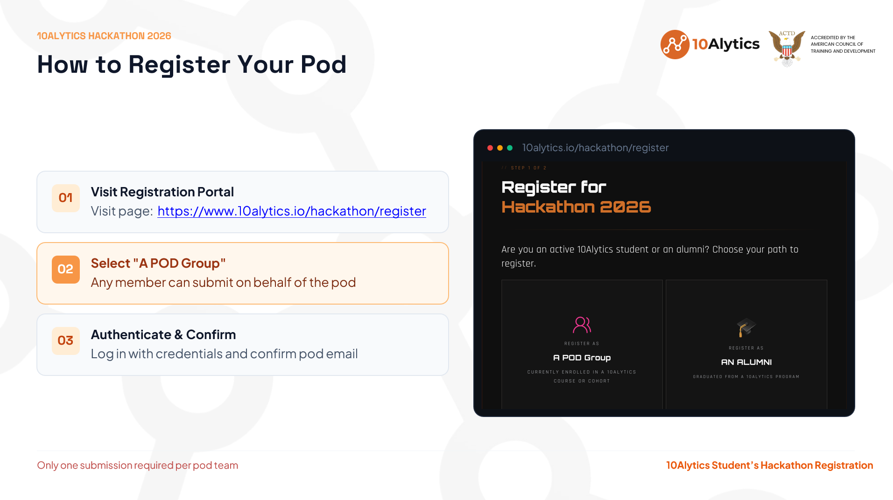

Slide 31
