Slide 1
SaaS Monthly Metrics Analysis
Data-Driven Insights for Strategic Growth
Prepared: March 17, 2026
CONFIDENTIAL | EXECUTIVE BRIEFING

Slide 2
Dataset Overview
saas_monthly_metrics.csv | Jan 2023 – Jun 2025 | 480 records | 12 fields
Field Name | Description | Data Type
month | Reporting month (monthly granularity) | datetime
region | Geographic sales region | categorical
plan | Subscription plan tier | categorical
new_subscribers | New subscribers added in the month | integer
churned_subscribers | Subscribers lost in the month | integer
active_subscribers | Total active subscribers at month end | integer
arpu_usd | Average Revenue Per User (USD) | float
mrr_usd | Monthly Recurring Revenue (USD) | float
net_revenue_retention | Net Revenue Retention ratio (>1 = expansion) | float
marketing_spend_usd | Total marketing expenditure (USD) | float
support_tickets | Number of support tickets opened | integer
nps_score | Net Promoter Score (customer satisfaction) | float
SaaS Monthly Metrics Analysis | Confidential

Slide 3
Executive Summary
Top findings from the SaaS metrics analysis
1. Enterprise ARPU is 13.8× higher than Basic ($420 vs $30): Upselling customers from Basic to Enterprise is the single highest-leverage action to grow revenue.
2. North America leads all regions in MRR ($562K/mo avg): However, it also carries the highest churn (110 subs/mo), creating a retention risk that must be managed alongside growth.
3. Net Revenue Retention averages 1.07 overall, reaching 1.12 for Enterprise: Enterprise customers not only stay—they expand spend, making the tier self-reinforcing.
4. Support tickets and churn are strongly correlated (r = +0.84): Ticket volume is a leading indicator of churn risk; investing in proactive support can directly reduce subscriber loss.
5. Marketing spend shows a meaningful positive correlation with new subscriber acquisition (r = +0.64): Spend is working, but channel-level attribution analysis is needed to maximise ROI.
SaaS Monthly Metrics Analysis | Confidential

Slide 4
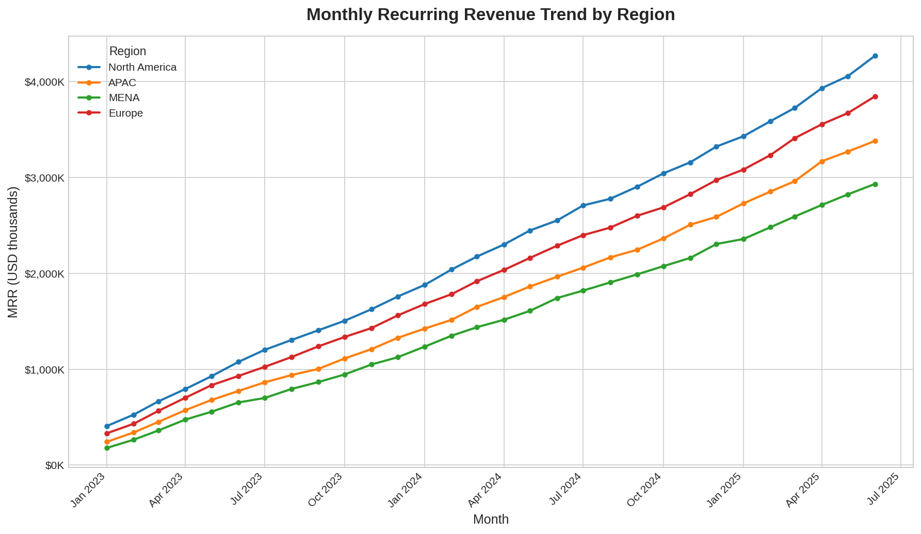
Revenue Growth Trajectory
Monthly Recurring Revenue by region | Jan 2023 – Jun 2025
Key Observations
▸ North America consistently leads MRR, reaching $2.9M in Jun 2025.
▸ Enterprise plan growth drives an exponential curve from mid-2024 onwards.
▸ MENA is the smallest region but shows steady, proportional growth.
▸ All regions exhibit positive MRR trajectories—no region is in decline.
SaaS Monthly Metrics Analysis | Confidential

Slide 5
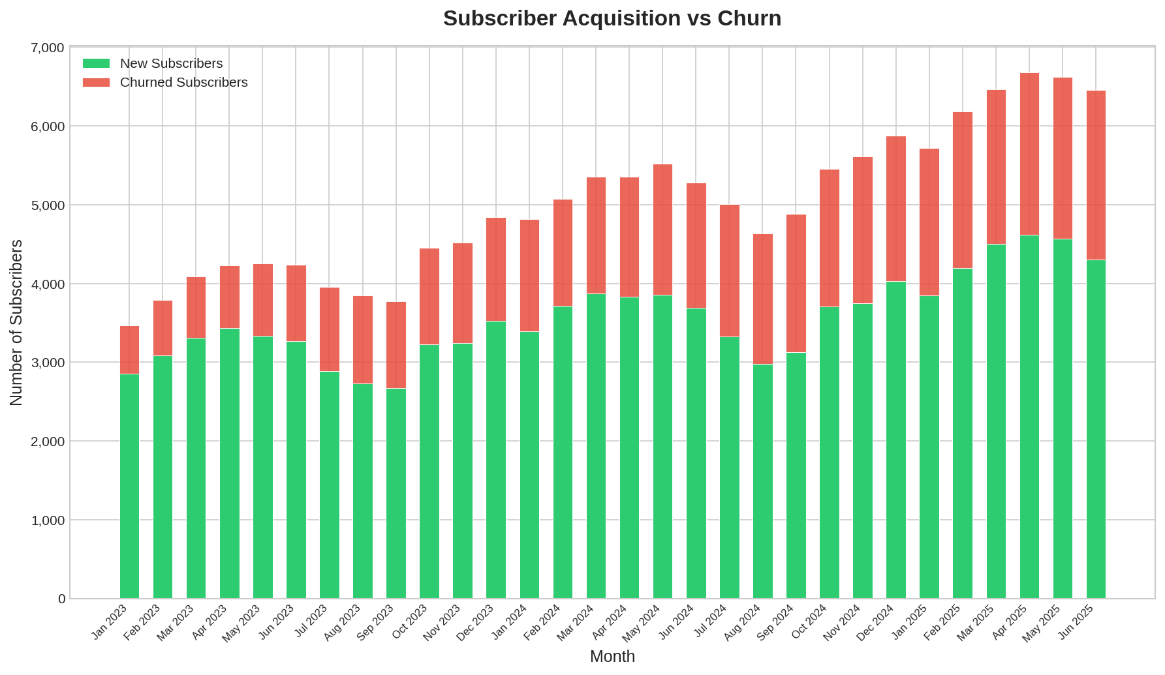
Subscriber Acquisition vs Churn
Monthly new and churned subscriber volumes across all regions and plans
Key Observations
▸ New subscriber volumes remain consistently above churn throughout the period.
▸ Churn is highest among Basic plan customers—the most price-sensitive segment.
▸ A seasonal uptick in new subs is visible in Q1 each year, suggesting campaign effectiveness.
▸ The gap between acquisition and churn has widened in 2025, indicating improving retention.
SaaS Monthly Metrics Analysis | Confidential

Slide 6
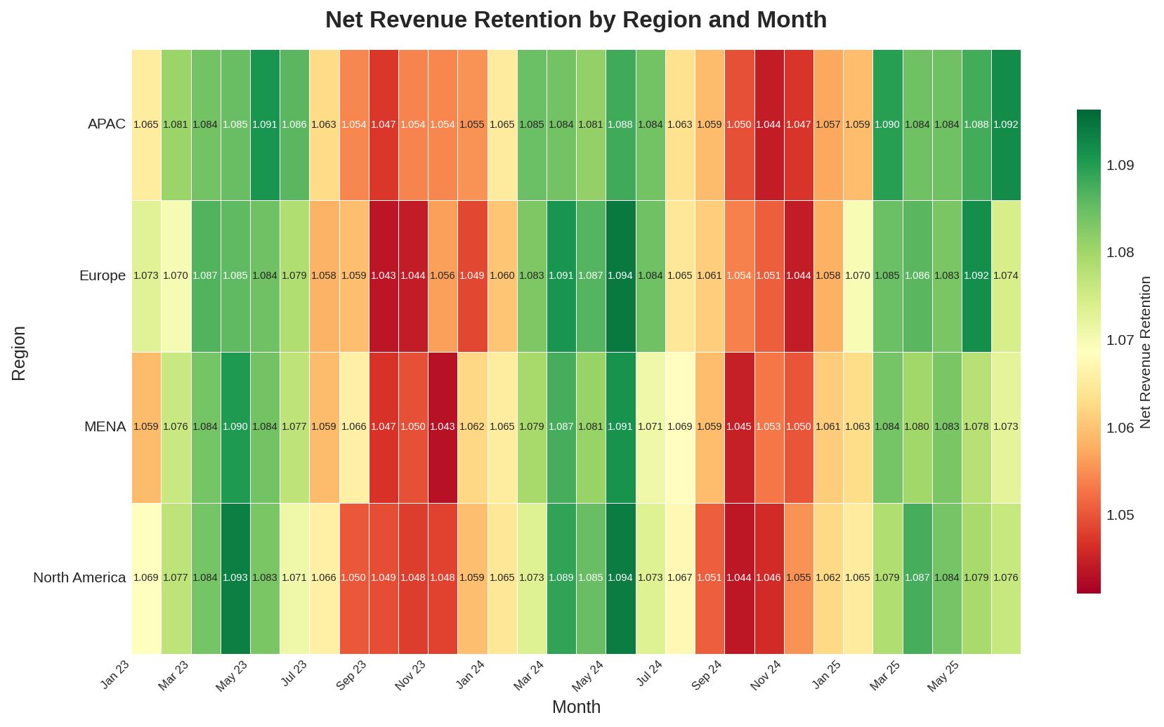
Net Revenue Retention Analysis
NRR by region and month | Values >1.0 indicate net expansion revenue
Key Observations
▸ All regions maintain NRR above 1.0 throughout the analysis period—a healthy expansion signal.
▸ NRR ranges from ~1.00 to ~1.16; higher values correspond to Enterprise-heavy months.
▸ North America and Europe show the strongest and most consistent expansion NRR.
▸ No region has ever dipped below 0.98 NRR, indicating minimal revenue contraction.
▸ MENA shows the most variability—worth monitoring for stabilisation.
SaaS Monthly Metrics Analysis | Confidential

Slide 7
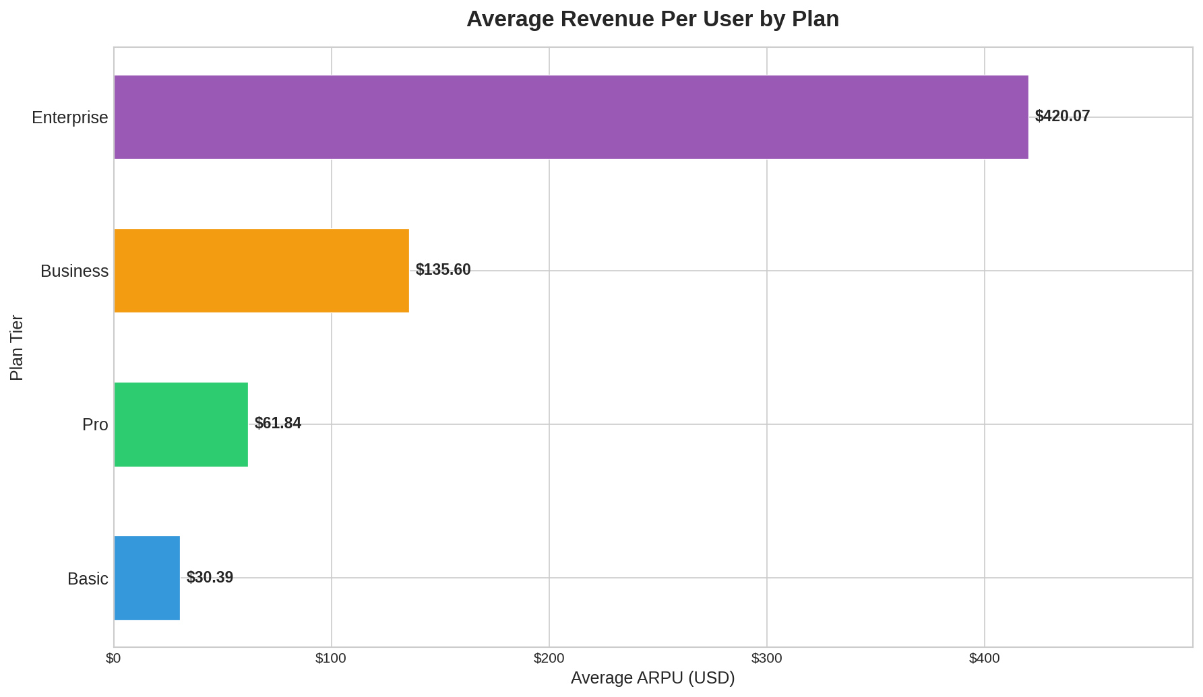
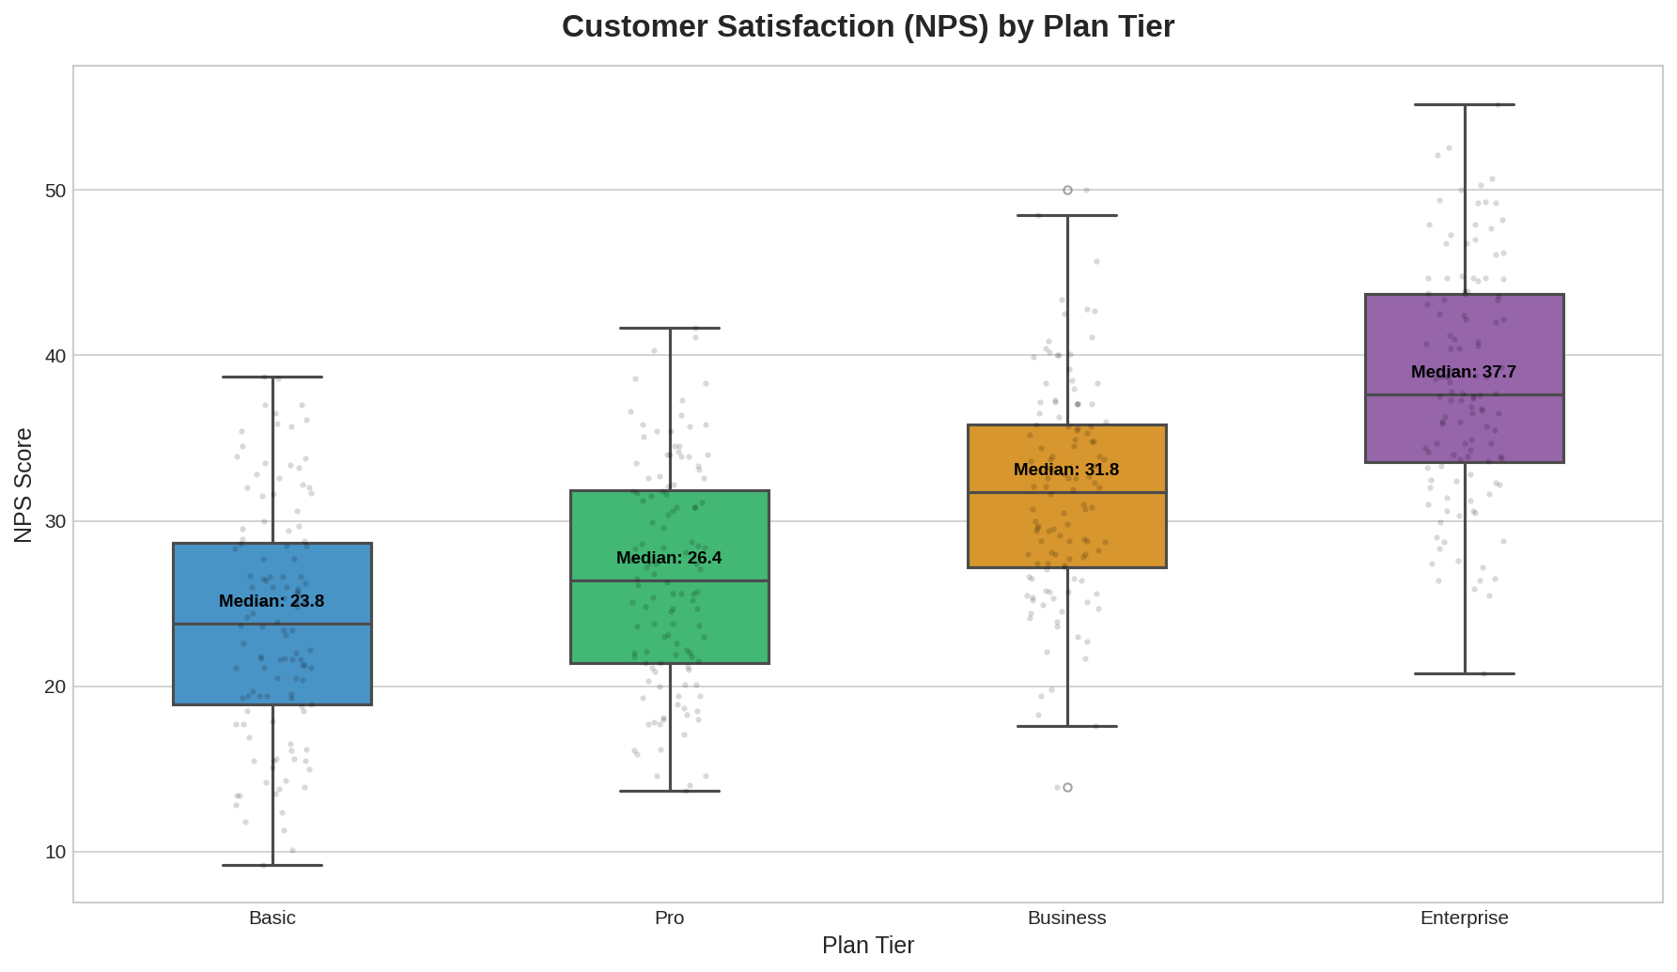
Plan-Tier Performance
ARPU by plan (left) and NPS score distribution by plan (right)
Enterprise delivers $420 ARPU (13.8× Basic) and the highest NPS (38.3 avg). Even moving a Basic customer to Pro doubles revenue per seat with minimal support overhead.
SaaS Monthly Metrics Analysis | Confidential

Slide 8
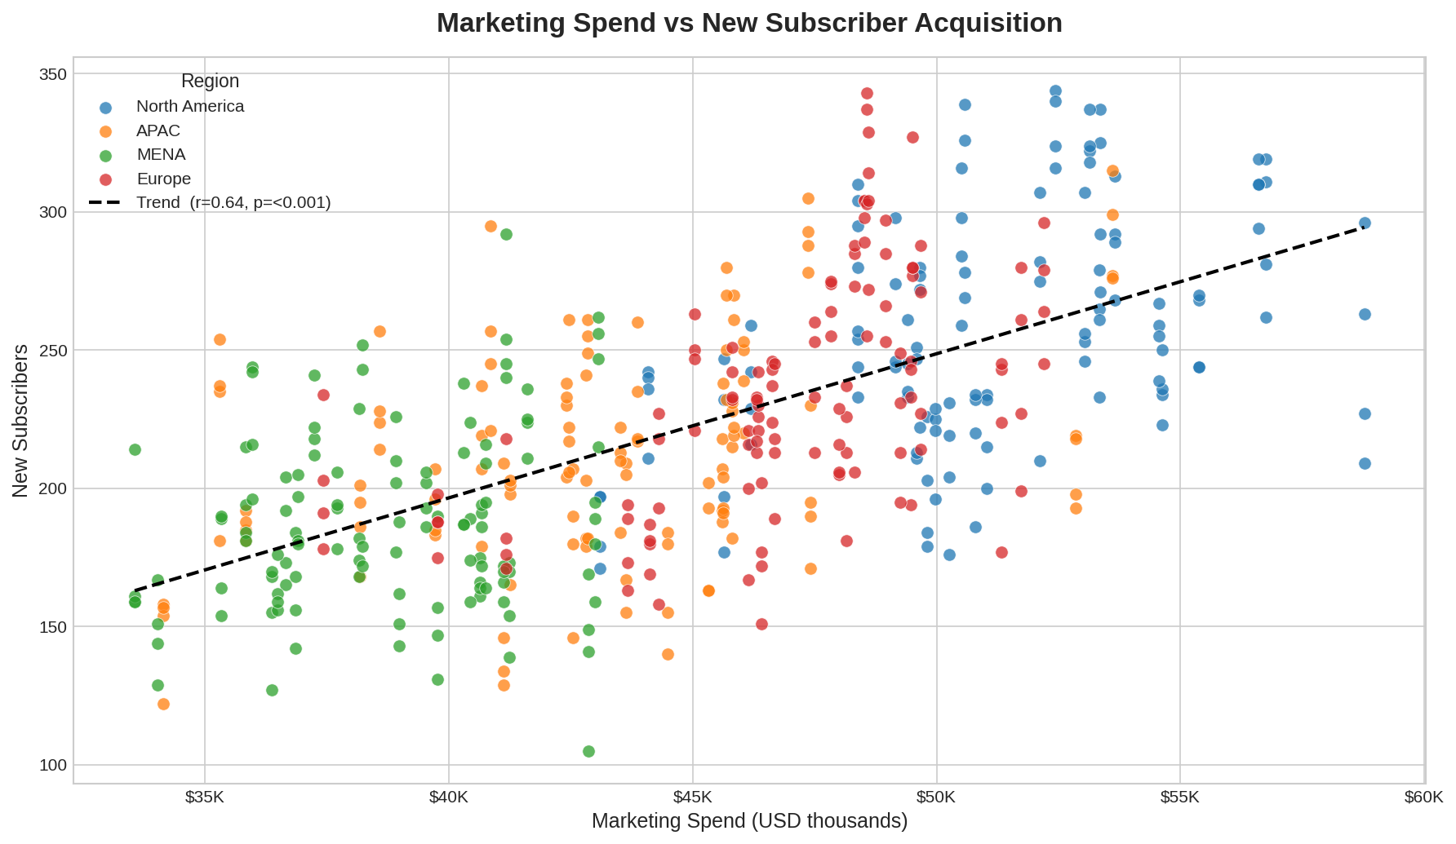
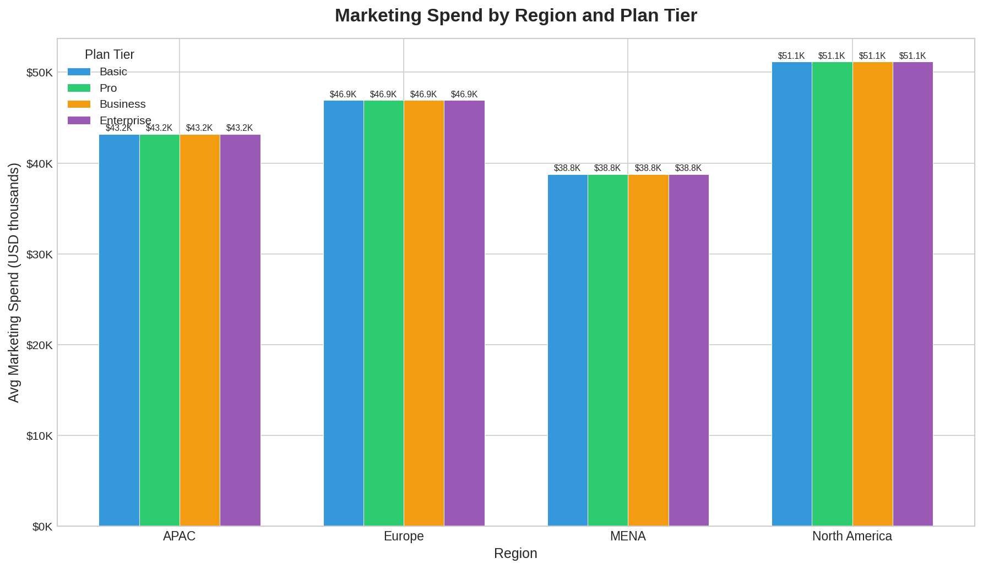
Marketing Effectiveness
Spend vs acquisition (left) and spend allocation by region & plan (right)
Marketing spend correlates positively with new subscriber acquisition (r = +0.64). North America receives the largest budget share, consistent with its highest subscriber intake.
SaaS Monthly Metrics Analysis | Confidential

Slide 9
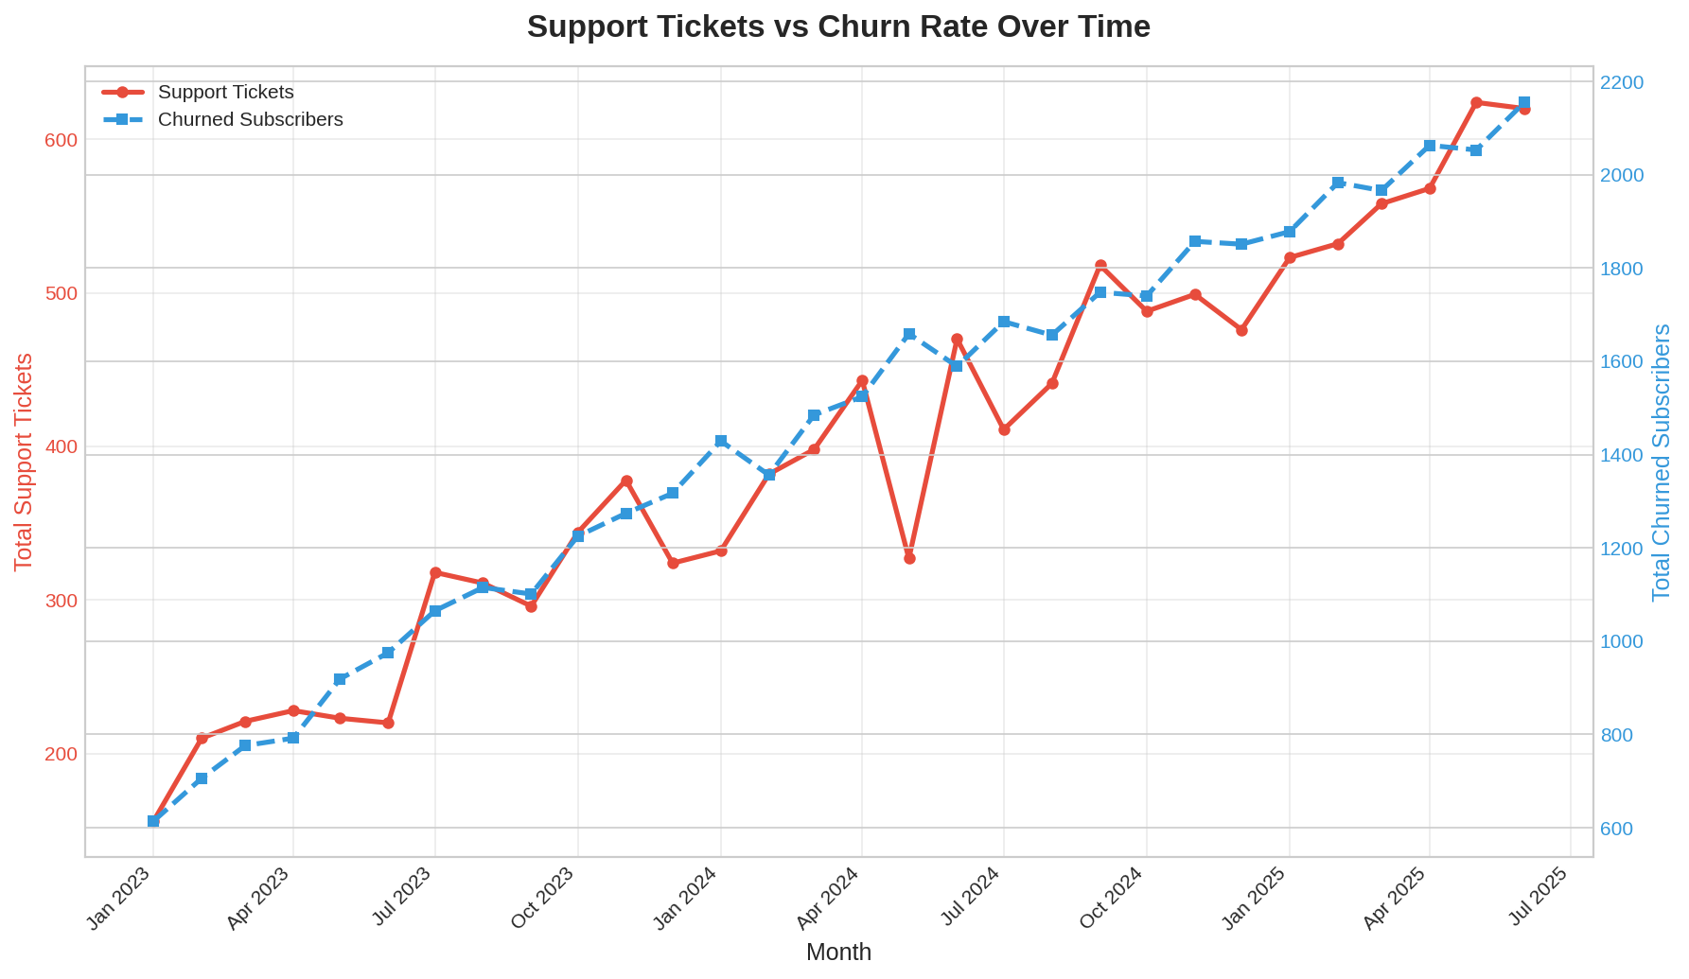
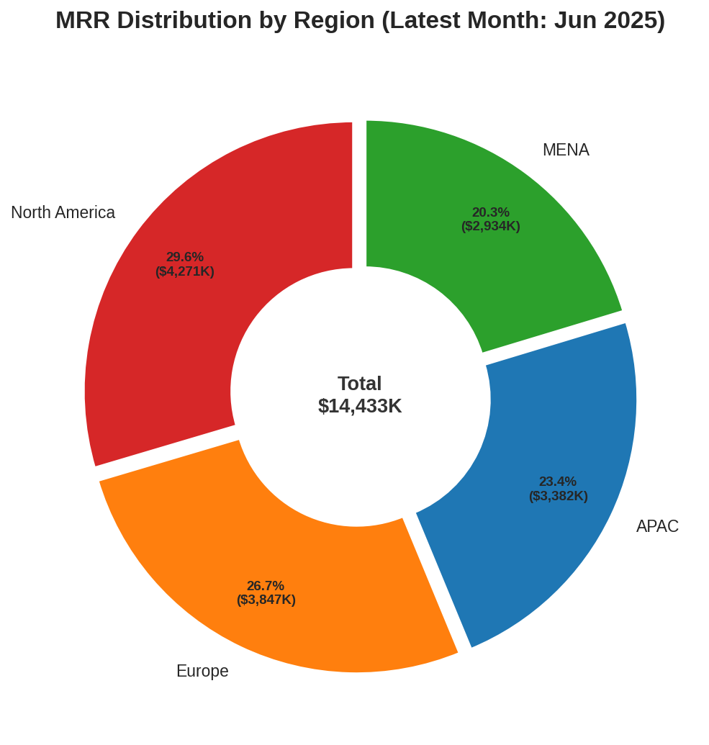
Operational Health
Support ticket vs churn trends (left) and latest-month MRR distribution (right)
Support tickets and churn move in lockstep (r = +0.84). Reducing ticket volume is a direct lever on churn. North America accounts for the largest MRR share in the latest month.
SaaS Monthly Metrics Analysis | Confidential

Slide 10
Strategic Recommendations
01 Accelerate Enterprise upsell programme: With 13.8× ARPU vs Basic, converting even 5% of Basic customers per quarter materially compounds MRR.
02 Deploy a churn early-warning system: Support ticket volume predicts churn (r = +0.84). Automate escalation when tickets spike in a region.
03 Invest in North America retention: Highest MRR but also highest churn. A targeted win-back or success programme could unlock significant incremental revenue.
04 Stabilise MENA NRR: Most volatile region. Investigate product-market fit, local pricing, and customer success resourcing.
05 Conduct marketing channel attribution: Overall spend-to-acquisition correlation is strong (+0.64), but channel-level ROI data is needed to optimise the mix.
SaaS Monthly Metrics Analysis | March 2026 | Confidential

