Slide 1
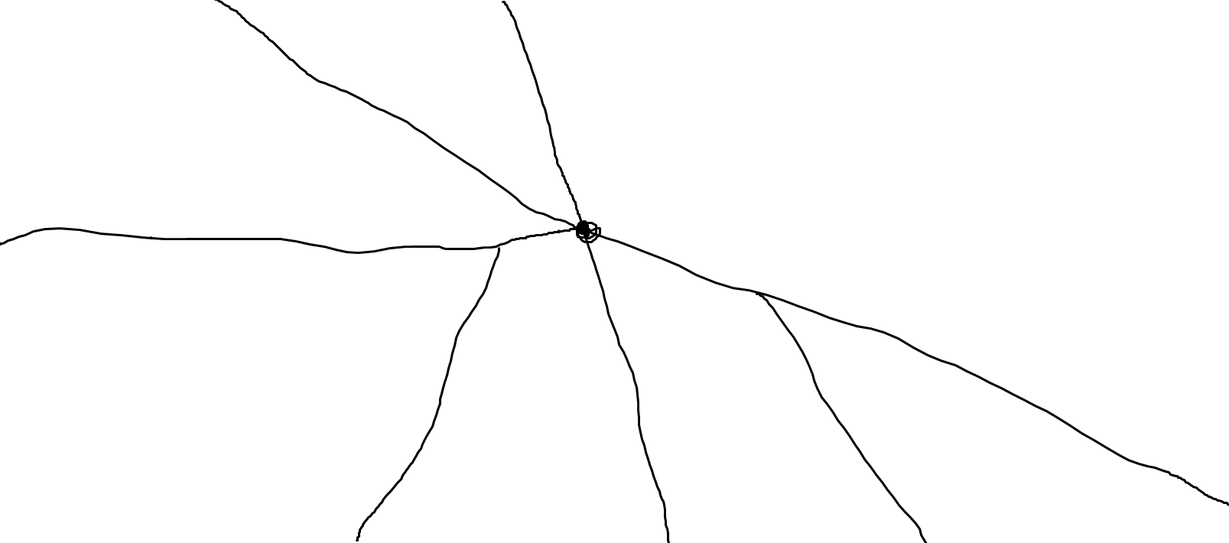
A(0.25, 0)
B(0.45, 0)
C(0.47, 0.5)
E(0.4, 0.51)
D(0, 0.53)
H(0.62, 0.6)
J(1, 0.95)
F(0.35, 1)
G(0.51, 1)
I(0.75, 1)

