Slide 1
CS184 - Milestone
Blake Tickell & Victor Vong

Slide 2
Current Progress
Created a force pipeline to handle all current and future particle motion
Adjusted particle particle features (transparency) to get a better visualization of particle collisions (i.e. depth of water)
Started plane geometry to handle collision leading into self collisions

Slide 3
Road Blocks
Started our own visualization implementation. Scraped it. Went to provided simulation and spent time understanding code base.
Got confused on plane geometry. Coordinate system didn’t make much sense when we tried to ranger a plane below the water particles.

Slide 4
Next Steps
Finish up plane collision which leads into handling inter particle collisions (basing off cloth simulation)
Implement fluid mechanics described in paper(s)

Slide 5
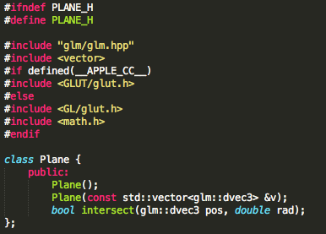
Plane Header

Slide 6
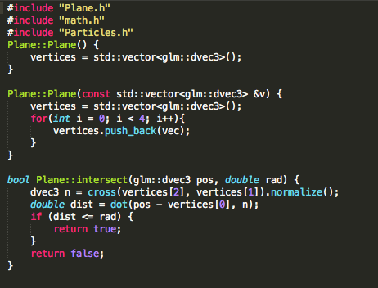
Plane Class

Slide 7
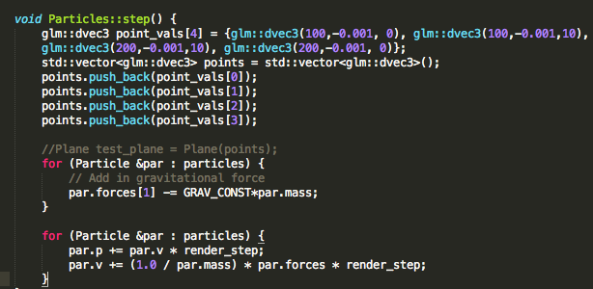
Particle Step

