Slide 1




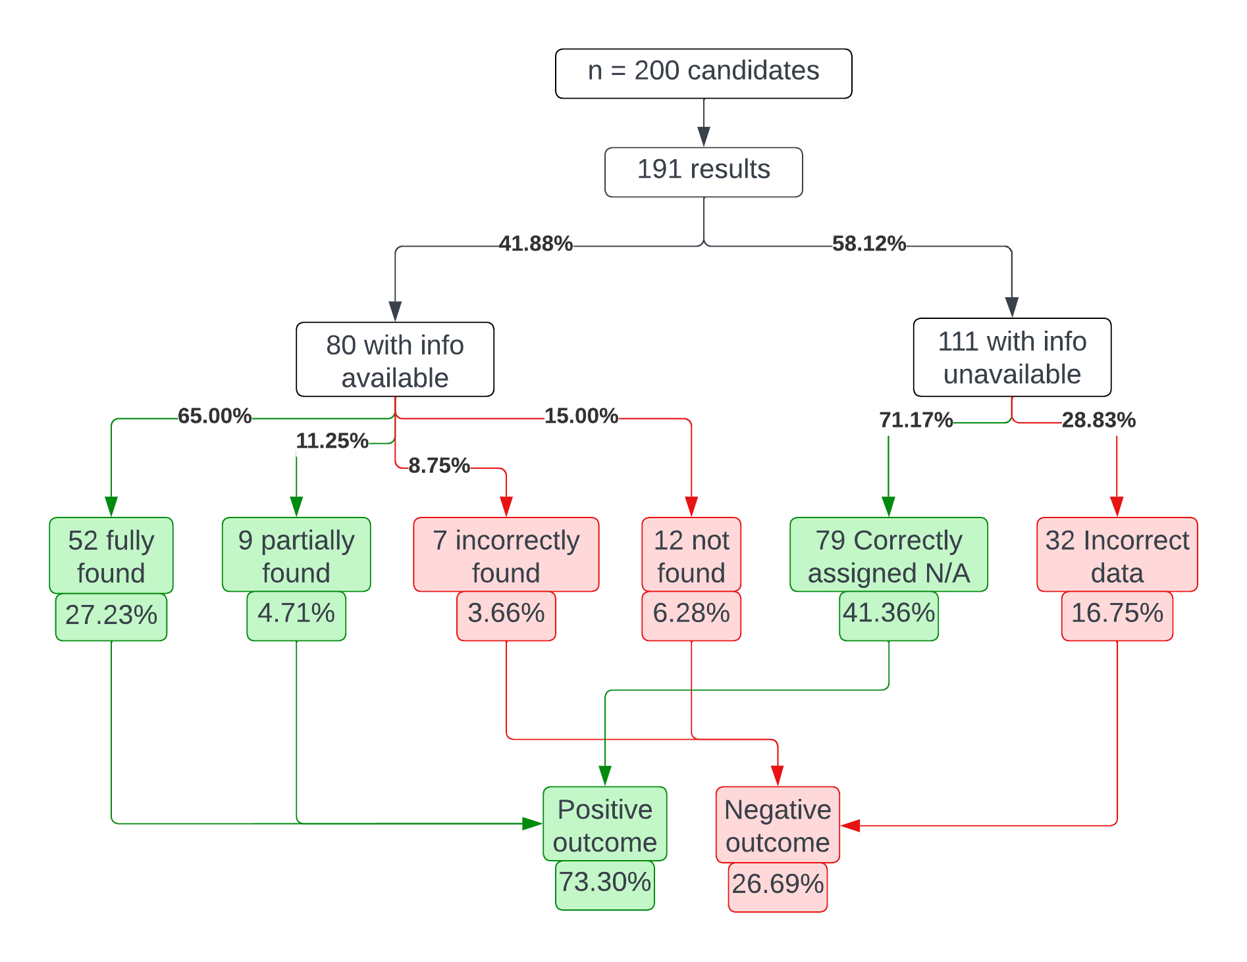
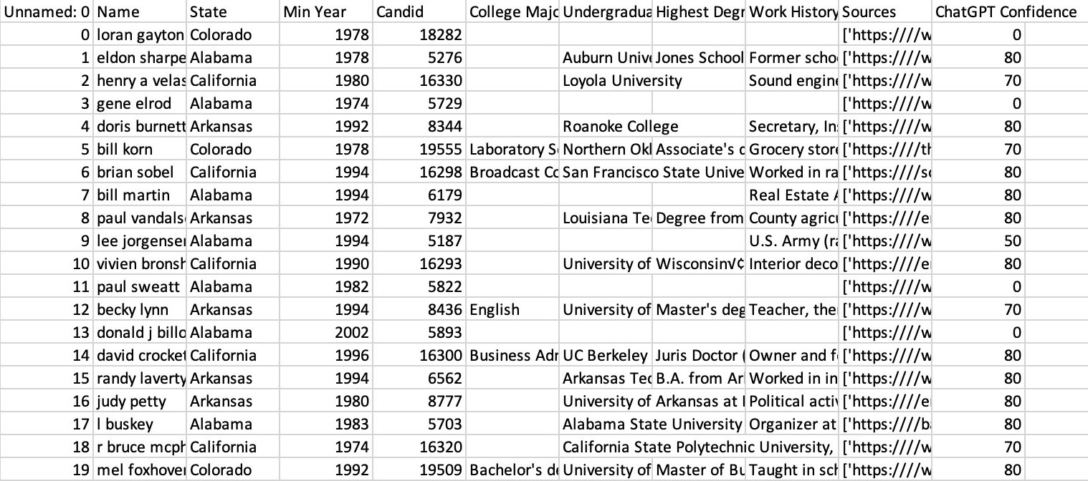
Meet the Author
Using Large Language Models for Massive Political Science Data Scraping
Victor Verma
Victor Verma
I am a third-year student at Boston University majoring in Math and Computer Science, and minoring in Data Science, and I hope to use all three fields in some capacity in my career. In my free time, I like going to the gym, watching movies, and solving the Rubik’s Cube.
Abstract
Data and Results
Major Conclusions
Large Language Models like ChatGPT have recently gained popularity, but much of their potential still needs to be explored. For this project, I developed Python software utilizing ChatGPT’s ability to efficiently summarize large amounts of text in order to obtain the biographical data of nearly 150,000 U.S. state legislator candidates who ran for office between 1967 and 2017. Specifically, I gathered the college major, undergraduate institution, highest degree and institution, and work history of each candidate. Prior to this effort, there was no comprehensive database containing the desired biodata for this scale. This unique dataset offers us insights into the background experience and influences of state legislative candidates.
Through testing so far, I can estimate that approximately 40% of U.S. state legislator candidates between 1967 and 2017 had biodata available on the web. This percentage generally increases as one searches for more recent candidates.
Based on the manual verification of the data produced for about 700 candidates, I can say that the final output is approximately 70% accurate.
If the candidates are filtered to only those who ran after 1998, this accuracy jumps to nearly 80%.
It is worrying that only 40% of U.S. state legislator candidates in the last 50 years have biodata online.
The methodology used in this project is extremely powerful and can serve as a general blueprint to create large-scale information databases related to any topic that can be found on the web.
The tendency of large language models to “hallucinate” warrants a cautious interpretation of their responses.
Human intervention can improve the quantity and quality of the data output, emphasizing the role of humans in monitoring AI in this era of technology.
View my LinkedIn, portfolio website, & GitHub repos!
Research in Context
My mentor, Professor Jetson Leder-Luis, is working with a team of researchers to assess the impact of revolving door lobbying laws on the composition of U.S. state legislators.
The biodata I am gathering will be used as part of the evaluation of the background and credentials of all the candidates.
Specifically, the research team will analyze the biodata using machine learning techniques to find hidden patterns.
The database that I create will be the first of its size containing U.S. state legislator candidates and could be replicated and used by other researchers in their work.
Research Goals
Create Python software to programmatically gather the biodata of U.S. state legislator candidates from 1967 – 2017.
Display each candidate’s college major, undergraduate institution, highest degree and institution, work history, and source URLs in a CSV file.
Improve my ability to write neat and efficient code.
Gain experience in utilizing APIs and external libraries while programming.
Better my critical thinking and problem-solving skills.
Future Research Directions
References
There is room to improve the selection process for the source URLs of the candidates - currently, the first 4 results are chosen for the sake of convenience.
A better web scraping algorithm could be created to reduce the number of candidates whose source URLs cannot be processed.
With additional funding, it would be possible to use a ChatGPT API model with a larger token context, allowing for larger prompt inputs and greater candidate coverage.
A robust methodology needs to be developed in order to verify the accuracy of the gathered data. Currently, manual verification is the only way to know if the gathered data is accurate.
Google’s API Documentation
OpenAI’s API Documentation
API Documentation for the utilized Python libraries
ChatGPT
Research Methods
Data Loss
Google Search Engine – Google Custom Search API.
Web Scraping – BeautifulSoup Python library.
Text Summarization and Processing – ChatGPT API.
Data Compilation – pandas and json Python libraries.
Documentation – the inputs, parameters, and outputs of each function were summarized in a PDF file to ensure transparency and replicability.
Content Validation – sample outputs were manually cross-referenced to assess the overall accuracy.
92% of candidates appear in the final output.
2% of candidates lost their data due to “prompt errors”, where the ChatGPT prompt was too long for the API.
4% of candidates lost their data due to “parse errors”, where the response is in the wrong format.
2% of the candidates lost their data because of issues scraping their source URLs.
The only way to get the missing data (for now) is to manually search for the candidate information.
Acknowledgements
Professor Jetson Leder-Luis
Professor Raymond Fisman
Professor Silvia Vannutelli
Catherine O’Donnell
Undergraduate Research Opportunities Program
Boston University

