Slide 1
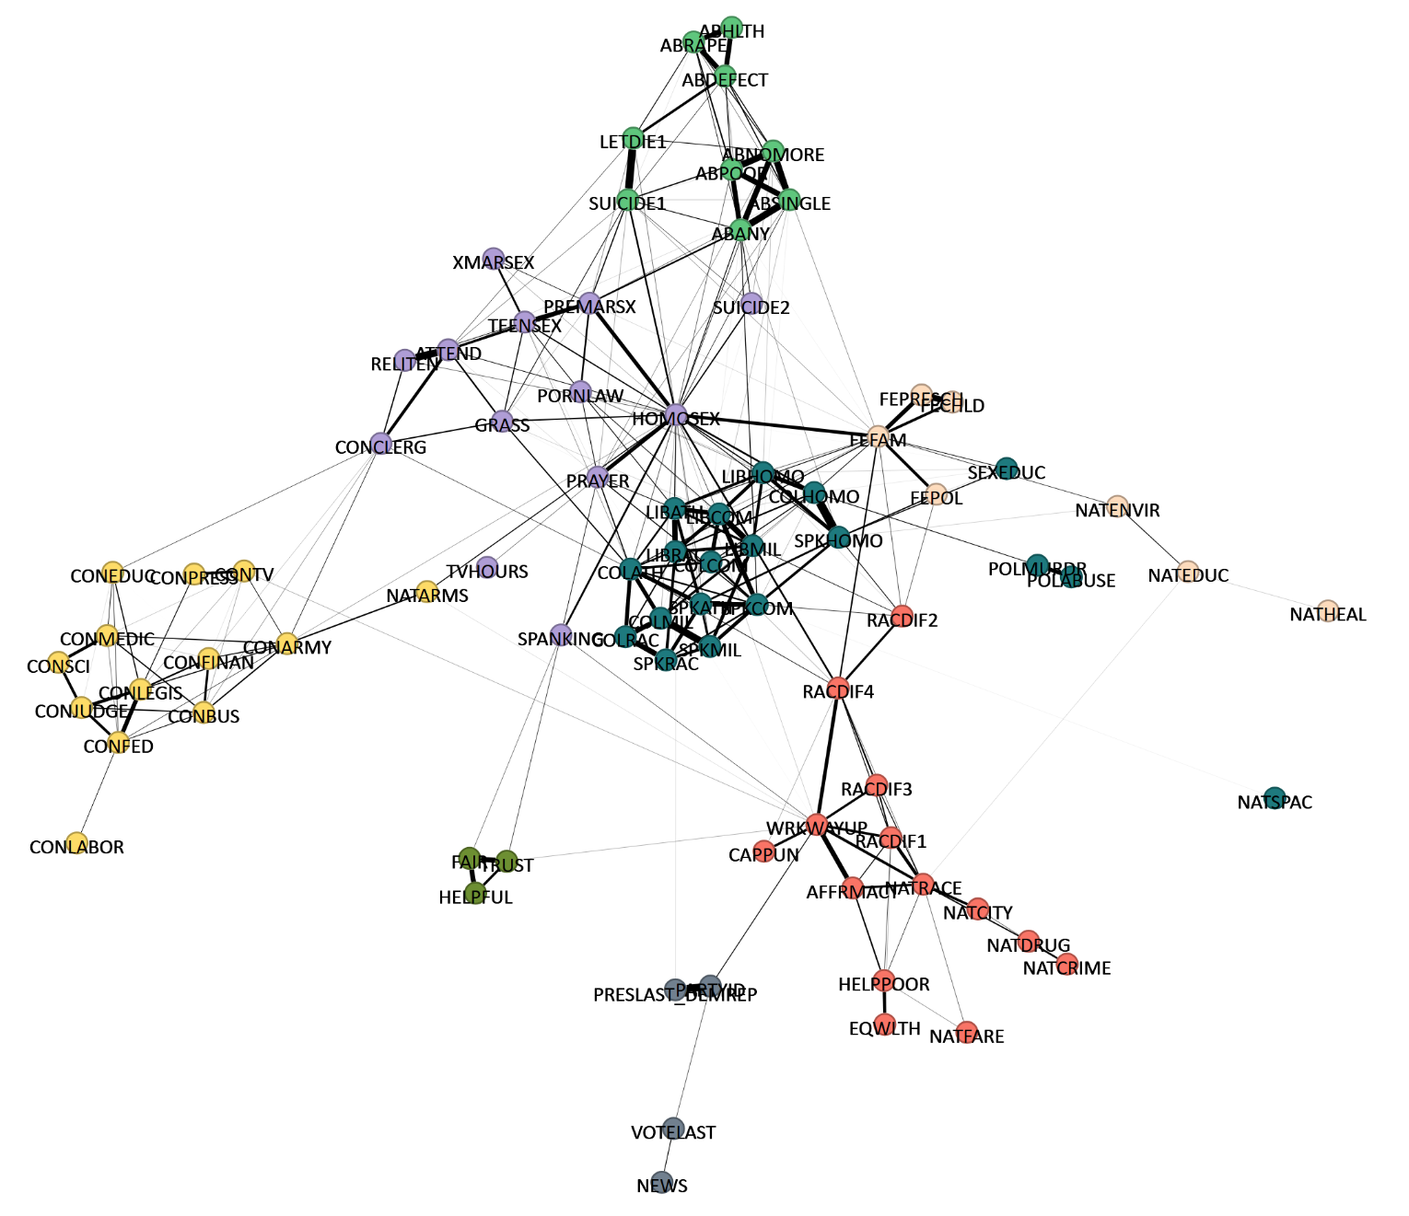
STRUCTURE AND EVOLUTION OF BELIEF NETWORKS

Slide 2
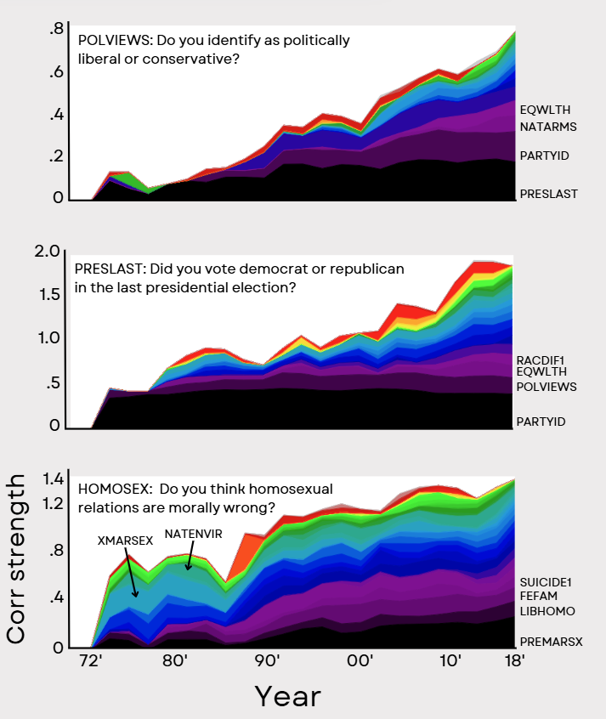
DEGREE EVOLUTION

Slide 3
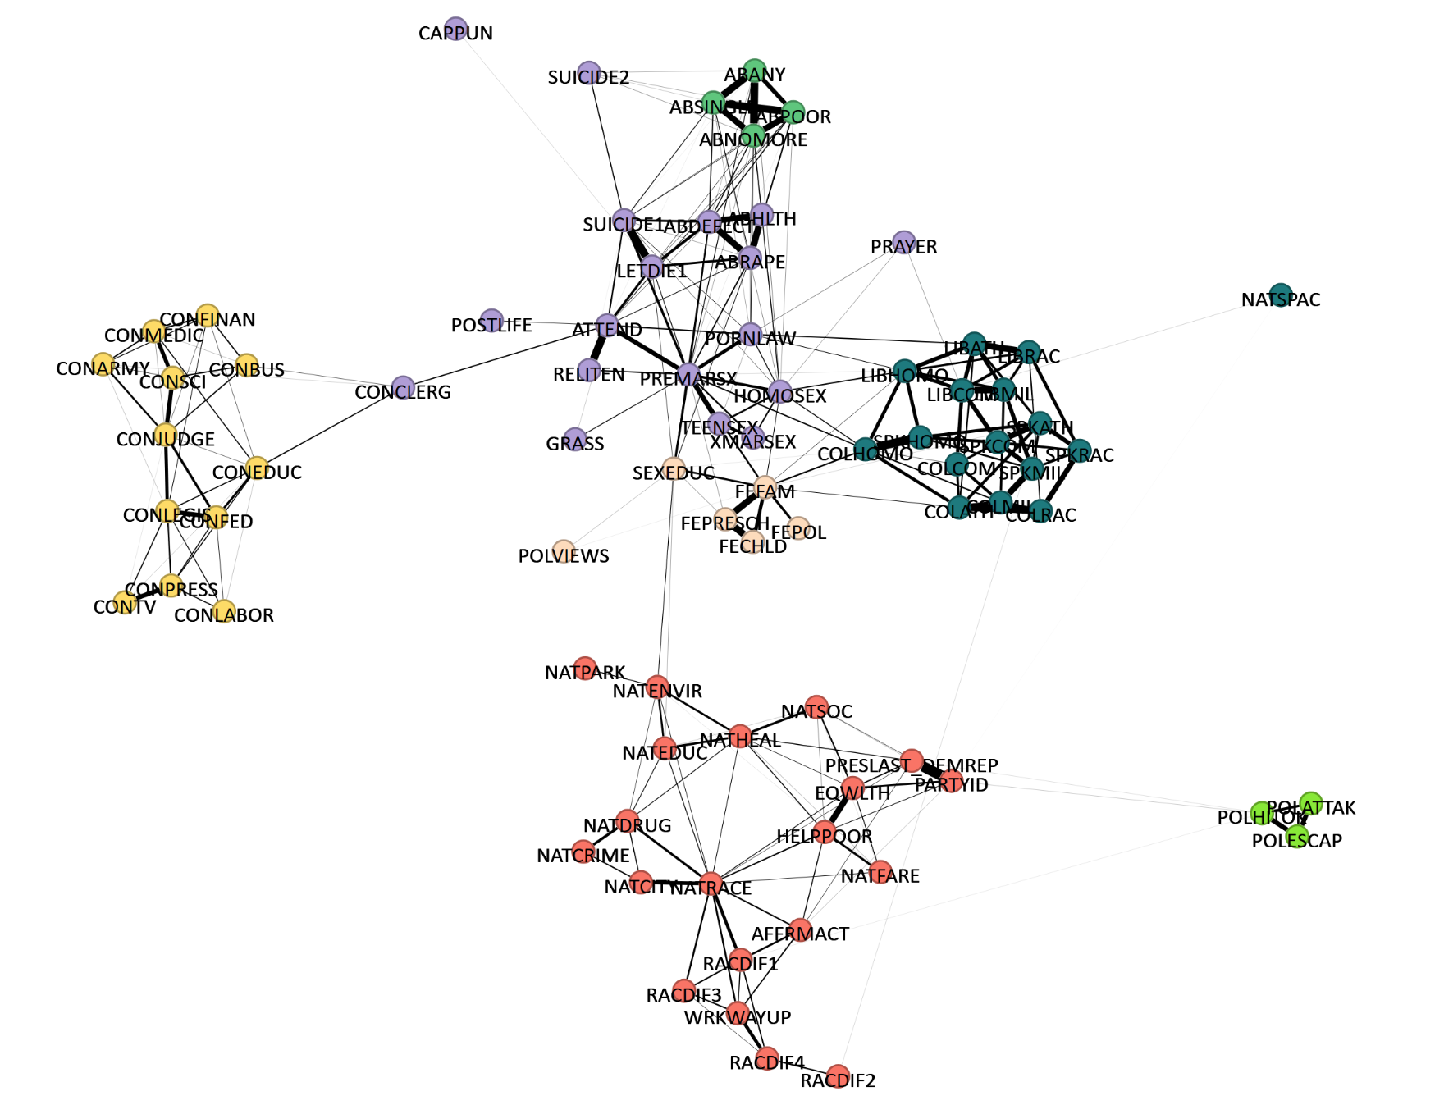
CONDITIONING
LIBERAL
CONSERVATIVE

Slide 4
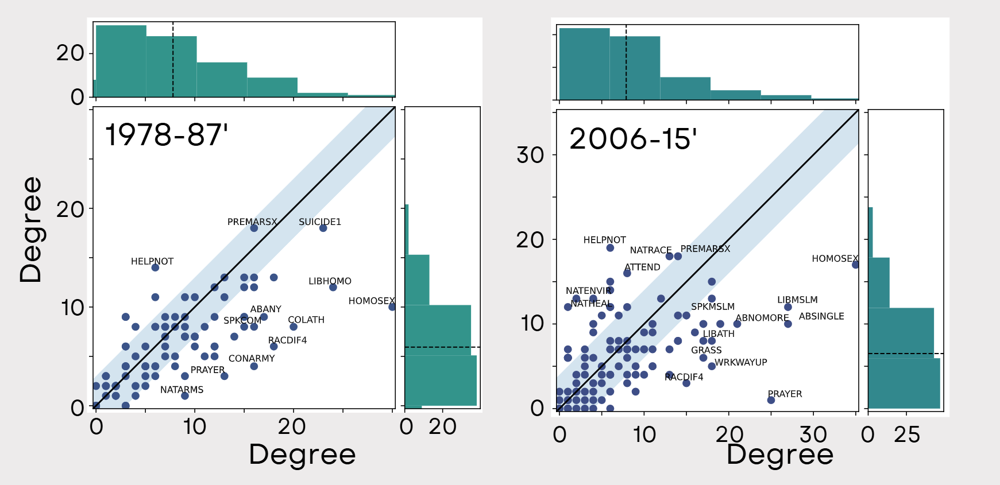
CONDITIONING

