Slide 1
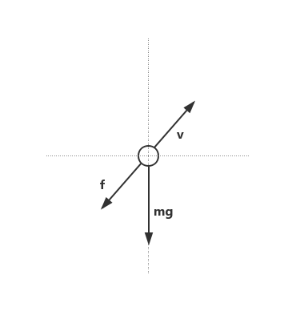
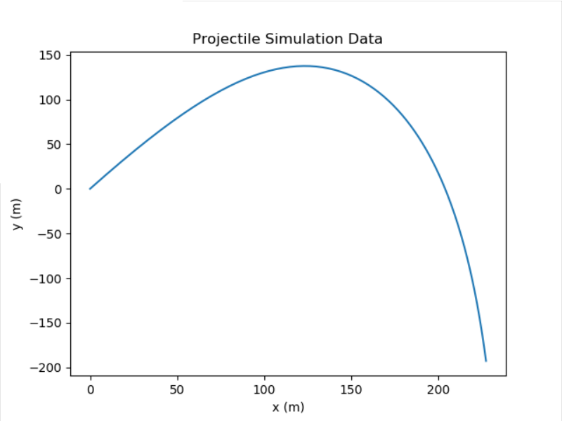
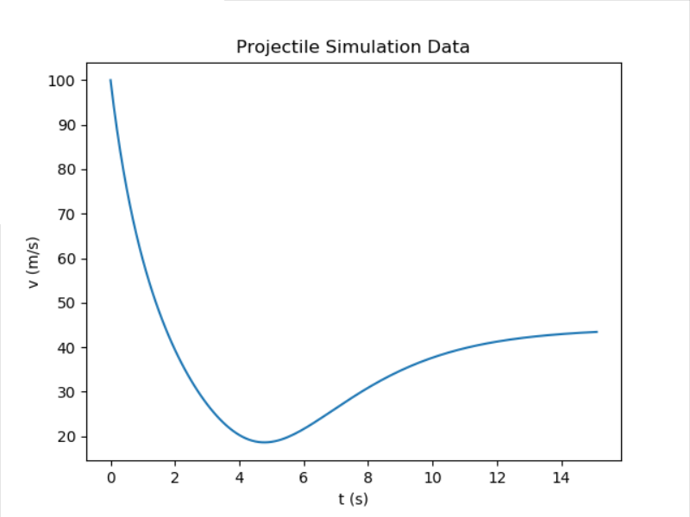
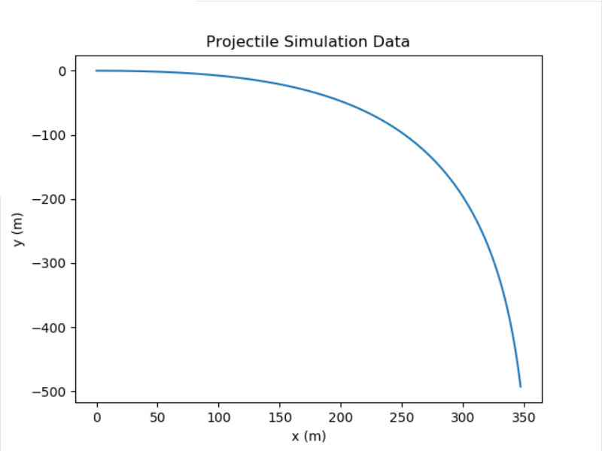
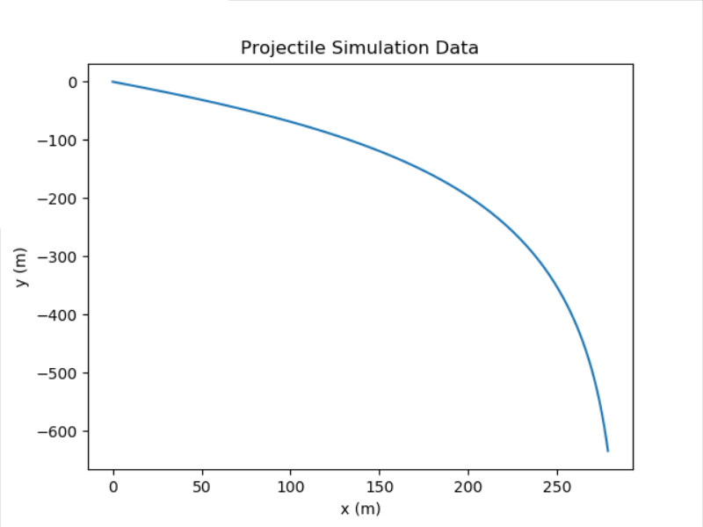
Projectile Model Considering the Effect of
Air Resistance With Python to Simulate
Haochen.Wang
2436518
Abstract
Methods
Force:
G = mg and f = k * v^2
Acceleration:
horizontal : m * ax = f * cos(θ)
vertical : m * ay = f * sin(θ) + mg
* Consider ball in a time
interval as uniformly accelerated linear motion
Displacement:
x[i] = x[i-1] + 0.5 * ax[i-1] * dt^2
y[i] = y[i-1] + 0.5 * ay[i-1] * dt^2
Velocity:
vx[i] = vx[i-1] + ax[i-1] * dt
vy[i] = vy[i-1] + ay[i-1] * dt
Angle:
θ = atan(vy[i-1] / vx[i-1])
Implement a projectile model
Take the effect of air resistance into consideration
Use Python to simulate
Introduction
Read system parameters from input
Calculate physical parameters of motion at each time by physical formula
Print calculation results in console windows
Save calculation results into file
Plot the trajectory of the ball
Animate the movement of the ball
Results
Conclusion
θ = 60
If the time is long enough, the parabolic motion considering air resistance will eventually become a uniform linear motion falling vertically.
θ = 0
When the air drag coefficient remains unchanged, the larger the mass of the object, the greater the initial velocity, the larger the angle between the throw and the throw, the greater the maximum height that the object can reach.
Python lib
Use math and numpy to calculate
Use matplotlib.pyplot to plot trajectory
Use graph to animate movement
θ = -30
Improvement
1. Read system parameters through files
2. Supporting multi-sphere simulation together
3. The process of rebound after hitting the ground
4. Designing a more user-friendly interface
Reference
[1] https://www.fisicalab.com/en/section/uarm-equations#contents
[2] https://courses.lumenlearning.com/physics/chapter/3-4-projectile-motion/
[3] https://matplotlib.org/tutorials/introductory/pyplot.html
[4] https://www.tutorialspoint.com/python/python_graphs.htm

