Slide 1
Web 2.0 應用技術-CSS, JavaScript 及 HTML
CM310.1-09-2013-C
Lesson 3

Slide 2
Outline
Traversing and Manipulating
Events
Effects
Ajax

Slide 3
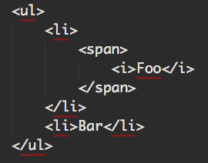
HTML vocabulary
The first list item is a child of the unordered list.
The unordered list is the parent of both list items.
The span is a descendant of the unordered list.
The unordered list is an ancestor of everything inside of it.
The two list items are siblings.
Notes:
<ul>
<li>
<span>
<i>Foo</i>
</span>
</li>
<li>Bar</li>
</ul>

Slide 4
Traversal
Filtering Selections
Finding elements relative to a selection
http://api.jquery.com/category/traversing/

Slide 5
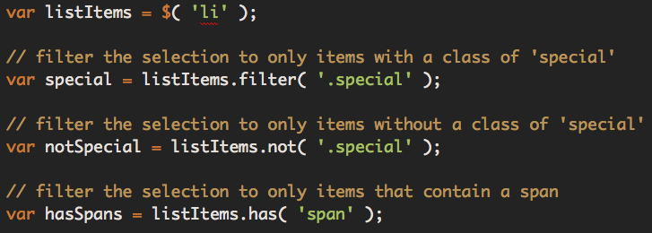
Filtering Selection
Notes:
var listItems = $( 'li' );
// filter the selection to only items with a class of 'special'
var special = listItems.filter( '.special' );
// filter the selection to only items without a class of 'special'
var notSpecial = listItems.not( '.special' );
// filter the selection to only items that contain a span
var hasSpans = listItems.has( 'span' );

Slide 6
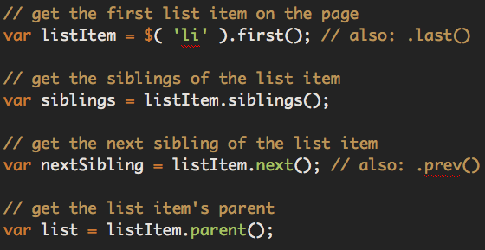
Finding elements relative to a selection
Notes:
// get the first list item on the page
var listItem = $( 'li' ).first(); // also: .last()
// get the siblings of the list item
var siblings = listItem.siblings();
// get the next sibling of the list item
var nextSibling = listItem.next(); // also: .prev()
// get the list item's parent
var list = listItem.parent();

Slide 7
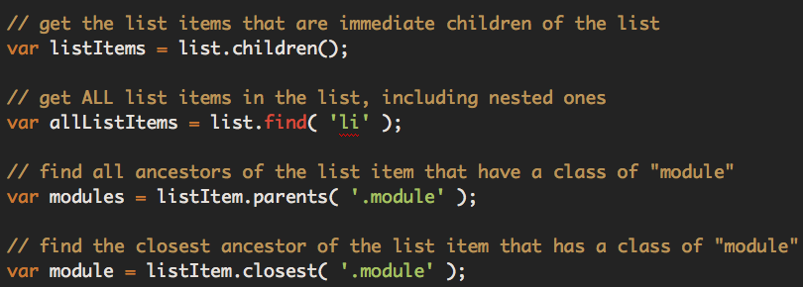
Notes:
// get the list items that are immediate children of the list
var listItems = list.children();
// get ALL list items in the list, including nested ones
var allListItems = list.find( 'li' );
// find all ancestors of the list item that have a class of "module"
var modules = listItem.parents( '.module' );
// find the closest ancestor of the list item that has a class of "module"
var module = listItem.closest( '.module' );

Slide 8
Manipulating Style
Querying CSS
.css; function(a,c){if(arguments...
.css(); TypeError: Cannot call method
.css("font-size"); "16px"
Setting CSS Explicitly
$("p").css("font-size", "24px"); [<p>...

Slide 9
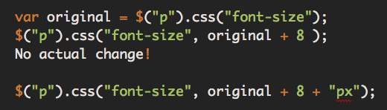
Setting CSS Relatively
Notes:
var original = $(“p”).css(“font-size”);
$(“p”).css(“font-size”, original + 8 );
No actual change!
$(“p”).css(“font-size”, original + 8 + “px”);

Slide 10


Setting Multiple Attributes
Using Method Chaining
Using a Map
Notes:
Using Method Chaining
$(“p”).css(“font-size”,“24px”).
css(“font-weight”,“bold”).
css(“line-height”,“32px”);
Using a Map
$(“p”).css({“font-size”:“24px”,
“font-weight”:“bold”,
“line-height”:“32px”});

Slide 11
WAIT!!
HTML content
CSS presentation
JavaScript interaction

Slide 12
The CSS Interface
DOM and CSS communicate via IDs and Classes
Manipulate IDs and Classes
More reliable and maintainable

Slide 13

CSS Class
Querying CSS Class
true / false
Adding A CSS Class
Notes:
Querying CSS Class
$(“p:first”).hasClass(“plan”);
true / false
Adding A CSS Class
$(“p:first”).addClass(“bigger”);

Slide 14


Removing A CSS Class
Removing all CSS Classes
Toggling a Class
Notes:
Removing A CSS Class
$(“p:first”).removeClass(“bigger”);
Removing all CSS Classes
$(“p:first”).removeClass();
Toggling a Class
$(“p:first”).toggleClass(“bigger”);

Slide 15
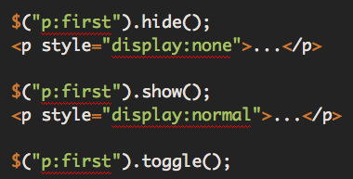
Visibility
switches between show and hide
Notes:
$(“p:first”).hide();
<p style="display:none">...</p>
$(“p:first”).show();
<p style="display:normal">...</p>
$(“p:first”).toggle();
switches between show and hide

Slide 16
Manipulating Content
Setting Text Content
$(“p#time span.label”).text(“Departs At:”);
[<span class="label">Departs At:”</span>]
Text is just Text
$(“p#time”).text();
“Departs At: 10:36AM”
$(“p#time”).text(“<b>Departs At:</b> 10:36AM”);
[<p id="time">&lt;b&gt;Departs At:&lt;/b&gt; 10:36AM</p>]

Slide 17
Queries & Setting with html()
$(“p#time”).html();
“<span class="label">Departs At:</span>10:36AM”
$(“p#time”).html(“<b>Departs At:</b> 10:36AM”);
“<b>Departs At:</b> 10:36AM”

Slide 18
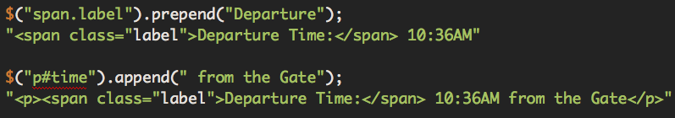
Prepend & Append
Notes:
$("span.label").prepend("Departure");
"<span class="label">Departure Time:</span> 10:36AM"
$("p#time").append(" from the Gate");
"<p><span class="label">Departure Time:</span> 10:36AM from the Gate</p>"

Slide 19
Inserting siblings with before & after
Notes:
$(“p#time”).before(“<h3>Departure Details</h3>”);
$( "h1" ).after(“<h3>Departure Details</h3>”);

Slide 20


Manipulating Nodes
Removing Nodes
Moving Nodes
Notes:
Removing Nodes
$(“span.label”).remove();
Moving Nodes
var gate = $(“p.gate”).remove();
$(“p#time”).before(gate);

Slide 21
Review
function | without parameter | with parameter
.text | query the plain text | set the plain text
.html | query html and text | set html and text
 | description
.prepend | add element inside the beginning of the selection
.append | add element inside the end of the selection
.before | add element before selection
.after | add element after selection
.remove | remove element from the DOM
Notes:
p.81 REVIEW

Slide 22
jQuery Events
jQuery provides simple methods for attaching event handlers to selections. When an event occurs, the provided function is executed. Inside the function, this refers to the element that was clicked
http://api.jquery.com/category/events/

Slide 23


Connecting Events to Elements
Binding an event
Convenience methods for most common events
Notes:
Binding an event
$('#foo').bind('click', function() {
alert('User clicked on "foo."');
});
Convenience methods for most common events
$('p').click(function() {
console.log('click');
});

Slide 24
Disconnecting Events
To disconnect an event handler, you use the $.fn.unbind method and pass in the event type to unbind. If you attached a named function to the event, then you can isolate the unbinding to that named function by passing it as the second argument.
Unbinding all click handlers on a selection
$('p').unbind('click');

Slide 25
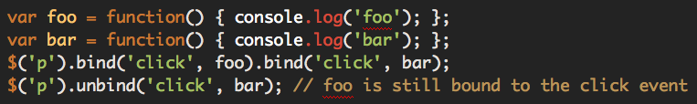
Unbinding a particular click handler
Notes:
var foo = function() { console.log('foo'); };
var bar = function() { console.log('bar'); };
$('p').bind('click', foo).bind('click', bar);
$('p').unbind('click', bar); // foo is still bound to the click event

Slide 26
Mouse Events
http://api.jquery.com/category/events/mouse-events/
.click() / .dblclick()
.hover()
.mousedown() / .mouseup() // click and release mouse click
.mouseover() / .mouseout() // cursor move around and move outside
.mouseenter() / .mouseleave() // cursor go inside and outside
.mousemove()

Slide 27
Inside the Event Handling Function
$('a').click(function(e) {
var $this = $(this);
if ($this.attr('href').match('evil')) {
e.preventDefault();
$this.addClass('evil');
}
});

Slide 28
Hover
The .hover() method binds handlers for both mouseenter and mouseleave events.
$('#menu li').hover(function() {
$(this).toggleClass('hover');
});

Slide 29
// same thing:
$('#menu li').hover(
function() {
$(this).addClass('hover');
}, function() {
$(this).removeClass('hover');
}
);

Slide 30
Form Events
http://api.jquery.com/category/events/form-events/
.blur() / .focus() // loses focus or gains focus
.change() // value changed
.select() // makes a text selection
.submit() // submit a form

Slide 31
Browser Events
http://api.jquery.com/category/events/browser-events/
.resize() // the size of the browser window changed
.scroll() // scrolls to a different place in the element

Slide 32
Document Loading
http://api.jquery.com/ready/
.ready() // when the DOM is fully loaded.

Slide 33
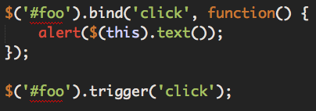
Triggering Event Handlers
Trigger the event handlers bound to an element without any user interaction via the $.fn.trigger method
Notes:
$('#foo').bind('click', function() {
alert($(this).text());
});
$('#foo').trigger('click');

Slide 34
Handling future events
.one() // the handler is unbound after its first invocation
.on() / .off()

Slide 35
Effects
jQuery makes it trivial to add simple effects to your page
http://api.jquery.com/category/effects/

Slide 36
Built-in Effects
.show() / .hide()
.fadeIn() / .fadeOut()
.fadeTo()
.toggle()
.slideUp() / .slideDown()
.slideToggle()
$('h1').show();

Slide 37
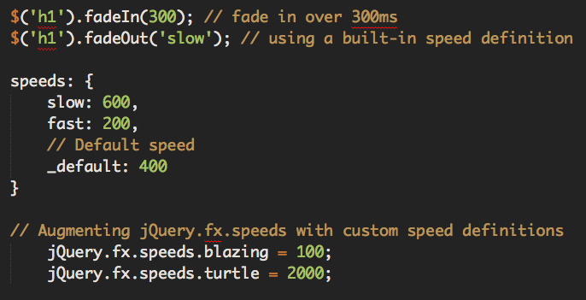
Changing the Duration of Built-in Effects
Notes:
$('h1').fadeIn(300); // fade in over 300ms
$('h1').fadeOut('slow'); // using a built-in speed definition
speeds: {
slow: 600,
fast: 200,
// Default speed
_default: 400
}
Augmenting jQuery.fx.speeds with custom speed definitions
jQuery.fx.speeds.blazing = 100;
jQuery.fx.speeds.turtle = 2000;

Slide 38
Custom Effects with $.fn.animate
jQuery makes it possible to animate arbitrary CSS properties via the $.fn.animate method. The
$.fn.animate method lets you animate to a set value, or to a value relative to the current value.

Slide 39
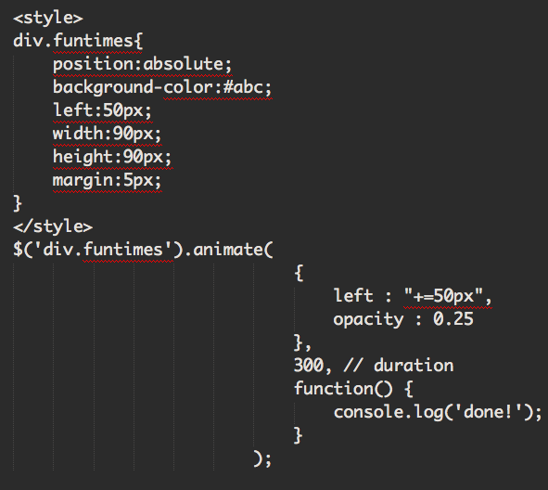

Slide 40
Custom Effects with $.fn.animate
Easing - jQuery includes only two methods of easing: swing and linear. If you want more natural transitions in your animations, various easing plugins are available.
http://jqueryui.com/demos/effect/easing.html
It is possible to do per-property easing when using the $.fn.animate method.
$('div.funtimes').animate(
{
left : [ "+=50", "swing” ],
opacity : [ 0.25, "linear" ]
},
300
);

Slide 41
Managing Effects
jQuery provides several tools for managing animations
.stop() // Stop currently running animations on the selected elements.
.delay() // Wait the specified number of milliseconds before running the next animation.
$('h1').show(300).delay(1000).hide(300);
jQuery.fx.off // If this value is true, there will be no transition for animations; elements will immediately be set to the target final state instead.
jQuery.fx.off = true;

Slide 42
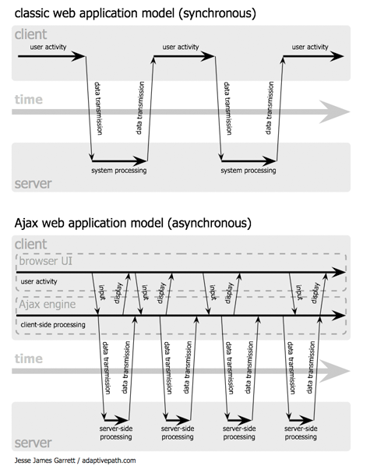
Ajax (Asynchronous JavaScript and XML)

Slide 43
Ajax Overview
Most jQuery applications don’t in fact use XML, despite the name “Ajax”; instead, they transport data as plain HTML or JSON (JavaScript Object Notation).
Limitation: Ajax does not work across domains.

Slide 44
Ajax Methods
jQuery provides Ajax support that abstracts away painful browser differences. It offers both a full featured $.ajax() method
Simple convenience methods, such as
$.get() / $.post()
$.getScript()
$.getJSON()
$.fn.load()

Slide 45
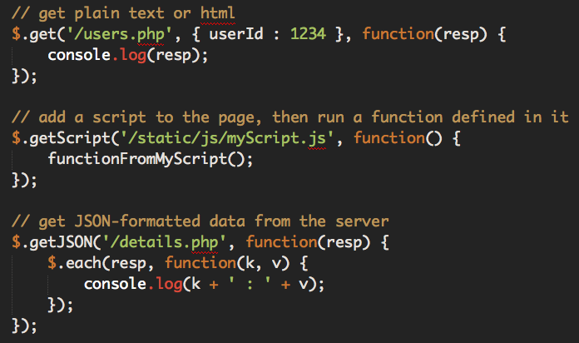
Ajax Examples
Notes:
// get plain text or html
$.get('/users.php', { userId : 1234 }, function(resp) {
console.log(resp);
});
// add a script to the page, then run a function defined in it
$.getScript('/static/js/myScript.js', function() {
functionFromMyScript();
});
// get JSON-formatted data from the server
$.getJSON('/details.php', function(resp) {
$.each(resp, function(k, v) {
console.log(k + ' : ' + v);
});
});

Slide 46

Same-Origin Policy and JSONP
In general, Ajax requests are limited to the same protocol (http or https), the same port, and the same domain as the page making the request. This limitation does not apply to scripts that are loaded via jQuery's Ajax methods.
The other exception is requests targeted at a JSONP service on another domain. In the case of JSONP, the provider of the service has agreed to respond to your request with a script that can be loaded into the page using a <script> tag, thus avoiding the same-origin limitation; that script will include the data you requested, wrapped in a callback function you provide:
Notes:
<script>
callback({ data: "here is the data you want from another domain"});
</script>

Slide 47
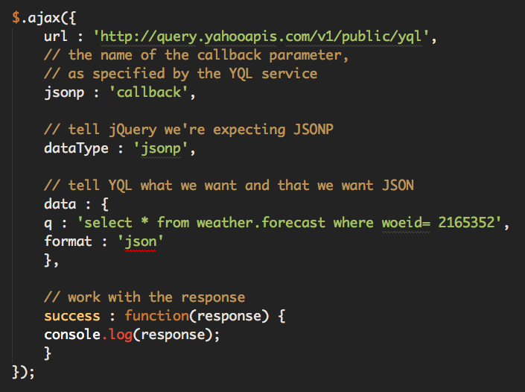
Working with JSONP
Notes:
$.ajax({
url : 'http://query.yahooapis.com/v1/public/yql',
// the name of the callback parameter,
// as specified by the YQL service
jsonp : 'callback',
// tell jQuery we're expecting JSONP
dataType : 'jsonp',
// tell YQL what we want and that we want JSON
data : {
q : 'select * from weather.forecast where woeid= 2165352',
format : 'json'
},
// work with the response
success : function(response) {
console.log(response);
}
});

Slide 48

Ajax Events
Often, youʼll want to perform an operation whenever an Ajax requests starts or stops, such as showing or hiding a loading indicator. Rather than defining this behavior inside every Ajax request, you can bind Ajax events to elements just like you'd bind other events.
http://docs.jquery.com/Ajax_Events
Setting up a loading indicator using Ajax Events
Notes:
$('#loading_indicator').ajaxStart(function() { $(this).show(); })
.ajaxStop(function() { $(this).hide(); });

