Slide 1
Web 2.0 應用技術-CSS, JavaScript 及 HTML
CM310.1-09-2013-C
Lesson 2

Slide 2
Outline
CSS Properties
CSS Box Model
CSS Position
Introduction to JavaScript
Working with Object and Array in JavaScript
jQuery Selector

Slide 3
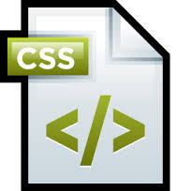
CSS Properties
Text and Fonts
Colours and Backgrounds
The Box Model
Positioning and Display
Lists
Tables
Generated Content
Paged Media
Misc.
http://www.htmldog.com/reference/cssproperties/

Slide 4
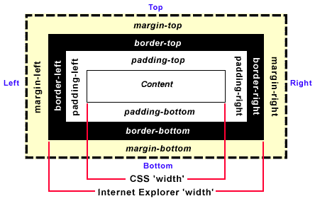
CSS Box Model
http://css-tricks.com/the-css-box-model/

Slide 5
Total calculated box width
Total calculated box width
= content width + padding width + border width
Notes:
Total calculated box width = content width + padding width + border width

Slide 6
CSS Position
Learn CSS Positioning in Ten Steps
http://www.barelyfitz.com/screencast/html-training/css/positioning/

Slide 7
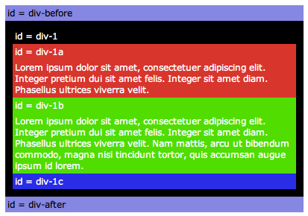
1. position:static
#div-1 {
position:static;
}

Slide 8
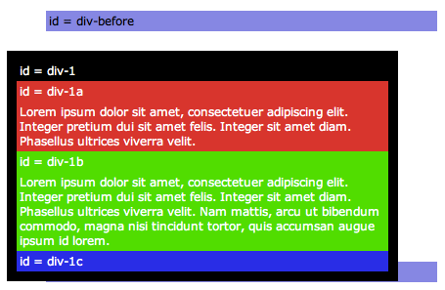
2. position:relative
#div-1 {
position:relative;
top:20px;
left:-40px;
}

Slide 9
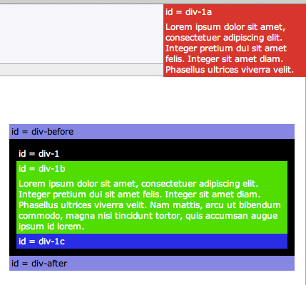
3. position:absolute
#div-1a {
position:absolute;
top:0;
right:0;
width:200px;
}

Slide 10
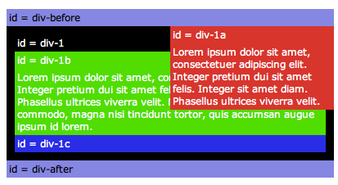
4. position:relative + position:absolute
#div-1 {
position:relative;
}
#div-1a {
position:absolute;
top:0;
right:0;
width:200px;
}

Slide 11
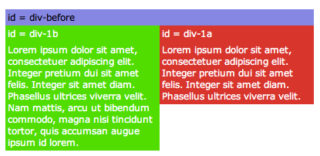
5. two column absolute
#div-1 {
position:relative;
}
#div-1a {
position:absolute;
top:0;
right:0;
width:200px;
}
#div-1b {
position:absolute;
top:0;
left:0;
width:200px;
}

Slide 12
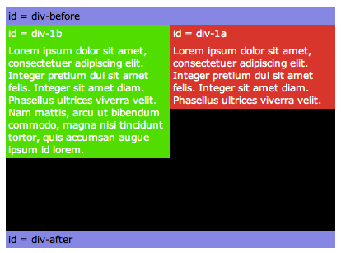
6. two column absolute height
#div-1 {
position:relative;
height:250px;
}
#div-1a {
position:absolute;
top:0;
right:0;
width:200px;
}
#div-1b {
position:absolute;
top:0;
left:0;
width:200px;
}

Slide 13
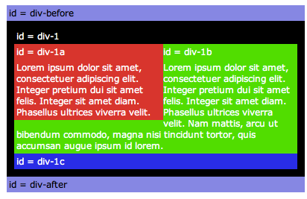
7. float
#div-1a {
float:left;
width:200px;
}

Slide 14
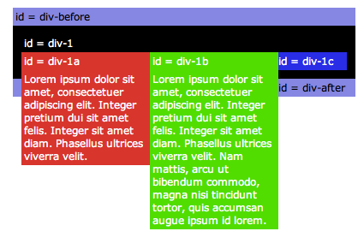
8. float columns
#div-1a {
float:left;
width:150px;
}
#div-1b {
float:left;
width:150px;
}

Slide 15
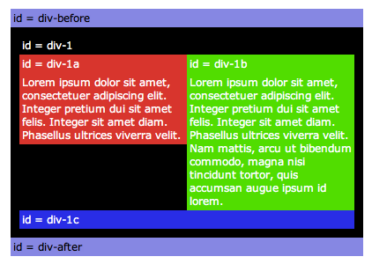
9. float columns with clear
#div-1a {
float:left;
width:190px;
}
#div-1b {
float:left;
width:190px;
}
#div-1c {
clear:both;
}

Slide 16
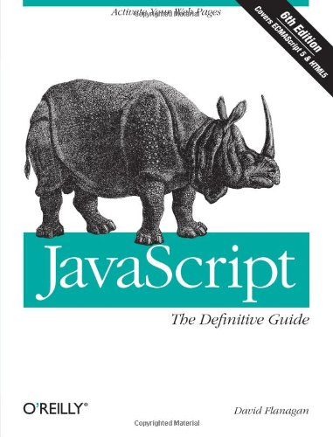
JavaScript

Slide 17
JavaScript
JavaScript (JS) is an interpreted computer programming language. It was originally implemented as part of web browsers so that client-side scripts may interact with the user, control the browser, communicate asynchronously and alter the document content that is displayed. [Wikipedia]

Slide 18

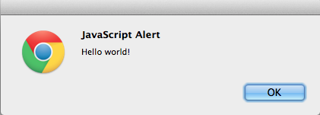
JavaScript - Hello World
Notes:
<script type="text/javascript">
alert("Hello world!");
</script>

Slide 20
JavaScript Object
"Everything" in JavaScript is an Object: a String, a Number, an Array, a Date....
In JavaScript, an object is data, with properties and methods.
Properties are values associated with an object.
Methods are actions that can be performed on objects.
http://www.w3schools.com/js/

Slide 21
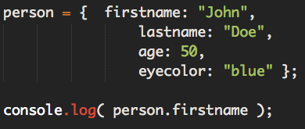
JavaScript Object - Implementation
Notes:
person = { firstname: "John",
lastname: "Doe",
age: 50,
eyecolor: "blue" };
console.log( person.firstname );

Slide 22
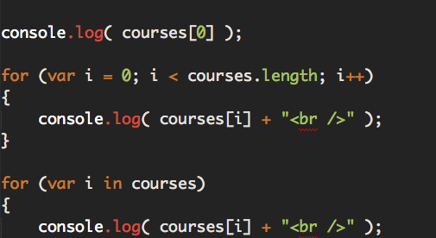
JavaScript Array
Notes:
var courses = ["HTML", "CSS", "JavaScript"];
console.log( courses[0] );
for (var i = 0; i < courses.length; i++)
{
console.log( courses[i] + "<br />" );
}
for (var i in courses)
{
console.log( courses[i] + "<br />" );
}

Slide 23
Example – Student records
Define a student name, marks, and behavior.
Based on the details we have, display the corresponding message

Slide 24
Student variables
var student1Name = "John";
var student1Mark1 = 40;
var student1Mark2 = 60;
var student1Mark3 = 70;
var student1Mark4 = 82;
var student1Behavior = "A";

Slide 25
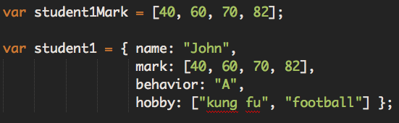
Refactoring by using object and array
Notes:
var student1Mark = [40, 60, 70, 82];
var student1 = { name: "John",
mark: [40, 60, 70, 82],
behavior: "A",
hobby: ["kung fu", "football"] };

Slide 26
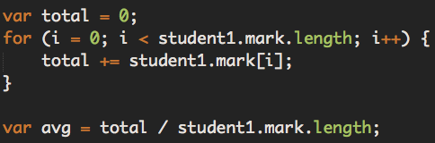
Loop through an array
Notes:
var total = 0;
for (i = 0; i < student1.mark.length; i++) {
total += student1.mark[i];
}
var avg = total / student1.mark.length;

Slide 27
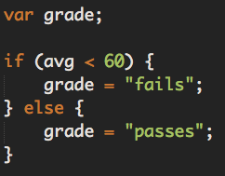
if-else condition
Notes:
var grade;
if (avg < 60) {
grade = "fails";
} else {
grade = "passes";
}

Slide 28
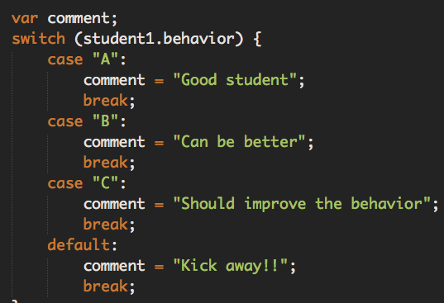
switch statement
Notes:
var comment;
switch (student1.behavior) {
case "A":
comment = "Good student";
break;
case "B":
comment = "Can be better";
break;
case "C":
comment = "Should improve the behavior";
break;
default:
comment = "Kick away!!";
break;
}

Slide 29
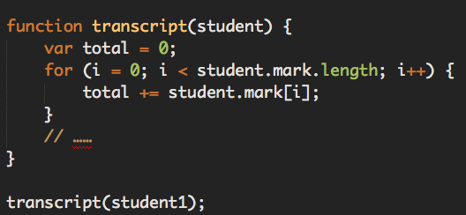
Abstract codes into a function
Notes:
function transcript(student) {
var total = 0;
for (i = 0; i < student.mark.length; i++) {
total += student.mark[i];
}
// ……
}
transcript(student1);

Slide 30
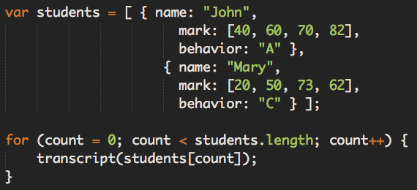
Generalize
Notes:
var students = [ { name: "John",
mark: [40, 60, 70, 82],
behavior: "A" },
{ name: "Mary",
mark: [20, 50, 73, 62],
behavior: "C" } ];
for (count = 0; count < students.length; count++) {
transcript(students[count]);
}

Slide 31
JavaScript Object Notation (JSON)
http://www.google.com/ig/calculator?hl=en&q=1USD=?HKD
{lhs: "1 U.S. dollar",
rhs: "7.75662804 Hong Kong dollars",
error: "",
icc: true}

Slide 32


Slide 33
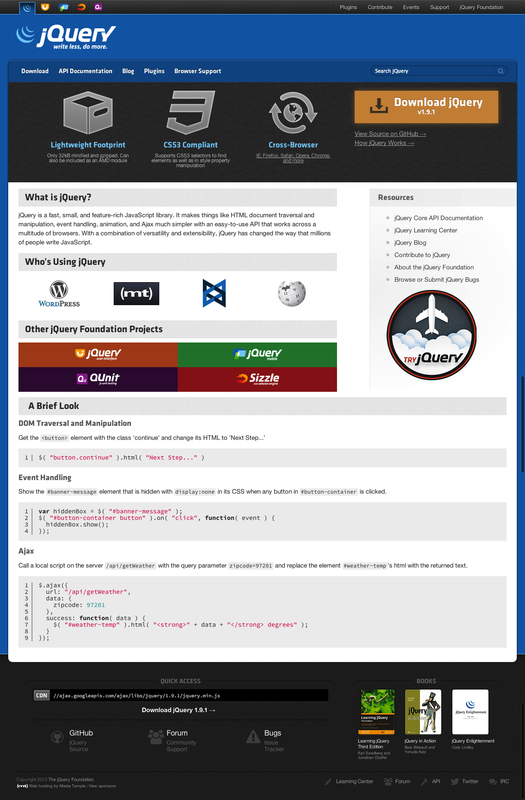
http://jquery.com

Slide 34
Loading jQuery
Local file system
<script src="jquery.js"></script>
Google’s Content Devliery Network (CDN)
<script src=
"https://ajax.googleapis.com/ajax/libs/jquery/1.10.2/jquery.min.js">
</script>
Notes:
<script type="text/javascript">
alert("Hello world!");
</script>
Why and how to include jQuery?
CDN

Slide 35
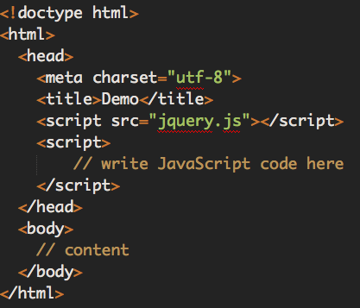
Notes:
<!doctype html>
<html>
<head>
<meta charset="utf-8">
<title>Demo</title>
</head>
<body>
<a href="http://jquery.com/">jQuery</a>
<script src="jquery.js"></script>
<script>
</script>
</body>
</html>

Slide 36
Confirm jQuery is loaded
jQuery
ReferenceError: jQuery is not defined
jQuery is not loaded
jQuery
function (j,s){return new b.fn.init(j,s)}
Ready to go!
$
function (j,s){return new b.fn.init(j,s)}
Still jQuery
Notes:
Install Firebug add-ons in Firefox
console.log( jQuery);

Slide 37
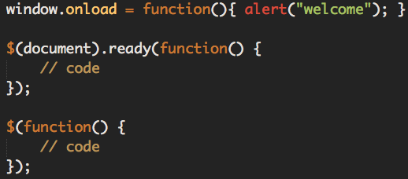
Launching code
Notes:
window.onload = function(){ alert("welcome"); }
$(document).ready(function() {
// code
});
$(function() {
// code
});

Slide 38
Selecting Elements
The most basic concept of jQuery is to "select some elements and do something with them."
jQuery supports most CSS3 selectors, as well as some non-standard selectors.
For a complete selector reference, visit
http://api.jquery.com/category/selectors/

Slide 39
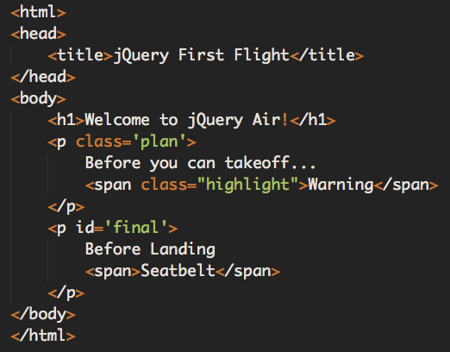
Document Object Model (DOM)
Notes:
<html>
<head>
<title>jQuery First Flight</title>
</head>
<body>
<h1>Welcome to jQuery Air!</h1>
<p class=‘plan’>
Before you can takeoff...
<span class="highlight">Warning</span>
</p>
<p id=‘final’>
Before Landing
<span>Seatbelt</span>
</p>
</body>
</html>

Slide 40
html
- head
- title
- body
- h1
- p.plan
- p#final

Slide 41
CSS Selectors
$("h1");
$("p");
$("p.plan");
$("p#final");

Slide 42
Selection Result
jQuery
$("p");
DOM
p.plan (Before you can takeoff...)
p#plan (Then, before landing...)
JavaScript Results
["<p class=‘plan’>Before you can takeoff...</p>",
"<p class=‘final’>Then, before landing...</p>"]

Slide 43
Non-match Results
jQuery
$("h2");
DOM
There were no H2s in the DOM
JavaScript Results
[]
Watch out, I'm "truthy"
if ($("h2").length) { … }

Slide 44
Saving Selections
Every time you make a selection, a lot of code runs, and jQuery doesn't do caching of selections for you. If you've made a selection that you might need to make again, you should save the selection in a variable rather than making the selection repeatedly.
var $divs = $('div');

Slide 45
Understanding Whitespace
$("p#final");
This matches paragraphs with ID "final"
$("p #final");
This matches any element with class "final" within a paragraph

Slide 46
Pseudo-Classes and Direct Descendants
$("p:first");
This is not the same as
$("p.first");

Slide 47
Descendants
Any span within body
$("body span");
Only spans directly under body
$("body > span");
$("p.plan > span");

