Slide 1
Web 2.0 應用技術-CSS, JavaScript 及 HTML
CM310.1-03-2013-C
Lesson 4

Slide 2
Outline
Ajax
Form Validation
Plugins

Slide 3
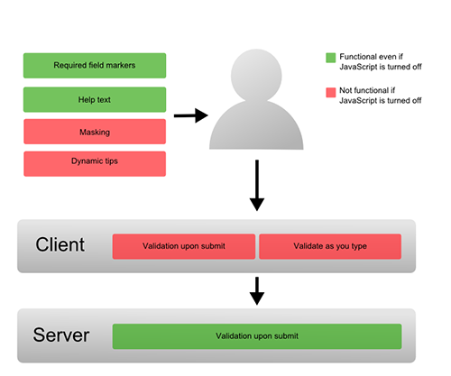

Slide 4
What to validate
Required Fields (*)
Correct Format
Confirmation Fields

Slide 5
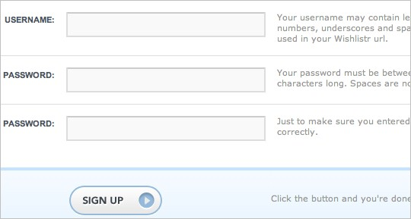
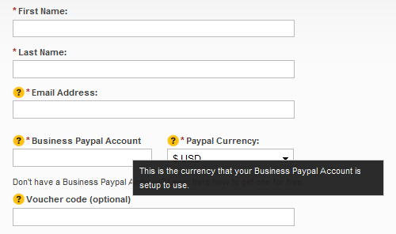
Help Hints

Slide 6
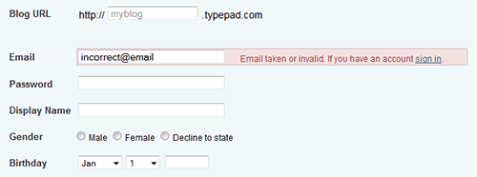
Instant Validation Feedback

Slide 7
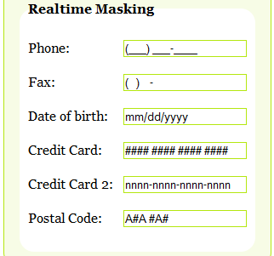
Dynamic Tips
Masking and Reformatting User’s Input
Typecast http://typecast.arapehlivanian.com/index.html
jQuery Masked input plugin http://digitalbush.com/projects/masked-input-plugin/

Slide 8

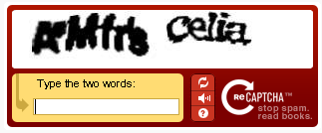
Are you human?
CAPTCHA
Completely Automated Public Turing test to tell Computers and Humans Apart

Slide 9
jQuery Plugins

Slide 10
A basic plugin template
The this keyword within the new plugin refers to the jQuery object on which the plugin is being called:
$.fn.myNewPlugin = function() {
//do sth with #target (this)
return this;
};
$('#target'). myNewPlugin();
Also, return "this" to let it support chaining.

Slide 11
Make a plugin to support collections
Let it support the collection target, use this.each() to do so:
$.fn.myNewPlugin = function() {
return this.each(function(){
//do something
});
};
$('.target'). myNewPlugin();

Slide 12
Make it private
This has the effect of creating a "private" scope that allows us to extend jQuery using the dollar symbol without having to risk the possibility that the dollar has been overwritten by another library:
(function($){
$.fn.myNewPlugin = function() {
return this.each(function(){
// do something
});
};
})(jQuery);
$('.target'). myNewPlugin();

Slide 13
Show Link Location Plugin
<a href="page.html">Foo</a> <a href="page.html">Foo (page.html)</a>
(function($){
$.fn.showLinkLocation = function() {
return this.filter('a').append(function(){
return ' (' + this.href + ')';
});
};
})(jQuery);
$('a'). showLinkLocation();

Slide 14
Slideshow plugin
(function($){
$.fn.slideshow = function(){
var $slideshow = $(this);
$slideshow.find('li').hide();
$slideshow.find('li:first').fadeIn();
var rotate = function(){
var $current = $slideshow.find('li:visible');
$current.hide();
var $next_li = $current.next('li');
if( $next_li.length == 0 ){
$next_li = $slideshow.find('li:first');
}
$next_li.fadeIn();
}

Slide 15
Slideshow plugin (cont.)
var $btn = $("<button>rotate</button>").click(rotate);
setInterval(rotate, 3000);
return $slideshow.append($btn);
}
})(jQuery);

Slide 16
Advance - with an option
A plugin with an option:
(function($) {
$.fn.slideshow = function(interval){
var $slideshow = $(this);
// ...
setInterval(rotate, interval );
return $slideshow.append($btn);
}
})(jQuery);
$('#slideshow').slideshow(3000);

Slide 17
Advance - with options / configuration
A plugin with options / configuration using object:
(function($) {
$.fn.slideshow = function(opts){
var $slideshow = $(this);
// ....
var $btn = $("<button>" + opts.btnText + "</button>").click(rotate);
setInterval(rotate, opts.interval );
return $slideshow.append($btn);
}
})(jQuery);
$('#slideshow').slideshow( { interval: 3000 , btnText : "next" } );

Slide 18
Advance - options with default values
jQuery built-in function $.extend helps your to merge objects
(function($) {
$.fn.slideshow = function(options){
var opts = $.extend( {interval: 3000 , btnText : "next" }, options);
var $slideshow = $(this);
// ....
var $btn = $("<button>" + opts.btnText + "</button>").click(rotate);
setInterval(rotate, opts.interval );
return $slideshow.append($btn);
}
})(jQuery);
$('#slideshow').slideshow( { btnText : "next" } );

Slide 19
How to Find jQuery Plugins
Search “most popular jQuery plugins”
View the source code of a dynamic website

Slide 20
Slider
Coda Slider (http://kevinbatdorf.github.com/codaslider/)
easySlider (http://cssglobe.com/easy-slider-17-numeric-navigation-jquery-slider/)
s3Slider (http://www.serie3.info/s3slider/index.php)
CrossSlide (http://tobia.github.com/CrossSlide/)
simplyScroll (http://logicbox.net/jquery/simplyscroll/)

Slide 21
Photos
ColorBox (http://www.jacklmoore.com/colorbox)

