Slide 1
”ENTERTAINEMENT PREFERENCES”
CAPSTONE PROJECT 1
Victor xavier vijay .m

Slide 2
OBJECTIVE
The objective of this project is to analyze entertainment consumption patterns across different age groups and demographics to understand preferred entertainment types, platform usage trends, spending behavior, and factors influencing satisfaction levels.
Research Questions
1. Which entertainment type is most preferred?
2. How many hours do people spend weekly on entertainment?
3. Does age influence platform choice?
4. What is the average monthly spending on entertainment?
5. Does subscription status impact satisfaction level?
6. Is there a correlation between weekly hours and spending
7. How does the intersection of geographic location and gender influence monthly spending across different entertainment genres?
8. What is the distribution of educational level among respondents?

Slide 3
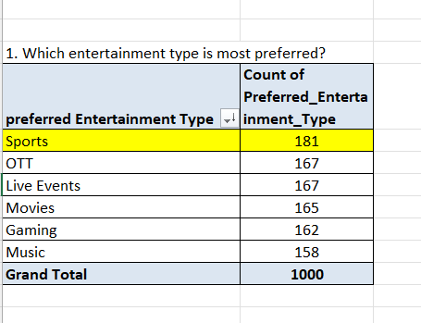
1. Which entertainment type is most preferred?
Sports emerges as the leading entertainment category, but the market is structurally diversified rather than concentrated.
The preference gap between highest (Sports – 18.1%) and lowest (Music – 15.8%) is only 2.3 percentage points.
This indicates low dominance concentration
Consumer demand is evenly distributed across categories

Slide 4
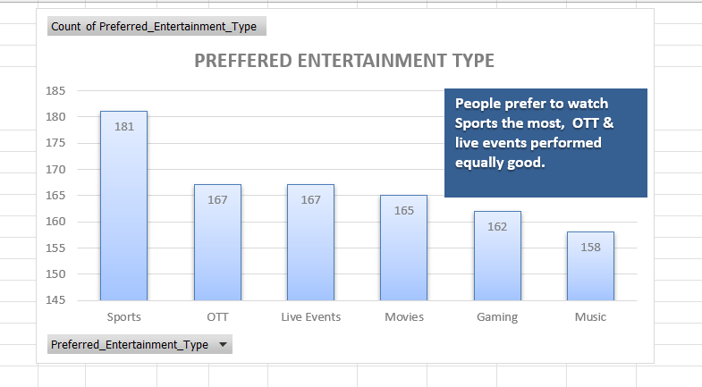
📈 Data Interpretation
The market shows diversified consumer behavior.
Preferences are evenly distributed, suggesting:
  Consumers engage in multiple entertainment types.
  There is no single dominant segment.
Small percentage differences indicate marginal preference advantage, not strong market control.
Conclusion:Sports is the most preferred entertainment type with 18.1% of total responses. However, the minimal variation across categories indicates a balanced and diversified entertainment preference pattern among respondents.

Slide 5
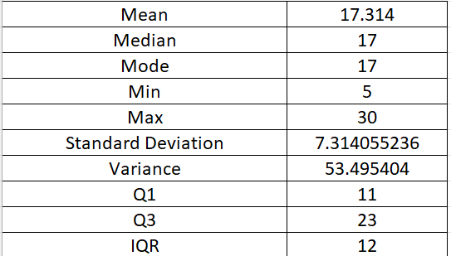
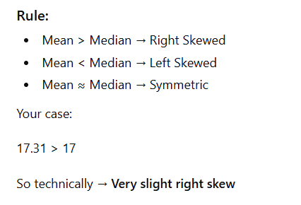
2. How many hours do people spend weekly on entertainment?
Average Weekly Engagement
Respondents spend approximately 17 hours per week on entertainment.
Mean, median, and mode are almost identical (≈17 hours).
📌 This indicates a highly centered and stable distribution.

Slide 6
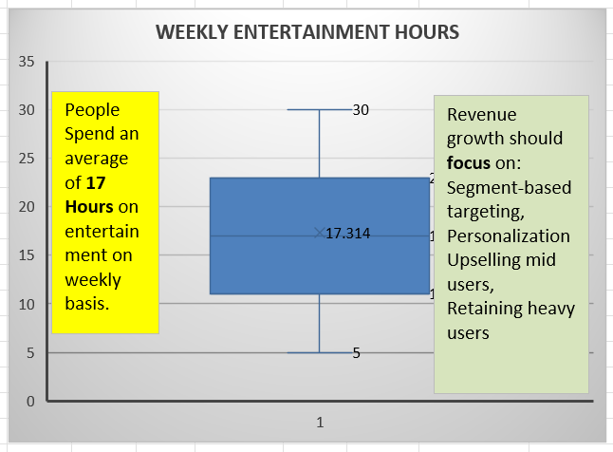
📈 Interpretation
Weekly entertainment consumption is consistent across respondents.
Majority of users fall in a mid-engagement bracket (11–23 hours).
There is no heavy concentration of extreme low or extreme high users.
This suggests a balanced user engagement pattern.
🎯 Conclusion On average, individuals spend 17 hours per week on entertainment. The distribution is approximately symmetrical with moderate variability and no significant outliers, indicating stable and consistent engagement levels across respondents.

Slide 7
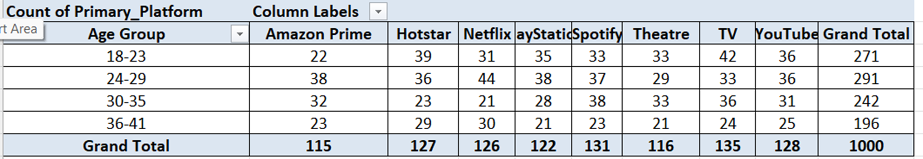
3. Does age influences the platform choice?
Pattern Analysis ✅ Gaming (PlayStation) High in 18–29 Declines after 30 ➡ Indicates gaming preference decreases with age.
✅ TV
Remains consistent across all age groups.
➡ Traditional media still holds stable relevance
✅ OTT Platforms (Netflix, Hotstar, Prime)
Strong in 18–29
Slight decline in older age groups
➡ Younger groups prefer streaming-heavy consumption.

Slide 8
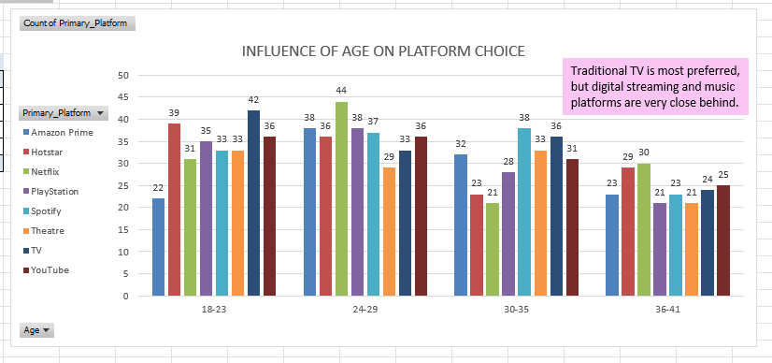
🎯 Final Conclusion
Yes, age influences platform choice. Younger age groups (18–29) show stronger preference for digital streaming and gaming platforms, while older groups (30+) demonstrate relatively higher stability toward traditional platforms like TV and music streaming. However, TV remains consistently relevant across all age segments.

Slide 9
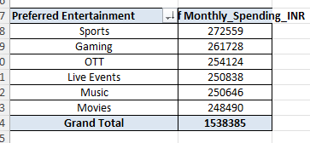
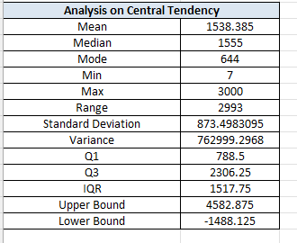
Average (Mean) Monthly Spending = ₹1,538.38 per person
4. What is the Average Monthly Spending on Entertainment?
📌 Supporting Statistical Evidence
1️⃣ Central Tendency
Mean: ₹1,538.38
Median: ₹1,555
The mean and median are very close (difference of ₹17).

Slide 10
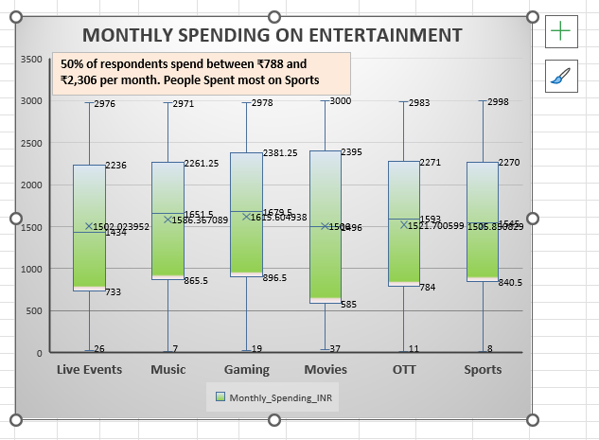
➡ This indicates the distribution is approximately symmetrical with very slight negative skewness.
➡The average monthly spending on entertainment is approximately ₹1,538 per person. The distribution is fairly balanced with moderate variability and no significant outliers, indicating stable spending behavior among respondents.

Slide 11
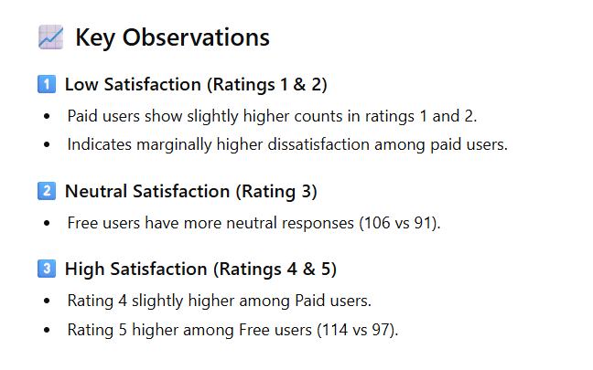
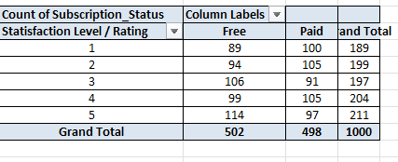
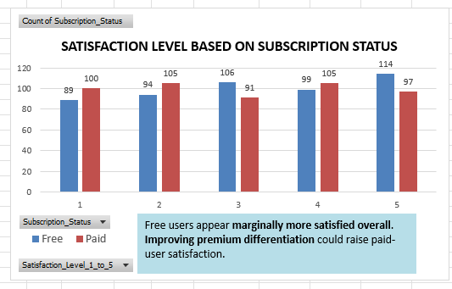
5. Does subscription status impact satisfaction level?
.
🎯 Conclusion
Subscription status does not significantly impact satisfaction level. While free users show slightly higher top-level satisfaction and paid users show marginally higher dissatisfaction at lower ratings, the overall variation between groups is minimal.

Slide 12
6. Is there corelation between weekly hours and spending?
Hours Spent on Weekly basis | Sum of Monthly_Spending_INR
5 | 45676
6 | 67805
7 | 49296
8 | 60167
9 | 72258
10 | 52154
11 | 58858
12 | 60165
13 | 44288
14 | 46521
15 | 67557
16 | 41247
17 | 84287
18 | 72006
19 | 58050
20 | 56554
21 | 60706
22 | 66057
23 | 71385
24 | 54931
25 | 64785
26 | 70129
27 | 59873
28 | 52871
29 | 47653
30 | 53106
Grand Total | 1538385
Correlation Coefficient
Correlation | 0.073973495
Overview on comparison between Weekly hours spent on entertainment & Expenditure:
Total Respondents: 1000
Total Weekly Hours: 17,314
Total Monthly Spending: ₹1,538,385

Slide 13
Average Weekly Entertainment Hours: 17.3 hours per week
Average Monthly Spending: ₹1,538 per month
➡ As engagement (hours) increases, spending generally tends to increase.
➡ But the relationship is not perfectly linear due to variability.

Slide 14
7. How does the intersection of geographic location and gender influence monthly spending across different entertainment genres?
Across all demographics and regions, the total monthly spending on entertainment is ₹1,538,385.
Sports is the highest-grossing genre overall, with a total spend of ₹216,381, closely followed by Drama at ₹216,116.
The Urban sector is the largest contributor to revenue, accounting for ₹533,947 Metro users prioritize Comedy, spending ₹75,807, which is significantly higher than their spend on Pop or Action.

Slide 15
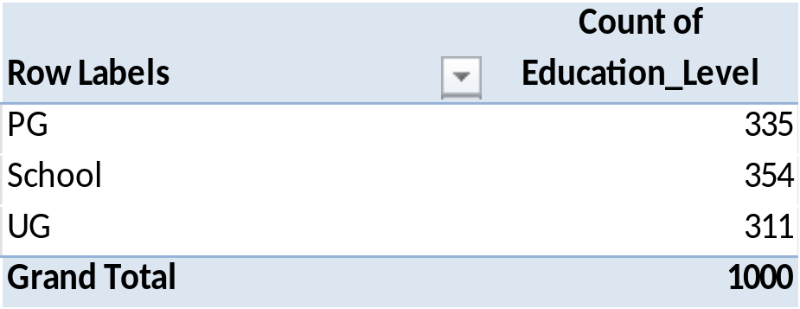
8. What is the distribution of educational level among respondents?
The survey respondents are almost evenly distributed across education levels, with School-level individuals making up 35.40% (354).
Post-Graduates (PG) at 33.50% (335).
Undergraduates (UG) at 31.10% (311) of the 1,000-person sample.

Slide 16
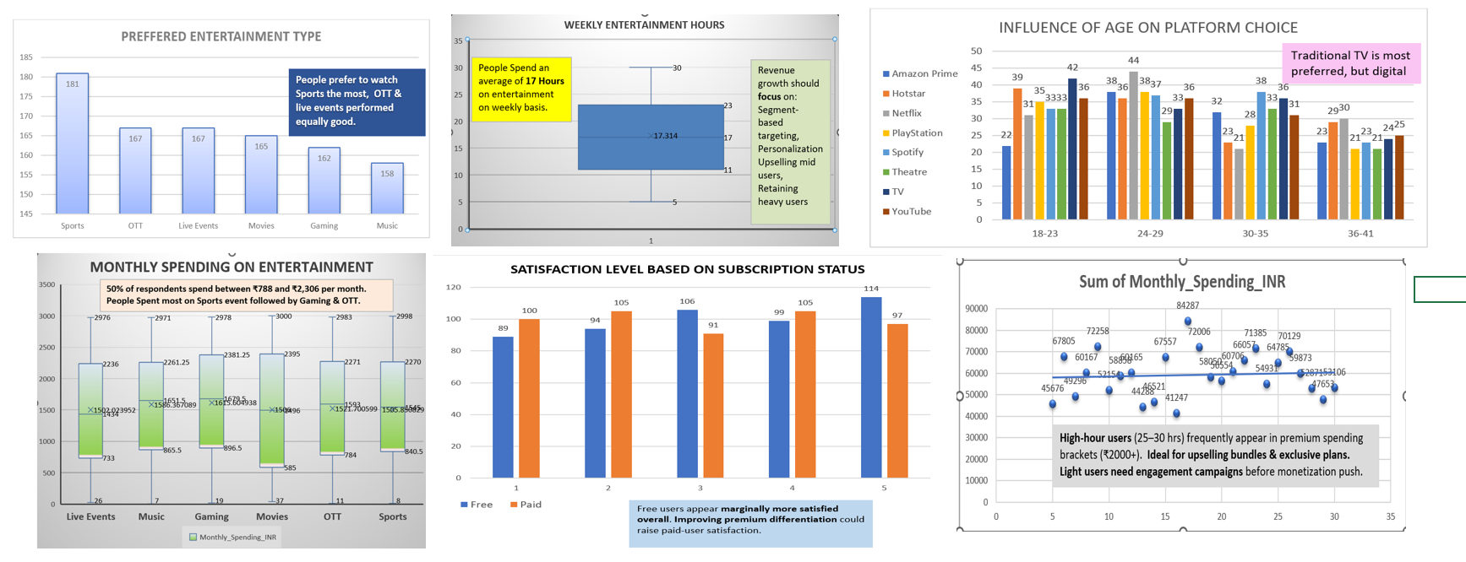
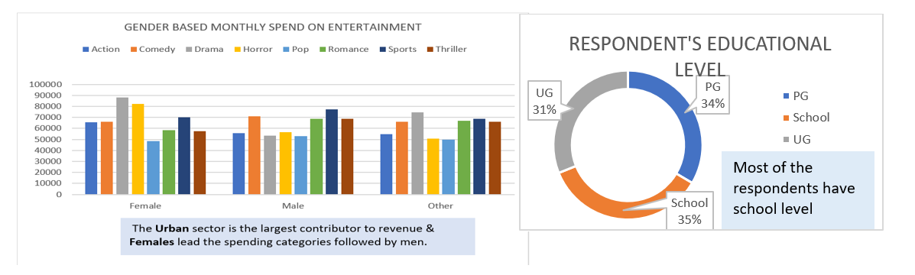

Slide 17
“OVERVIEW”
" Entertainment Preferences & Consumption Patterns," analyses the consumption patterns of 1,000 respondents aged 18–40. Below is a high-level overview of the findings:
Engagement & Platform Trends
Weekly Usage: On average, people spend 17.3 hours per week on entertainment. Engagement is balanced, with 50% of users falling between 11 and 23 hours.
Top Platforms: TV (135 preferences) remains the most popular platform, followed closely by Spotify (131) and YouTube (128).
Age Dynamics: Younger audiences (18–29) lean toward digital consumption like OTT and gaming, while traditional platforms like TV and Theatre regain strength in the 30+ age groups.

Slide 18
Average Spend: The average monthly expenditure is approximately ₹1,538 per person. Total spending across the sample reaches ₹1,538,385.
Top Genres: Sports (₹216,381) and Drama (₹216,116) are the highest-grossing genres. Pop content consistently sees the lowest spend across all demographics.
Regional & Gender Drivers: Urban areas are the largest revenue contributors (₹533,947). Females lead overall spending, particularly in Drama and Horror, while Males spend most on Sports and Comedy.
Satisfaction & Subscription
Subscription Impact: The user base is almost perfectly split between Free (50.2%) and Paid (49.8%) users.
Perceived Value: Paid status does not strongly impact satisfaction; in fact, free users appear marginally more satisfied, likely due to having lower expectations than paid subscribers. Respondent Profile
Education: Respondents are evenly distributed among those with School-level education (35.4%), Post-Graduates (33.5%), and Undergraduates (31.1%).

Slide 19
Thank you

