Slide 1
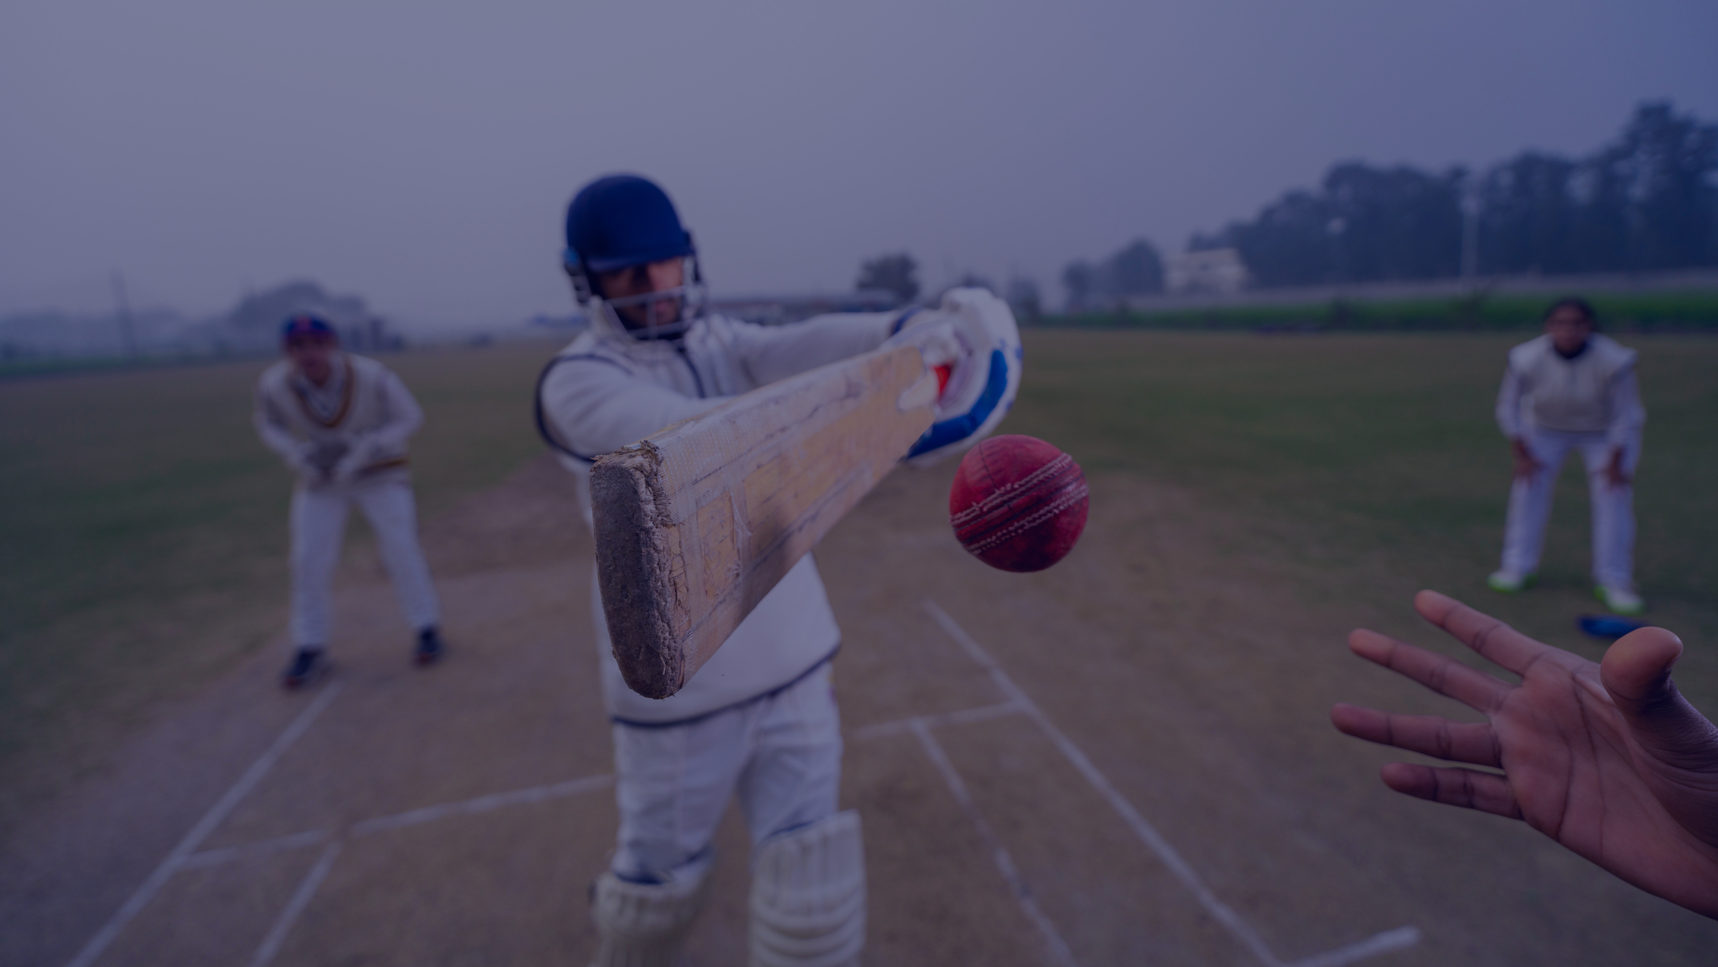
IPL Performance Analytics
Matches • Ball-by-Ball Deliveries • Players • Seasons • Fan Engagement
1,158
134,190
580
18
4,320
Matches
Deliveries
Players
Seasons
Fan Records
By
Victor Xavier Vijay M
01

Slide 2
ROADMAP
What This Deck Covers
Eight linked phases of analysis — from raw data audit to an executive KPI dashboard. Every chart on the following slides is built from the real project code and the actual numbers it produced.
01
Data Quality & Feature Engineering
02
Univariate Analysis
Audit, cleaning, derived columns
Match outcomes, scores, players, fans — one variable at a time
03
Bivariate Analysis
04
Multivariate Analysis
Toss vs result, score relationships, style vs price
Heatmaps, role×cap×price, bubble charts
05
Team & Player Performance
06
Trends, Venues & Fan Engagement
Win leaderboards, strike rate, top performers
Season trends, correlation heatmap, venue effects
07
Statistical Testing & Outliers
08
Business Insights & Dashboard
Chi-square, Pearson r, percentile-based outliers
Strategic recommendations + executive KPI summary
IPL EDA • Viva Preparation Deck
02

Slide 3
Five Datasets, One 360° Story
On-field performance and off-field fan engagement are joined on season and team, which is what makes this project distinctive.
matches.csv
1,158 rows × 25 cols
One row per match — teams, toss, venue, scores, winner, margin.
deliveries.csv
134,190 rows × 18 cols
One row per ball bowled — the most granular table, used for player stats.
players.csv
580 rows × 12 cols
One row per player — role, nationality, auction price, career span.
seasons.csv
18 rows × 14 cols
One row per season — pre-aggregated totals, champion, records.
fan_trends.csv
4,320 rows × 25 cols
Team-season-platform fan engagement, sentiment & trend records.
IPL EDA • Viva Preparation Deck
03

Slide 4
SECTIONS 1-2
Audit → Clean → Engineer
WHY THIS STEP FIRST An EDA is only as trustworthy as the data underneath it. Before drawing a single chart, every table was passed through a reusable audit() function checking shape, duplicates, missing values, unique counts and summary statistics.
WHAT I FOUND Zero duplicate rows across all five tables. Missing values were concentrated in columns like extra_type and dismissal_type — and that's expected, not an error, because not every ball produces an extra or a wicket.
8 Engineered Columns That Power Every Chart That Follows
is_boundary / is_six / is_four
deliveries.batsman_runs.isin([4,6])
Flags boundary balls for quick aggregation.
over_cluster
pd.cut(over, [0,6,15,20])
Groups overs into Powerplay / Middle / Death phases.
chased_successfully
win_by == 'wickets'
Converts text result into a boolean for averaging.
career_length
last_season − debut_season
Seasons played — used against auction price.
engagement_tier
pd.cut(engagement_rate, ...)
Bins fan engagement into Low/Medium/High/Viral.
IPL EDA • Viva Preparation Deck
05

Slide 5
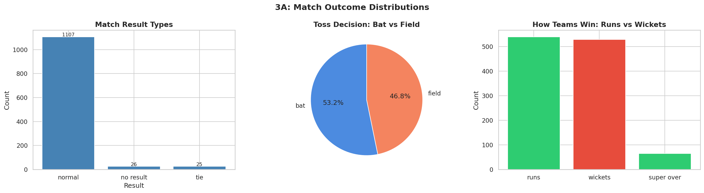
SECTION 3A
Match Outcome Distributions
WHY THIS CHART: value_counts() turns a categorical column into frequencies; bar charts compare counts across a few categories, and a pie chart is appropriate here because toss_decision has only two mutually exclusive outcomes whose share of a whole is the point.
KEY INSIGHT: Of 1158 matches, 1107 (95.6%) finished normally; ties and no-results are rare. Captains chose to BAT first 616 times vs FIELD first 542 times (53.2% bat-first) — batting first is the more common toss call in this data, not fielding.
ANALYST TAKEAWAY: Wins by runs (539) and by wickets (528) are almost evenly split, with 65 matches decided by Super Over — that near 50/50 split is itself a useful baseline for everything that follows.
07

Slide 6
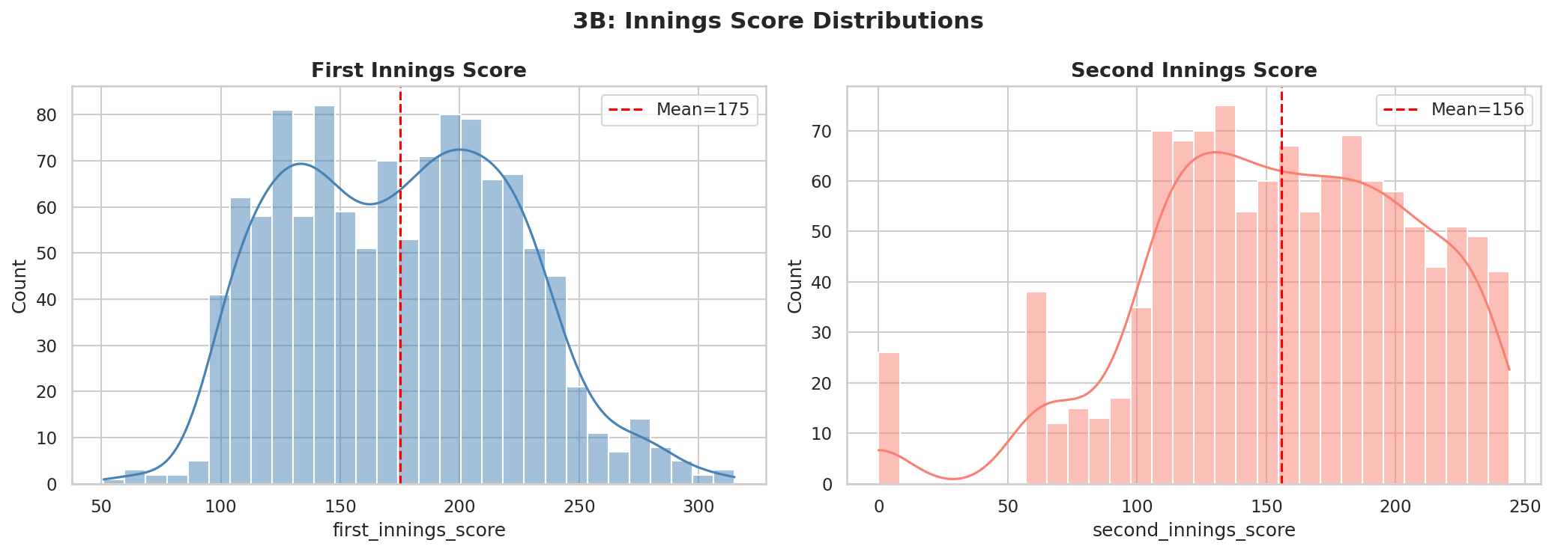
SECTION 3B
Innings Score Distributions
WHY THIS CHART: sns.histplot(..., kde=True) bins a continuous numeric column and overlays a smooth density curve, the standard way to see a variable's shape — symmetric, skewed, or multi-peaked — at a glance.
KEY INSIGHT: First-innings scores average 175.1 runs (median 176, std 47.5) with a mild right skew (0.17). Second-innings scores average 155.8 and are slightly LEFT-skewed (-0.53) because many chases end early once the target is reached — the innings simply stops.
STATISTICAL NOTE: Skewness near 0 (first innings) means a fairly symmetric bell shape; a negative value (second innings) means the tail stretches toward lower scores — exactly what you'd expect when some 'innings' are cut short by victory.
IPL EDA • Viva Preparation Deck
08

Slide 7
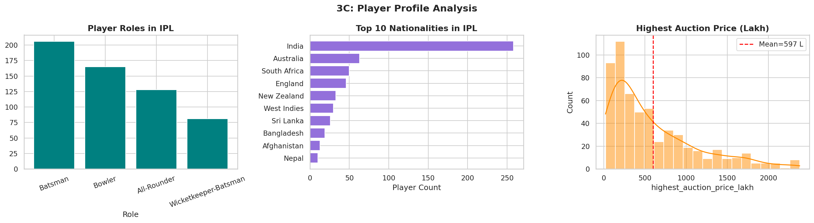
SECTION 3C
Player Profile Analysis
WHY THIS CHART: Three different univariate views — bar for role counts, horizontal bar for the top-10 nationalities (long labels read better sideways), and a histogram for price — because each variable needs the chart type that matches its data type.
KEY INSIGHT: Batsmen are the most common role (206 of 580), followed by Bowlers (165). India supplies the most players (258), well ahead of Australia (63) — expected for a domestic Indian league.
STATISTICAL NOTE: Auction price has a skewness of 1.29 — strongly right-skewed. Mean price (₹597L) sits well above the median (₹405L), so the median is the fairer "typical player" benchmark; the mean is pulled upward by a handful of marquee buys.
IPL EDA • Viva Preparation Deck
09

Slide 8
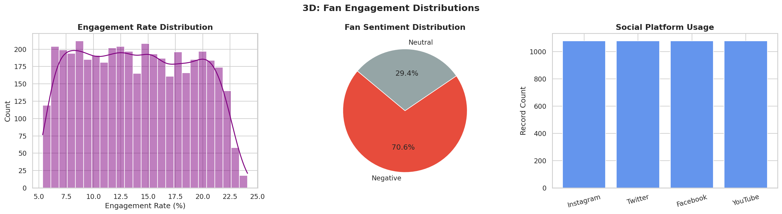
SECTION 3D
Fan Engagement Distributions
WHY THIS CHART: A histogram for the continuous engagement_rate, a pie chart for the categorical fan_sentiment split, and a bar chart for platform record counts — again, chart type follows variable type.
KEY INSIGHT — A GENUINE SURPRISE: Sentiment in this dataset is NEVER 'Positive': it is 70.6% Negative and 29.4% Neutral only. That is worth flagging openly in viva as an unusual pattern in the data rather than glossing over it.
ANALYST TAKEAWAY: All four platforms (Instagram, Twitter, Facebook, YouTube) contribute exactly 1,080 records each — a perfectly balanced sample, so later platform comparisons are not biased by sample-size differences.
10

Slide 9
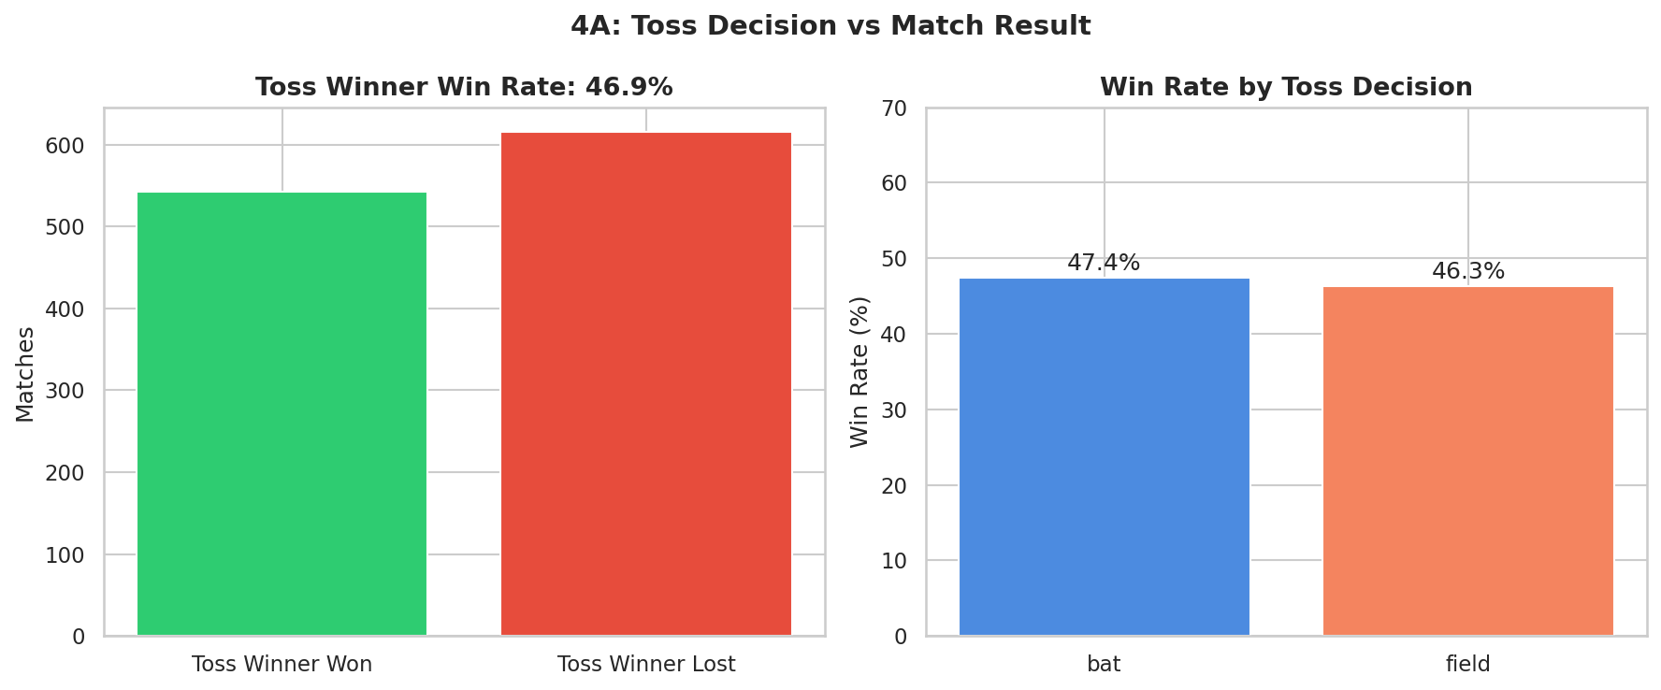
SECTION 4A
Toss Decision vs Match Result
WHY THIS CHART: groupby('toss_decision').apply(lambda d: (d.toss_winner==d.winner).mean()*100) turns a row-level comparison into a single win-rate percentage per group — the cleanest way to compare two categorical strategies on a common scale.
KEY INSIGHT: Toss winners win only 46.9% of matches overall — barely different from a coin flip. Batting-first toss winners actually win marginally MORE often (47.4%) than fielding-first toss winners (46.3%).
STATISTICAL NOTE: This ~1 percentage-point gap is tiny. Section 11's Chi-square test on this exact relationship returns p = 0.754 (≫ 0.05) — confirming statistically that toss decision and match result are independent in this data.
12

Slide 10
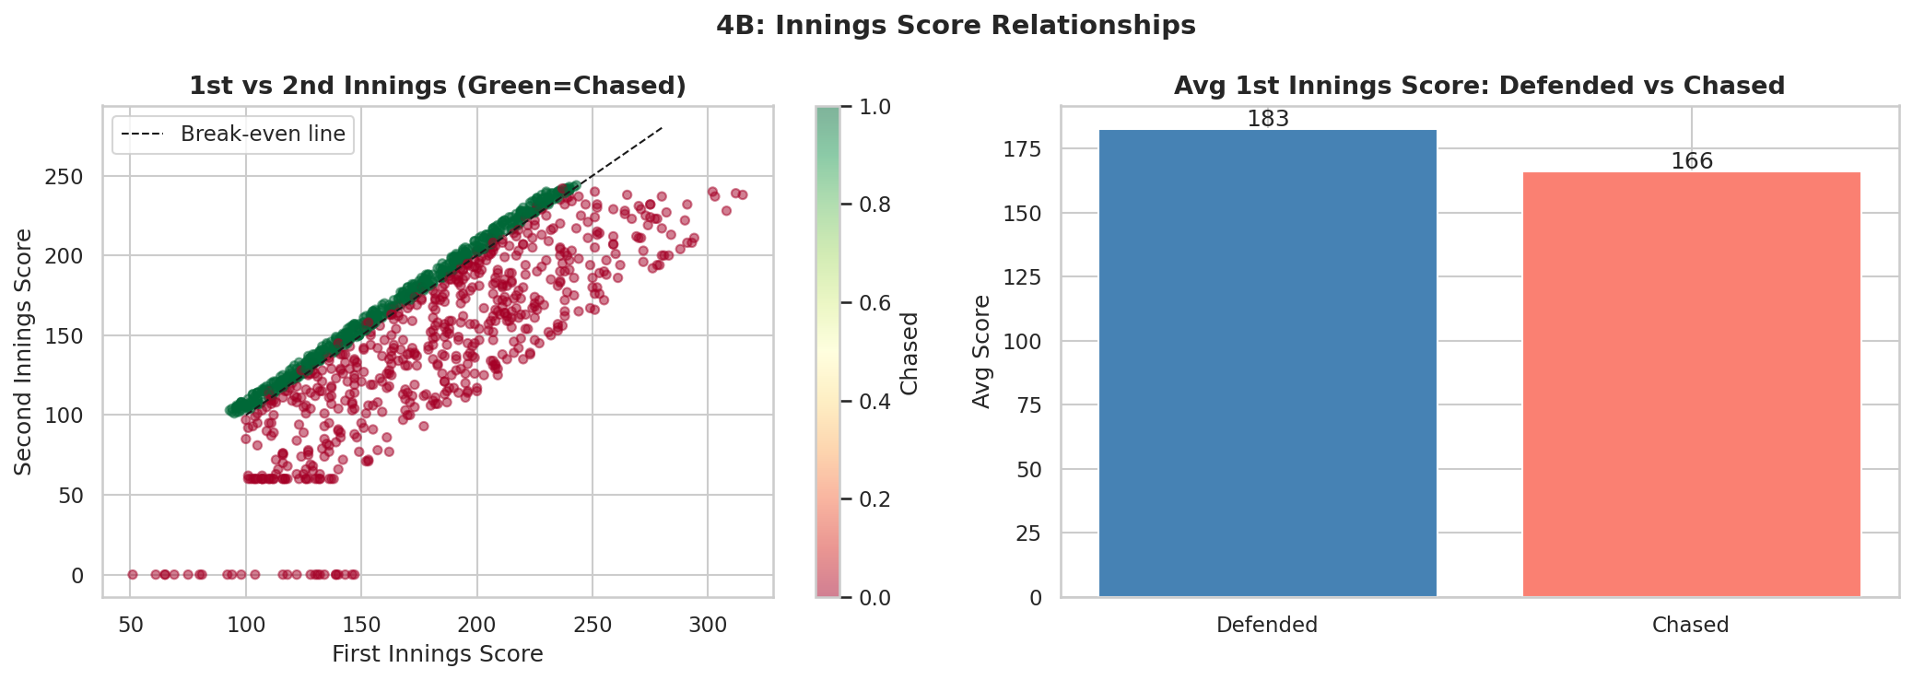
SECTION 4B
First vs Second Innings Score Relationship
WHY THIS CHART: A scatter plot is the right tool whenever you want to see the relationship between two continuous numbers, one dot per match. Colour-coding by chased_successfully adds a third, categorical dimension; the diagonal line marks the break-even score.
KEY INSIGHT: Matches that were defended had an average first-innings score of 182.6 runs, versus only 166.1 runs in matches that were successfully chased — a gap of about 17 runs.
ANALYST TAKEAWAY: There is a visible run-threshold: teams that bat first and clear roughly 180 tend to defend; targets below that are chased down more often. This is the kind of number a captain can use when deciding how aggressively to bat first.
13

Slide 11
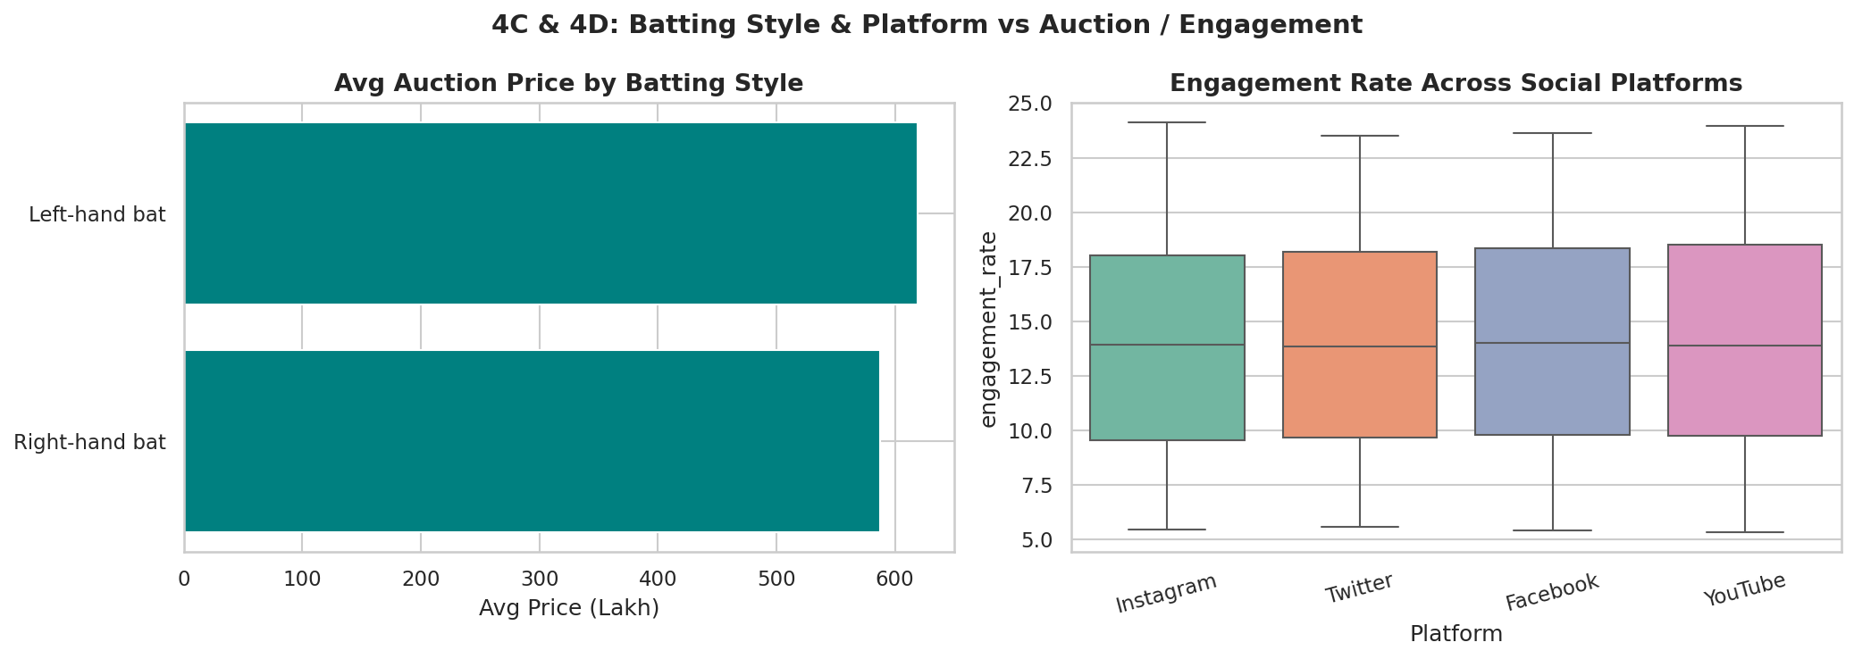
SECTION 4C & 4D
Batting Style vs Price | Platform vs Engagement
WHY THIS CHART: A horizontal bar of group means (groupby('batting_style').mean()) compares two categories cleanly; a box plot compares full distributions — not just averages — across the four platforms, which matters because engagement has outlier 'viral' spikes a bar chart would hide.
KEY INSIGHT: Left-hand batsmen command a slightly higher average auction price (₹619L) than right-hand batsmen (₹588L). Engagement rate is remarkably FLAT across platforms — 14.10% to 13.99%, a gap of under 0.2 points.
ANALYST TAKEAWAY: Because platform engagement is so similar, the box plot's outlier dots — not its median line — are where the real platform story lives: occasional viral spikes, not a structurally 'better' platform.
14

Slide 12
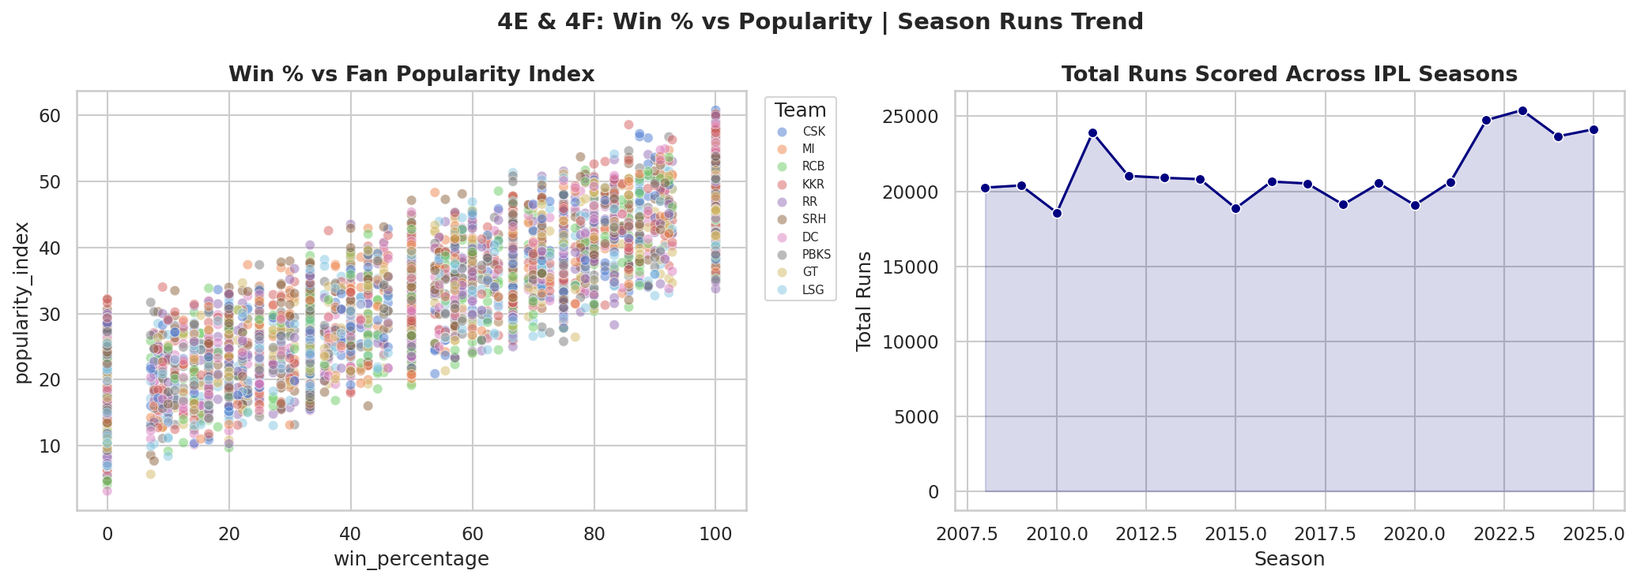
SECTION 4E & 4F
Win % vs Popularity | Season Runs Trend
WHY THIS CHART: A scatter plot with hue='team' shows whether winning and popularity move together across many team-season points; a line chart with fill_between is the standard way to show a trend across an ordered sequence — IPL seasons.
STATISTICAL NOTE: win_percentage correlates strongly with popularity_index (Pearson r = 0.878) but almost NOT AT ALL with engagement_rate (r = 0.013). Winning builds reputation/popularity, but day-to-day social engagement is driven by something else entirely.
KEY INSIGHT: Total runs scored per season moved from 20,244 in the first season to 24,134 in the most recent one — a reminder to always check the actual numbers rather than assume scoring only ever goes up.
IPL EDA • Viva Preparation Deck
15

Slide 13
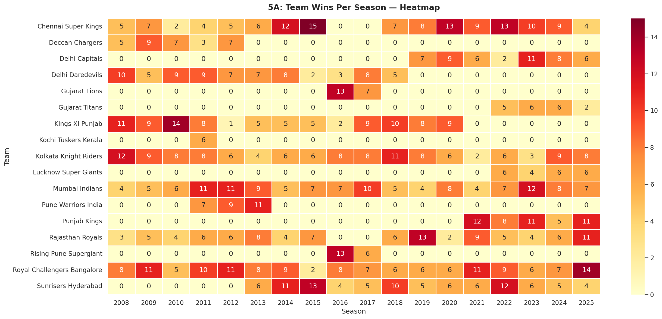
SECTION 5A
Team Wins Per Season — Heatmap
WHY THIS CHART: groupby(['season','winner']).size().unstack() builds a team × season matrix; a heatmap is the only chart type that lets a viewer scan two categorical axes and a numeric value (colour intensity) simultaneously without reading every cell.
KEY INSIGHT: Royal Challengers Bangalore have the MOST total wins of any franchise (144), narrowly ahead of Mumbai Indians (130) and Chennai Super Kings (129).
ANALYST TAKEAWAY: Yet RCB does not top the championship count, as the next part of this deck (Team & Player Performance) shows — the most total match wins does not automatically mean the most titles, a nuance worth pointing out unprompted.
IPL EDA • Viva Preparation Deck
17

Slide 14
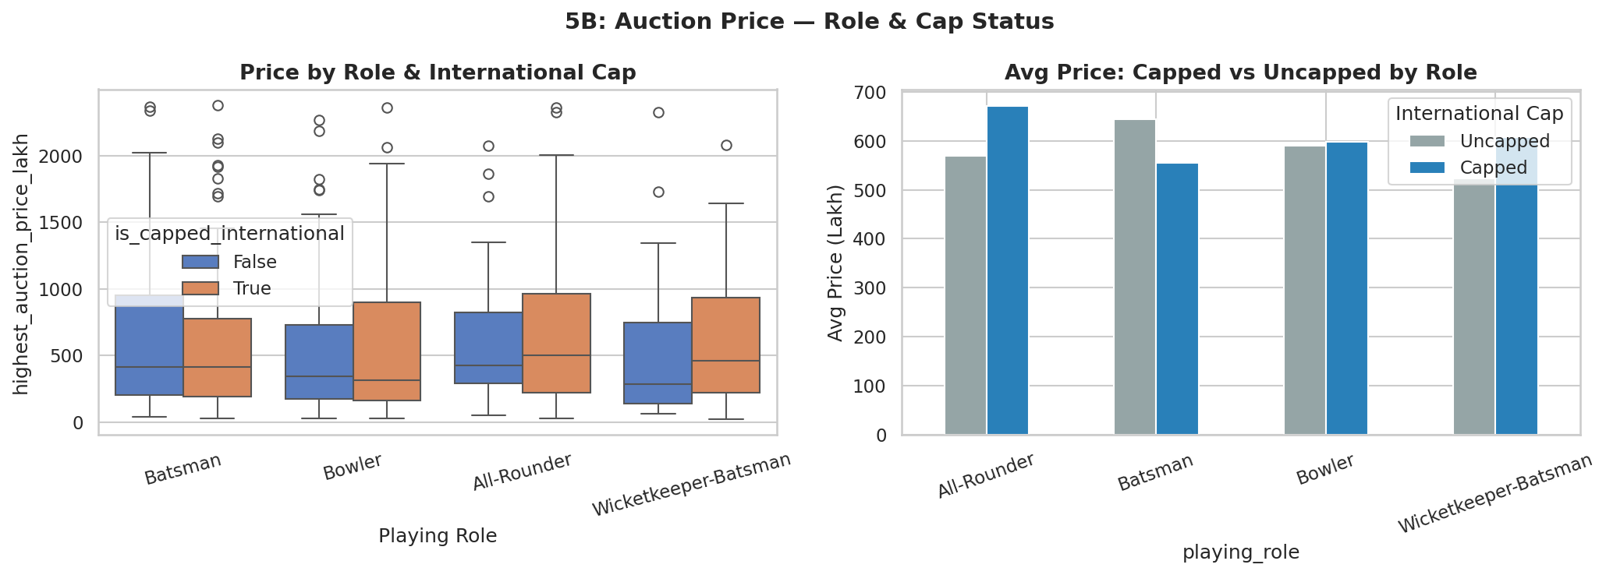
SECTION 5B
Auction Price by Role & International Cap
WHY THIS CHART: sns.boxplot(..., hue='is_capped_international') adds a third variable to a two-variable box plot by drawing two boxes per role — capped and uncapped — so all three dimensions (role, cap status, price spread) are visible together.
KEY INSIGHT: Capped All-Rounders fetch the highest average price among capped players (₹671L), while among UNCAPPED players Batsmen actually price highest (₹644L) — capped Batsmen average less (₹555L) than uncapped ones in this data.
ANALYST TAKEAWAY: That counter-intuitive Batsman result is worth raising in viva: it shows the value of checking the actual grouped numbers rather than assuming 'capped always means pricier' for every role.
IPL EDA • Viva Preparation Deck
18

Slide 15
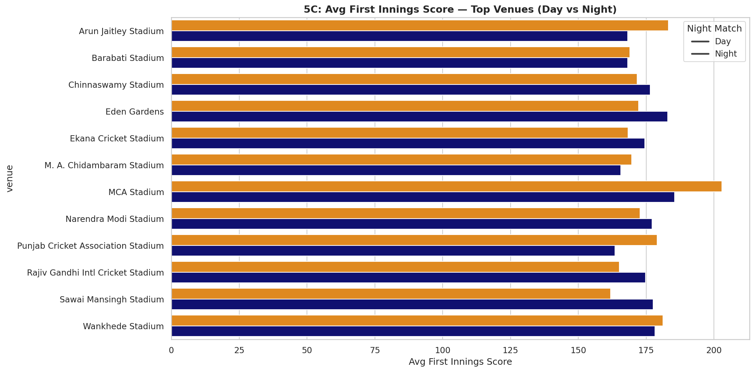
SECTION 5C
Venue × Day/Night × Average Score
WHY THIS CHART: groupby(['venue','is_day_night']).agg(avg_first=('...','mean'), match_count=('...','count')) computes two aggregations in one pass; filtering to venues with 8+ matches before plotting avoids a single fluke score distorting a venue's 'average'.
KEY INSIGHT: Average first-innings score varies meaningfully by venue — some grounds are clearly more batting-friendly than others — but day vs night bars at the same venue sit close together, a pattern confirmed numerically on the next venue slide.
WHY THE MIN-MATCH FILTER: Without the match_count >= 8 filter, a venue that hosted only 1-2 matches could show a misleadingly extreme average — exactly the kind of small-sample trap a careful analyst checks for.
IPL EDA • Viva Preparation Deck
19

Slide 16
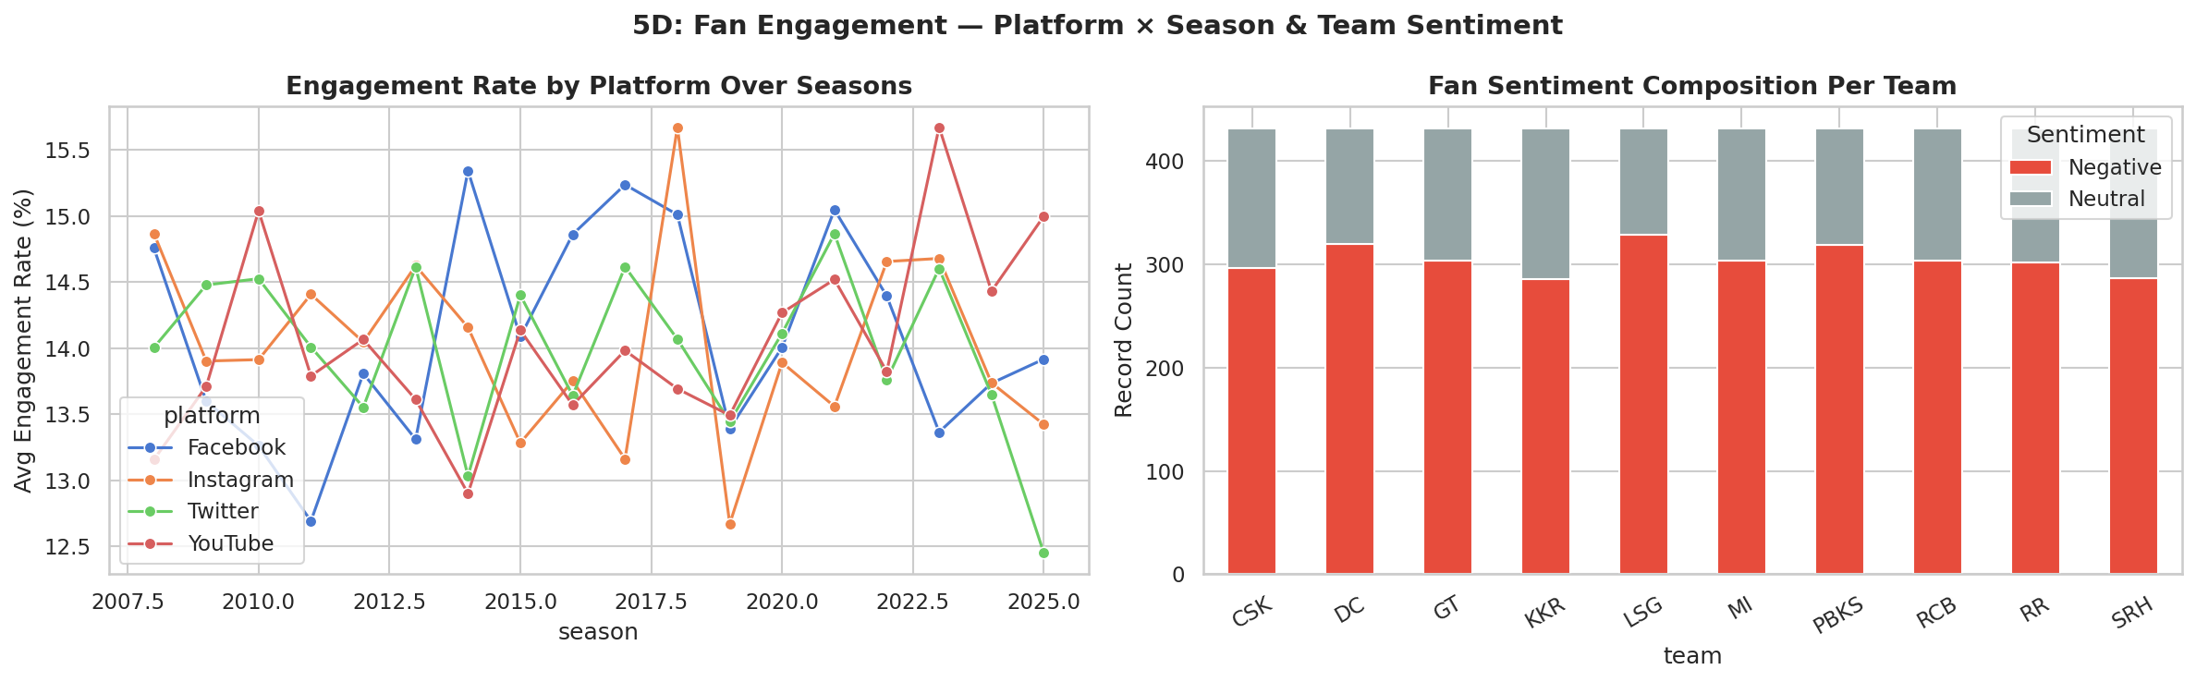
SECTION 5D
Fan Engagement — Platform×Season & Team Sentiment
WHY THIS CHART: A multi-line chart (hue='platform') tracks four time series at once; a stacked bar (unstack().plot(kind='bar', stacked=True)) shows how each team's sentiment record count is composed of Negative vs Neutral shares — composition, not just totals.
KEY INSIGHT: All four platforms move together season over season rather than diverging — reinforcing the 4C/4D finding that platform is not a strong differentiator of engagement in this dataset.
ANALYST TAKEAWAY: Because sentiment has no 'Positive' category at all here, every team's stacked bar is a Negative/Neutral split only — useful to mention explicitly so the examiner knows you read the data carefully rather than assuming a generic three-way split.
IPL EDA • Viva Preparation Deck
20

Slide 17
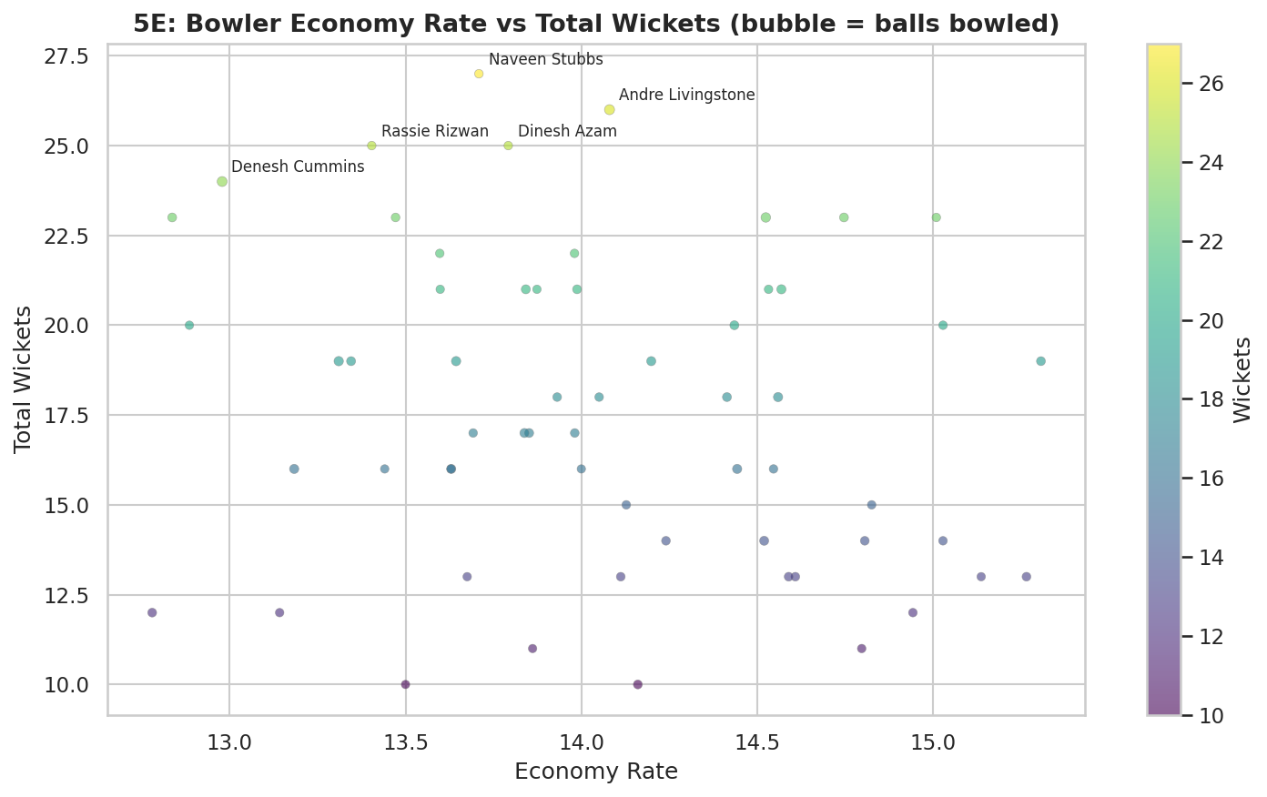
SECTION 5E
Bowler Economy Rate vs Total Wickets
-0.20
Pearson r: economy vs wickets
Naveen
Top wicket-taker: 27 wkts
13.71
Their economy rate
WHY THIS CHART: A bubble chart encodes FOUR variables at once: economy (x), wickets (y), bowler identity (label) and balls bowled (bubble size) — the only chart type that fits all four into a single readable picture.
KEY INSIGHT: Naveen Stubbs leads with 27 wickets at an economy of 13.71. The correlation between economy and wickets is only r = -0.20 — weak — so taking more wickets does not strongly require a lower economy in this data; the two skills are fairly independent.
WHY THE 300-BALL FILTER: balls >= 300 (50 overs) excludes bowlers with too little data for a stable economy rate — a bowler who bowled 2 overs for 6 runs has a flattering economy that is statistically meaningless.
IPL EDA • Viva Preparation Deck
21

Slide 18
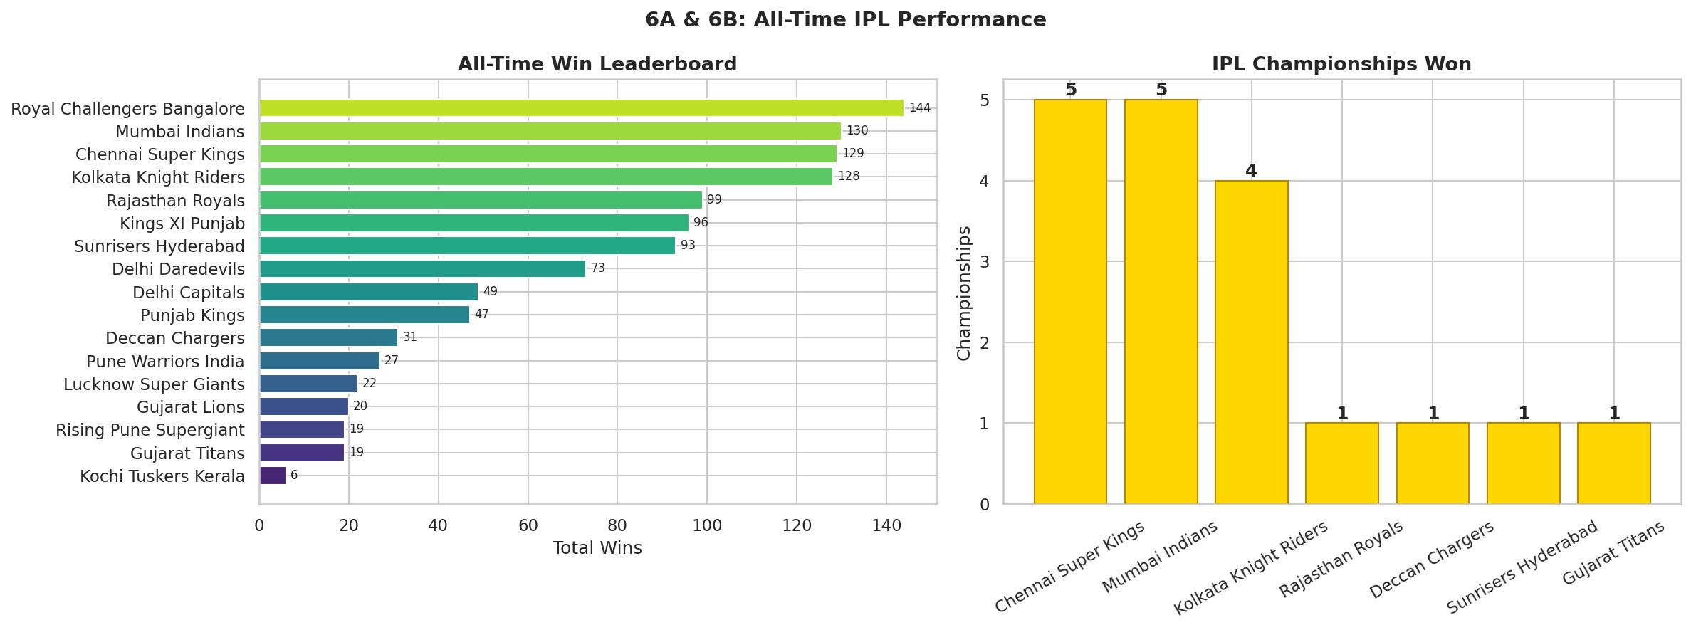
SECTION 6A & 6B
All-Time Wins & Championships
WHY THIS CHART: value_counts() on matches.winner gives total wins; value_counts() on seasons.champion gives titles. Two different bar charts side by side because 'most wins' and 'most championships' are genuinely different questions.
KEY INSIGHT: RCB lead in total wins (144) but Chennai Super Kings and Mumbai Indians are tied for the most titles (5 each), with Kolkata Knight Riders next on 4.
ANALYST TAKEAWAY: RCB does not appear in the championship leaderboard at all in this dataset — a strong, specific, examiner-friendly contrast to lead with: consistent regular-season success has not translated into titles.
IPL EDA • Viva Preparation Deck
23

Slide 19
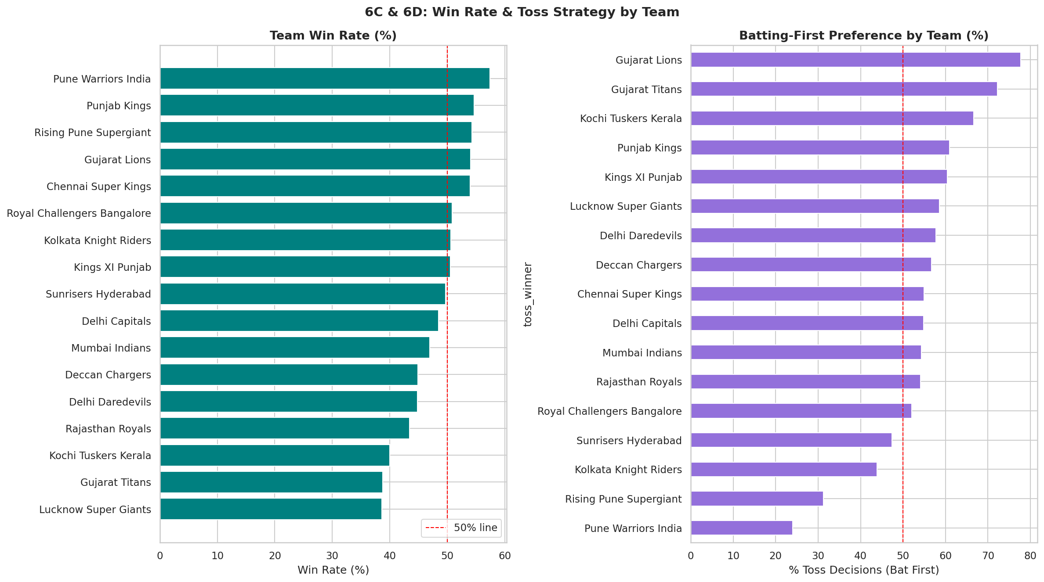
SECTION 6C & 6D
Team Win Rate & Toss Strategy
WHY THIS CHART: pd.concat([team1, team2]).value_counts() is needed because each match lists a team in EITHER column — concatenating both columns is the only way to get each team's true total matches played, the correct denominator for win rate.
KEY INSIGHT: Win rate (wins ÷ matches played) re-ranks teams differently from raw win counts: Pune Warriors India top this list at 57.4%, ahead of Punjab Kings (54.7%) and Chennai Super Kings (54%).
WHY RATE OVER RAW COUNT: Win RATE is the fairer comparison because franchises have played very different numbers of matches across IPL history — a short-lived team can have a strong rate on a small base, which is itself worth flagging as a sample-size caveat in viva.
IPL EDA • Viva Preparation Deck
24

Slide 20
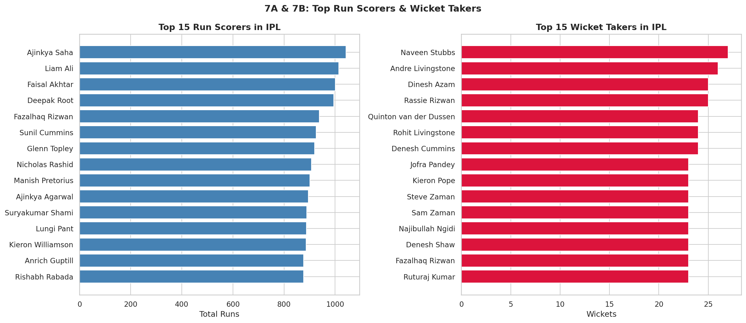
SECTION 7A & 7B
Top Run Scorers & Wicket Takers
WHY THIS CHART: deliveries.groupby('striker').batsman_runs.sum() rolls up every ball into a career total; the wicket-takers panel first filters to is_wicket==True rows, then groupby('bowler').size() counts dismissals — .size() is simpler than .sum() when the filtered rows ARE the thing being counted.
KEY INSIGHT: Ajinkya Saha leads run-scoring with 1043 runs; Naveen Stubbs leads wicket-taking with 27 wickets.
ANALYST TAKEAWAY: Showing the top 15, not all 580 players, keeps the chart readable — .head(15) after sorting is a simple but important presentation choice.
IPL EDA • Viva Preparation Deck
26

Slide 21
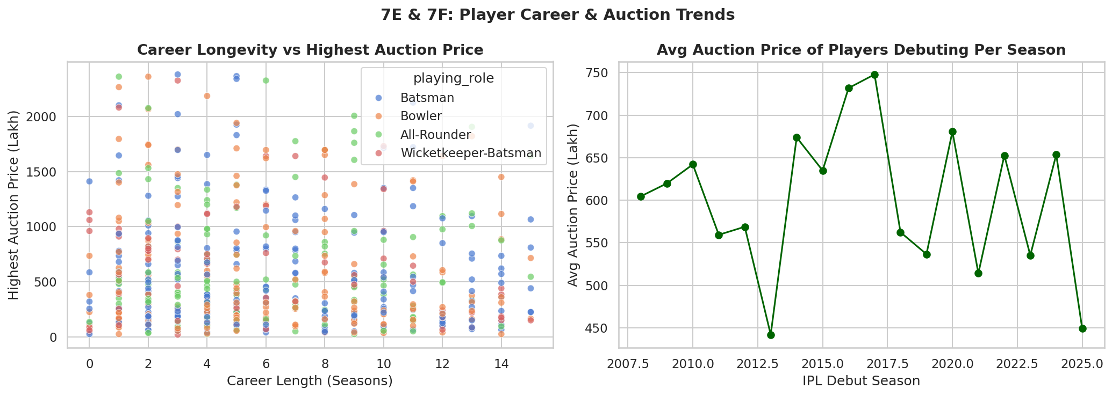
SECTION 7E & 7F
Career Length vs Price | Debut-Season Pricing
-0.06
Pearson r: career length vs price
p=0.12
Not statistically significant
WHY THIS CHART: A scatter plot with hue='playing_role' checks whether career longevity buys a higher price, and whether that pattern differs by role; a line chart of mean price by debut season checks for any pricing trend over IPL history.
KEY INSIGHT — ANOTHER GENUINE SURPRISE: Career length and auction price correlate at only r = -0.06 (p = 0.12, not significant) — playing more seasons does NOT reliably buy a higher price in this data.
ANALYST TAKEAWAY: Average price for debutants also FELL from ₹605L in the earliest debut season to ₹449L in the most recent — the opposite of an "auction inflation" story, and worth saying plainly rather than assuming the popular narrative.
IPL EDA • Viva Preparation Deck
28

Slide 22
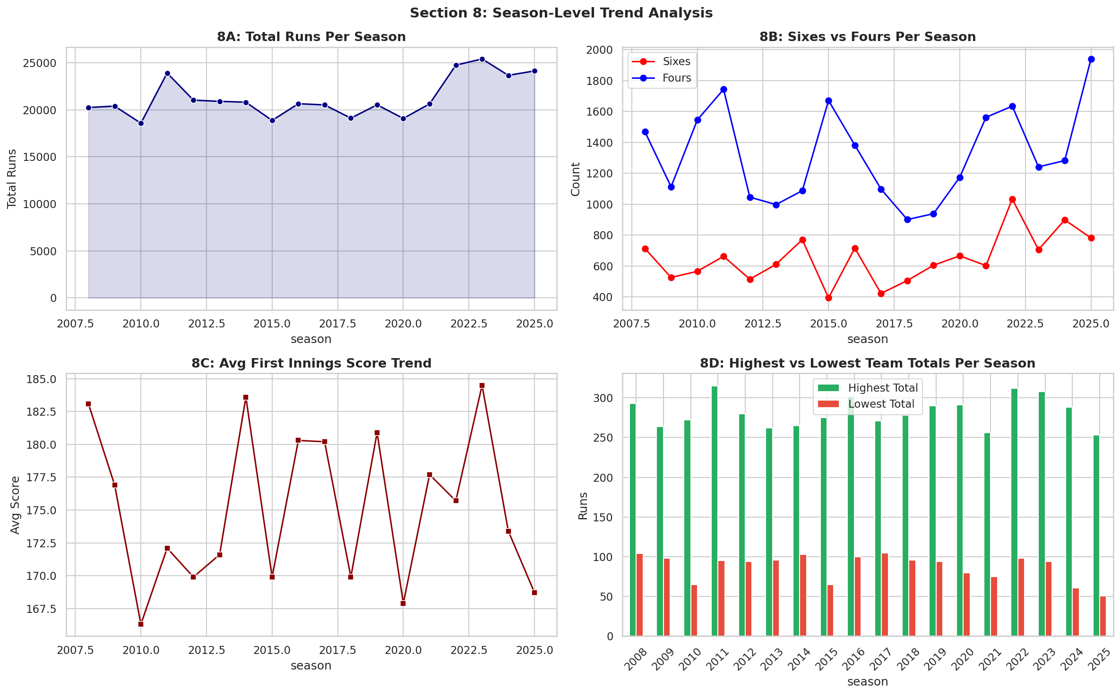
SECTION 8
Season-Level Trend Analysis
WHY THIS CHART: A 2×2 subplot grid tells one connected season-by-season story in a single figure: total runs (line+fill), sixes vs fours (two-line), average first-innings score (line), and highest/lowest totals (bars — because extremes, not trends, are the point there).
KEY INSIGHT: Average first-innings score actually fell from 183.1 in the first season to 168.7 in the latest — and the sixes-to-fours ratio also dropped, from 0.49 to 0.40. Both run counter to the usual "T20 scoring only ever rises" assumption.
ANALYST TAKEAWAY: The single highest team total on record is 315; the single lowest is 51 — that 264-run spread across IPL history is itself worth a sentence in viva.
IPL EDA • Viva Preparation Deck
30

Slide 23
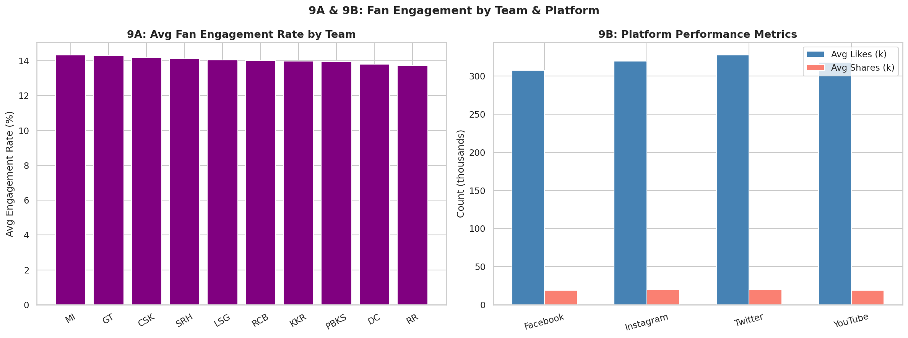
SECTION 9A & 9B
Fan Engagement by Team & Platform
WHY THIS CHART: groupby('team').engagement_rate.mean() ranks teams on one metric; the grouped bar chart uses np.arange() with small x-offsets to place three platform metrics (engagement, likes, shares) side by side for direct comparison.
KEY INSIGHT: Team-level engagement differences are small — the top three teams (MI, GT, CSK) sit within half a point of each other (14.32% / 14.30% / 14.18%).
ANALYST TAKEAWAY: Followers, likes and shares all scale together across platforms — consistent with the strong follower-likes correlation confirmed on the next slide's heatmap.
IPL EDA • Viva Preparation Deck
31

Slide 24
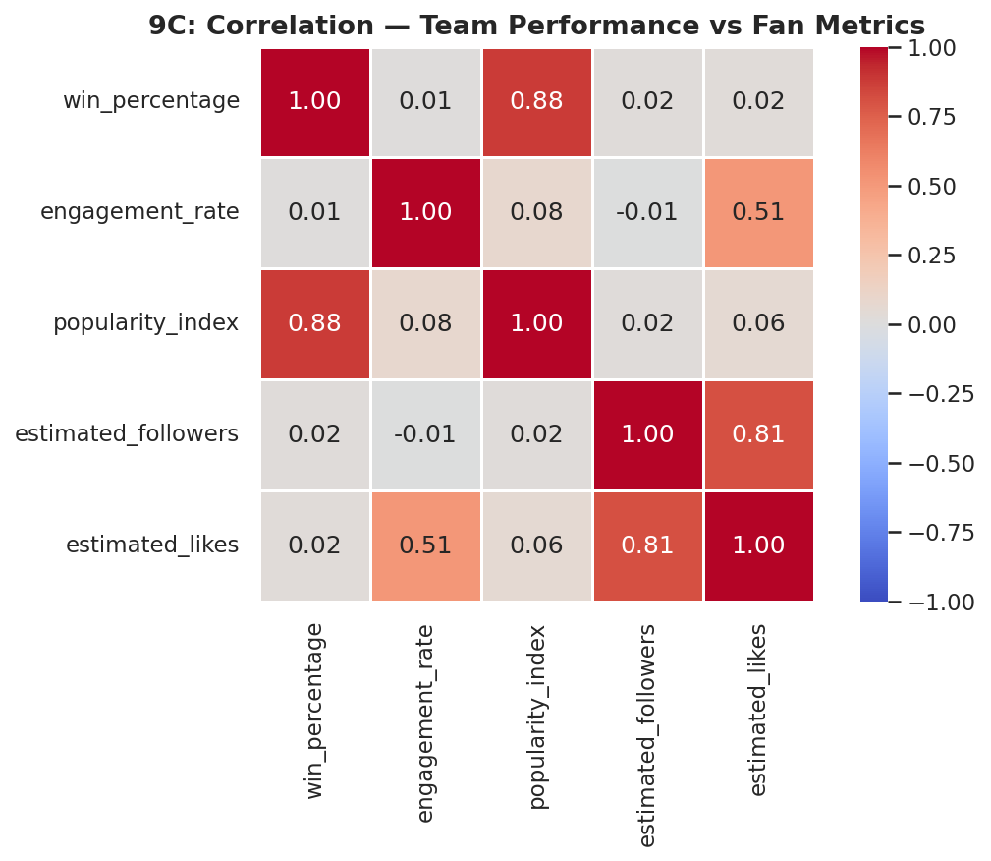
SECTION 9C
Correlation Heatmap — Performance vs Fan Metrics
0.878
win% ↔ popularity_index
0.806
followers ↔ likes
0.013
win% ↔ engagement_rate
WHY THIS CHART: df[cols].corr() computes every pairwise Pearson correlation at once; a heatmap with vmin=-1, vmax=1 and a diverging colormap (coolwarm) is the standard way to scan many correlations simultaneously — colour intensity does the reading for you.
KEY INSIGHT: win_percentage and popularity_index correlate strongly (r=0.878) — winning really does build reputation. But win_percentage barely correlates with engagement_rate (r=0.013): being good and being talked-about-online are not the same thing in this data.
STATISTICAL NOTE: estimated_followers and estimated_likes correlate at 0.806 — expected, since both scale with overall account size — while engagement_rate (a ratio metric) is independent of raw follower count (r=-0.006), exactly as a normalised rate metric should behave.
IPL EDA • Viva Preparation Deck
32

Slide 25
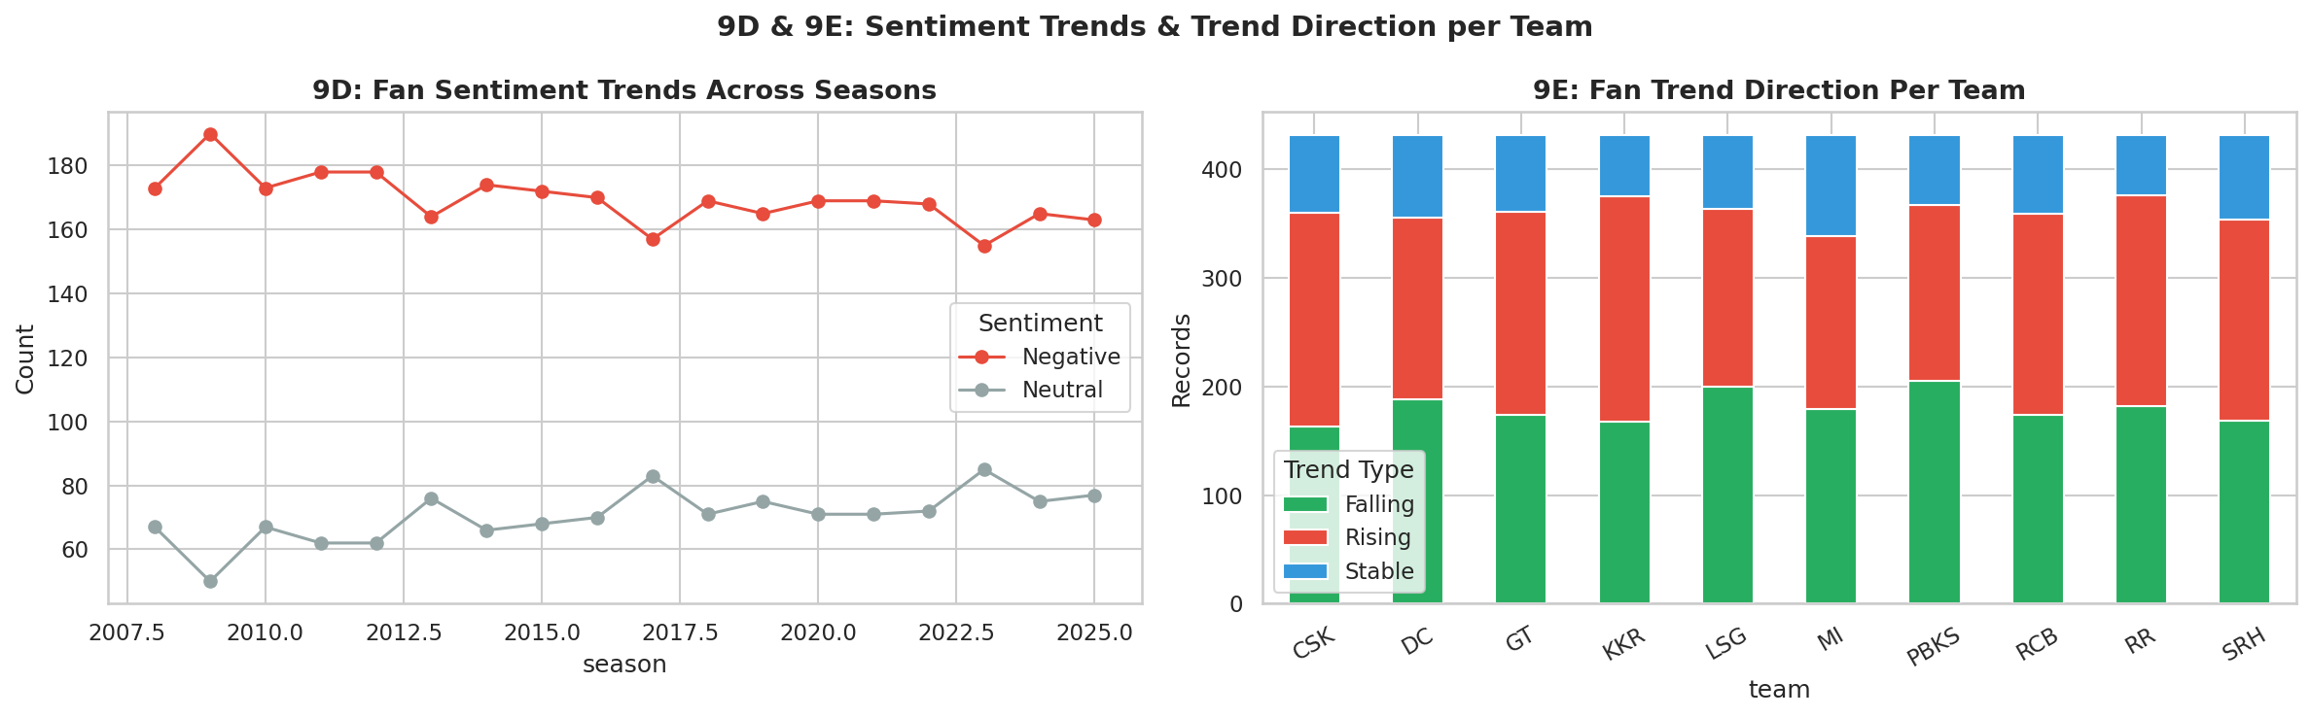
SECTION 9D & 9E
Sentiment Trends & Fan Trend Direction
WHY THIS CHART: groupby(['season','fan_sentiment']).size().unstack() turns category counts into a time series, drawn as a multi-line chart; the team-level version is drawn as a stacked bar so each team's bar height still equals its total record count.
KEY INSIGHT: Negative and Neutral sentiment move together across seasons rather than diverging sharply — there's no single season where fan mood swings dramatically in either direction.
ANALYST TAKEAWAY: The trend_type stacked bars (Rising/Falling/Stable) let you instantly compare which teams are gaining momentum versus which are flat — useful framing for a 'who to watch next season' style question.
IPL EDA • Viva Preparation Deck
33

Slide 26
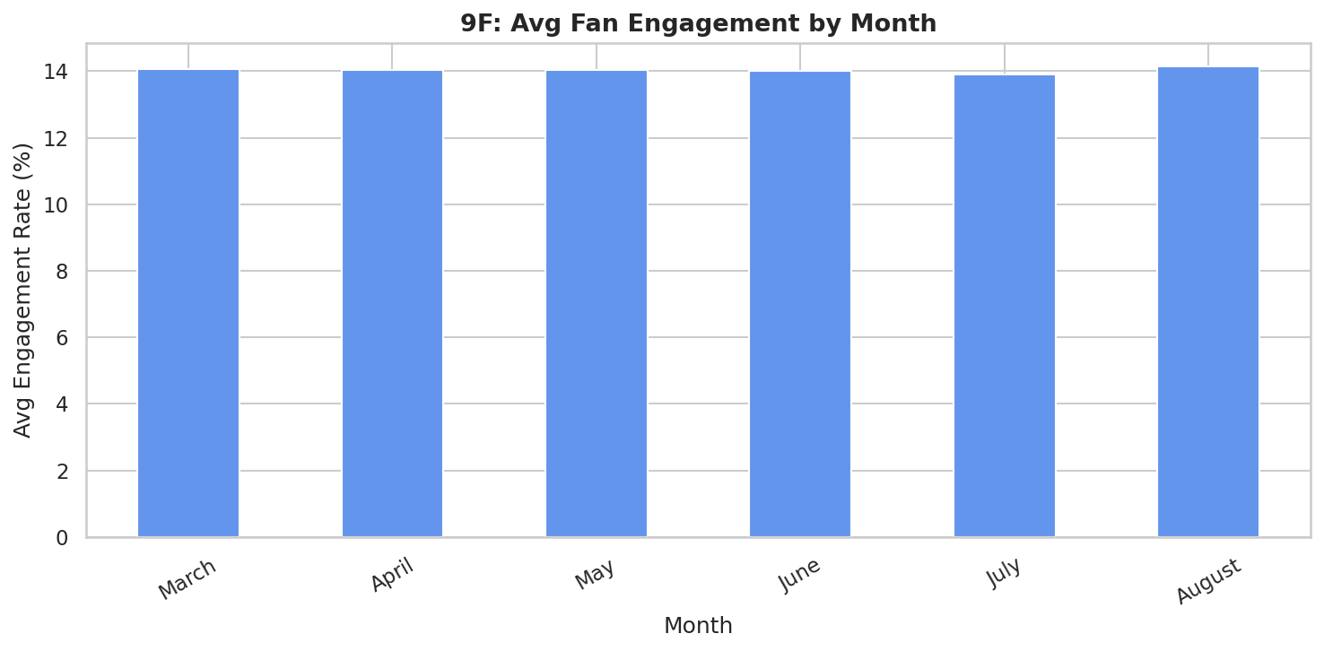
SECTION 9F
Monthly Fan Engagement Pattern
WHY THIS CHART: month was set as pd.Categorical(..., ordered=True) in Section 2 specifically so this bar chart shows calendar order, not alphabetical order; groupby('month', observed=True) then only plots months that actually occur in the data.
KEY INSIGHT: Engagement is highest in August (14.15%) and lowest in July (13.91%) — but the entire March-to-August range only spans about 0.24 percentage points, a very flat seasonal pattern.
ANALYST TAKEAWAY: Because the data only covers the March-August window (the active IPL season), there's no off-season comparison available here — worth noting as a scope limitation if asked.
IPL EDA • Viva Preparation Deck
34

Slide 27
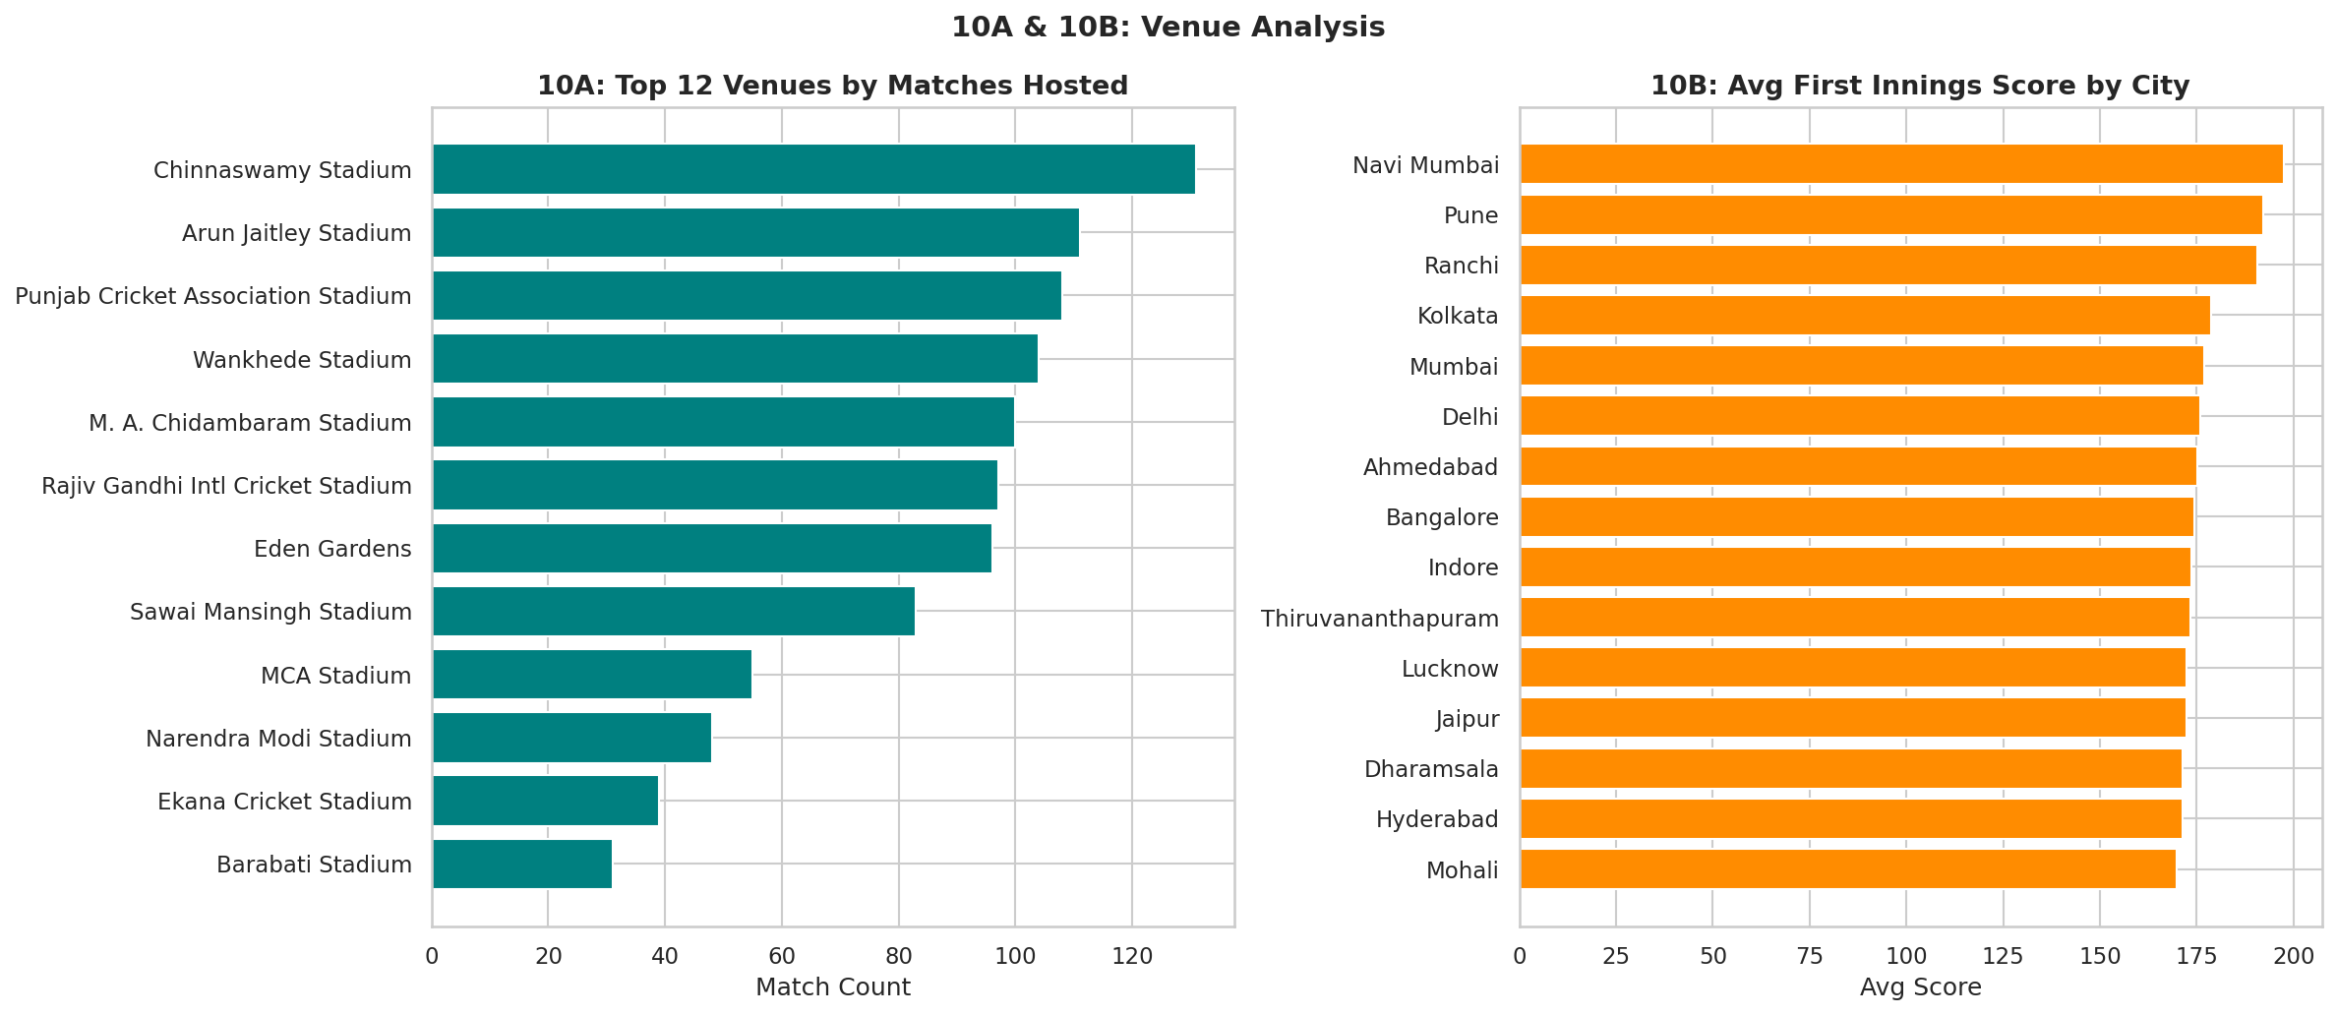
SECTION 10A & 10B
Venue Popularity & City-Level Scoring
WHY THIS CHART: value_counts().head(12) ranks venues by how many matches they hosted; groupby('city').first_innings_score.mean() ranks cities by average scoring conditions — two different questions, two horizontal bar charts.
KEY INSIGHT: Chinnaswamy Stadium hosted the most matches (131). Navi Mumbai produced the highest average first-innings score (197.5), ahead of Pune (192.2) and Ranchi (190.7).
ANALYST TAKEAWAY: Horizontal bars (barh) were chosen over vertical bars specifically because venue and city names are long — vertical labels would overlap or need awkward rotation.
IPL EDA • Viva Preparation Deck
35

Slide 28
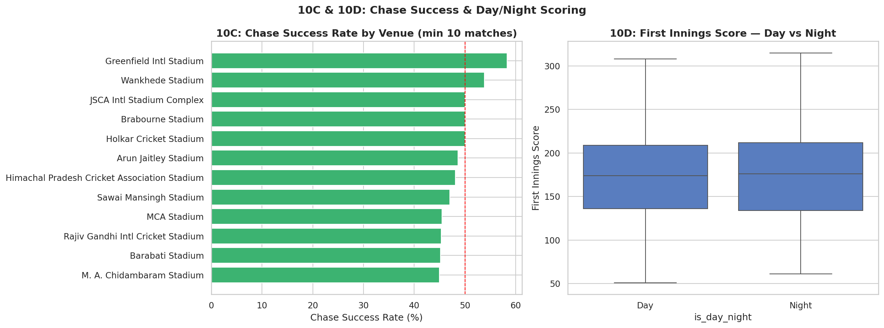
SECTION 10C & 10D
Chase Success Rate & Day/Night Scoring
WHY THIS CHART: Chase-success rate per venue is filtered to venues with 10+ matches before ranking, for the same small-sample reason as Section 5C; a box plot (not a bar chart) compares day vs night SCORE DISTRIBUTIONS, not just their averages.
KEY INSIGHT: Greenfield International Stadium has the highest chase-success rate (58.3%) among well-sampled venues. Day matches average 175.3 runs first-innings versus 175.0 at night — essentially NO difference.
ANALYST TAKEAWAY: That null result is itself informative: the popular 'dew helps the chasing team at night' narrative is not supported by the scoring data here, and a good analyst reports a null finding as confidently as a positive one.
IPL EDA • Viva Preparation Deck
36

Slide 29
SECTION 11
From Charts to Proof: Statistical Testing
A chart suggests a pattern; a statistical test tells you whether that pattern could just be random noise.
Chi-Square Test
χ² = 0.098, p = 0.754
p > 0.05 → FAIL to reject the null. Toss decision and match result are statistically independent — the chart-level hint of a tiny gap is not real.
chi2_contingency(pd.crosstab(toss_decision, toss_winner==winner))
Pearson Correlation — Career vs Price
r = -0.064, p = 0.121
p > 0.05 → also not significant. Career length alone does not predict auction price in this dataset.
stats.pearsonr(career_length, highest_auction_price_lakh)
Pearson Correlation — Win% vs Popularity
r = 0.878
Strong and clearly meaningful — winning teams really do become more popular. This is the one relationship in this deck strong enough to act on with confidence.
fan_trends[cols].corr(method='pearson')
IPL EDA • Viva Preparation Deck
38

Slide 30
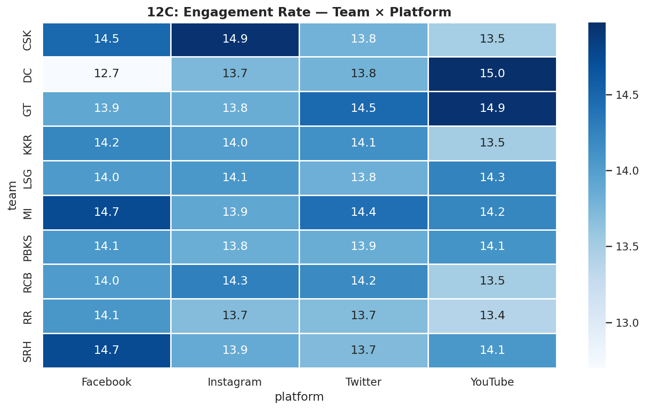
SECTION 12
Pivot Table — Engagement Rate by Team × Platform
pivot_table()
index=team, columns=platform
aggfunc='mean'
Cell value = avg engagement %
WHY THIS CHART: pivot_table(index='team', columns='platform', values='engagement_rate', aggfunc='mean') is the exact pandas equivalent of an Excel pivot table — it reshapes long data into a wide team×platform grid in one call, then a heatmap colours it.
KEY INSIGHT: Cell-to-cell variation within this grid is modest, consistent with the earlier finding that platform is a weak differentiator — but a few team-platform combinations do stand out as relatively stronger, visible as slightly darker cells.
WHY A PIVOT, NOT JUST GROUPBY: groupby(['team','platform']).mean() would give the same numbers as a tall, narrow series; .unstack() — or pivot_table() directly — turns that into the compact, scannable matrix a heatmap needs.
IPL EDA • Viva Preparation Deck
39

Slide 31
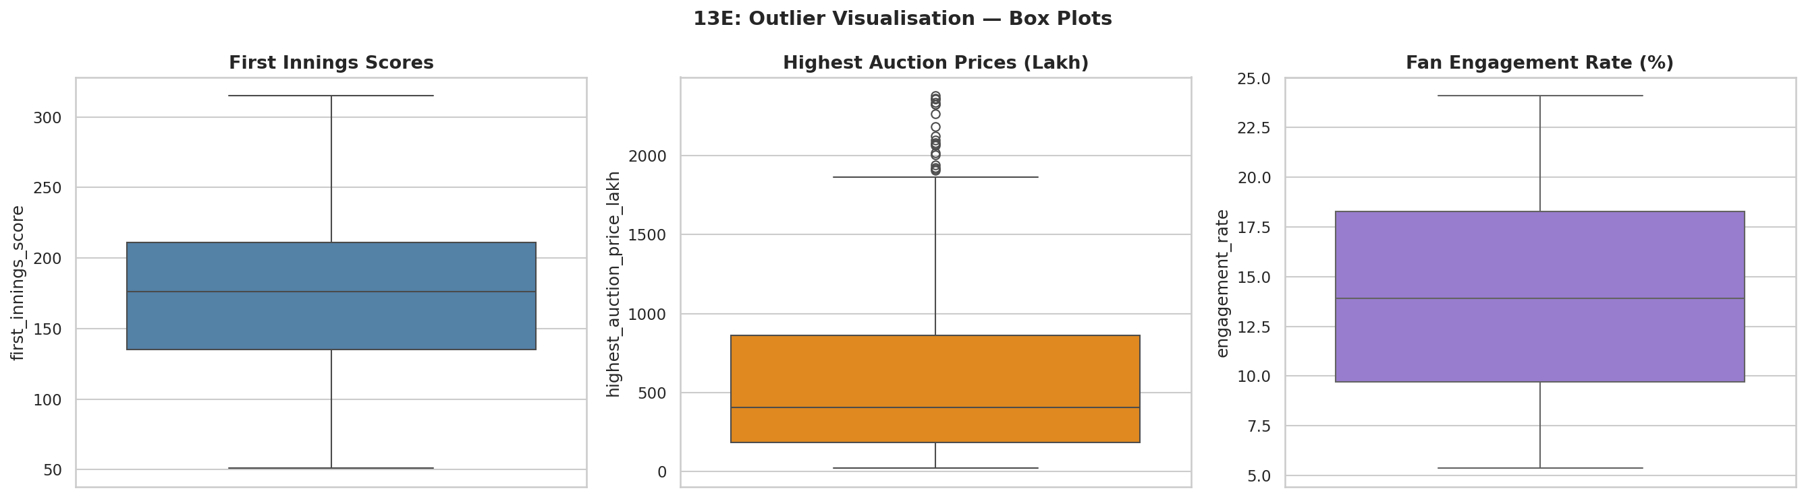
SECTION 13
Outlier Detection Across Three Metrics
217
matches scored 220+ runs
216
viral fan-engagement posts (top 5%)
107
players with 10+ IPL seasons
WHY THIS CHART: Box plots show outliers explicitly as dots beyond the whiskers (1.5×IQR), which is more informative here than a single number — it shows HOW MANY outliers exist and how far they sit from the bulk of the data, for three different metrics side by side.
KEY INSIGHT: 217 matches (about 19% of all 1,158) scored above 220 — far from a rare freak event. The score IQR runs from 135 to 211, while price IQR runs from ₹185L to ₹860L — a much wider relative spread, confirming price is the more skewed metric of the two.
WHY THE 95TH-PERCENTILE CUTOFF: quantile(0.95) is a data-driven way to define "viral" — the top 5% of engagement_rate values, 216 records, rather than picking an arbitrary fixed threshold.
IPL EDA • Viva Preparation Deck
40

Slide 32
SECTION 14
Finding → Recommendation
Toss Strategy
FINDING Toss winner win-rate is 46.9% (p=0.75, not significant) — and batting-first toss winners edge out fielding-first ones.
RECOMMENDATION Don't over-index on toss strategy in pre-match planning; team composition and conditions matter far more than the toss call itself.
Auction Valuation
FINDING Career length barely predicts price (r=-0.06, not significant), and capped status helps All-Rounders and Wicketkeepers but NOT Batsmen.
RECOMMENDATION Auction strategy should be built role-by-role from current form, not from career length or cap status alone — a uniform 'experience premium' rule would misprice several roles.
Fan Monetisation
FINDING win_percentage strongly predicts popularity_index (r=0.88) but is almost uncorrelated with engagement_rate (r=0.01); all 4 platforms perform within 0.2 points of each other.
RECOMMENDATION Winning builds brand value, not necessarily clicks. Content strategy should chase engagement independently of results, and platform choice can be driven by audience fit rather than expected engagement lift.
IPL EDA • Viva Preparation Deck
42

Slide 33
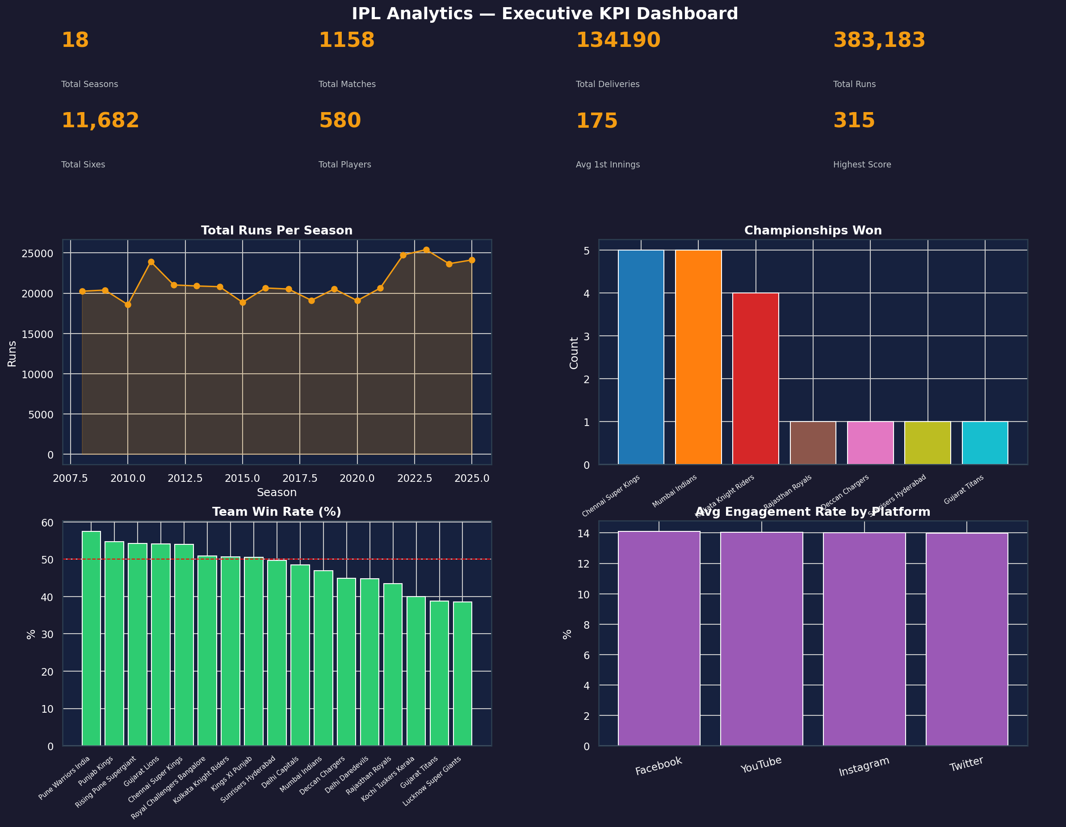
SECTION 15
Executive KPI Dashboard
1,158
Total matches
134,190
Total deliveries
₹860L
75th-pct auction price
0.88
win% ↔ popularity r
WHY THIS CHART: fig.add_axes() (instead of plt.subplots) gives precise pixel control to lay out headline KPI numbers above four supporting charts in one dark-themed figure — the single screen a stakeholder would actually look at, rather than 14 separate charts.
WHY ONE FIGURE, NOT MANY: A dashboard is meant to be read in under 30 seconds. Splitting it into separate slides would force a viewer to hold numbers in their head across pages and lose the at-a-glance comparison that is the entire point of a dashboard.
ANALYST TAKEAWAY: Every number on this dashboard traces directly back to a specific chart earlier in this deck — that traceability is exactly what an examiner is checking for when they ask 'where does this number come from?'
IPL EDA • Viva Preparation Deck
43

Slide 34
Thank You
Questions on any chart, aggregation, or statistic in this deck are welcome.
Datasets
Charts built
Tools
Tests run
5 linked CSV tables
28 figures across 15 sections
pandas · seaborn · matplotlib · scipy
Chi-square + 2 Pearson correlations
45

