Slide 1
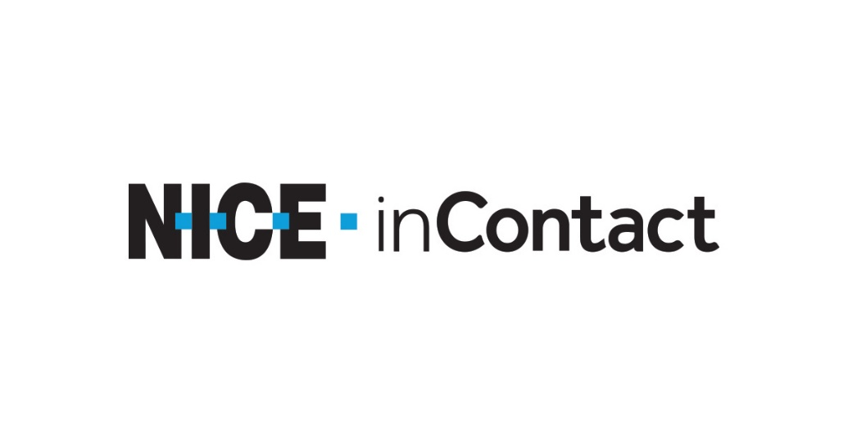
Avoid putting yourself in a silver platter for the hackers Security frameworks 101
Victor Steven Morales – Sr DevOps Engineer
Notes:
Hope you are enjoying yourself at Saintcon
Welcome to “avoid putting yourself on a sliver platter, Security Frameworks 101”
I’m Victor Steven Morales a Sr DevOps Engineer at Nice Incontact
Been in the industry for 10 years now
Devops engineer, I think I'm in the wrong talk. He isn’t even on the security team
In or not. Security is everyone responsibility. We should strive to do our due diligences.
My passion for security has sky rocketed from attending various cyber security conferences and of courses ticking around with various technologies. The best part
For the security folks in the room. This will be your role. For the rest of us, its another thing to add to our bucket
But I already have all these things in my bucket. I know the feeling. But who else has that much knowledge of their environment. You and your team
Because of the lack of time. We can rely on frameworks to give us a baseline. A starting point. Get the conversation going

Slide 2
Table of contents
What are frameworks
Raising the bar
Types of frameworks
Understanding your needs
Implementation
Not the silver bullet
Gotchas

Slide 3


Security Frameworks
Notes:
-organizations should follow specific cybersecurity frameworks that will assist them in redefining and reinforcing their IT security and staying vigilant against cyber attacks.
-Let’s make their life a bit harder
-Levels of hackers, let’s raise the bar

Slide 4
Security Frameworks
-What they are?
-Benefits
-Purpose
-What they are not.
Notes:
What they are
-Cybersecurity framework is a predefined set of policies and procedures that are defined by leading cybersecurity organizations to enhance cybersecurity strategies within an enterprise environment, and it is documented for theoretical knowledge and practical implementation procedures.
-These frameworks are, at times, designed targeting a specific industry and are built to reduce the unknown vulnerabilities and misconfigurations existing within an enterprise network.
-To keep this simple, let's say the cybersecurity framework is a blueprint to enrich your enterprise IT security.
-Since these frameworks are well designed and tested under different situations, enterprises can ensure they are reliable.
Benefits
follow specific cybersecurity frameworks that will assist them in redefining and reinforcing their IT security and staying vigilant against cyber attacks
Cybersecurity frameworks will upgrade your existing security protocols, and bring in new security layers if there isn't one existing already.
These frameworks will also help enterprises understand where their security standards are and how can they improve it.
That are the basics
to become aware of different attack vectors
they give you every possible controls and throw at you.
what matters
What they are not.
not a silver bullet
but can all these unforeseen cyber attacks be prevented proactively? That's definitely a ‘NO,
proper cybersecurity practices, one can reduce the chances of becoming a victim. raising the ball
KEEP IN MIND THIS IS THE BARE MIN FOR GETTING INSURANCE

Slide 5
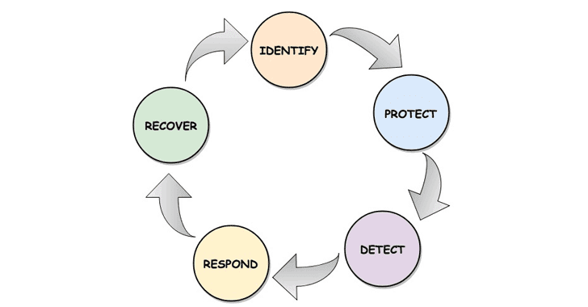
Framework Skeleton
Notes:
Identify:
This function helps the organization identify the existing cyber touch points within a business environment. Those could be IT assets, resources, information, and more. Protect:
This one takes care of corporate access control, data security, and maintenance to take care of cybersecurity in and around the business environment. Most likely, it is a proactive phase of enterprise cybersecurity. Detect:
This function is where an organization will identify any potential breaches by monitoring the logs and taking care of intrusion detection procedures at the network and device level. Security information and event management are all covered under this procedure. Respond:
Once the breach is detected organizations need to take care of the respond procedure—understanding the breach, fixing the vulnerability, and proceeding with the recovery. The mitigation, response planning, and improvements will be handled at this stage. Recover:
Recover planning procedures, like disaster recovery system and backup plans, will be handled in this stage of the cybersecurity framework strategy.

Slide 6
Your needs
-Inventory
-What is important (critical/ senative)
-What is our risk
-What is priority
-Aligning to business goals (providing value)
-Where does the data live
Notes:
aligning to business
what is important to the non-technical management. They will fund the project
What applies to you

Slide 7
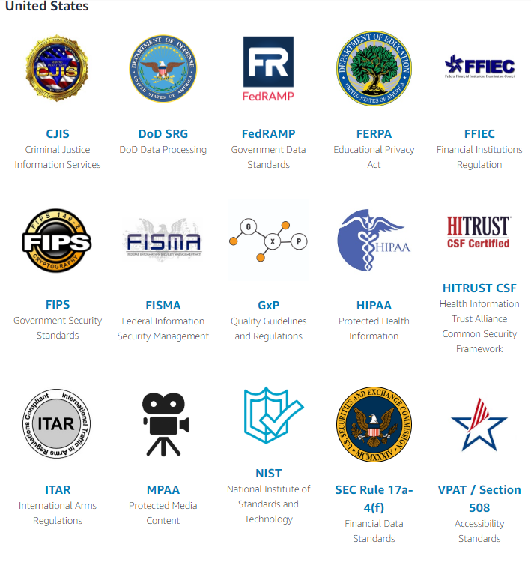
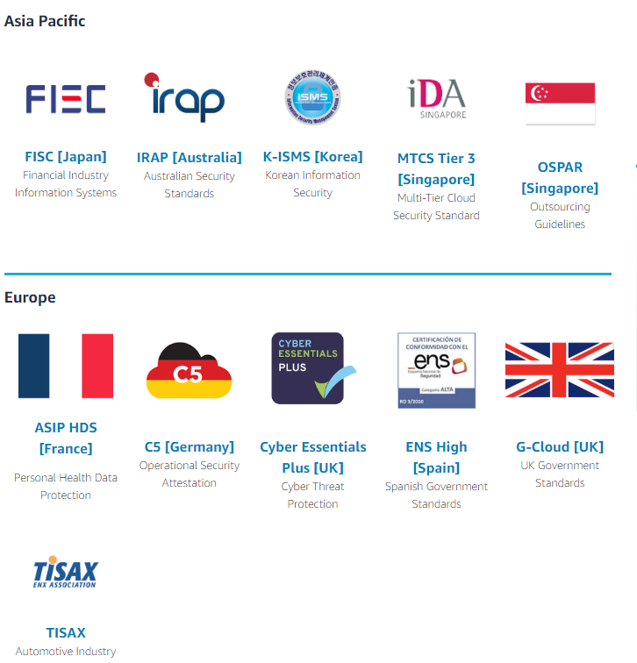
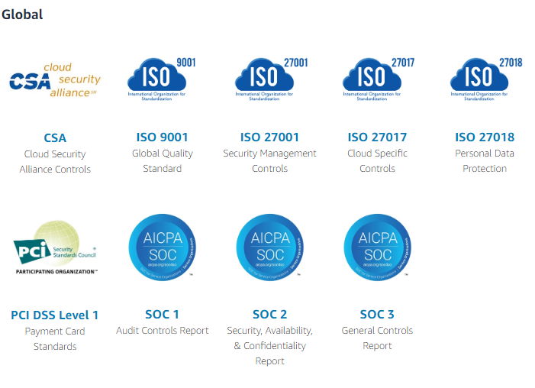
Types of frameworks
Notes:
Now, let's get into the types of cybersecurity frameworks. There are a number of cybersecurity frameworks existing in the industry; however, we included the most frequently used ones in this article. ISO 27001/27002
International Standards Organizations (ISO) was the one who did develop ISO27000, that covers all the broad aspects of the cybersecurity framework that can be applied to businesses of any vertical. Considered as an equivalent to ISO 9000 standards for manufacturing, helps organizations define and measure their quality of cybersecurity existing within their environment. ISO2700 defines an overview, while ISO27001 takes care of the requirements, and ISO27002 takes care of the implementation procedures. All these frameworks are documented to help enterprises establish the same around their corporate networks.
Along with the above list of standards, ISO 27799 defines security pertaining to the healthcare industry. CIS Security Controls
Center for Internet Security (CIS) has defined a set of critical security controls that organizations must establish within their network for effective cybersecurity strategies and framework. CIS has defined three sets of critical security controls—they are basic, foundational, and organizational—counting 20 controls altogether. They address various security controls that should be existing inside an enterprise environment. Organizations need to deploy all these 20 critical controls to achieve the best security environment and sustain the same forever. If businesses can't establish 20, they can at least try establishing 10 security controls to reach halfway there. NIST framework
The US National Institute of Standards and Technology (NIST) have similar policies and norms that are documented, targeting government organizations to build effective information security practices. This framework can also be applied to other industries as well. There are Controlled Unclassified Information (CUI), which will be the prime focus of this framework. PCI DSS
Payment Card Industry Data Security Standard (PCI DSS) is a cybersecurity framework designed to improve the security of payment accounts, which is protecting debit, credit, and cash card transactions.
All these frameworks are built and documented to make sure enterprises are practicing the industry standards and keeping their security clean and safe.

Slide 8
Implementation
-Frameworks are not a one size fits all approach
-Read all documentation
-Identify resources
-Document and communicate the entire plan with the key players,
including stakeholders
-proceed with the implementation aligned with the business goals
Notes:
After identifying the right cybersecurity framework for the enterprise, this has to be practiced as per the document guidelines. To do that, some steps have to be implemented to get things started and going.
Frameworks are not a one size fits all approach
you have unique threats, vulnerabilities and risk tolerances
ultimately the framework is aimed at reducing and better managing risk
-* don’t blindly apply policies to your environments. -Businesses first need to test and identify the current security posture inside their environment
-Analyze the existing projects, the process involved in these projects and the resources involved with it
-Understand the cybersecurity framework by reading through the documents
Distinguish what security controls exist and doesn't exist within the enterprise network
-Communicate where the security layers are lagging and define a plan to establish the same
-Implement the same in a defined time-frame to keep things on track and time
-Highlight controls that outperform the controls defined by the framework
-Discuss the entire plan with the key players, including stakeholders, and proceed with the implementation
-Audit the progress of implementation continuously
-Generate reports and conduct meetings to measure the challenges
-Document the entire process for audits and other benefits
-Cybersecurity frameworks will play a key role in establishing and sustaining unforeseen cyber situations, giving organizations an upper hand over cyber criminals. -Businesses need to understand the demands that they need to keep up to, analyze the entire implementation procedures, and do the same only after discussing the same with stakeholders and IT departments.

Slide 9
Not the silver bullet
-Insurability
-Starting point
-Getting the ball rolling
Notes:
Unless you know what is your attack surface, what are the possibilities?
-Compliance is not security
which merely required completing a self-assessment questionnaire and passing quarterly security scans.
The process can be exhausting
-“It’s like getting your driver’s license. You do the bare minimum to get your driver’s license and then you are allowed on the road. That doesn’t mean you’re not going to drive a truck through a herd of nuns. Its just means you are allow to drive.” – Dan Tentler
-Compliance is not mere window dressing, but it’s far from a guarantee of security.
Advantages
Cybersecurity frameworks and its policies can overlap with each other allowing organizations to become compliant to multiple frameworks with minimum efforts
Enhanced cybersecurity
Better data protection
Easy compliance and audit management
Disadvantages
Implementation can take days, thus affecting productivity
An improper implementation may lead to security loopholes
Financial limitations may apply

Slide 10

….
Notes:
-priority
-what is the biggest risk
-you can’t do it all. You must break it down.
Story: Building a boat but it’s never been to sea. It’s beautiful but does it work? Does it float?

