Slide 1
Victor Steven Morales DevOps Engineer, University Of Utah
Over worked, over stressed, and closer to getting Pwned
Notes:
Open statement:
Name:
Hook:
Fun fact:
What’s in it for them:
I'm excited:

Slide 2
Systems Admin pain points
Project deadlines
Low number of full-time employees
Budget
Learning new technology
Time vs cost
Prevention vs clean-up
Notes:
Hook:
Talk: How many of you wear different hats
Alerts
-information inquiries
-requests
-incidents
-your requests
New tech for new project
Buying the solution or configuring using open sources tools
No money for training. Self taught route. (google is our best friend)
Story: DFPM with creston
Ucloud with MF
Cisco just came out with devnet

Slide 3
The numbers
Ransomware detections have been more dominant in countries with higher numbers of internet-connected populations. The United States ranks highest with 18.2 percent of all ransomware attacks. (Symantec)
Most malicious domains, about 60 percent, are associated with spam campaigns. (Cisco)
In 2017, spear-phishing emails were the most widely used infection vector, employed by 71 percent of those groups that staged cyber attacks. (Symantec)

Slide 4
False sense of security
What is out there?
How do we know if our controls work?
Compliance is not security
Compliance is the legal bare minimum to run a business and get insurance
Are we communicating correctly about our risks?
Can management make an educated decision?
This is unhackable?
Notes:
Hook:
You must know this
You can not teach effective to your users
You can not communicate effectively with management
Unless you know what is your attack surface, what are the possibilities?
“It’s like getting your driver’s license. You do the bare minimum to get your driver’s license and then you are allowed on the road. That doesn’t mean you’re not going to drive a truck through a herd of nuns. Its just means you are allow to drive.” – Dan Tentler
Story: Building a boat but it’s never been to sea. It’s beautiful but does it work? Does it float?
Now how we going to fix it
Pain Point for sys admins:

Slide 5
How do we make the job of a hacker harder?
Attack surface
Blind to attacks
How easy is it to get in
Raising the bar
Levels of hackers
Script kiddies
Notes:
Hook: Let’s make their life a bit harder
Levels of hackers, let’s raise the bar
Story: download and point without knowing how it works

Slide 6
How do I look from the inside/outside?
Communication within our infrastructure
2FA on external-facing infrastructure
What is visible on the internet
Ports open
Company public files (meta data)
Exposed company directory
Lack of network egress controls
What portals are open
Looking for anything to pivot externally
Exposed web administrator panels
Notes:
Hook: Look at yourself
What am I able to see from the outside and once I’m inside
Story:
Can smb egress out of your network?
Requires port 445 (used for smb) egress to the internet
Windows will automatically attempt to authenticate
Connections can be triggered through html image tags
Authentication uses ntlmv2 hash, which can be cracked offline
Send email with image tag. (that easy)
Remediation
Block network egress of unnecessary protocols and prevent smb egress via host based firewall rules
Pain point for sys admins:

Slide 7
Inventory
How do we manage it if we don’t know it exists?
Do you know every piece of:
Software on your machines?
Hardware?
Notes:
Hook: Can’t defend what you don’t know you have
Story: Gathering the inventory at dfpm
Pain Point for sys admins: Manual count of every box is very time-consuming
Our staff goes rogue and buys their own device
BYOD

Slide 8
Patch management
Process of implementing patches
Zero days
CVE
Notes:
Hook: Bare minimum is to patch your systems
Do what is in your reach
Story: NSA eternal blue
Pain Point for sys admins: Building out the infrastructure
Updates/patches bringing down environments

Slide 9
Logging and Monitoring
Blind to most attacks
Centralize monitoring and logging
Monitor up/down
Logging for errors
Identify abnormalities
Alert fatigue
Layers
Network, Physical, Storage, Databases, Virtualization, Application, UI
Notes:
Hook: A study found that US companies took an average of 206 days to detect a data breach (2018 Cost of a Data Breach Study by Ponemon)
Story: hey the domain admin logged in at 3 in the morning
Pain Point for sys admins: Knowing what to monitor and log outside of the defaults

Slide 10
Local Administration
What are the risks that come from giving everyone admin rights?
What rights does your user have?
If compromised, what can the hacker get access to?
If the hackers want access to the whole infrastructure …
Privileged escalation
2FA
Notes:
Hook: Everyone wants admin rights
Story:
They can install anything
Ransomware hits
We have all the keys to the kingdom. Convenient.
We are not immune from hacks
Pain Point for sys admins: Everyone wants admin rights

Slide 11
Password re-use and length – 2FA
Default passwords
Phrases over words
Top password list
Weak domain passwords
Password spraying
Notes:
Hook: passwords are the downfall of every company that relies on them as their sole form of authentication
Story:
Same password on multiple systems
Banking password for something else
https://haveibeenpwned.com/
go look into password dumps and partially search for your password.
Humans are very predictable
Password straying – build a user list from social media or exposed company directory, spraying outlook web access timing-based enumeration
Rainbow tables
Pain Point for sys admins: Having users pick the same pool of passwords

Slide 12
Network Segmentation
A properly segmented network is essential
Where does your server sit?
Security controls for access
Flat network
Lateral movement
Notes:
Hook: Avoid the flat network
Story: What do I see when I get into your network?
Pain Point for sys admins: everyone wanting access to everything. They don’t need it. It’s easy but it comes at a price.

Slide 13
Vulnerability Scanning
What are the threats on my systems?
Regular and consistent basis
Notes:
Hook: After we have an inventory of everything, let’s see what it’s vulnerable to
Story: config management is your best friend
Management needs to be aware of the risks for legacy systems
Pain Point for sys admins: acting on those reports. Someone needs that old piece of software. Segment it from the rest of your network

Slide 14
System Hardening
Is there a hardening process?
Learning the new technologies
Frameworks available
The same server delivering different services
Everyone wants admin rights
Notes:
Hook: Base line is not meant for your org. Default passwords and configs are available through the internet.
Story:
Cis is here to help
Pain Point for sys admins: new tech means we need in-depth knowledge to fully know how to secure it

Slide 15
Data classification
Where it’s stored
Classified
Contained
Managed
Access
Notes:
Hook: Shield what is important
Story: What does the sec and hr have access to.
Pain Point for sys admins: we don’t know all the information out there

Slide 16
Security Strategic Plan
Frameworks
Measure performance and progress
Score card
Notes:
Hook: Start with a framework.
Story: Managing the PCI environment for HPS
Pain Point for sys admins: we don’t get the buy-off from management. Our goal is to communicate the risks.

Slide 17
Security and System admin staff
System admin purpose
Security admin purpose
Notes:
Hook: We want the lights on and security wants as few people in there as possible. Let’s find that middle ground
Story: tug-a-war
Pain Point for sys admins: sec and sys admins have different purposes

Slide 18
Social/Phishing Attacks
Very effective
What information is out there?
Notes:
Hook:
Job posting
Social events on the internet (badges)
Online documents
Punishment tactic (people will hide their findings)
Make a learning experience
Better to understand and respond to the incident
Story:
Utah State University
Report phishing and get 5 buck card to aggie ice cream
Pain Point for sys admins: Users click on the picture link

Slide 19
Who is doing what
Roles
Roadmap
Execute
Notes:
Hook: You can’t do everything at once.
Story: Now we have to do this on top of everything else.
Pain Point for sys admins: everyone doing their part

Slide 20
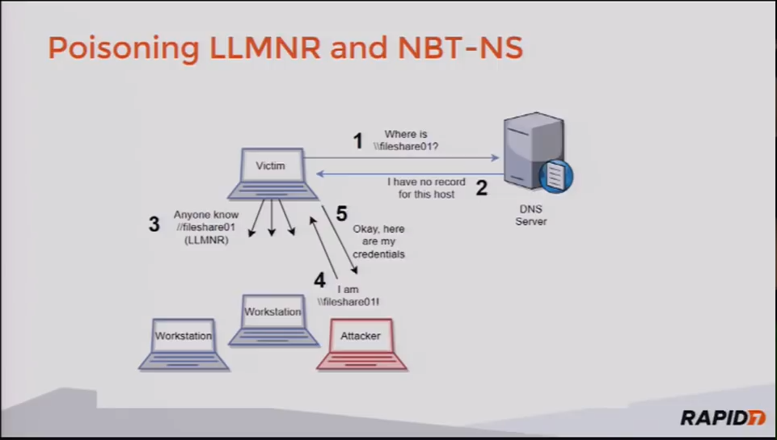
Poisoning LLMNR and NBT-NS
Notes:
LLMNR and NBT-NS help resolve hostnames as a backup to DNS
A malicious actor responds to broadcast requests
Pretends to be the requested resources
Poisons requests searching for file shares
Leads to an smb authentication attempt
Captures hashes
Metaspoilt
Disable those protocols or use the principle of least privilege

Slide 21
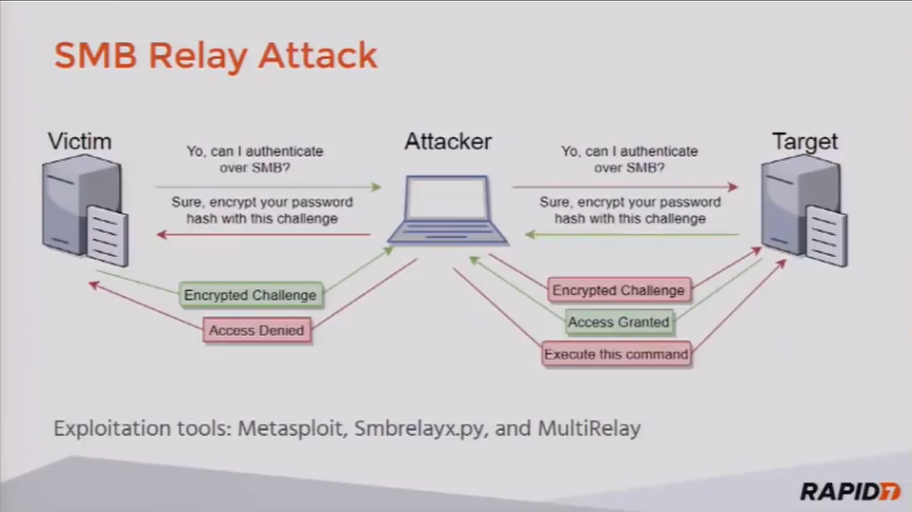
SMB Signing Disabled
Notes:
Signing allows the recipient of smb packets to confirm their authenticity
This is done by digitally signing the communications between the hosts, and helping prevent man in the middle attacks
Exploitable through the 15 year old smb relay attack
Set smb signing to required on all hosts

Slide 22
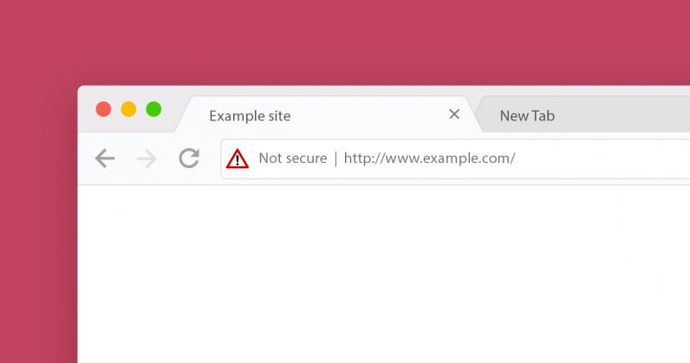
HTTP vs HTTPS

Slide 23
Credentials Cached in Memory
LSASS.exe – Windows service that provides seamless single sign-on functionality
Apply patch KB2871997
Set registry key “UseLogonCredential’ to 0 in Wdigest of HKEY_LOCAL_MACHINE
Note: NTLM hashes can still be extracted
Win 8.1 and up
Prevent access to LSASS
Place LSASS in protected mode via LSA registry key set to 1
Notes:
Caches credentials in clear text in memory (all credentials since last reboot)
Use mimikatz to extract creds from memory but you need admin rights (powershell empire /metaspoilt)

Slide 24
Honeypots
The carney in the coal mine
Sends alerts with servers that should never be used
Luring the hackers

Slide 25
Eating the elephant
These seemingly small things bring great things
Little by little, you are better today then yesterday

Slide 26
Sources
Almost 10 years in the industry
Top 10 Critical Pentest Findings – Troy Jessup
Gigos PenTest War Stories “Why my job is so easy and how you can make it harder”
Security Basics Podcast – Security Weekly
Lesson from Kevin Mitnick – Red Sky Security Conference
Storytime With Viss! (Dan Tentler) Offensive Security Fails - Hak5 2414
https://cdn0.tnwcdn.com/wp-content/blogs.dir/1/files/2018/07/Not-Secure-hed-796x419.jpg

