Slide 1
Comparing Tyrosine Kinase Lapatinib Nano-Therapy Interventions to Trastuzumab Chemotherapy: Which is Most Effective for U.S. Females with HER2-Positive Breast Cancer?
Victoria Rodriguez Silva ~ HHA 506: Research Design and Methodology

Slide 2
Introduction
Breast cancer classified as HER2-positive is highly aggressive, invasive and accounts for approximately 20% of all breast cancer cases.¹
This cancer subtype arises from the HER2 gene, which is an acronym for “human epidermal growth factor receptor 2”, that creates proteins which serve as receptors on affected breast cells.²
It has been discovered that treatment options specifically targeting the HER2 protein are highly effective but that current chemotherapy methods and drugs lack the ability to target the growth factor causing issues.³
Patients who have undergone trastuzumab chemotherapy have built resistance to the drug.⁴
It has been proposed that nanotechnology can eliminate issues associated with traditional breast cancer treatment such as “the lack of early detection, inadequate drug concentrations, and the inability to monitor therapeutic responses”.⁵

Slide 3
Research Question
In U.S. female patients with HER2-positive breast cancer aged 30-65, how could nano therapy interventions compare to traditional trastuzumab chemotherapy in regards to more effective breast cancer treatment beginning 30-60 days after initial diagnosis?

Slide 4
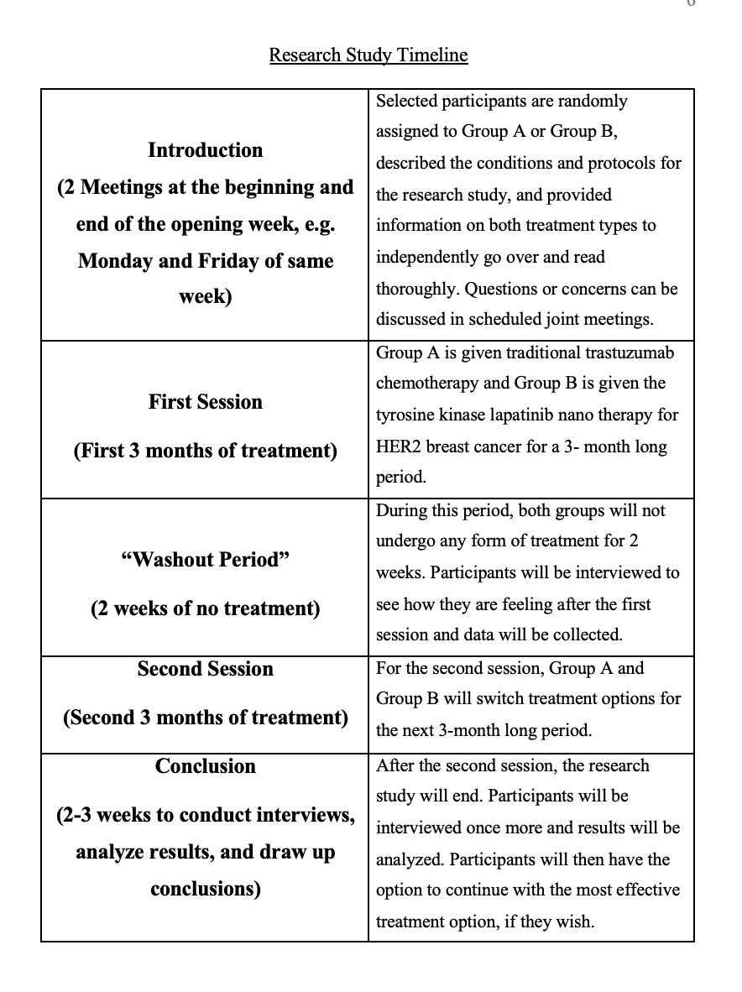
Research Method
Prospective crossover study
Location: Baylor College of Medicine Lester and Sue Smith Breast Center in Houston, TX
Total participants: 12
CT and PET scans will be used to monitor treatment outcomes
Participants will be their own controls

Slide 5
Recruitment Methods
Online web browser and social media advertisements, digital and physical newspaper articles, and partnerships with hospitals treating breast cancer patients.
Hotline communication and initial consult scheduling
Inclusion criteria: Female, resident of Houston, TX, 30-65 years old, diagnosed or received initial surgery for HER2-positive breast cancer no later than 60 days before study beings, willing to stay within Baylor’s facility for the entire study
Exclusion criteria: Non-female, females above or below desired age range, females living outside of Houston, TX., someone who has received cancer treatment in the past, regular smoker and drinker.

Slide 6
“COVID-19 Estimated Patient Impact and Hospital Capacity by State” Dataset Analysis
Results and Conclusion based on Jupyter Notebook

Slide 7
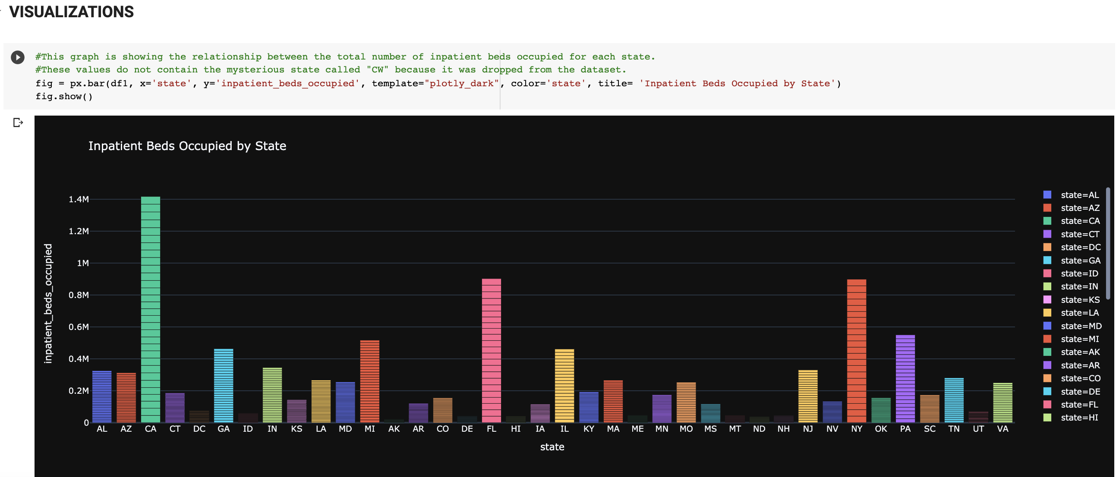
Total number of inpatient beds occupied per state
The states with the highest occupancy included California, Florida, and New York.

Slide 8
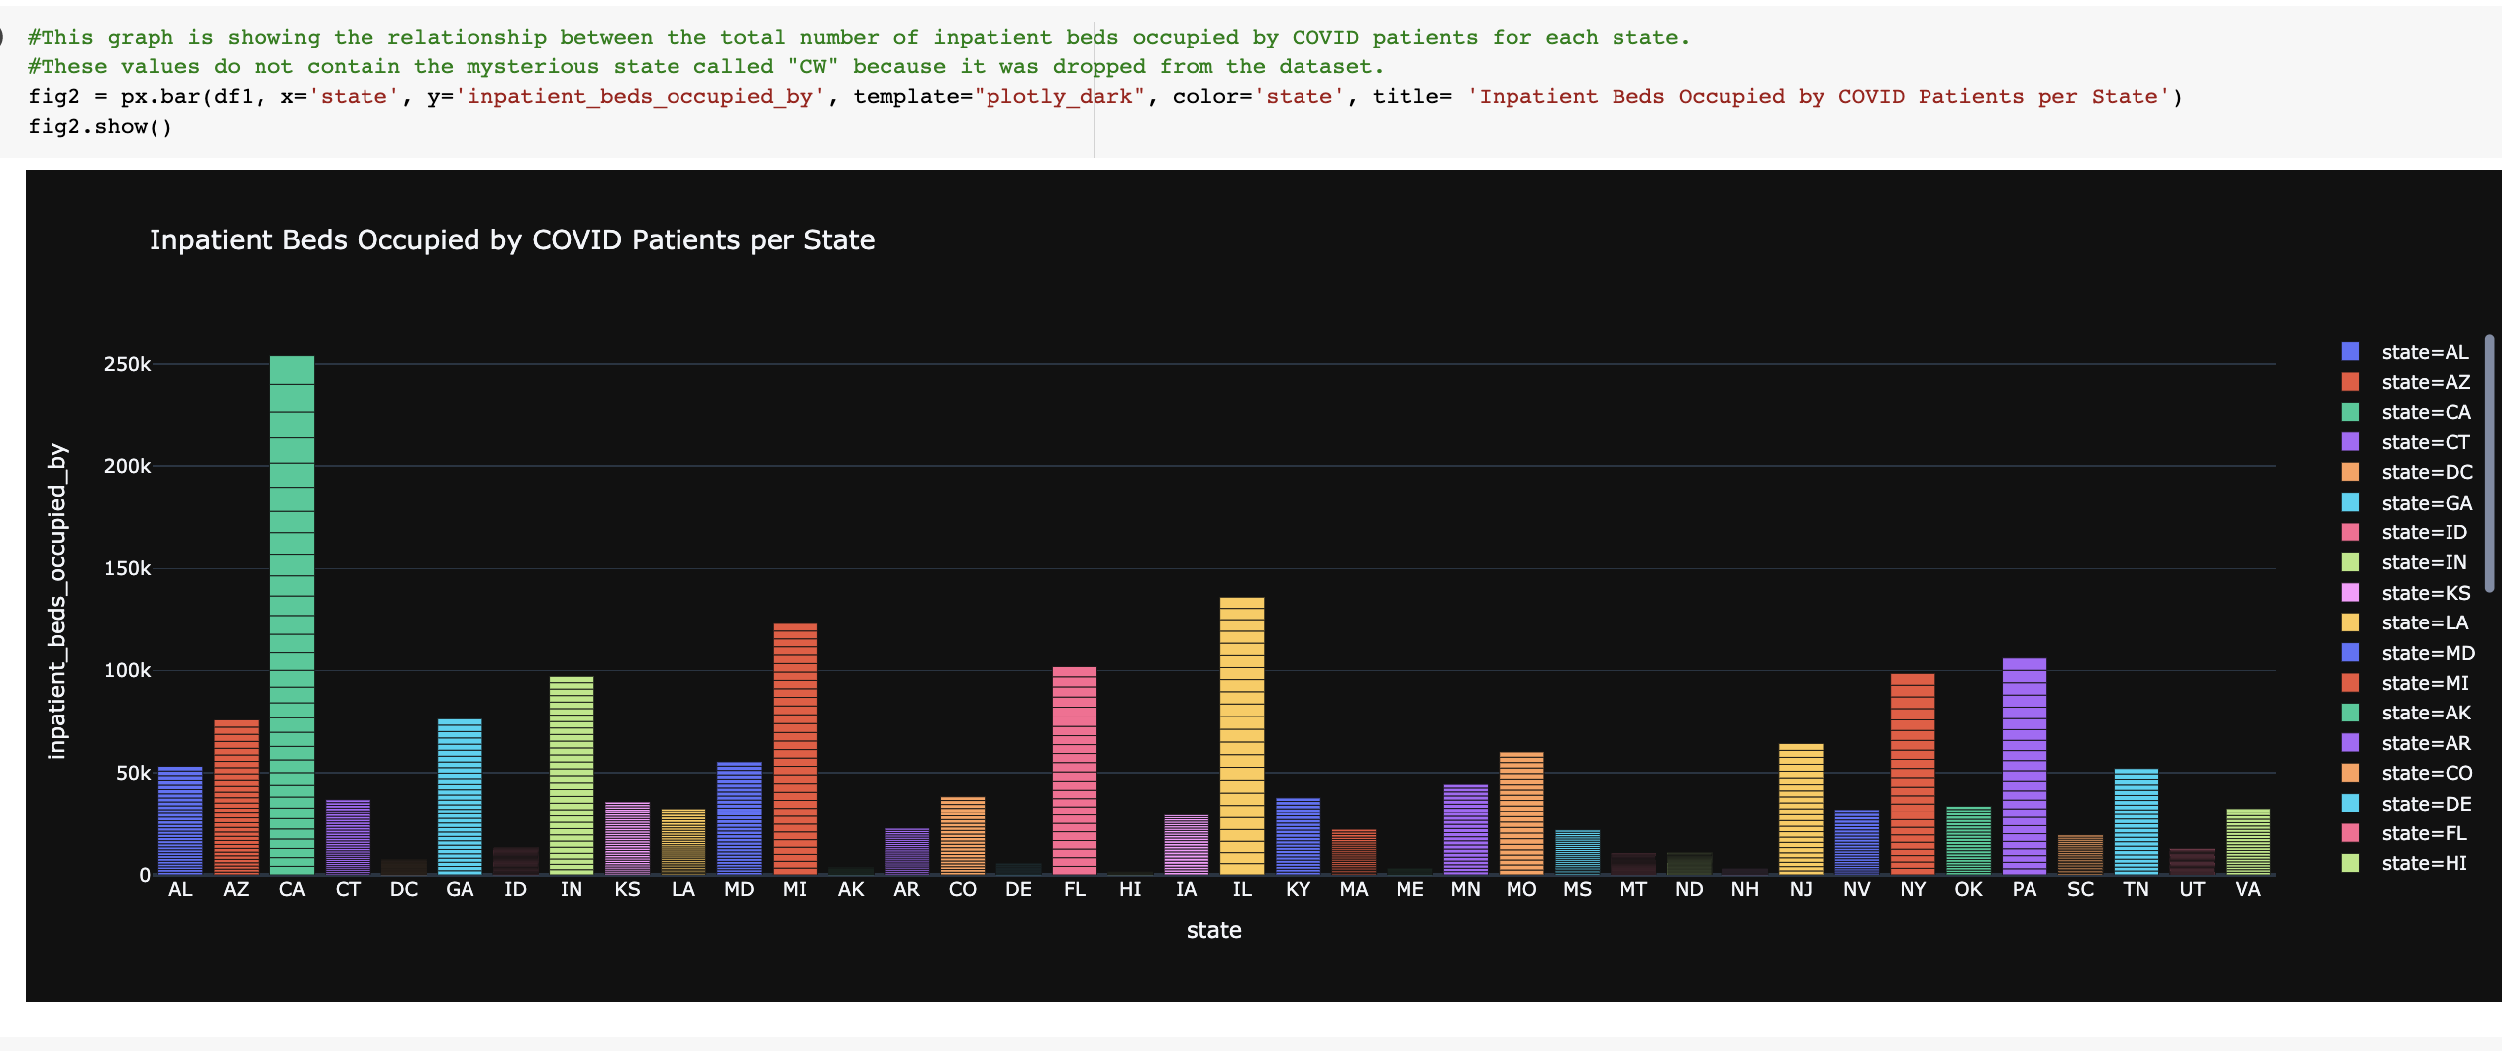
Number of inpatient beds occupied by COVID-19 patients per state
The states with the highest occupancy levels included California, Illinois, Michigan, and Pennsylvania.

Slide 9
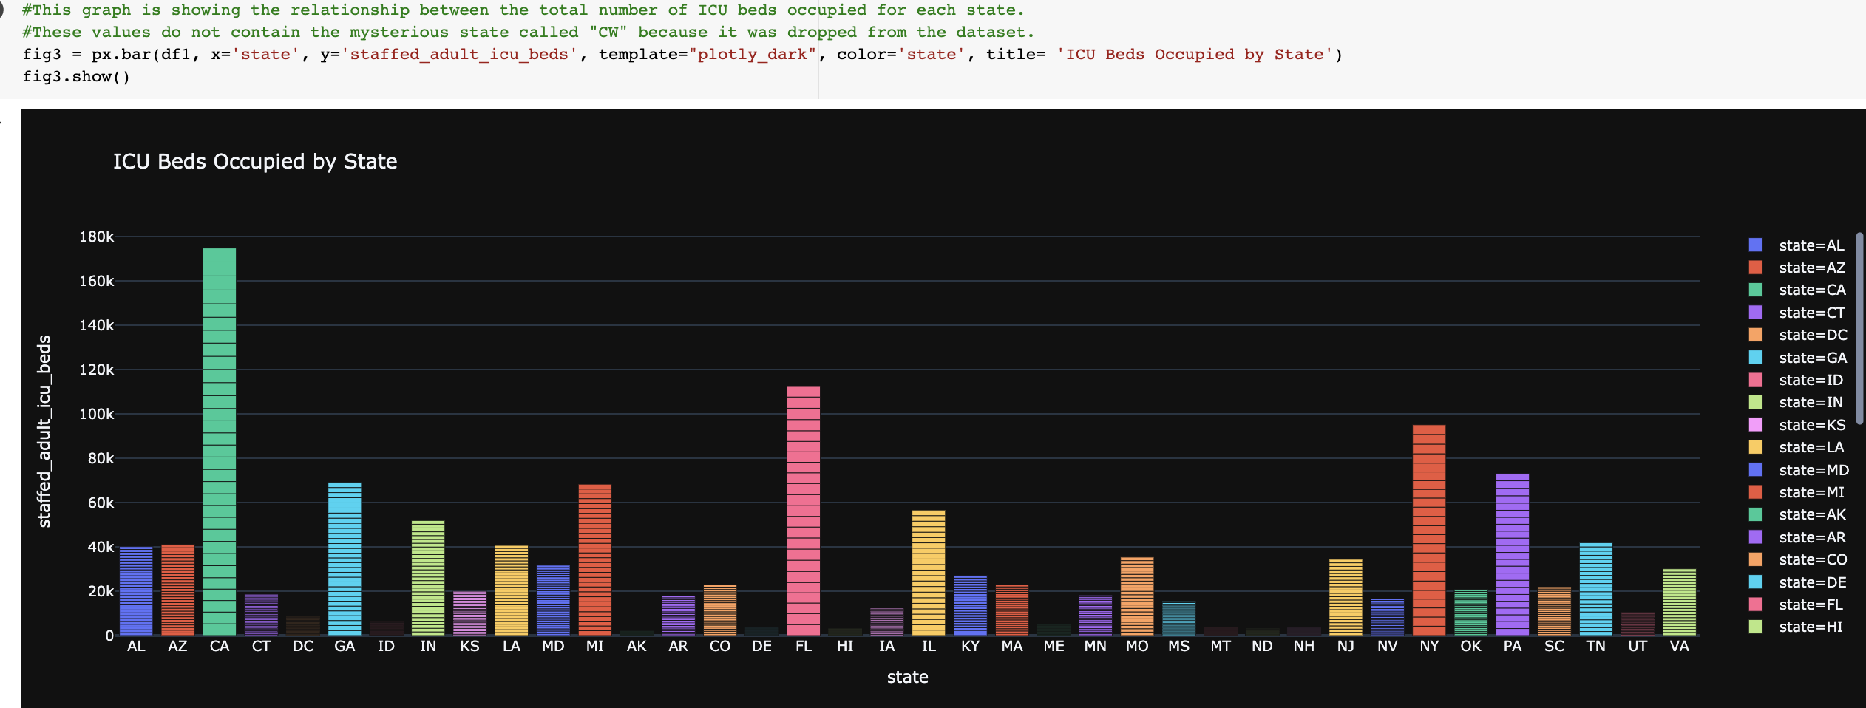
Total number of ICU beds occupied per state
The states with the highest occupancy included California, Florida, and New York.

Slide 10
References
1. Healthline Media. HER2-Positive Breast Cancer Survival Rates and Other Statistics. 2020. https://www.healthline.com/health/breast-cancer/her2-positive-survival-rates-statistics#outlook. Accessed August 11, 2021.
2. Breastcancer.org. HER2 Status. Ardmore, PA: Breastcancer.org. 2020. https://www.breastcancer.org/symptoms/diagnosis/her2. Accessed August 11, 2021.
3. Giridhar, K. HER2-positive breast cancer: What is it? Mayo Clinic. 2020. https://www.mayoclinic.org/breast-cancer/expert-answers/faq-20058066. Accessed August 11, 2021.
4. Barok, M., Joensuu, H. & Isola, J. Trastuzumab emtansine: mechanisms of action and drug resistance. Breast Cancer Res. 5;16(2): 209. 2014. https://pubmed.ncbi.nlm.nih.gov/24887180/. Accessed August 11, 2021.
5. Mohandas, R., Gayathri, R. & Priya, V. Cancer nanotechnology: A Review. Drug Invention Today. 2018. 10:2719-2726. http://web.b.ebscohost.com.proxy.library.stonybrook.edu/ehost/pdfviewer/pdfviewer?vid=0&sid=b11bc482-4dc2-49dd-9599-feb5e78ae13f%40pdc-v-sessmgr01. Accessed August 11, 2021.
6. HHS Office of the Chief Data Officer. COVID-19 Estimated Patient Impact and Hospital Capacity by State. HealthData.gov. 2021. https://healthdata.gov/dataset/COVID-19-Estimated-Patient-Impact-and-Hospital-Cap/vzfs-79pr. Accessed August 2021.

