Slide 1
PPE Solution
Long Island Sound Health System
HHA 502- Group 7
Ardis Moorehead, Mahbuba Sultana, Pedro Rosado, Samantha Benjamin, Victoria Rodriguez Silva

Slide 2
Background Knowledge
Organization: Long Island Sound Health System (LISHS)
Voluntary, non-profit community health system located in Southeastern Long Island
Includes a medical center with 25 hospital departments covering 100 patient beds
Includes a network of 5 outpatient sites that serve approximately 400,000 people in 20 communities
Current PPE Management Process for LISHS
PPE inventory is tracked and managed using a spreadsheet provided by the CDC.
Staff from each of the 5 outpatient sites and 25 hospital departments complete this spreadsheet every Tuesday and send it to IT for processing.
On average, it takes each staff member 2 hours each week to complete this spreadsheet.
IT analyst reviews each spreadsheet, combines the data received into a master spreadsheet, and calculates the burn rate.
On average, it takes the IT analyst 16 hours each week to consolidate the spreadsheets.

Slide 3
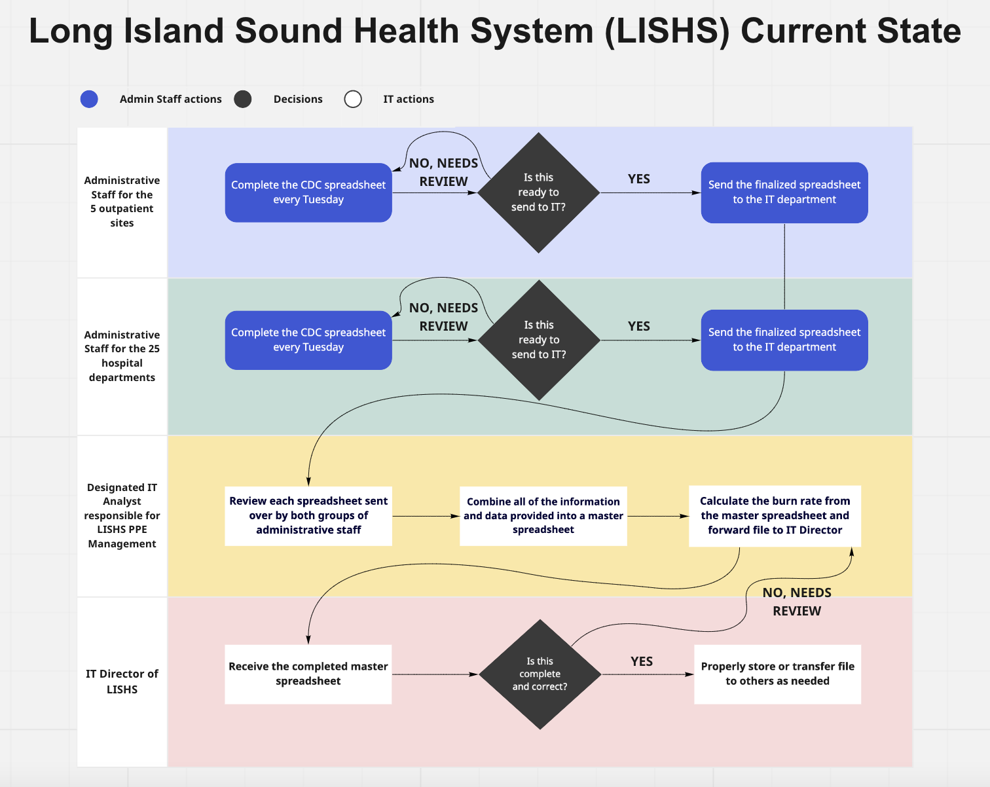
CURRENT STATE

Slide 4
Functional Requirements Narrative
LISHS is wanting a system that easily manages and distributes PPE equipment items to clinical staff for the 5 outpatient sites and 25 hospital departments.
The new system will decrease the time spent each week on PPE inventory management by streamlining requirements from the current management system through a software application connected to a dispensing system.

Slide 5
PPE System Requirements
Automatically track inventory of all PPE items
Automatically generate burn rate value for all PPE items
Able to include restock counts for each PPE item
Able to send PPE inventory data via email or fax
Able to send data to the Larson ERP platform via a REST API
Abide by the three CDC capacity guidelines
Include practical requirements for health system workflow
Able to document sites or departments use of PPE equipment

Slide 6
Proposed System Description
PPE Tracker Software by 3PL Mentor leveraged by Microsoft
Dispensing system built from scratch that consists of:
Portable touch screen monitor
ID scanner connected to the monitor
Dispensing unit housing N95 and face masks
Five drawers housing gowns of different sizes
Two cabinets housing gloves of different sizes and eye protection gear of universal sizing
System will be housed in individual rooms with limited access and ventilator check out will be done separately
IT Analyst retrieves auto-generated values weekly and forwards to IT Director who sends data to administration

Slide 7
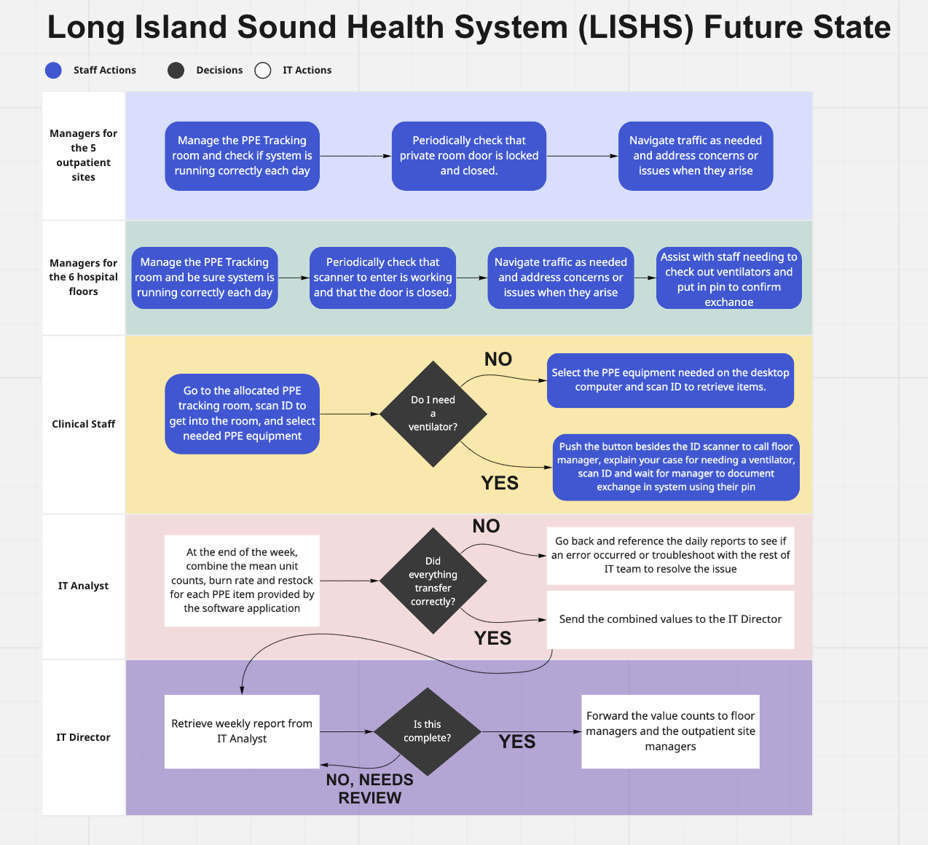
FUTURE STATE

Slide 8
System Architecture
Software components needed for system:
3PL Mentor PPE Tracker Application run on Microsoft Power Platform
Dynamics 365 subscription (supplies premade packages)
Power Apps support for PPE Tracker Application

Slide 9
System Architecture
Hardware components needed for system:
ThinkVision M14 Portable Monitors
ID Scanners connected by USB-C connectors
ID Scanners outside of the PPE room
Large Dispensing Systems
A set of 5 drawers and 2 cabinets for system
Red button beside system to call a manager

Slide 10
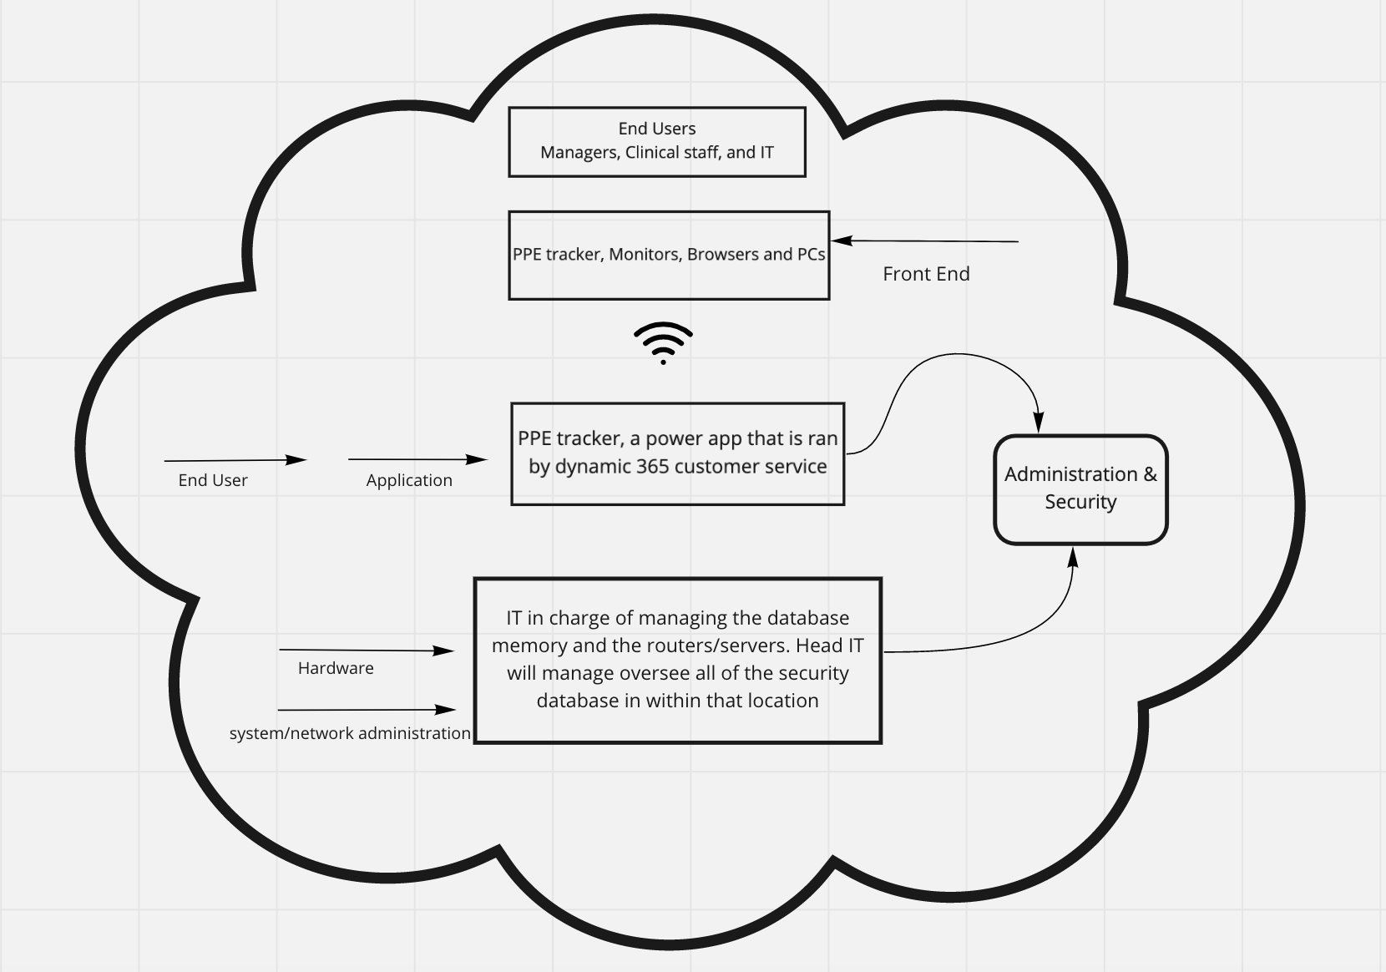
Cloud Architecture

Slide 11
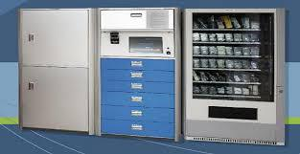
Sample Image
The image below provides a visual depiction of what the new system aims to look like.

Slide 12
Usability Requirements
Intuitive programming and display of PPE options on home screen
Large font and text sizes for end users to clearly read screen content
Auto-lock feature that unlocks system components once ID is scanned
Screen navigation icons to move between screens
Confirmation page that displays selected items at the end of exchange

Slide 13
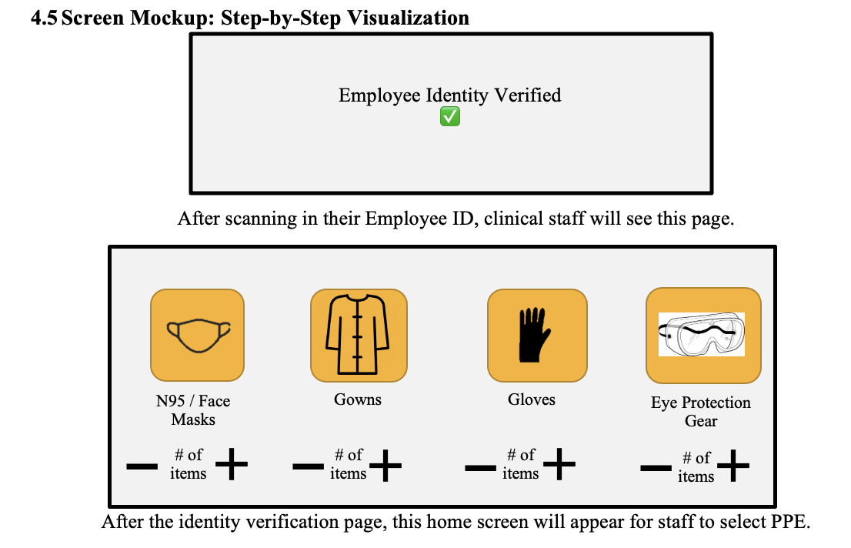
System Screen Mockups

Slide 14
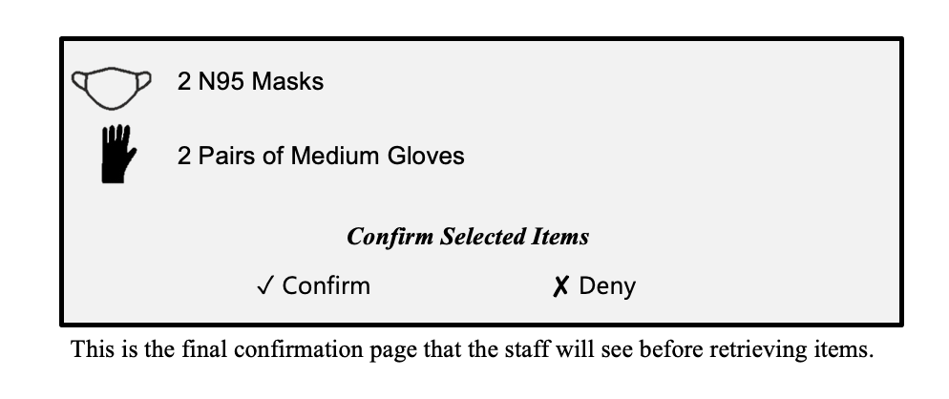
System Screen Mockups

Slide 15
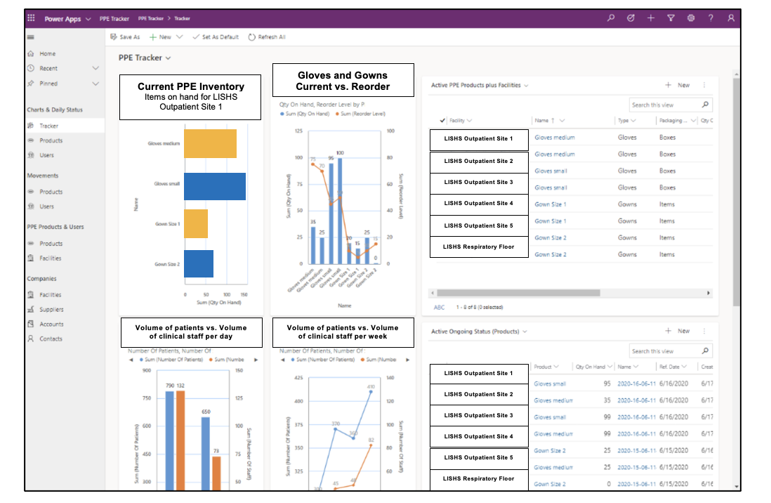
Microsoft Software Visualizations
This is the home dashboard that the IT Analyst will see at the end of each week.

Slide 16
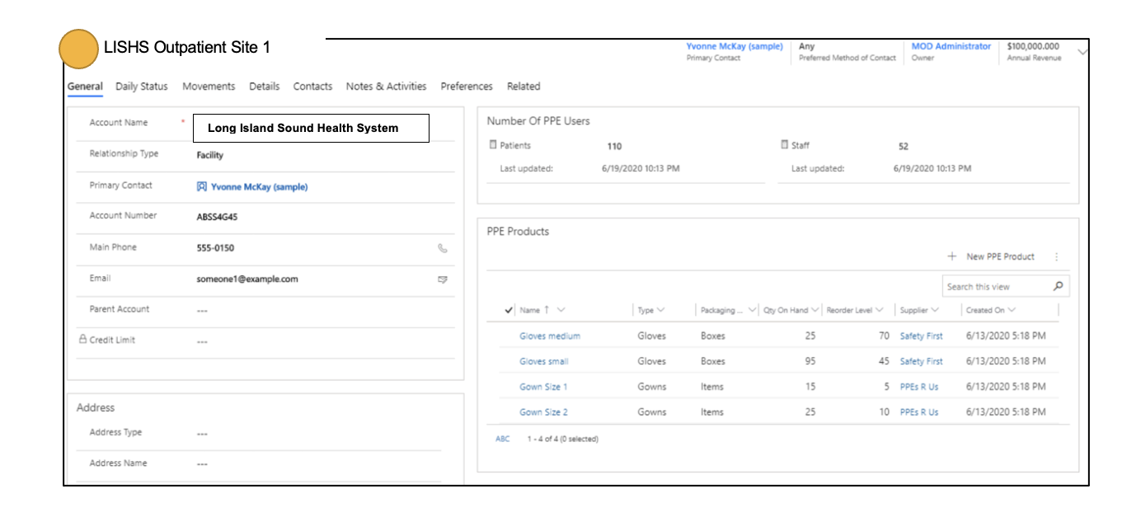
Microsoft Software Visualizations
This is the page that the managers will see to view employee and patient PPE use.

Slide 17
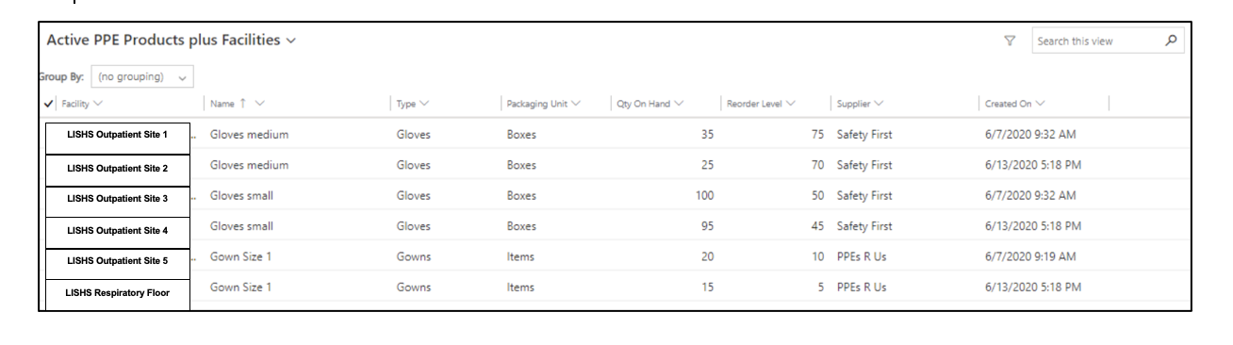
Microsoft Software Visualizations
This page will provide the IT team, floor managers, outpatient site managers and supporting staff with a quick overview of how many PPE items each facility has.

Slide 18
TESTING SCENARIOS
Equipment Testing
Requirements Testing
Dress Rehearsal
Post-Test Meeting
The IT Team and Product Development Team will set up the systems and test each piece of equipment.
The IT team will verify that technical requirements are established and test the software application.
After features have been tested, a group of clinical staff will test the system for one week in one outpatient site and one hospital floor.
After the dress rehearsal, the IT team will meet with the working group to identify issues. This will determine GO-Live date.

Slide 19
Performance Benchmarks
Technical Dress Rehearsal Benchmarks
Go-Live
Benchmarks

Slide 20
Security Issues
Ensure that only clinical staff have access to PPE room
Ensure that PPE room is closed when not being used
Ensure that PPE is not being stolen (i.e. camera surveillance)
Ensure that PPE equipment is safely stored
Ensure that only administrative staff know where additional PPE equipment is stored
Ensure that system users are always up to date

Slide 21
Go-Live Checklist
Setup and Customization Verification
Training and Creating Documentation
Technical Readiness
Final Data Load
Integration Configuration Verification
Transition to Support
Go-Live
Project Closure
Responsible parties
Administrative Staff
IT Analyst
IT Director
IT Team
Test Working Group
Product Development Team

Slide 22
THANK
YOU!

